Slide 1
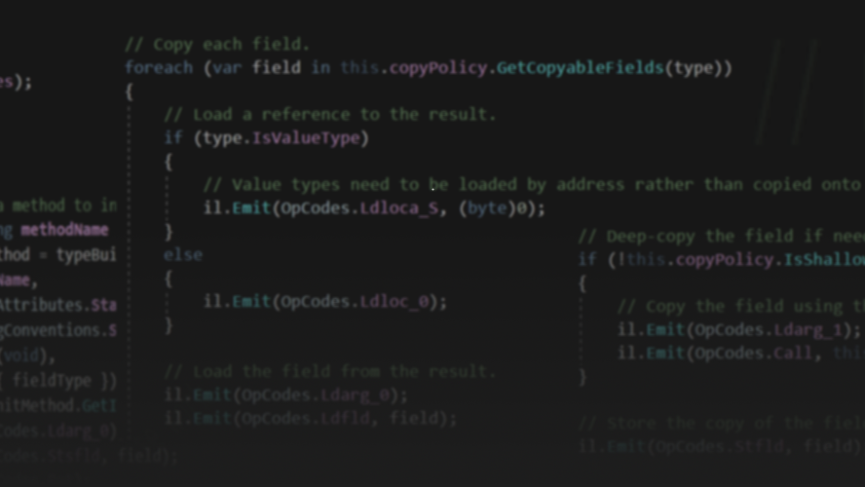
Code Generation on .NET
@ReubenBond
👍 interrupt me whenever.
Notes:
Hi
Reuben
Remote worker Microsoft Orleans
Kinda like “Serverless Objects” in a way
Dark arts, deep within the belly of just about everything
Feel free to interrupt me, please
This is my bread and butter – I only pretend to be a distributed systems developer

Slide 2

It’s not a story the Jedi would tell you
Notes:
Welcome to the dark side
The jedi fear these powers
So this is not a story the jedi would tell you

Slide 3
Goals
What
Why
Intro to
Expression Trees
IL
Roslyn
Notes:
Goal
Introduce you
Show you the way, where to look

Slide 4


Slide 5

Notes:
Yep.

Slide 6
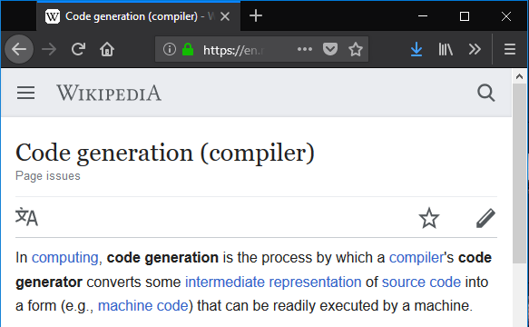
Code Generation is…
Not this kind!

Slide 7
Code Generation is…
in this context
A tool which takes some input and generates output which is intended to be later executed
Input can be:
Source code
Executable
Some other file (eg, .proto file)
Output is typically:
Source code
Executable (either on disk or in-memory)

Slide 8
Seems obscure…
Serializers (JSON.NET, protobuf-net, BinaryForma)
RPCs (gRPC, Orleans)
ORMs (EF, Dapper)
Mocks (NSubstitute, Moq)
UI tooling (XAML, Razor)
Dependency Injection

Slide 9
Code gen is crucial, but it is not magic

Slide 10
.NET

Slide 11
Expression Trees
Using LINQ Expression Trees to compile expressions at runtime
✔ Easy to use, expressive API
✔ Allows level of access to private members
❌ Not fully supported on AOT-only platforms like iOS
❌ Not all language constructs are supported

Slide 12
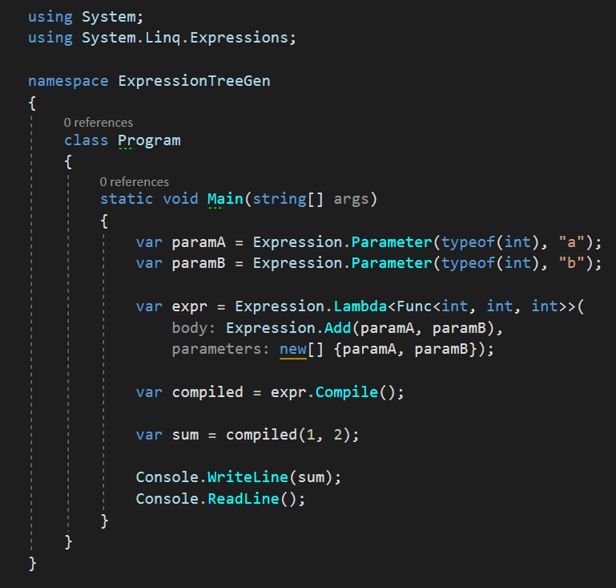
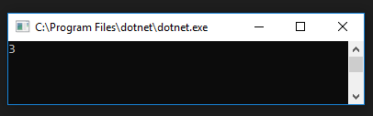

👍

Slide 13
IL Generation
Using Reflection.Emit to dynamically create types/methods
✔ Can produce code which cannot be expressed in C#
❌ Very verbose
❌ Very difficult to debug
❌ No higher level abstractions (async, enumerators, loops)
❌ Not supported on AOT-only platforms like iOS

Slide 14
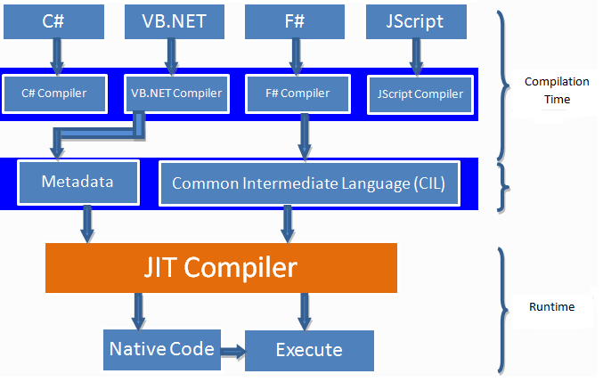

Slide 15
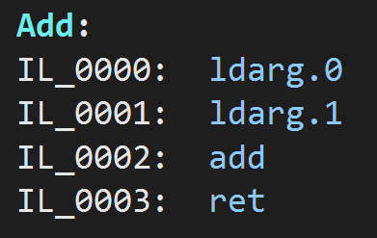
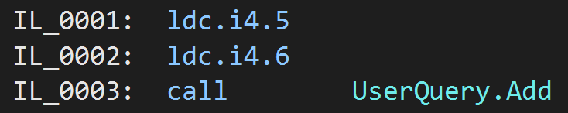
First: What is IL

Slide 16
Example: Emit IL
🙏 Please, demo gods, let this work…

Slide 17
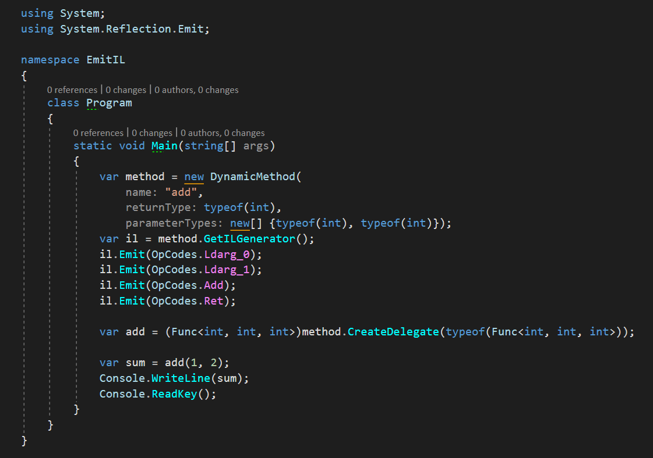

Slide 18
Example: CreateGrainReferenceCaster
More complex example from Orleans codebase

Slide 19
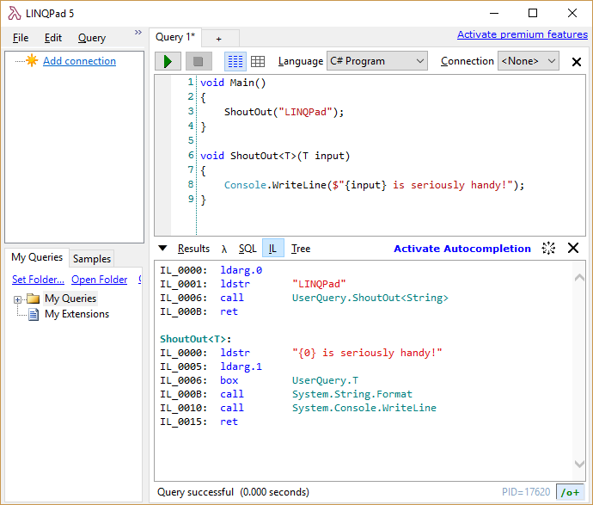

Slide 20
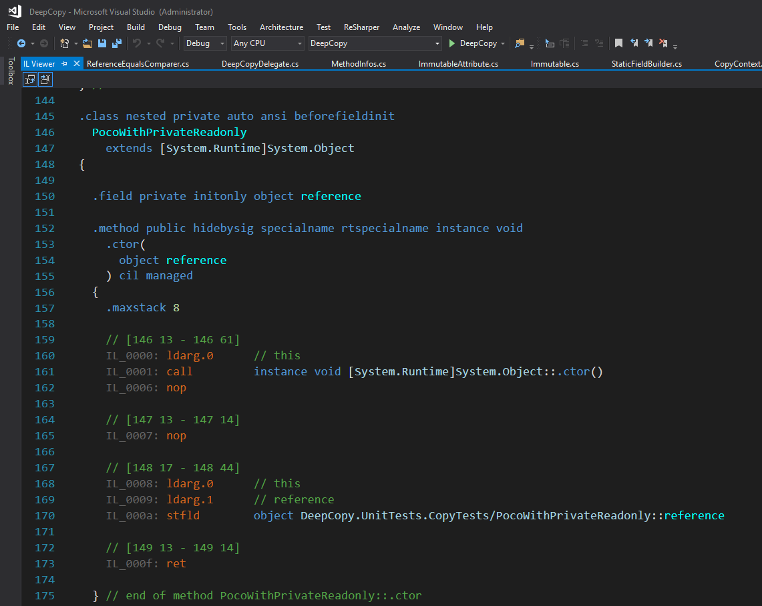

Slide 21
Syntax Generation
Using Roslyn to generate C# syntax trees in code
✔ Access all C# features (async!)
✔ Supported on AOT platforms
✔ Debuggable output
✔ Human-readable output (kinda)
❌ API isn’t always obvious
❌ Code must obey C# rules (no privates, can’t write to readonly)

Slide 22
Roslyn is a compiler
Notes:
Roslyn is *THE* compiler.
It’s not designed to be used for this sort of code generation.
API can be a little rough.

Slide 23
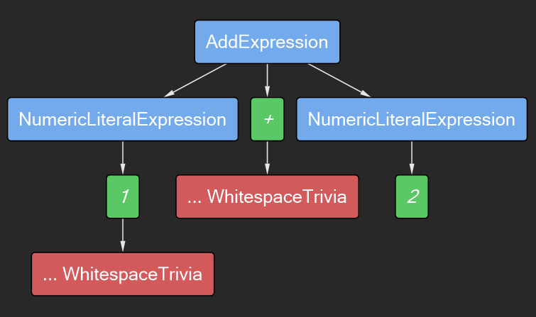
Syntax Trees

Slide 24
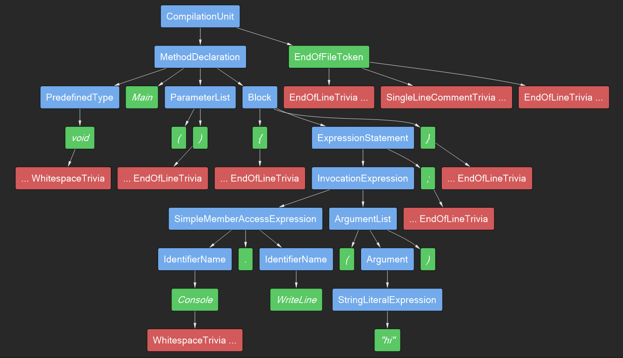

Slide 25
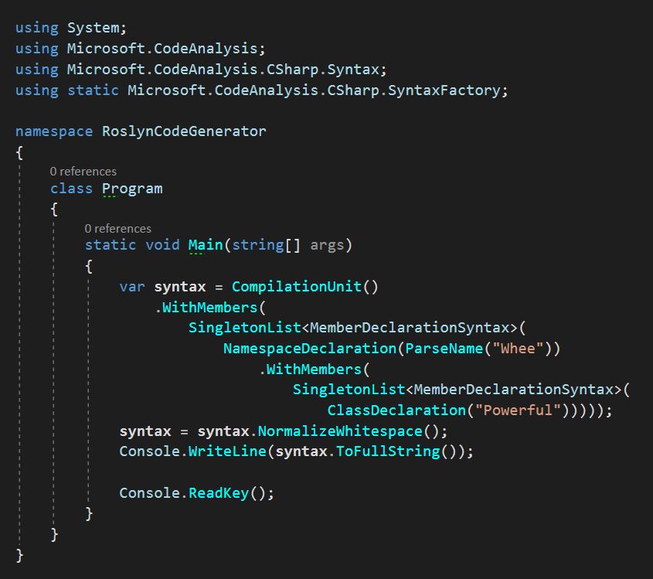
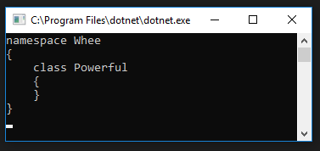

Slide 26
General strategy
Input
Model
Generated Code
Phase 1: Build model from input
Phase 2: Generate code from model

Slide 27
Choices….
Input
Compiled Binary
.NET Reflection APIs
System.Reflection.Metadata
Source Code
Roslyn code analysis APIs
.proto file, etc
Custom parser
Output
Compile at runtime?
Write source to disk?

Slide 28
Example: Hagar
Source-to-source serializer generator
Notes:
Show Model: TypeDescription, PropertyDescription, FieldDescription
Show GenerateCode

Slide 29
Example: Orleans

Slide 30
Which one do you use?
Usually: Roslyn
When necessary: IL

Slide 31

Thank You
https://reubenbond.github.io/posts/codegen-1
https://reubenbond.github.io/posts/codegen-2-il-boogaloo

Slide 32
What

