Slide 1
Basics of PowerPoint

Slide 2
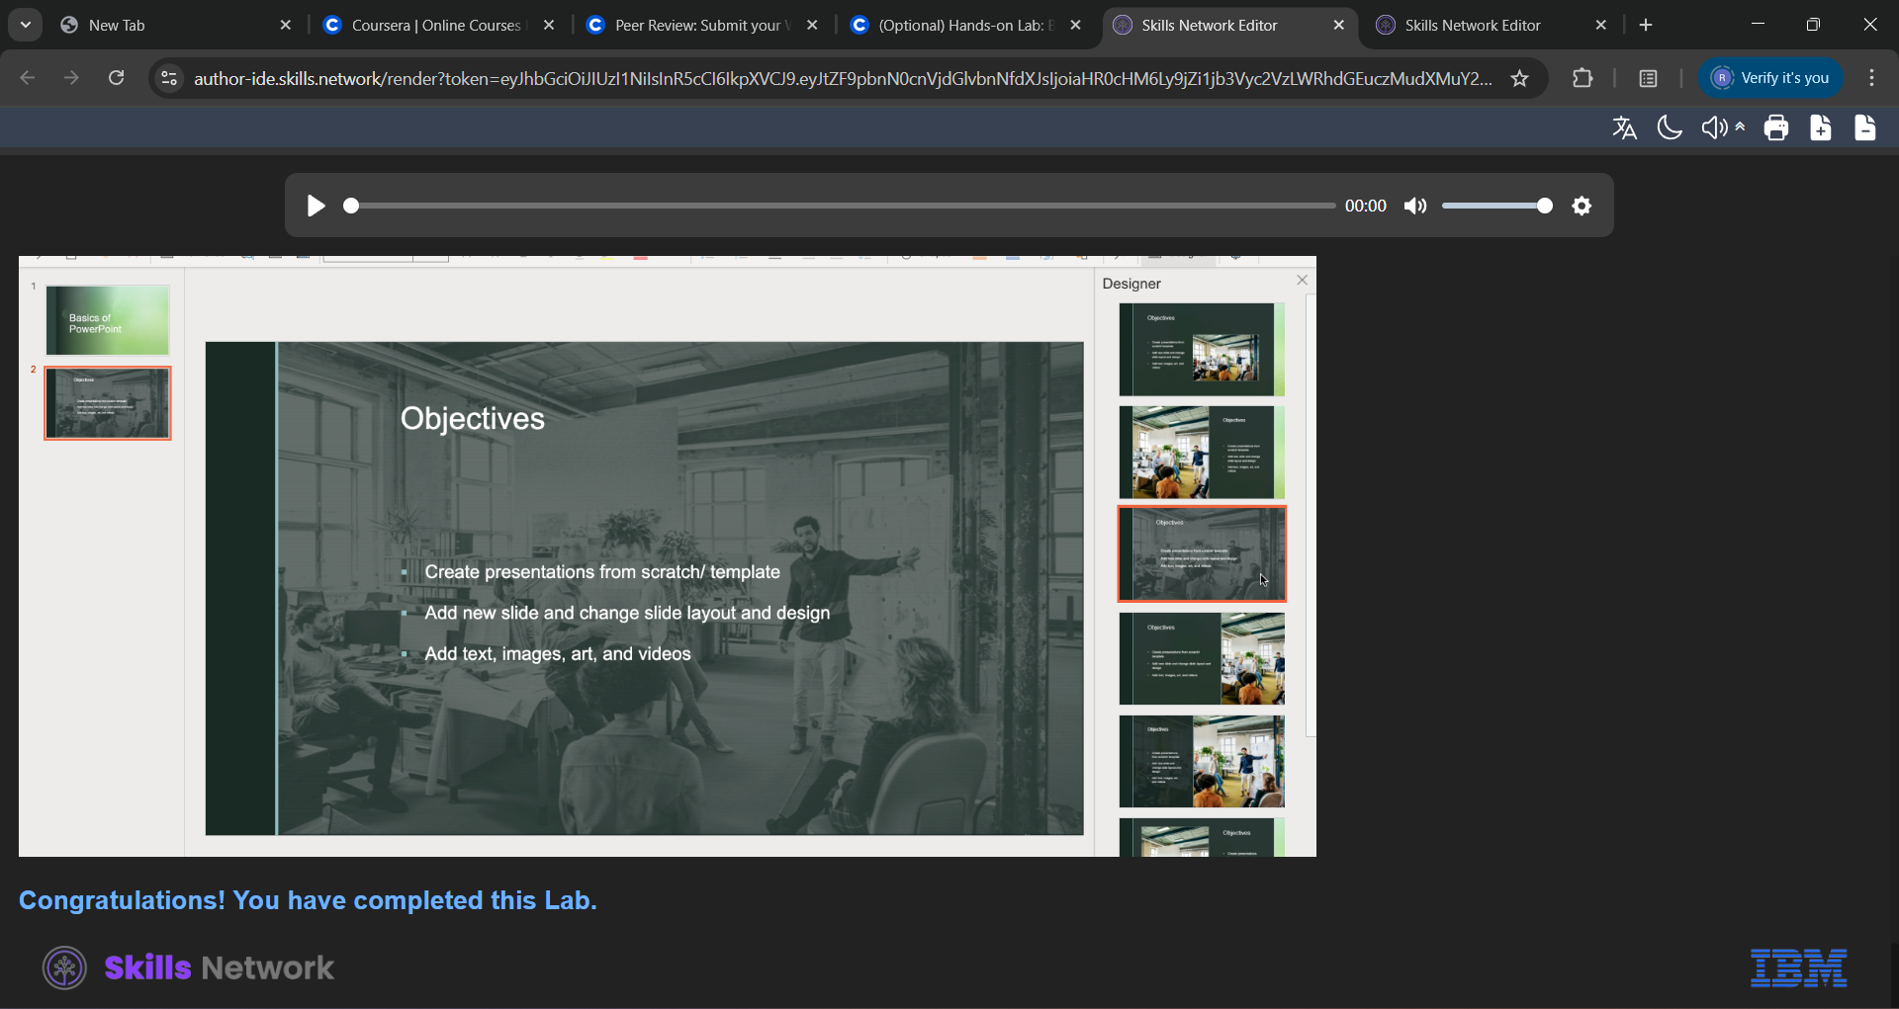
Objectives
Create presentations from scratch/ template
Add new slide and change slide layout and design
Add text, images, art, and videos

