Slide 1
MINIPROJECT CS6301- MACHINE LEARNING CIFAR-10 IMAGE RECOGNITION ENGINE USING CNNs
PRESENTED BY:
GOKUL . S – 2018103026
REUEL SAMUEL SAM – 2018103053
ON 6.11.2020

Slide 2
OBJECTIVE
The modern internet world is heavily plagued with malicious and spam content that ruin the experience of a wonderful invention. One of the most prominent forms of such content is via images.
Our objective is to identify and portray the features occurring in an image in terms of the object or type of land cover these features actually represent on the ground.
This interest in image classification was piqued and we have tried to train a model that can classify images.
For this purpose, we propose a convolutional neural network (CNN)-based architecture using a dataset of sufficient training capacity.

Slide 3
INTRODUCTION
Image classification is an active research area and has been studied in popular applications such as driverless vehicles and emergency robots. Classification algorithms typically employ two phases of processing: Training and Testing.
In the initial training phase, characteristic properties of typical image features are isolated and, based on these, a unique description of each classification category, i.e. training class, is created.
In the subsequent testing phase, these feature-space partitions are used to classify image features.
A CNN works by extracting features from images. This eliminates the need for manual feature extraction. The features are not trained! They’re learned while the network trains on a set of images. This makes deep learning models extremely accurate for computer vision tasks. CNNs learn feature detection through tens or hundreds of hidden layers. Each layer increases the complexity of the learned features.

Slide 4
PROBLEM DESCRIPTION
Type of Problem : Image Classification
Dataset Used: CIFAR – 10
Goal: Accurately classify unseen images using the trained model.
Model Used: Convolutional Neural Network (CNN)
Layers Used:
6 x Convolutional Layers
3 x Max Pooling Layers
4 x Dropout Layers
1 x Flatten Layer
2 x Fully Connected Layers

Slide 5
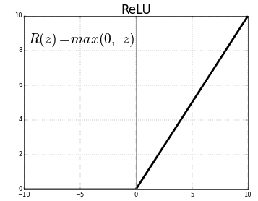
MAIN CONCEPTS
Convolutional Neural Network
Neural Network model with hierarchical layers
Each layer involves convolutions with learned filters followed by pointwise non-linearity and downsampling operation called feature-pooling
Convolutional Layer
Parts of the image are taken and compared. These parts are called features/kernels.
Each pixel is multiplied with its corresponding feature pixel. Find mean for that specific feature and replace the original pixel with this new value.
ReLU Activation
Rectified linear unit

Slide 6
Max-Pooling Layer
Used to shrink the image
Specific Window size is chosen and the window is moved along the ReLU activated image.
Maximum pixel value within the window is chosen to represent the group
Fully Connected Layer
Conversion of the resultant image into a flattened vector.
Dropout Layer
In Keras, dropout layer randomly sets input units to 0 during training while the inputs not set to 0 are scaled up. This is done to avoid the problem of over-fitting.
Batch Normalization
Standardizes the input at each layer for a mini-batch
Standardization is the rescaling of data to have a mean of 0 and standard deviation of 1

Slide 7
Dataset Information
CIFAR-10 is a labelled dataset consisting of numerous images of 32x32 dimensions classified and labelled into 10 different classes.
The target classes are: Airplane, Automobile, Bird, Cat, Deer, Dog, Frog, Horse, Ship, Truck
The classes are completely mutually exclusive. There is no overlapping between classes.
This essentially means that there is no image that can be classified into two target classes. There are 60000 images with 10000 images in each class, making this a very large dataset to work on and use for training.
Link: https://www.cs.toronto.edu/~kriz/cifar.html

Slide 8
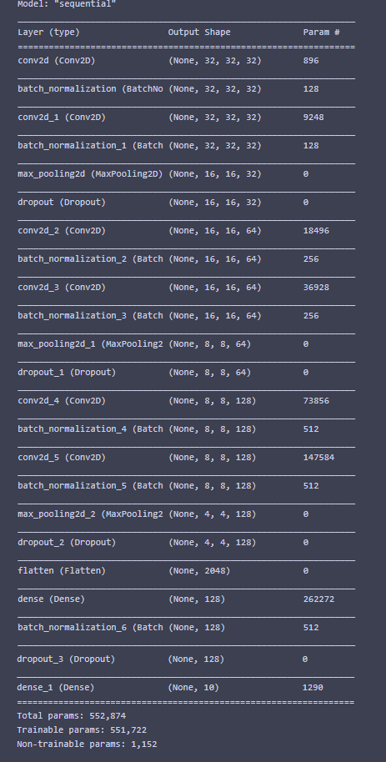
System Architecture
Model Summary:
6 x Convolutional Layers
3 x Max Pooling Layers
4 x Dropout Layers
1 x Flatten Layer
2 x Fully Connected Layers
Diagram follows in next slide

Slide 9
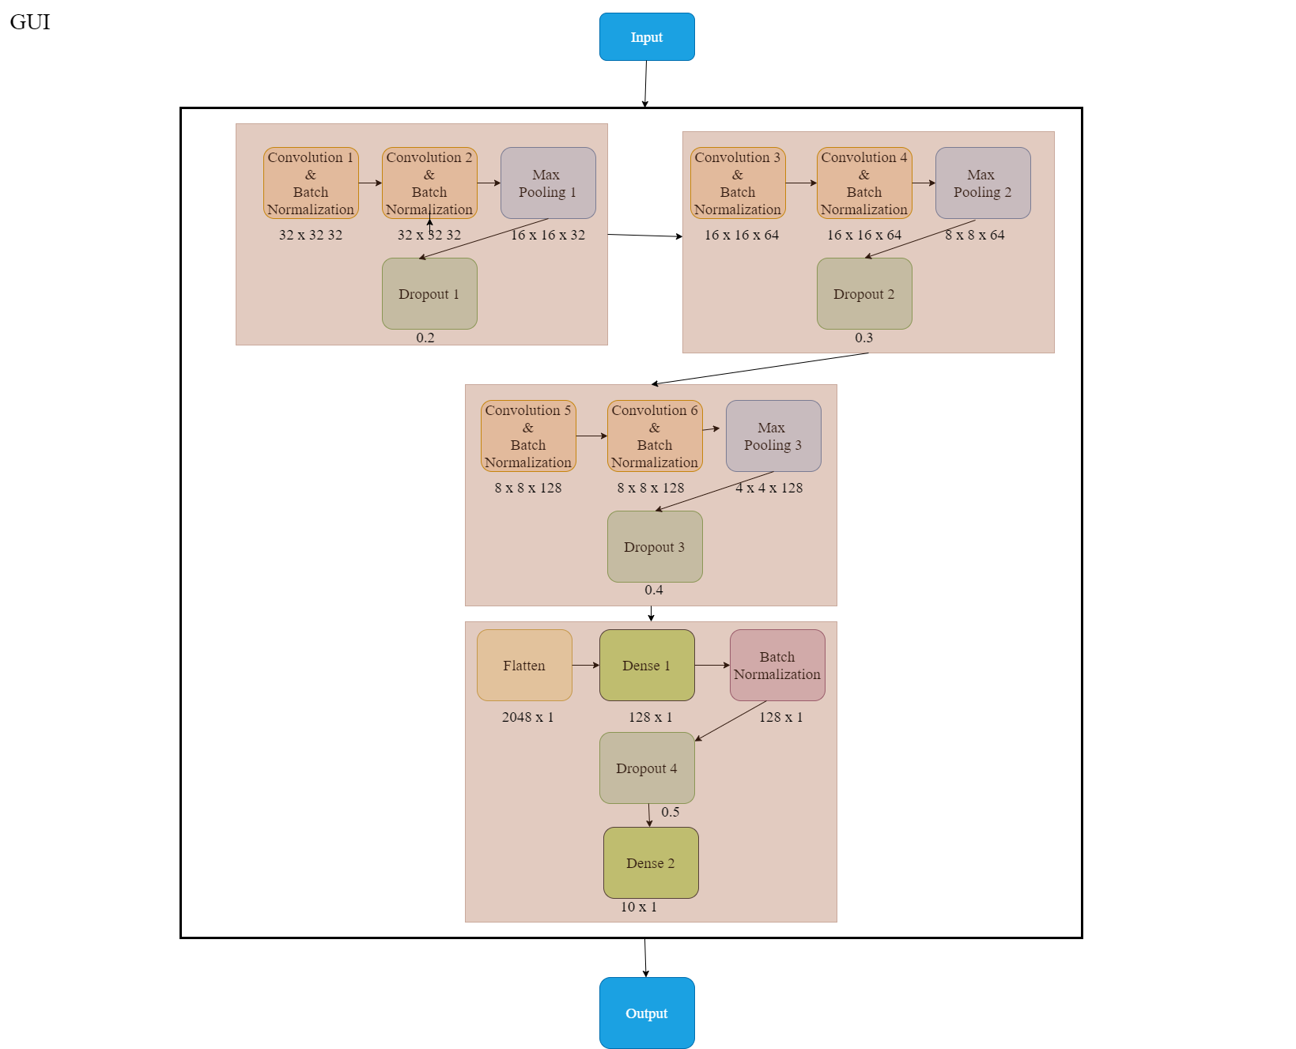
System Architecture

Slide 10
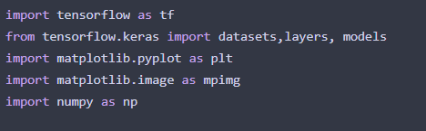
Module-Wise Algorithms
Pre-defined modules used:
Tensorflow
Open source Machine Learning Platform
Keras
Open source library that provides python interface for a artificial neural networks
Matplotlib (not necessarily required for functioning)
numpy

Slide 11
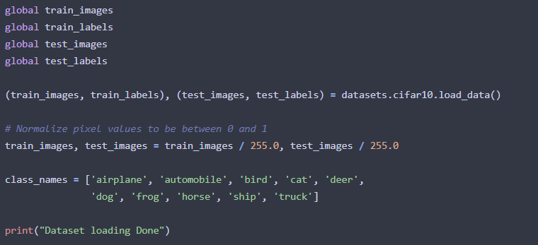
Importing of Dataset:
Dataset is loaded in from tensor flow library.
Images are split and stored into training and testing data
The images consist of pixels that have values between 0 to 255. We have divided each by 255 to achieve some form of normalization
The different class labels are added to the list for convenient output (seen later)

Slide 12
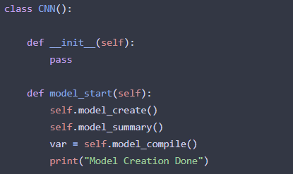
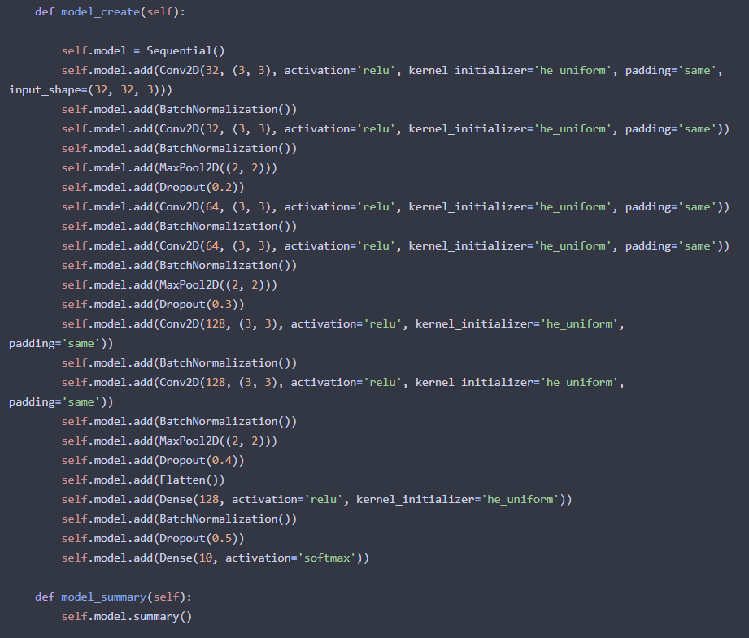
Module | Snippet
Initialization
Model Creation and Summary
NOTE: Has been explained and expanded upon earlier

Slide 13
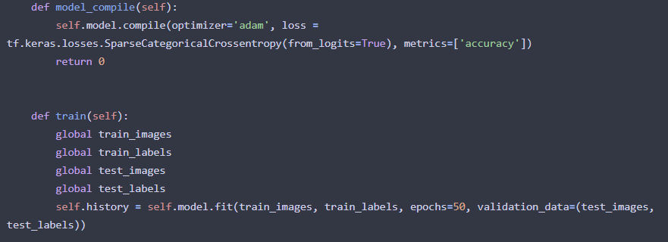
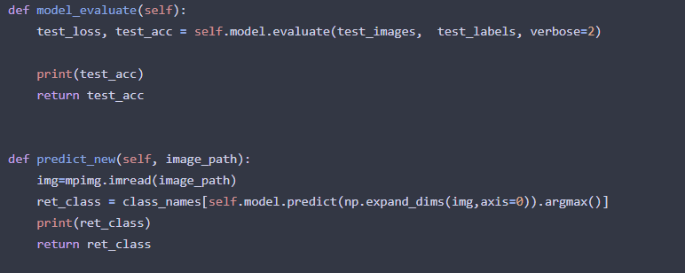
Module | Snippet
Compiling and Training
Evaluation and Prediction of New

Slide 14
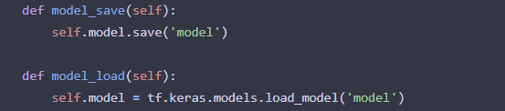
Module | Snippet
Saving and Loading of Model
Additional Information
he_uniform Kernel Initializer
Initializes the kernel/feature by drawing samples from a uniform distribution
Sparse Categorical Cross Entropy
Cross entropy function used as in multi-class situations
Cross Entropy is the measure of difference between two probability distributions for a given random variable.
This is used as the loss function.

Slide 15
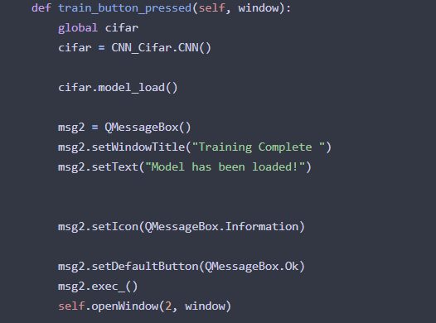
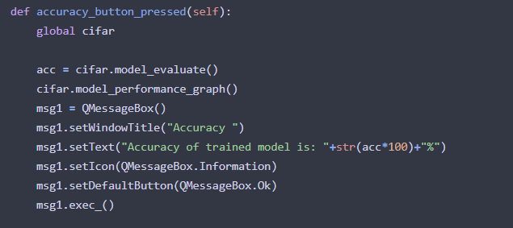
Invoking of CNN within GUI
Initialization and training
Evaluation and Accuracy

Slide 16
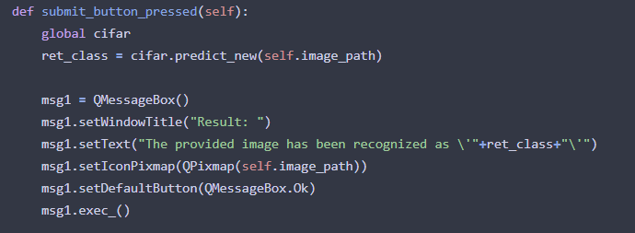
New Image Classification

Slide 17
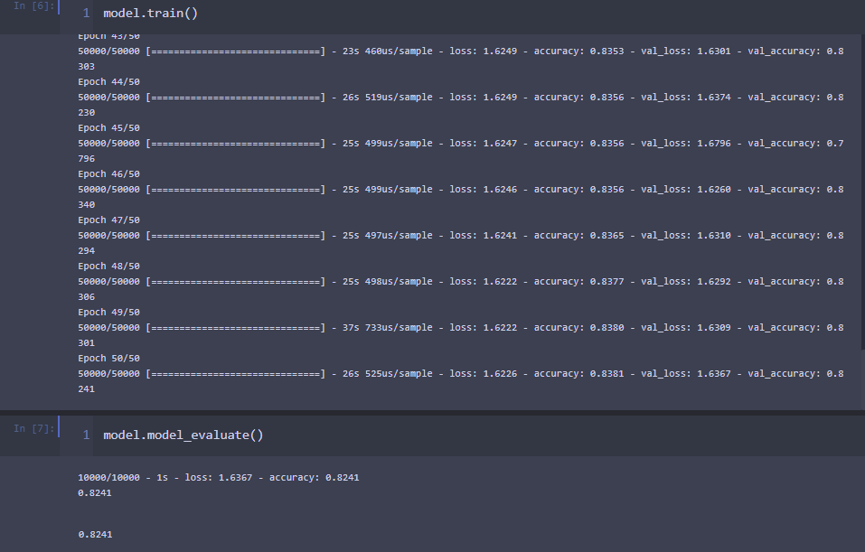
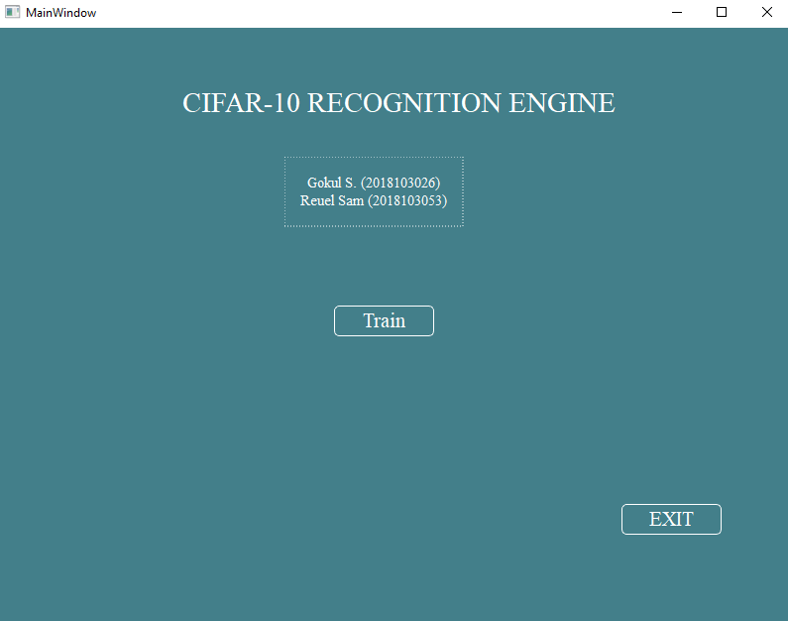
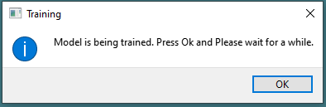
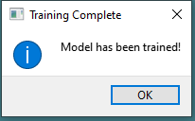
Training
After the loading of the data and preprocessing, the model has to be trained.
The training took about 20-21 minutes.
Initially we had the training to be live when the model was much simpler as shown below:
This was then replaced by just loading of data as per instruction
Shown in the next few slides

Slide 18
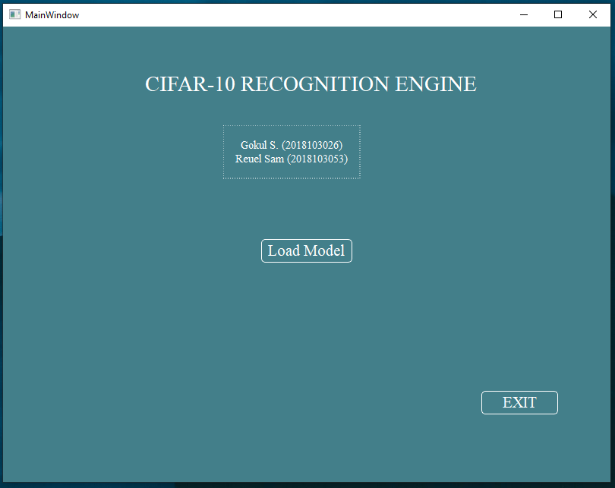
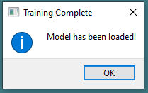
Output Screenshot

Slide 19
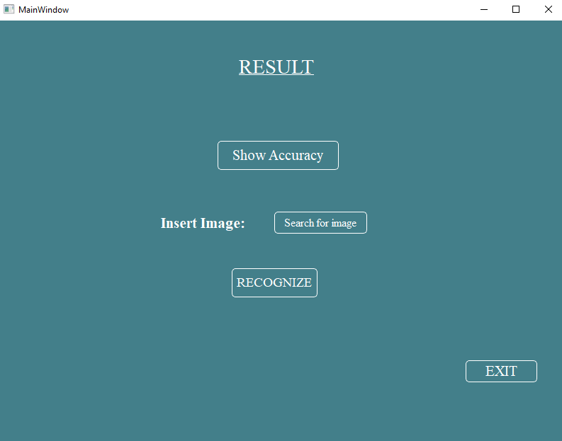

Slide 20
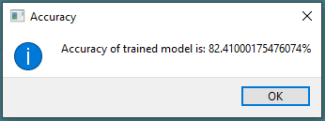
Loss Function : Sparse Categorical Cross Entropy
Performance Metric used: Sparse Categorical Accuracy

Slide 21

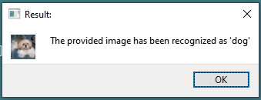

Slide 22

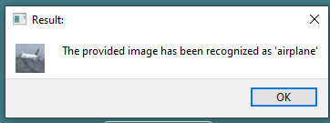

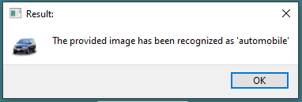

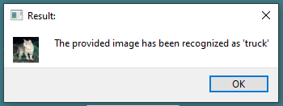
Test Cases
Input Image | Expected Classification | Actual Classification | Status
 | Airplane |  | Correct
 | Automobile |  | Correct
 | Cat |  | Incorrect

Slide 23

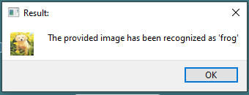

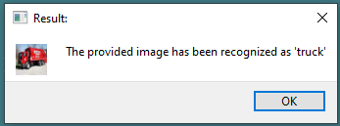
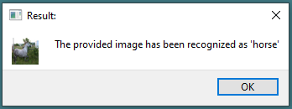

Test Cases
Input Image | Expected Classification | Actual Classification | Status
 | Dog |  | Incorrect
 | Truck |  | Correct
 | Horse |  | Correct

Slide 24

Analytical Ablation Study
An analytical ablation study refers to the addition or removal of some features, layers, fine-tuning parameters etc. from the model and noting the difference in performance.
This is done in order to understand the importance of a particular feature towards the final testing accuracy.
Original Model Architecture:

Slide 25
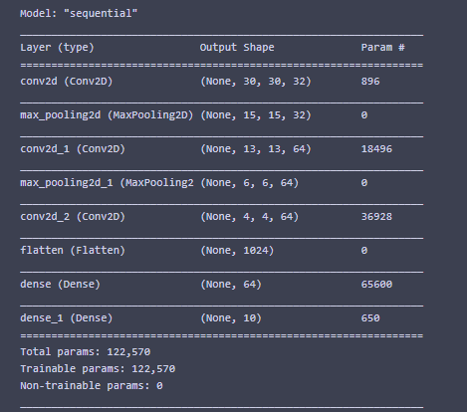
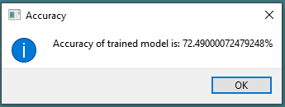
Iteration 1:
Removed:
Batch Normalizations
3 Convolution Layers
1 Max-Pooling Layer
All Dropouts
1 Dense Layer
Accuracy obtained for this model:

Slide 26
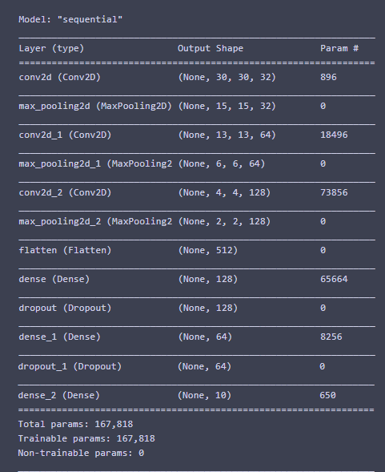
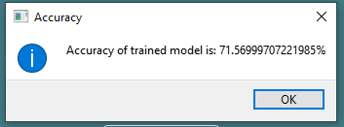
Iteration 2:
Added:
1 New Max-Pooling Layer
2 Dropout Layers
1 New Dense Layer
Edited dimensions of Conv2D layers
Accuracy obtained for this model:

Slide 27
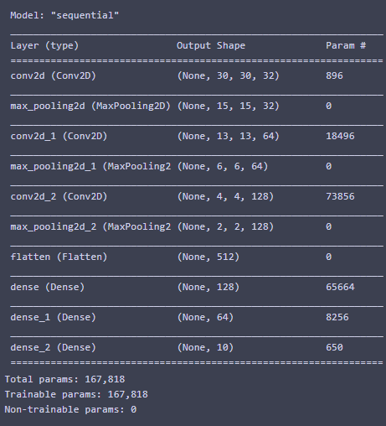
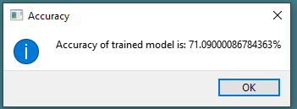
Iteration 3:
Removed:
2 Dropout layers
Accuracy obtained for this model:

Slide 28
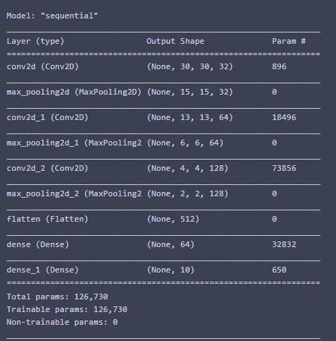
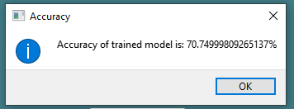
Iteration 4:
Removed:
1 Dense layer
Accuracy obtained for this model:

Slide 29
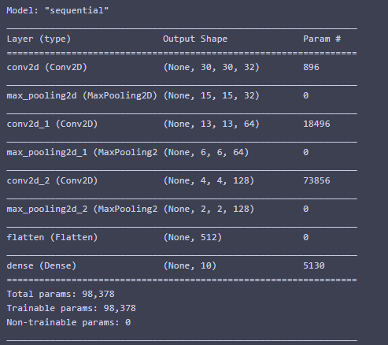
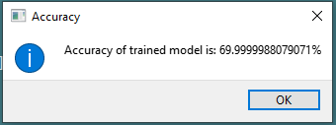
Iteration 5:
Removed from:
1 Dense layer
Accuracy obtained for this model:

Slide 30
Analytical Ablation Study: Inferences
Normalization of batches heavily increases accuracy of the model
Model performs better with dropout layers as it prevents over-fitting (Dropout Regularization).
Removing Dense Layers does not affect the model by a significant amount. Validation accuracy does not deviate by much.
This implies that most of the significant performance of a CNN is attributed to the Convolutional layers and not the fully connected Dense Layers.
This can be seen from the fact that the accuracy has not varied much from Iteration 3 through Iteration 5.

Slide 31
Conclusion
As seen in the prior slides, we were able to achieve the goals we set.
The model was successfully able to classify unseen images correctly.
We were able to make a sophisticated application that allowed the user to interact with the image classification engine in an effortless manner.
The engine developed can further be used in numerous other applications including captcha tests, malicious content classification etc.

Slide 32
References
Sharma, Neha & Jain, Vibhor & Mishra, Anju. (2018). An Analysis Of Convolutional Neural Networks For Image Classification. Procedia Computer Science. 132. 377-384. 10.1016/j.procs.2018.05.198
Calık, Caner & Demirci, M. Fatih. (2018). Cifar-10 Image Classification with Convolutional Neural Networks for Embedded Systems. 1-2. 10.1109/AICCSA.2018.8612873
Simonyan, Karen & Zisserman, Andrew. (2014). Very Deep Convolutional Networks for Large-Scale Image Recognition. arXiv 1409.1556.

