Slide 1

NAGESH KARAJAGI ORCHID COLLEGE OF ENGINEERING & TECHNOLOGY, SOLAPUR
Quadcopter Drone
DEPARTMENT OF ELECTRONICS & TELECOMMUNICATION ENGINEERING
Presented by:-
Mr. Raosaheb Dhotre (A-04)
Ms.Gaytri Gurav(A-09)
Ms.Nikita Kabade(A-13)
Mr.Deepak Mench(B-17)
Mr.Brijesh Patange(B-19)
Mr.Shankar Patil(B-22)
Ms.Shrawani Burla(B-29)
Guided by:-
Prof. A. A. Kshirsagar

Slide 2
CONTENT
Introduction
Motivation
Problem Statement
Component Used and Description
Block Diagram and System Description and Working
Used Software Information and Description
Simulated Results & Actual Results
Advantages
Disadvantages
Application
Future Scope
Challenges Faced during execution
Conclusion

Slide 3
Introduction
Over the last few years we have seen a massive growth in the manufacture And sales of remote control airborne vehicles known as Quadcopter
A quadcopter is lifted and propelled by four rotors.
The lift is generated by set of rotors and vertically oriented propellers.

Slide 4
Motivation
Study and development of vehicle. Since the application can apply to variety of areas such as rescue mission, military, film making, agriculture and others .

Slide 5
Problem Statement
Study and development of Quadcopter drone.

Slide 6
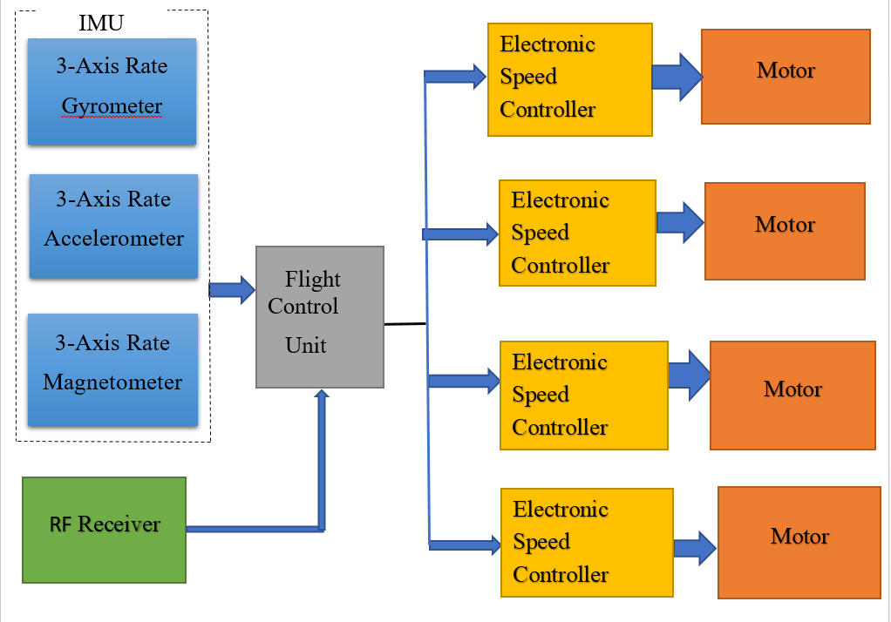
Block Diagram

Slide 7
Component Used
Frame
Flight Controller
Electronic Speed Controller (ESC)
Brushless DC Motor
Transmitter and receiver
Inertial Measurement Unit (IMU)
The battery pack
Propellers

Slide 8
Block Diagram Explanation
The quadcopter rotorcraft consists of an Inertial Measurement Unit (IMU), flight control unit, Electric Speed Controllers (ESC) for the motors and a Radio Frequency (RF) receiver; the IMU consists of an accelerometer, gyroscope and a magnetometer.
Working
1. Flight Controller
2. Transmitter and Receiver
3. Inertial Measurement Unit (IMU)
4. Electronic Speed Controller (ESC)
5. Brushless DC Motor
6. Battery pack
7. Propellers

Slide 9
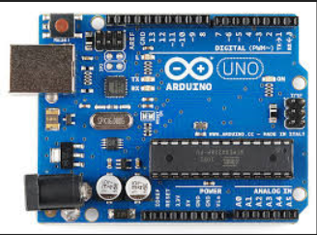
1. Flight Controller :
The flight control board is regarded as the brain of the Quadcopter.
It houses the sensors such as the gyroscopes and accelerometers that determines how fast each motor spin.
It determines how fast or slow each motor spins simultaneusly

Slide 10
2. Transmitter and Receiver
The transmitter and receives allows to controls the Quadcopter.
Four channels for a basic Quadcopter is required .
Quadcopters can be programmed and controlled in many different ways but most common ones are by RC transmitter
The receiver determines what the transmitter is saying and responds accordingly.

Slide 11
3. Inertial Measurement Unit
Accelerometers are devices that measure acceleration.
A gyroscope is a device consisting of a wheel or disk mounted so that it can spin rapidly about an axis that is itself free to alter in direction.
The orientation of the axis is not affected by tilting of the mounting.
Gyroscopes can be used to provide stability or maintain a reference direction in navigation systems. automatic pilots, and stabilizers.

Slide 12
4. Electronic Speed Controller
An electronic speed controller or ESC is an electronic circuit that vary motor's speed.
This is what controls the speed of motors.
It tells the motor how fast to spin at a given time.
For a quadcopter, ESC’s are needed, one connected to each motor.
Because the motors on a Quadcopter must all spin at precise speed to atchive accurate flight, the ESC is very important.

Slide 13
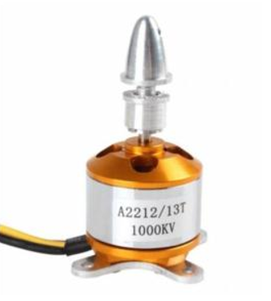
5. Brushless DC Motor
Each of the four rotors comprises of a Brushless DC Motor attached to a propeller.
This is what powers the Quadcopter to fly in the air.
The purpose of motors is to spin the propellers.
Each motor needs to be controlled separately by a speed controller.

Slide 14
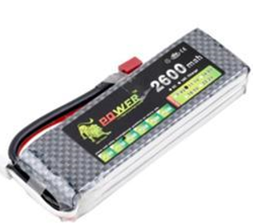
6. Battery Pack
It provides the power to all of the electronic on board, mainly the motors.
LiPo(Lithium Polymer) batteries are used because it is light weight
NiMH(Nickel Metal Hybrid) batteries are also used but they are heavier than LiPo.

Slide 15
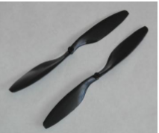
7. Propellers
The Quadrotor consists of four propellers coupled to the brushless motor.
Among these four propellers, two clockwise and the remaining other two are counter clockwise to avoid body spinning.
Clockwise and anticlockwise propellers cancel their torque from each other.
Fixed-pitch, symmetric, tapered Normal Rotation Carbon Fiber Propeller.

Slide 16
Software Used
Arduino
Proteus 8 Labcenter
Unity 3D
eCalc – xcopterCalc

Slide 17
Software Description
Arduino
Proteus 8 Labcenter
Unity 3D
eCalc – xcopterCalc

Slide 18
Arduino
Arduino is an open-source electronics platform based on easy-to-use hardware and software.
Arduino boards are able to read inputs - light on a sensor, a finger on a button, and turn it into an output - activating a motor, turning on an LED, publishing something online.
You can tell your board what to do by sending a set of instructions to the microcontroller on the board.

Slide 19
Proteus 8 Labcenter
Protues software by Labcenter enabling powerful features to design, test and layout professional PCB layouts and supports the schematics and simulation of 800 microcontrollers.

Slide 20
Unity 3D
Unity3D is a powerful cross-platform 3D engine and a user-friendly development environment for developing 3D projects and simulations.
It is equipped with graphical and programmatic documentation and scripting guide to simulate real world physics and variables making it easy for the user to run their simulations and see the result visually rather than tables and figures.

Slide 21
eCalc – xcopterCalc
eCalc is an online tool for simulating real-life quadrotor parameters by providing quadcopter parameters.
Such as model weight, number of rotors, frame size, elevation, etc.
Other parameters concerning the flight controller, Motors and propellers then assessing and providing suggestion to get the best performance of the quadcopter.

Slide 22
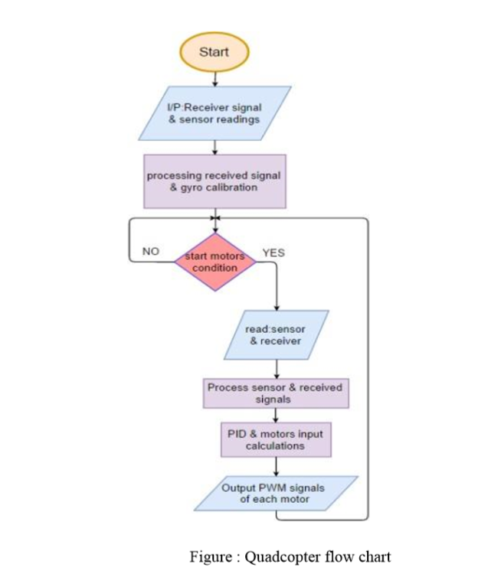
Software Working (Flowchart)

Slide 23
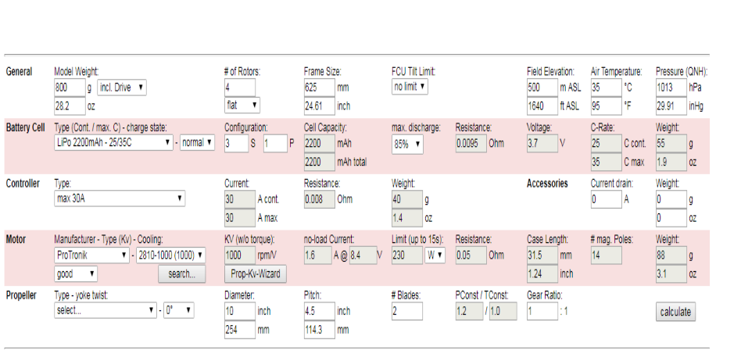
Simulated Results

Slide 24
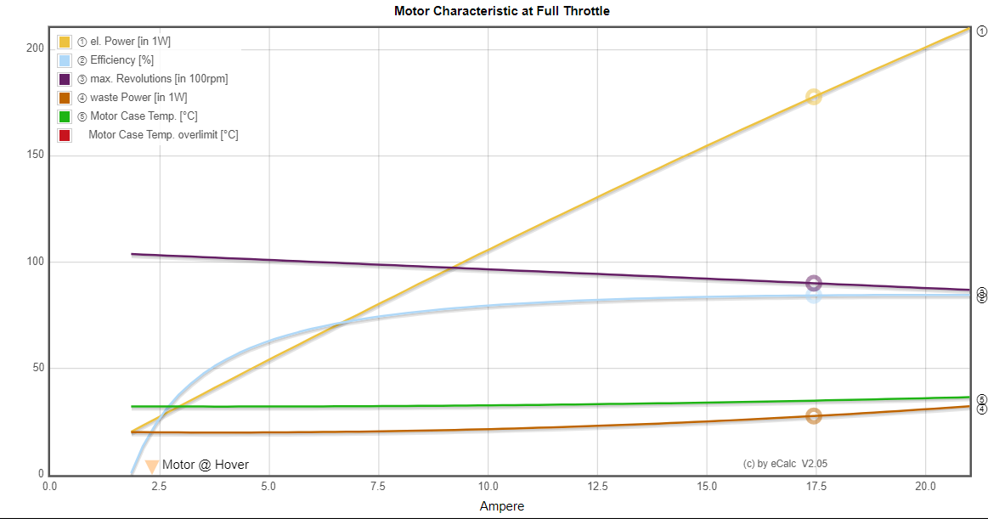

Slide 25
Advantages
They can traverse through difficult terrains because of their small size and there is less risk of damage.
Four small rotors have smaller diameter than one large helicopter rotor.
They can take off and land vertically
Easier to build four small blades compared to large one.

Slide 26
Disadvantages
Quadcopter have a limited flying time (usually 15-30 minutes)
They only have small payload capabilities
And most of the drone’s energy is spent on fighting gravity and stabilizing in the air

Slide 27
Applications
Aerial photography
Video aerial inspection
Agriculture
Construction
Security

Slide 28
Future Scope
Another method should be used to choose the proper PID gains for a more stable flight
Power distribution boards are more helpful in mounting the IMU properly on the frame beneath the microcontroller and placing the battery safely.
Replacing the RC transmitter with a motion sensor that captures hand gestures transmitted as movement commands with a wireless Wi-Fi communication.

Slide 29
Challenges faced during execution
Motor had a variation speed resulting from the ESC’s even software code or ardiuno connected
Power regulator must be used
Isolation and soldering of the components must be accurate and tight
A high vibration was clearly noticed in the propellers

Slide 30
Conclusion
Drones will soon take on be important role in the coming future.
They will be seen taking up larger roles for variety of jobes including business in the future .
They could become a part of our daily lives, from smallest details like delivering groceries to changing the way farmers manage their crops to revolutionizing private security.

Slide 31
THANK YOU

