Slide 1
• a title slide including team members names and demo title
• for each scene of the demo, one slide that explains what the team did and how the code works.
– emphasize interesting aspects of your code!
– use screenshots and/or diagrams if needed
• one final slide that shows practical aspects of the development of the project
– how did you work as a team?
– did you use version control?
– how did you debug?
– what did you do to make your project easier to develop? especially as a team
– etc.

Slide 2
DCCA GROUP2
Leran LV 999004195, Yiyang YAN 999005002,Zehui LIN 999003981, Junting Pan 999010440
Demo1 — Break the Brick
Demo2 — Scrolling Kirby
Demo3 — Sun&Earth&Moon

Slide 3
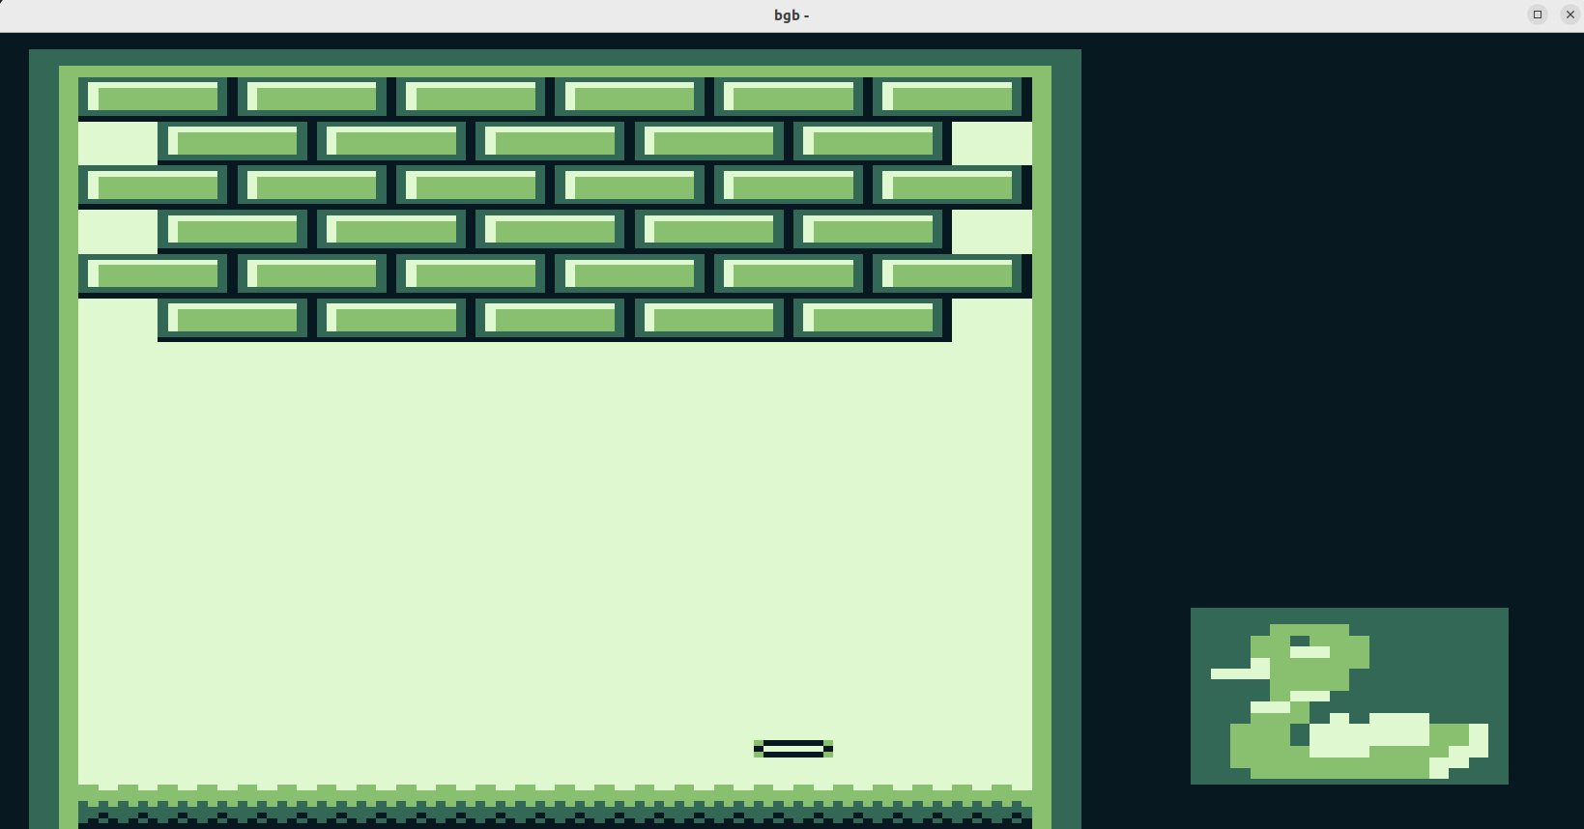
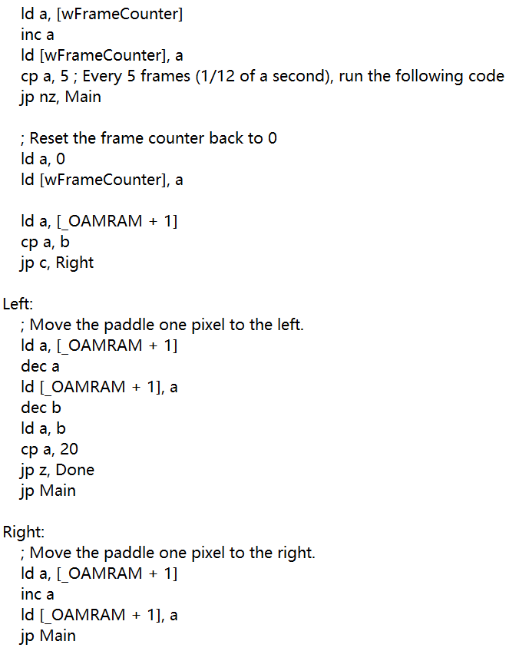
Demo1 — Break the Brick
background
Velocity modifying
Object movement
background
Paddle object
;b was originally set to 100
Figure 1. Layout of the demo
Notes:
The first demo is break the brick. It is a primary presentation in our project and only the paddle is moving.
The right side of the slide shows the layout of the demo, which consists of a background made of bricks and
a duck icon representing the player. They are simply implemented by copying the corresponding tiles and
tilemaps. As for the paddle object shown, the demonstration velocity can be alternated by setting a Framecounter.
In 60Hz refrash rate, setting 5 frames per movement indicates one step in one twelveth second.
The paddle will first move to the right till the x coordinate reaches 100 and then return to 20 and halt to the next scene.

Slide 4
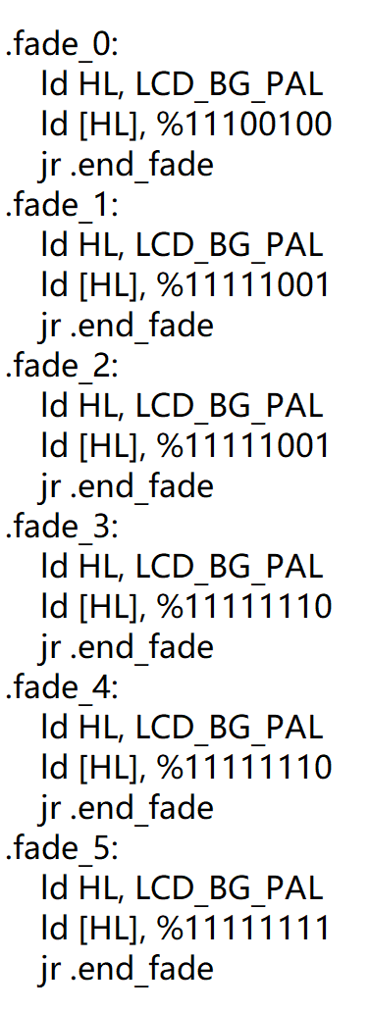
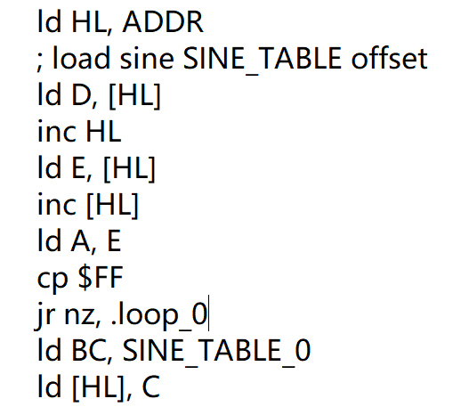
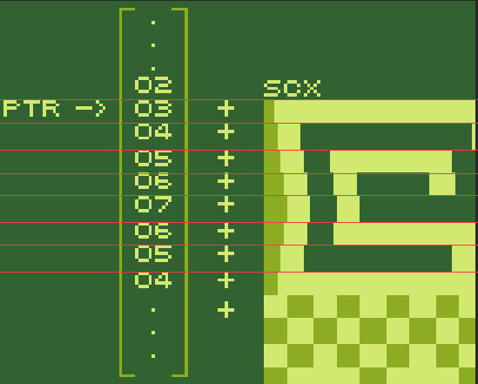
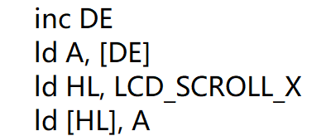
Demo2 — Scrolling Kirby
Fading & Blinking
Scrolling
Notes:
Fading and Blinking are achieved by modifying the background color palette register which is described in 4 sets of 2 bit values, the darkest is 11 and the lightest is 00. Here 11100100 is the default value and we gradually change it to 11111111.
Scolling is done by modifying the register SCX (Scroll X) with a different offset which has been pregenerated and stored in memory as a look up table. Then to make it move, we can just increment the pointer ADDR referring to the lookup table as shown in the figure.

Slide 5
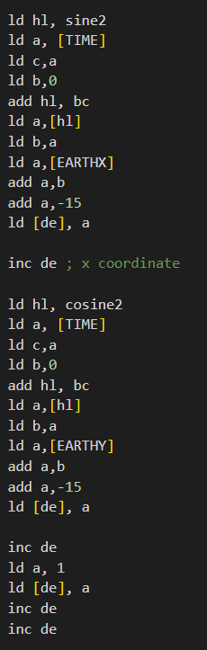
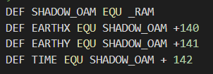
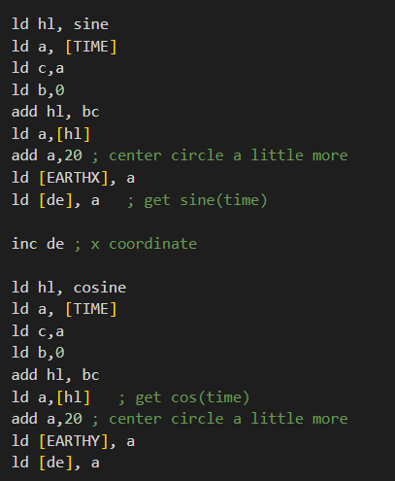


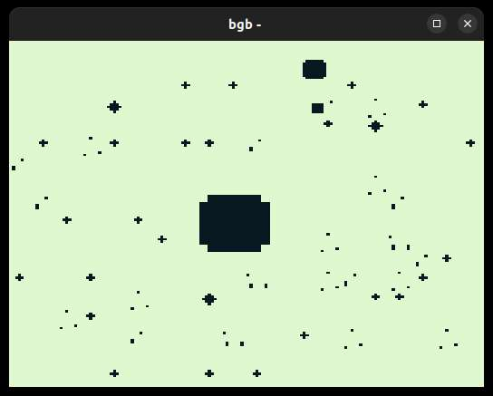
Demo3 — Sun&Earth&Moon
ORBIT
TIME
object
background
Notes:
The third demo simulate the motion between sun earth and moon. The specialty of this scene is that the graphic is drafted by author completely, including the tile for background, tile map and the object tile. The sun and the stars are a background. The earth and moon are the object. The main loop is modified based on the “circle” on the moodle. To realize the circular motion, we use a lookup table which is an array of value of R*sine or R*cosine loaded to RAM. As you can see, time is defined as a pointer(address) to an int inside the RAM. And it will behave like the index of corresponding value of cosine and sine value inside the lookup table. After each loop, we increment the value TIME and get into the next loop. To realize the orbit of moon, which is the vector sum of two circular motion, we define two additional address for the temporary storage of x,y coordinates of earth, which are EARTHX and EARTHY. And then we add two value of triangular functions in the calculation of moon’s coordiantes.

