Slide 1
Rev3rse Security
Stato lavori 2018
E
Novità 2019

Slide 2
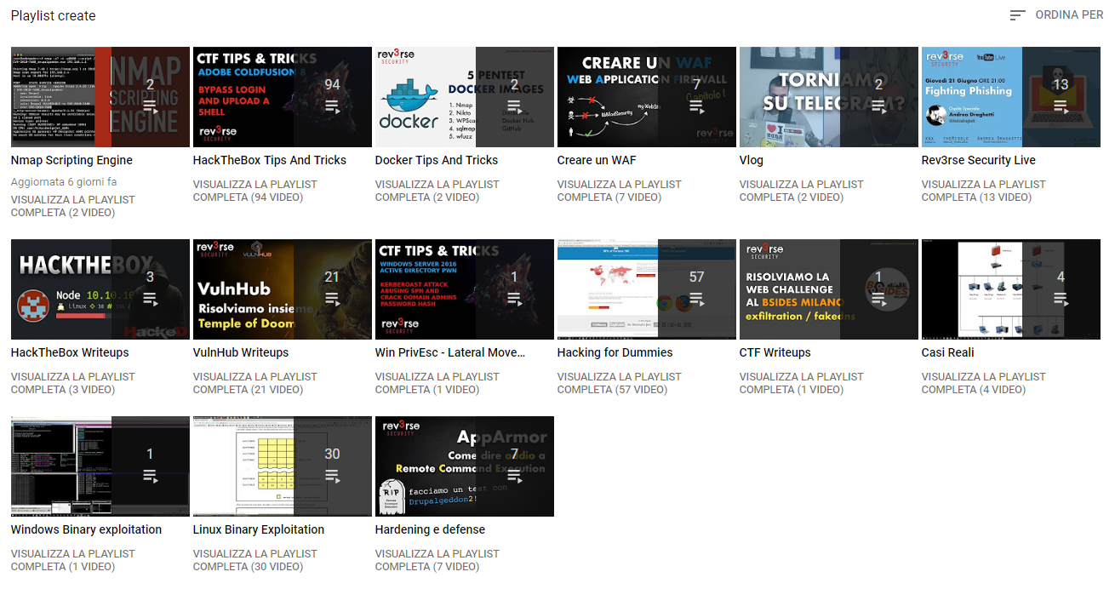

Slide 3
Win PrivEsc - Lateral Movement
HackTheBox: https://www.hackthebox.eu/home
  EndGame
  RastaLab
  OffShore
PentesterAcademy: https://www.pentesteracademy.com
  RedTeam Lab
Sparc FLOW: https://www.hacklikeapornstar.com
  Ultimate Hacking Challenge
  Ultimate Hacking Challenge ZETA
eLearnSecurity: https://www.elearnsecurity.com/course/
  PTPX

Slide 4
Windows Binary Exploitation
Corelan Team: https://www.corelan.be/
Offensive Security: OSCP
Offensive Security: AWE
eLearnSecurity: PTP

Slide 5
Linux Binary Exploitation
LiveOverflow: https://www.youtube.com/channel/UClcE-kVhqyiHCcjYwcpfj9w
GynvaelEN: https://www.youtube.com/user/GynvaelEN
Modern Binary Exploitation: http://security.cs.rpi.edu/courses/binexp-spring2015/

Slide 6
Casi Reali
PentesterLab: https://www.pentesterlab.com/exercises/

Slide 7
Novità 2019:
Attack/Defense LAB
Pentester Academy: https://public.attackdefense.com/members

