Slide 1


FocusRoom
AI-Powered Productivity Operating System

Slide 2

Problem Statement
📋 Too many disconnected workflows — tasks, notes, memories, planning, and reminders are handled separately.
🧠 Lack of context — traditional task managers don't remember user preferences or working habits.
🎯 Manual prioritization — users still need to decide what to work on first.
📅 Time-consuming planning — creating a realistic daily schedule requires manual effort.
🔔 Missed deadlines — important tasks can be forgotten without timely reminders.
🤖 Limited intelligent automation — conventional productivity tools don't coordinate multiple AI capabilities around a single request.

Slide 3
Key Features
📝 Smart Task Management
Create, update, complete and delete tasks
Priority, status and due-date tracking
Identify pending and high-priority work
🧠 Persistent Memory
Store user preferences and context
Search relevant memories when needed
Personalize planning based on previous information
📅 AI Daily Planning
Combines tasks + memories
Prioritizes work
Generates Morning / Afternoon / Evening schedule
🤖 Multi-Agent Assistant
Supervisor Agent coordinates requests
Task Agent manages tasks
Memory Agent manages context
Planning Agent creates schedules
Reminder Worker handles notifications
🔌 MCP Tool Integration
list_tasks, create_task, update_task, complete_task
search_memory, save_memory
daily_plan
productivity_report
📊 AI & MCP Telemetry
Prompt / completion / total token tracking
MCP request & response bytes
Agent execution traces

Slide 4
Solution: What is FocusRoom?
FocusRoom brings tasks, personal context, planning, and reminders together in one intelligent workspace.
How it works
User → Assistant → Agents → MCP Tools → LLM → Actionable Result
Example
Input : Check my pending tasks, consider my work preferences, and create my daily plan
FocusRoom does
Retrieves relevant pending tasks
Retrieves saved preferences/context
Determines priorities
Creates a Morning / Afternoon / Evening schedule

Slide 5
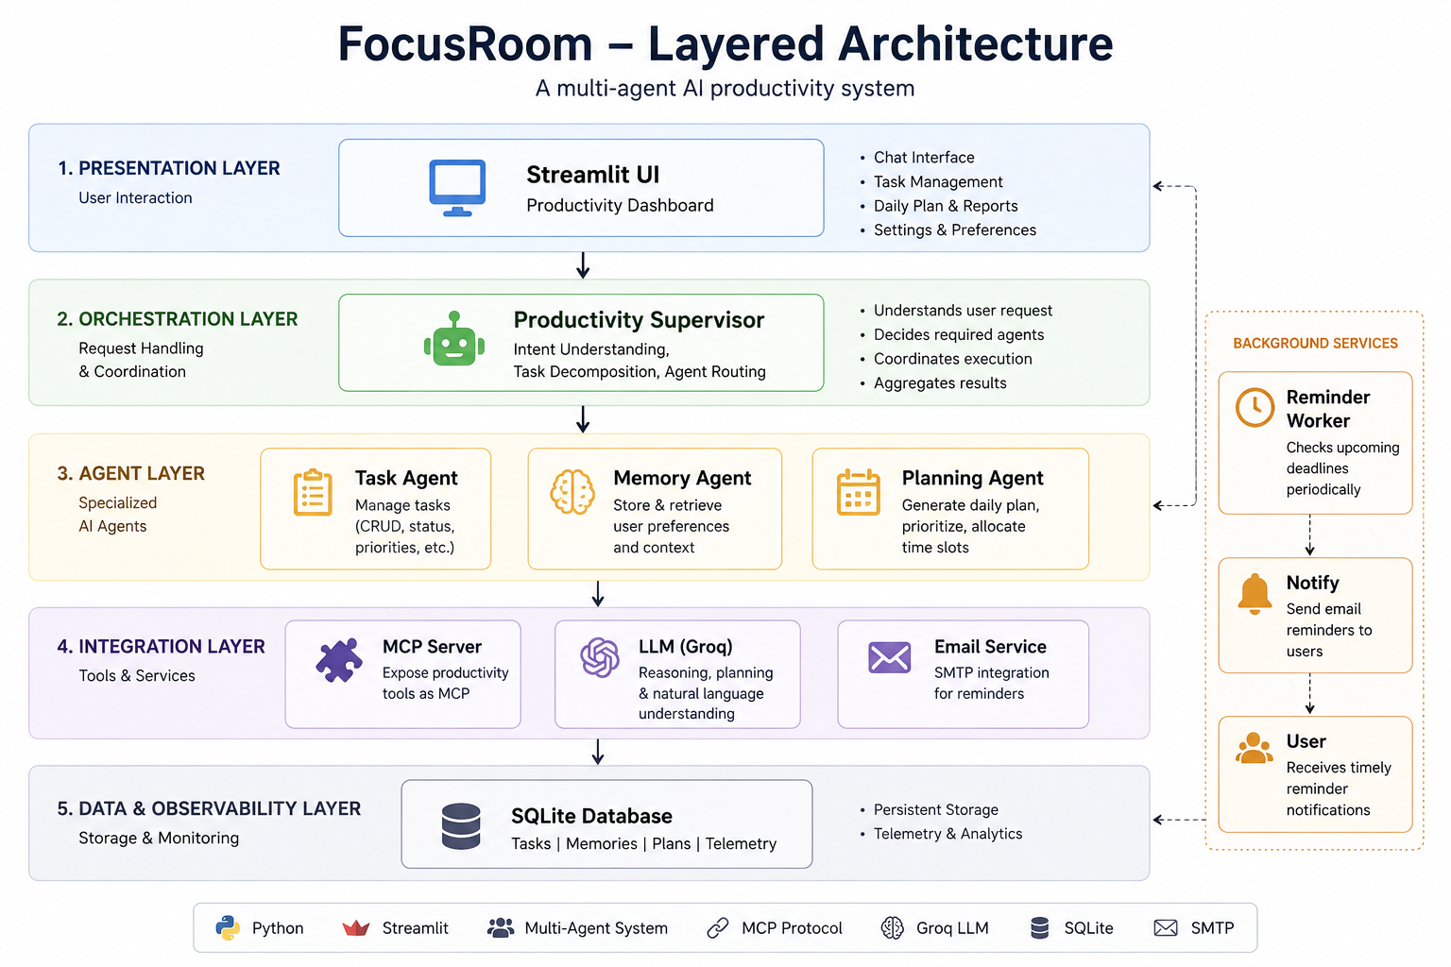
Layered Architecture

Slide 6
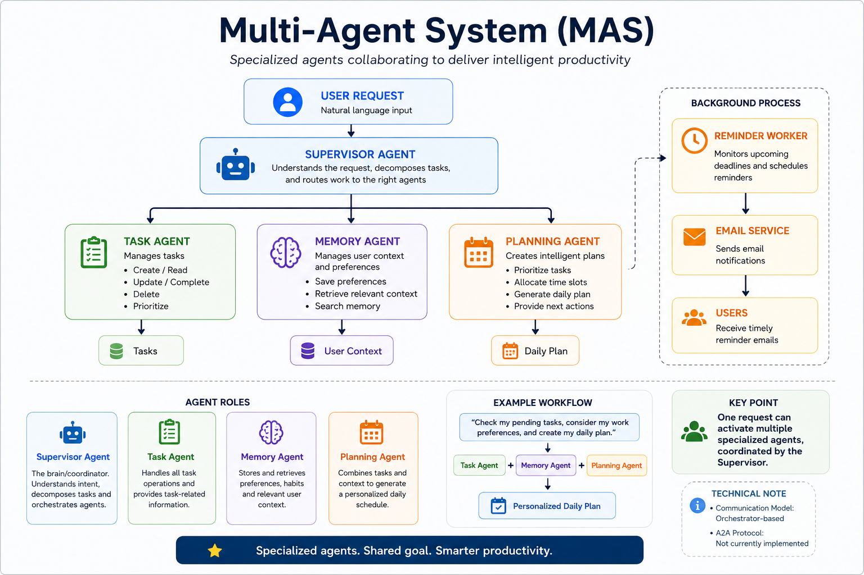
Multi-Agent System

Slide 7
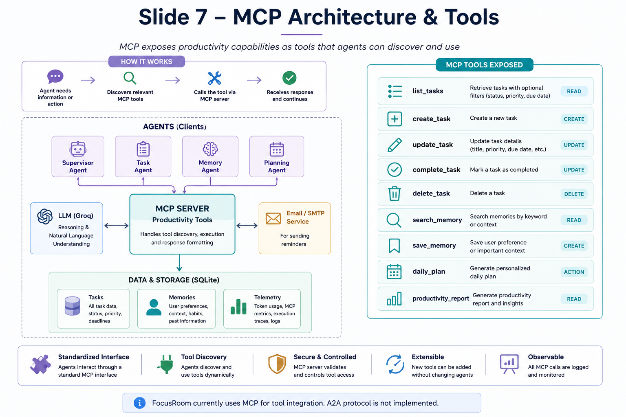
MCP Architecture and Tools

Slide 8
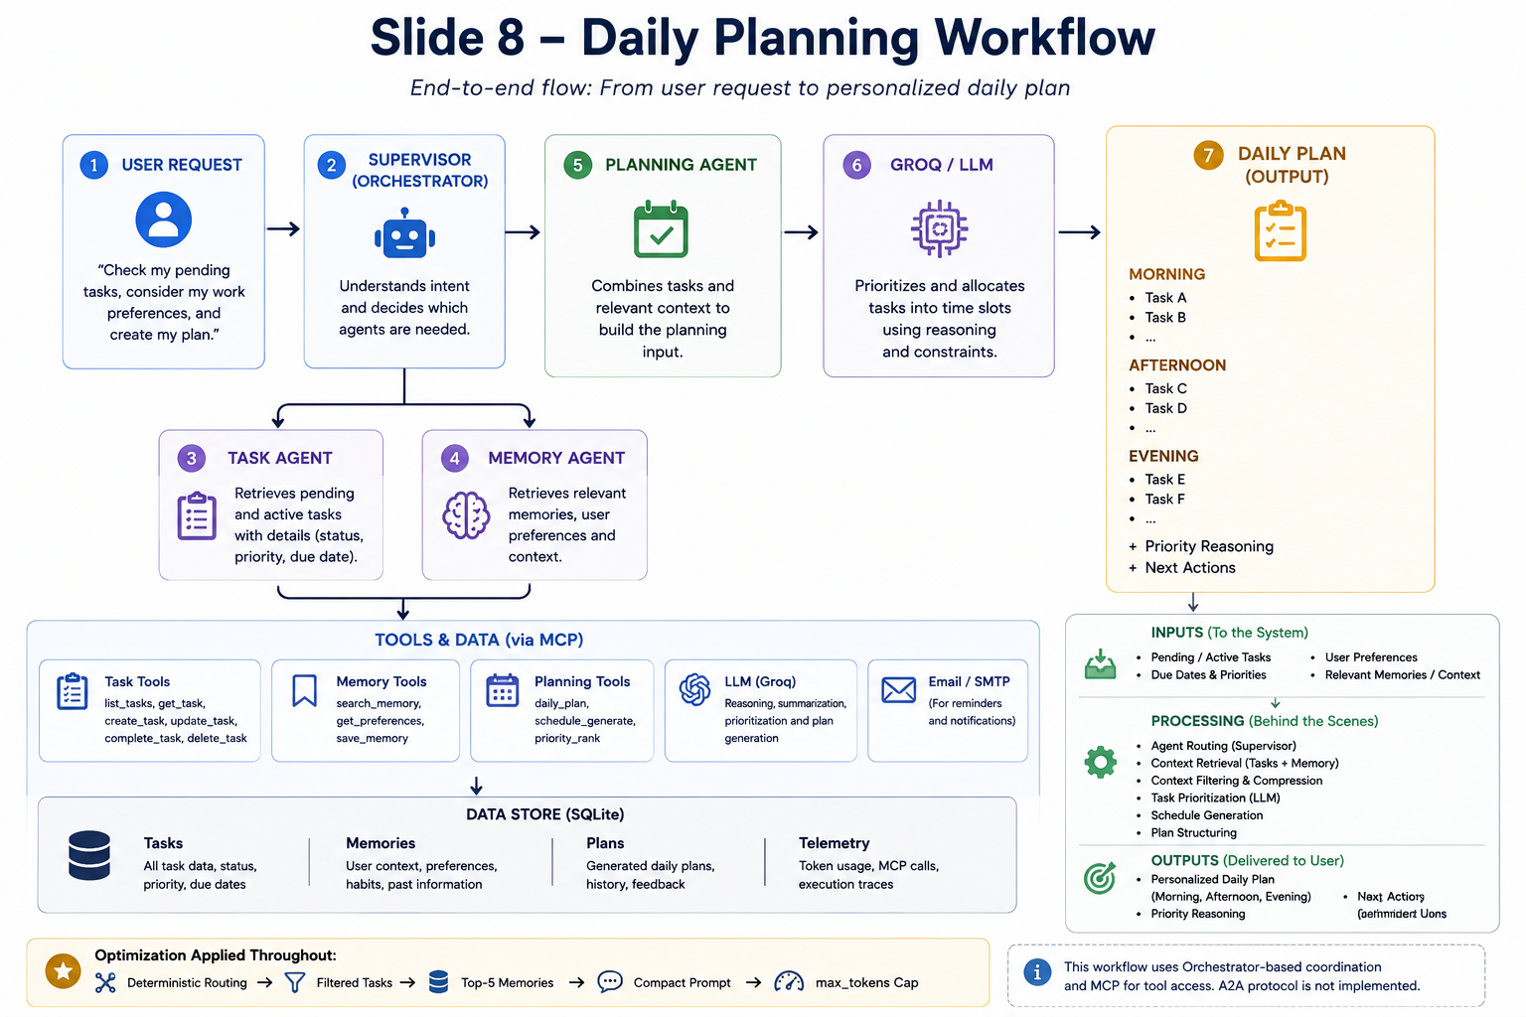
Daily Planning Workflow

Slide 9
Token Optimization & Cost Reduction
Reduce unnecessary context and LLM calls while preserving planning quality.
Before
All Tasks
Memories
Descriptions
Verbose JSON
LLM Call
───►
Optimization
Filter Tasks
Top 5 Memories
Compact JSON
Deterministic Routing
Max_tokens = 40000
───►
After
Relevant Context
Smaller Prompt
1,467 tokens ──────► 186 tokens ≈ 87% ↓

Slide 10
Telemetry & Observability
AI Token Tracking – records prompt, completion, and total tokens for each LLM operation.
Operation-Level Usage – separates usage by operations such as supervisor_decision and planning_request.
Execution Tracking – assigns each request an execution_id.
Agent Execution Trace – records the sequence of Supervisor → Agents → MCP → LLM → Result.
MCP Traffic Monitoring – tracks MCP request/response counts and transferred bytes.
Tool-Level Visibility – identifies which MCP tools were called during an execution.
Persistent Telemetry – stores AI and MCP metrics in SQLite for later analysis.
Current Execution Monitoring – displays token and MCP activity for the active request.

Slide 11
Technical Implementation & Results
Technology Stack : Python, Streamlit, Groq LLM, SQLite, MCP, SMTP/Email
Core Components : Supervisor, Task Agent, Memory Agent, Planning Agent, Reminder Worker
Implementation Results : Multi-agent orchestration working, MCP tools integrated, Persistent tasks & memory storage, AI token telemetry implemented, MCP transport telemetry implemented, Execution tracing implemented, Prompt optimization implemented
Testing : Unit/integration tests, Python compilation checks, MCP/tool execution verification

Slide 12
Challenges, Future Scope & Conclusion
🔧 Challenges
Token Optimization — controlling LLM usage and prompt size.
Multi-Agent Coordination — routing requests to the correct specialized agents.
MCP Reliability — handling tool calls, transport and response tracking.
Observability — tracing complex executions across agents, MCP and LLM calls.
🚀 Future Scope
A2A Protocol Integration — enable standardized agent-to-agent communication.
Agent Discovery — allow agents to discover available capabilities dynamically.
Better Parallelization — execute independent agent tasks concurrently.
Caching — reduce repeated LLM and database operations.
🎯 Conclusion
FocusRoom transforms traditional task management into an intelligent, A-aware productivity system by combining Multi-Agent Orchestration, MCP tools, memory, AI planning, automation, and observability.

