Slide 1
Quantum Computing

Slide 2
Introduction to Quantum Computing
Quantum computing is a new paradigm for computing that uses the principles of quantum mechanics to perform calculations. It has the potential to solve complex problems that are currently unsolvable by classical computers. Quantum computers use qubits, which can exist in multiple states simultaneously, allowing them to process vast amounts of data quickly and efficiently. This technology has far-reaching implications for fields such as cryptography, optimization, and simulation.
• What is quantum computing?
• Principles of quantum mechanics
• Qubits and quantum processing
• Applications of quantum computing
• Future directions

Slide 3
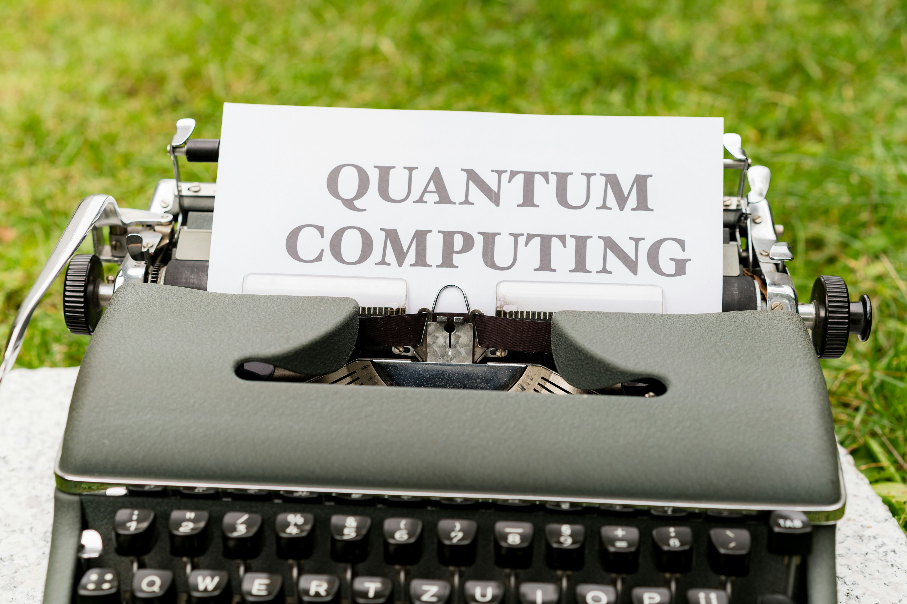
Quantum Algorithms
Quantum algorithms are designed to take advantage of the unique properties of qubits. Shor's algorithm, for example, can factor large numbers exponentially faster than classical algorithms. Grover's algorithm can search an unsorted database in polynomial time. These algorithms have significant implications for fields such as cryptography and data security.
• Shor's algorithm
• Grover's algorithm
• Quantum simulations
• Optimization problems
• Cryptography

Slide 4
Quantum Error Correction
One of the major challenges in building a practical quantum computer is error correction. Quantum computers are prone to errors due to the fragile nature of qubits. Developing robust and efficient error correction methods is essential for large-scale quantum computing.
• Types of errors in quantum computing
• Quantum error correction codes
• Error correction methods
• Challenges and limitations
• Future directions

Slide 5
Quantum Computing Hardware
Building a practical quantum computer requires significant advances in hardware. Superconducting qubits are one approach, while ion traps and topological qubits are others. Each has its advantages and limitations.
• Superconducting qubits
• Ion traps
• Topological qubits
• Quantum gate implementation
• Scaling up

Slide 6
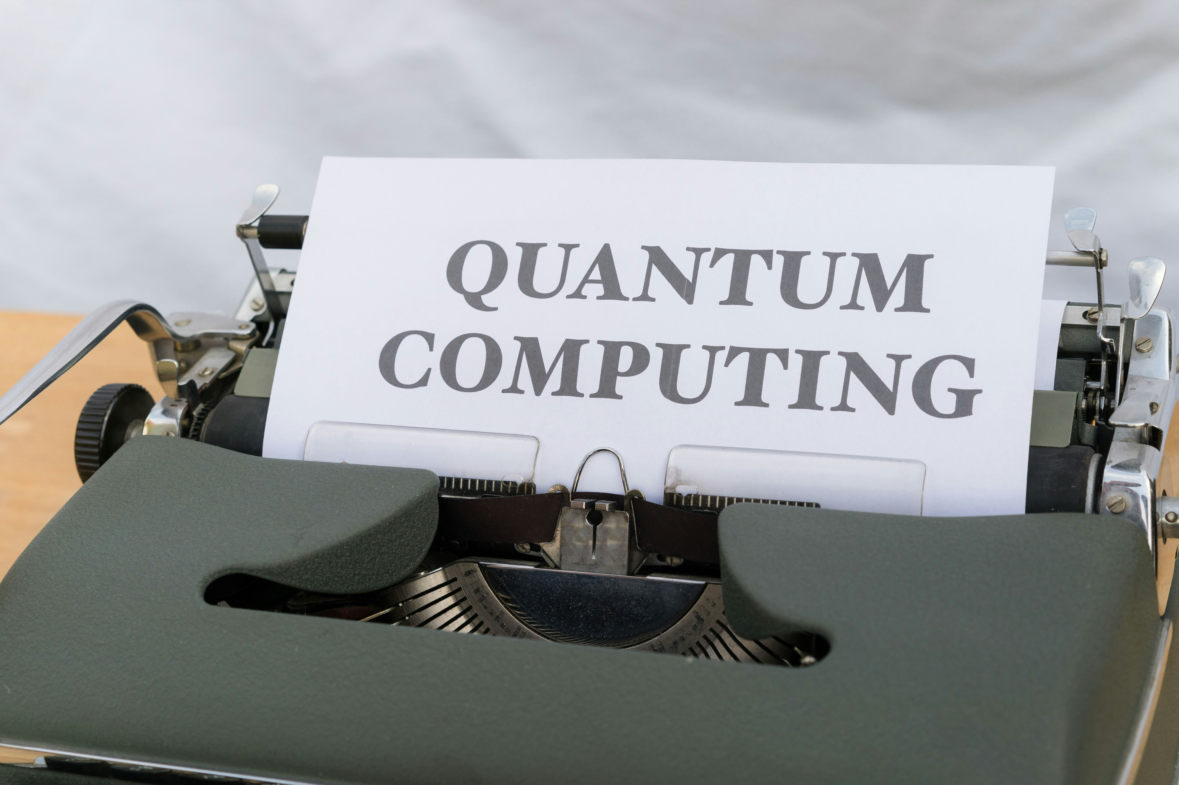
Applications of Quantum Computing
Quantum computing has the potential to revolutionize a wide range of fields. These include chemistry, materials science, machine learning, and finance. Quantum computers can solve complex optimization problems and simulate complex systems.
• Chemistry and materials science
• Machine learning and AI
• Finance and portfolio optimization
• Optimization problems
• Simulation

Slide 7
Conclusion and Future Directions - Conclusion Index (%)

Slide 8
Presentation Flow
Beginning
Middle
End
Introduction to Quantum Computing
Quantum Computing Hardware
Conclusion and Future Directions

Slide 9
Key Takeaways
✓ Introduction to Quantum Computing
✓ Quantum Algorithms
✓ Quantum Error Correction
✓ Quantum Computing Hardware
✓ Applications of Quantum Computing

