Slide 1
Introduction to Machine Learning

Slide 2
What is Machine Learning?
Machine learning is a subset of artificial intelligence that involves training algorithms to make predictions or take actions based on data. It's a self-improving process where the algorithm becomes better over time as it learns from new data. In this presentation, we'll explore the basics of machine learning and its applications.
• Definition of Machine Learning
• Types of Machine Learning
• Applications of Machine Learning
• Limitations of Machine Learning
• Future of Machine Learning

Slide 3

Machine Learning Basics
Machine learning algorithms are trained on datasets to learn patterns and relationships. The algorithm is then tested on a new dataset to evaluate its performance. There are three primary types of machine learning: supervised, unsupervised, and reinforcement learning. We'll dive deeper into each type in the next few slides.
• Supervised Learning
• Unsupervised Learning
• Reinforcement Learning
• Training vs Testing Data
• Evaluation Metrics

Slide 4
Supervised Learning
Supervised learning involves training an algorithm on labeled data to learn a mapping between input and output. The goal is to predict the output for new, unseen data. Examples of supervised learning include image classification, speech recognition, and sentiment analysis.
• Definition of Supervised Learning
• Types of Supervised Learning
• Applications of Supervised Learning
• Challenges in Supervised Learning
• Real-World Applications

Slide 5
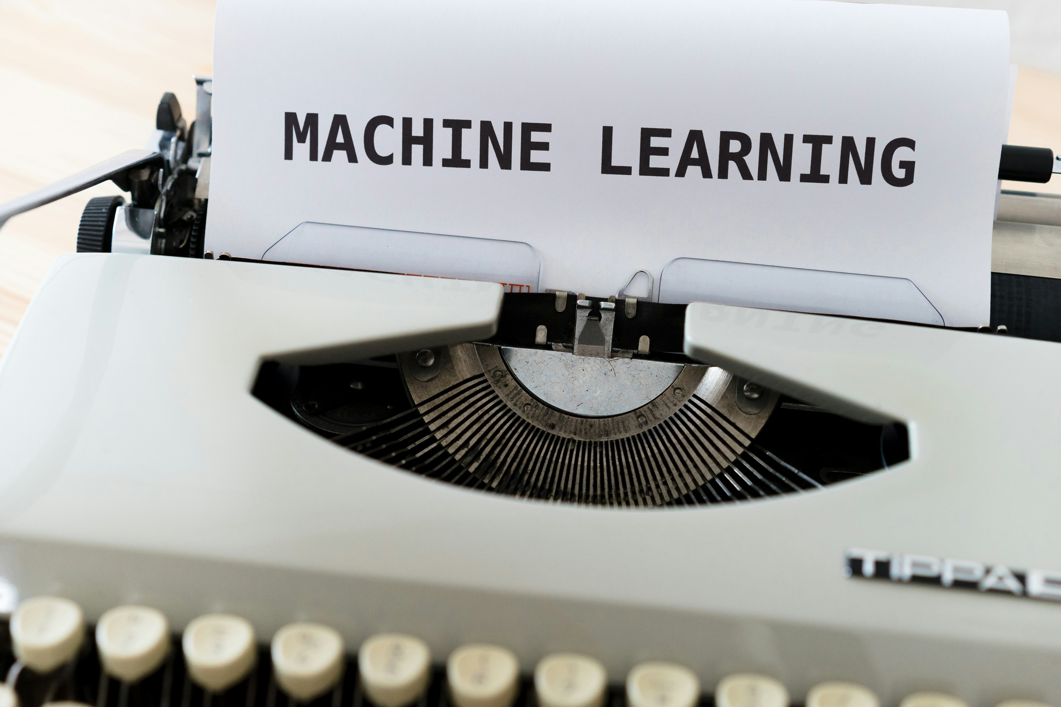
Unsupervised Learning
Unsupervised learning involves training an algorithm on unlabeled data to discover patterns and relationships. The goal is to identify hidden structures or clusters in the data. Examples of unsupervised learning include clustering, dimensionality reduction, and anomaly detection.
• Definition of Unsupervised Learning
• Types of Unsupervised Learning
• Applications of Unsupervised Learning
• Challenges in Unsupervised Learning
• Real-World Applications

Slide 6
Conclusion - Adoption (%)

Slide 7
Key Takeaways
✓ What is Machine Learning?
✓ Machine Learning Basics
✓ Supervised Learning
✓ Unsupervised Learning
✓ Conclusion

