Slide 1
The Impact of Climate Change

Slide 2
Introduction to Climate Change
Climate change is one of the most pressing issues of our time. It refers to the long-term warming of the planet, which is primarily caused by human activities that release greenhouse gases into the atmosphere. The Earth's temperature has risen by about 1 degree Celsius since the late 1800s, and the 20th century was the warmest decade on record. Climate change has significant implications for our environment, economy, and society.
• What is climate change?
• Causes of climate change
• Consequences of climate change
• Evidence of climate change
• What can we do about it?

Slide 3
The Causes of Climate Change
Human activities are the main cause of climate change. The burning of fossil fuels such as coal, oil, and gas for energy releases carbon dioxide into the atmosphere, leading to a greenhouse effect that traps heat. Deforestation, land-use changes, and agriculture also contribute to the release of greenhouse gases. Additionally, industrial processes and transportation also emit significant amounts of greenhouse gases.
• Carbon emissions from fossil fuels
• Deforestation and land-use changes
• Agriculture and livestock production
• Industrial processes and transportation
• Population growth

Slide 4
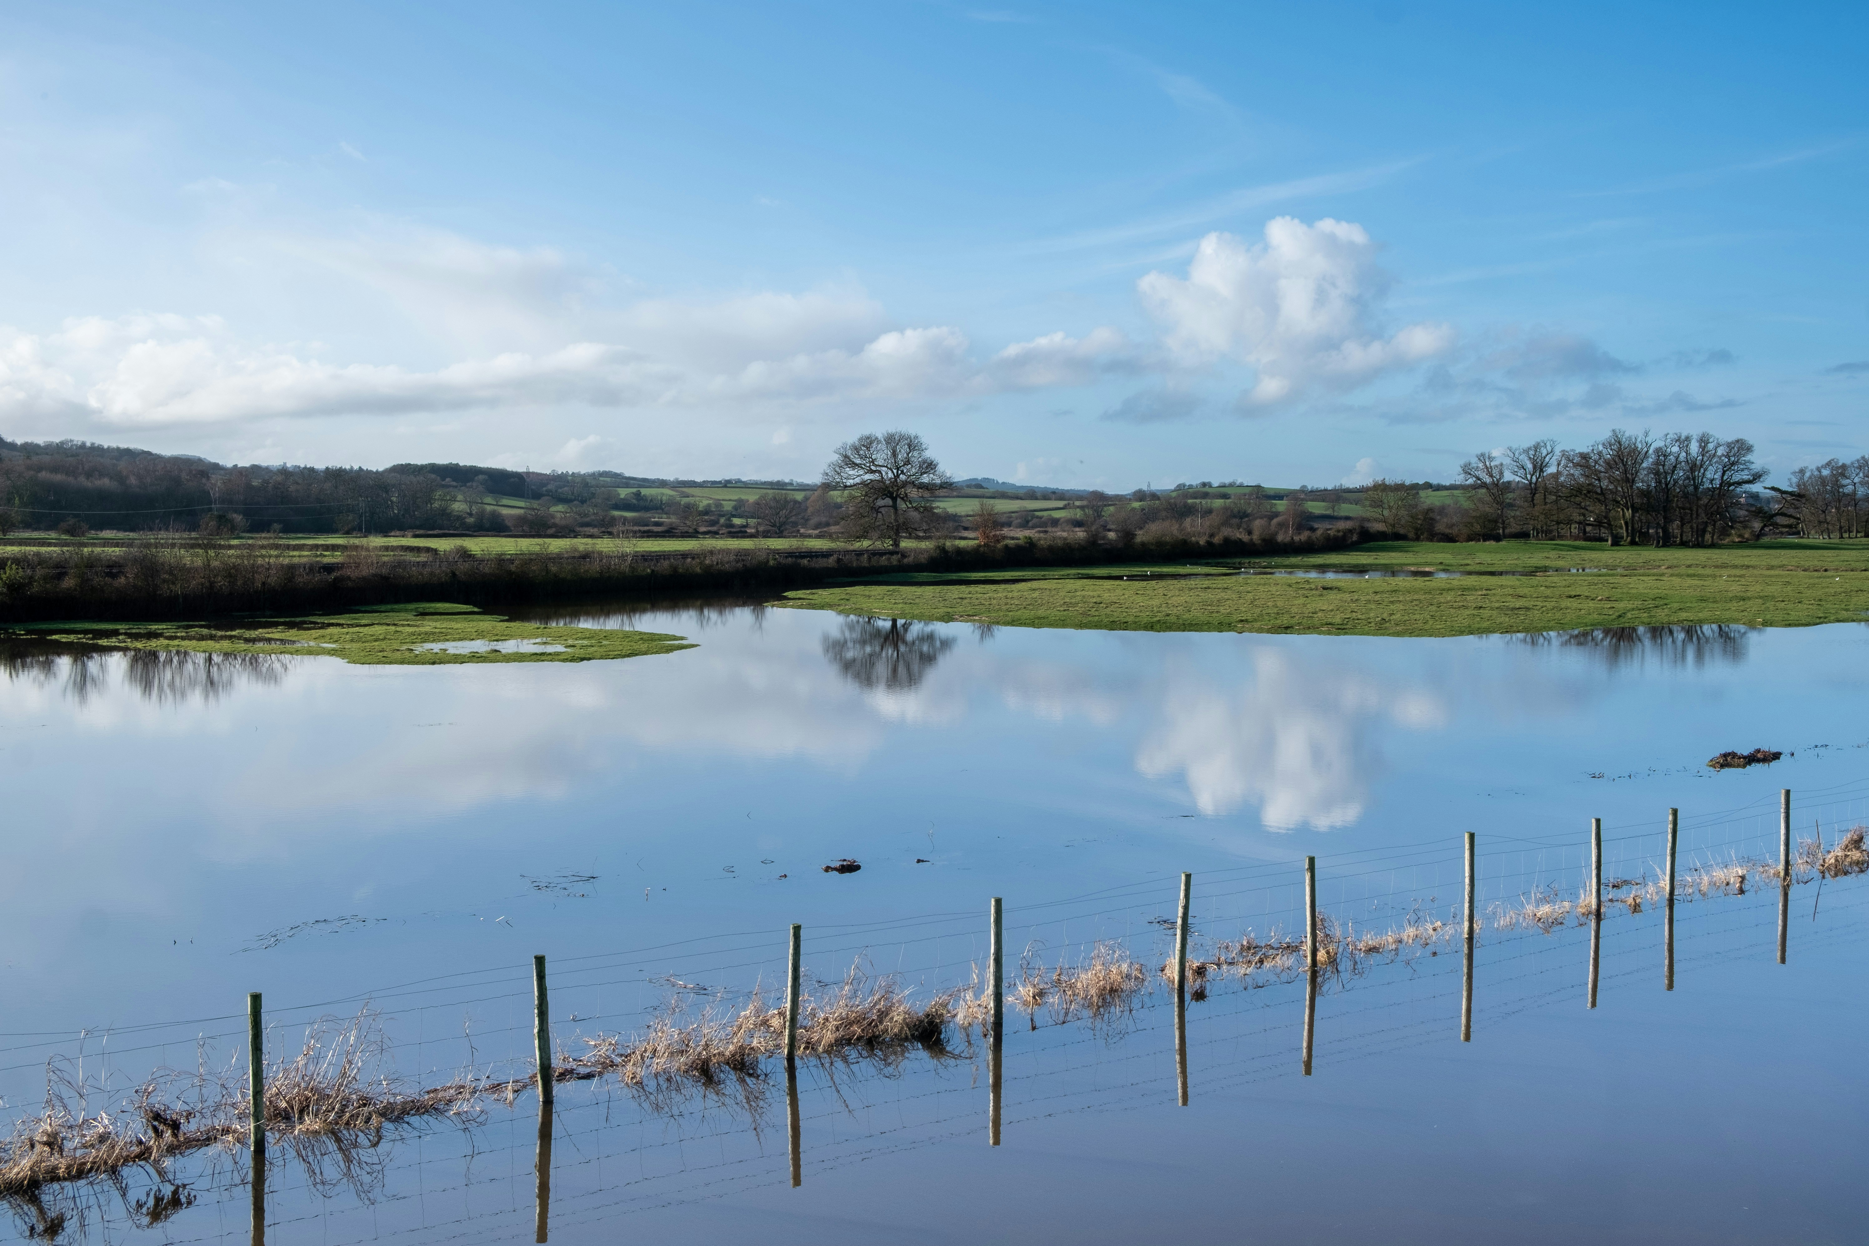
The Consequences of Climate Change
Climate change has significant consequences for our environment, economy, and society. Rising sea levels and more frequent natural disasters threaten coastal communities and infrastructure. Changes in precipitation patterns and increased evaporation lead to droughts and floods, affecting agriculture and water resources. Climate change also impacts human health, food security, and the global economy.
• Sea-level rise and coastal erosion
• Increased frequency of natural disasters
• Changes in precipitation patterns
• Impacts on agriculture and water resources
• Impacts on human health

Slide 5
What Can We Do About Climate Change? - What Index (%)

Slide 6
Key Takeaways
✓ Introduction to Climate Change
✓ The Causes of Climate Change
✓ The Consequences of Climate Change
✓ What Can We Do About Climate Change?

