Slide 1
Machine Learning in Day-to-Day Life

Slide 2
Introduction to Machine Learning
Machine learning is a subset of artificial intelligence that involves training algorithms on data to make predictions or decisions without being explicitly programmed. This technology has become ubiquitous in our daily lives, and it's essential to understand how it works. In this presentation, we'll explore the various applications of machine learning in day-to-day life. From personalized recommendations to image recognition, we'll delve into the fascinating world of machine learning. With its increasing importance, it's crucial to grasp the fundamental concepts of this technology.
• Definition and significance of machine learning
• Applications of machine learning
• How machine learning differs from traditional programming
• Examples of machine learning in daily life
• Importance of understanding machine learning

Slide 3
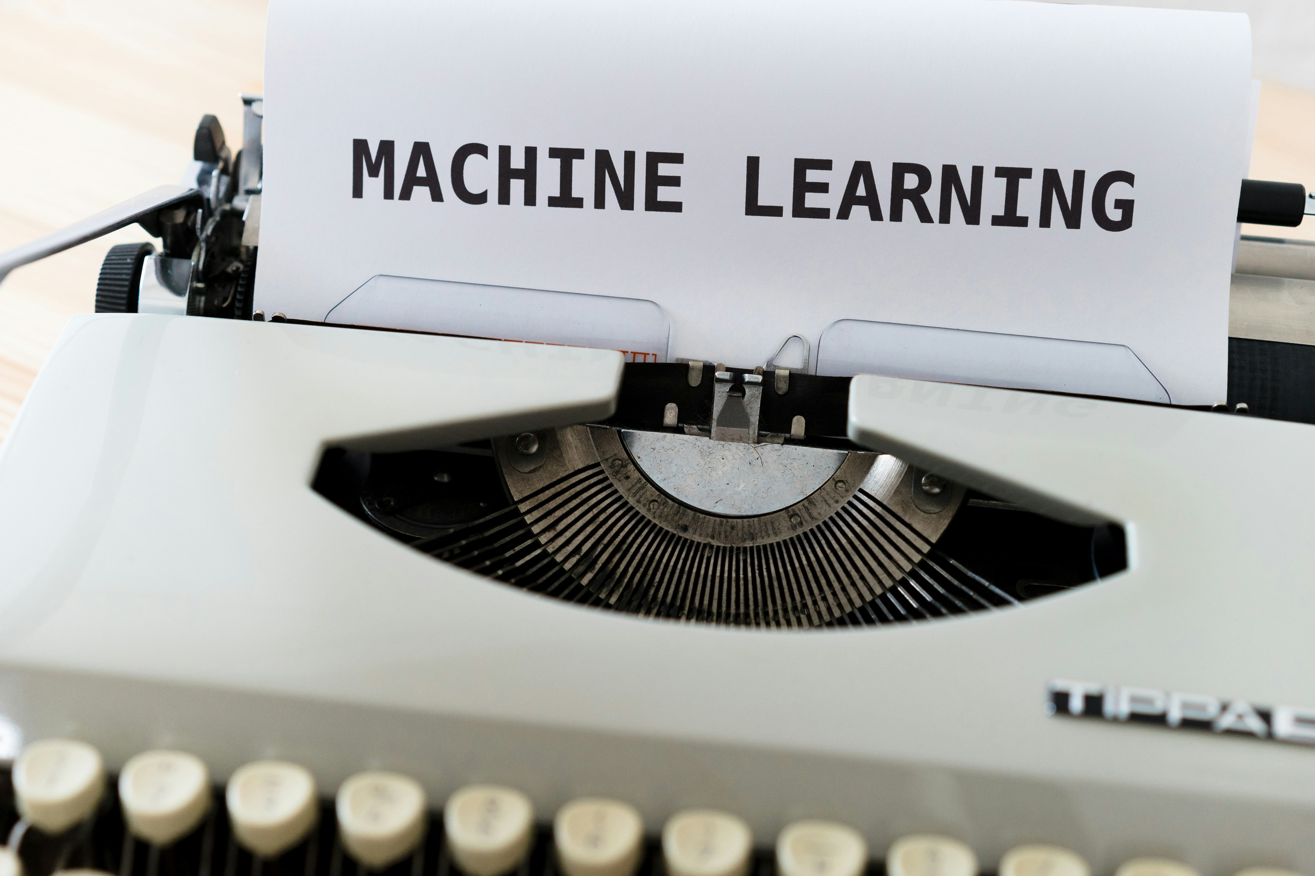
Recommendation Systems
One of the most popular applications of machine learning is recommendation systems. These algorithms analyze user behavior and provide personalized suggestions for movies, music, products, or even job opportunities. For instance, Netflix uses machine learning to recommend TV shows based on a user's viewing history. Recommendation systems have revolutionized the way we discover new content and make purchasing decisions.
• Definition of recommendation systems
• How machine learning is used in recommendation systems
• Examples of recommendation systems in daily life
• Benefits of personalized recommendations
• Challenges faced by recommendation systems

Slide 4
Image Recognition and Object Detection
Machine learning has also made significant strides in image recognition and object detection. This technology enables self-driving cars to identify pedestrians, animals, or other vehicles on the road. Similarly, facial recognition algorithms are used in security systems to verify identities. These advancements have far-reaching implications for industries like healthcare, finance, and law enforcement.
• Definition of image recognition and object detection
• How machine learning is used in image recognition
• Examples of image recognition and object detection in daily life
• Benefits of improved object detection
• Challenges faced by image recognition

Slide 5
Natural Language Processing (NLP)
Natural language processing (NLP) is another significant application of machine learning. This technology enables computers to understand and generate human-like text, making it possible for virtual assistants like Siri or Alexa to respond to voice commands. NLP has also enabled chatbots to provide customer support and improved language translation capabilities.
• Definition of natural language processing
• How machine learning is used in NLP
• Examples of NLP in daily life
• Benefits of improved NLP
• Challenges faced by NLP

Slide 6
Predictive Maintenance and Quality Control
Machine learning has also been instrumental in predictive maintenance and quality control. These algorithms analyze data from sensors and equipment to predict when a machine might fail or require maintenance. This technology has improved efficiency and reduced costs for industries like manufacturing and healthcare.
• Definition of predictive maintenance and quality control
• How machine learning is used in predictive maintenance
• Examples of predictive maintenance in daily life
• Benefits of improved predictive maintenance
• Challenges faced by predictive maintenance

Slide 7
Conclusion - Adoption (%)

Slide 8
Presentation Flow
Beginning
Middle
End
Introduction to Machine Learning
Natural Language Processing (NLP)
Conclusion

Slide 9
Key Takeaways
✓ Introduction to Machine Learning
✓ Recommendation Systems
✓ Image Recognition and Object Detection
✓ Natural Language Processing (NLP)
✓ Predictive Maintenance and Quality Control

