Slide 1
The Power of AI in Healthcare

Slide 2
Introduction to AI in Healthcare
Artificial intelligence (AI) has the potential to revolutionize the healthcare industry. By analyzing large amounts of medical data, AI can help identify patterns and trends that may not be apparent through traditional methods. This can lead to more accurate diagnoses, improved patient outcomes, and reduced costs. AI-powered systems can also assist clinicians with decision-making, freeing up time for more complex tasks. Ultimately, the integration of AI in healthcare aims to provide better care, faster.
• Improves diagnostic accuracy
• Enhances patient outcomes
• Reduces costs
• Assists clinician decision-making
• Streamlines workflow

Slide 3
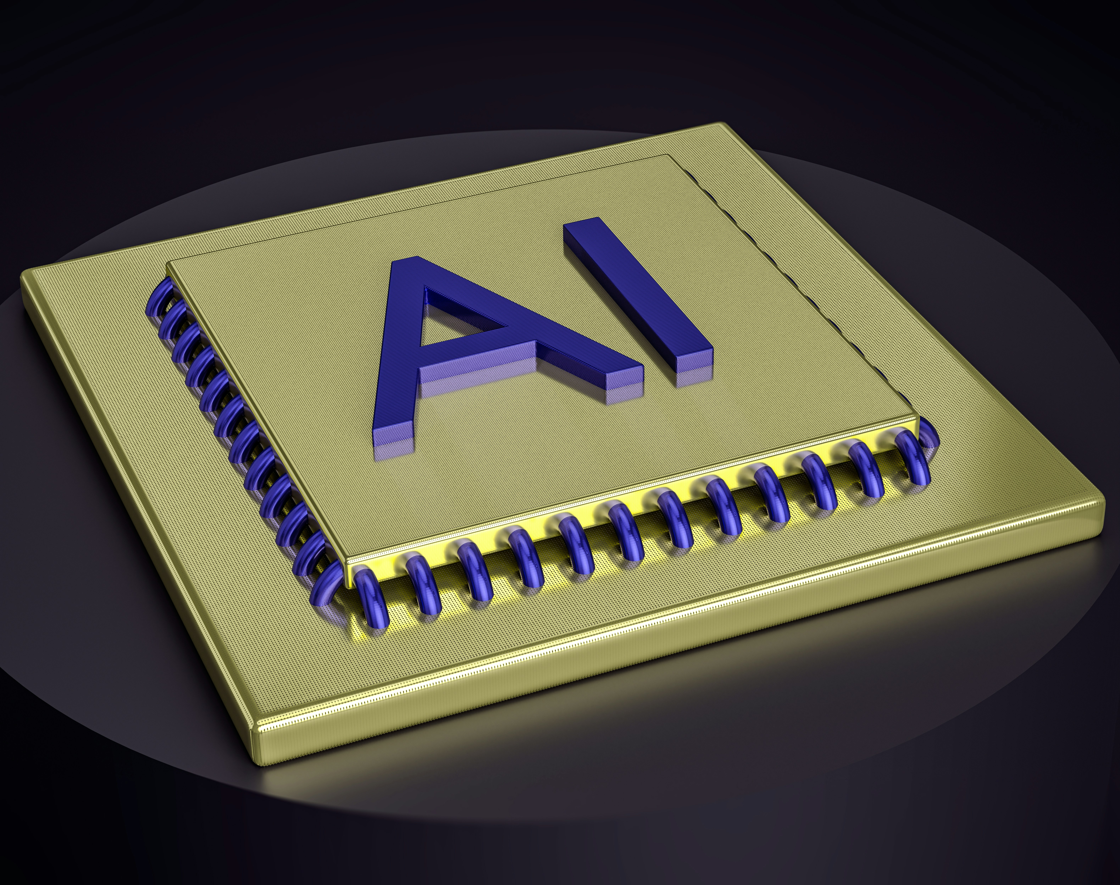
AI-Powered Diagnostics
AI-powered diagnostic tools can analyze medical images, such as X-rays and MRIs, to identify potential health issues earlier and more accurately. For instance, AI-assisted mammography screening has been shown to reduce false positives and improve detection rates for breast cancer. Similarly, AI-powered analysis of electroencephalograms (EEGs) can help diagnose neurological disorders like epilepsy and sleep apnea.
• Analyzes medical images
• Improves diagnostic accuracy
• Enhances patient outcomes
• Reduces costs
• Increases efficiency

Slide 4
Personalized Medicine with AI
AI-powered algorithms can analyze an individual's genetic data, medical history, and lifestyle to provide personalized treatment recommendations. This approach has been shown to improve patient outcomes, reduce side effects, and enhance overall quality of life. AI-powered decision support systems can also assist clinicians in developing customized treatment plans tailored to each patient's unique needs.
• Analyzes genetic data
• Considers medical history
• Takes lifestyle factors into account
• Improves patient outcomes
• Enhances quality of life

Slide 5

AI-Powered Chronic Disease Management
Chronic diseases, such as diabetes and heart disease, require ongoing management to prevent complications. AI-powered systems can help patients track their condition, receive personalized recommendations, and stay connected with healthcare providers. This approach has been shown to improve patient engagement, reduce hospitalizations, and enhance overall health outcomes.
• Tracks chronic disease
• Provides personalized recommendations
• Enhances patient engagement
• Reduces hospitalizations
• Improves health outcomes

Slide 6
Conclusion: The Future of AI in Healthcare - Adoption (%)

Slide 7
Key Takeaways
✓ Introduction to AI in Healthcare
✓ AI-Powered Diagnostics
✓ Personalized Medicine with AI
✓ AI-Powered Chronic Disease Management
✓ Conclusion: The Future of AI in Healthcare

