Slide 1
Flight Details: DEL to CCU (6E 6415)

Slide 2
Introduction
This introductory slide sets the stage for the presentation by providing essential information about the flight from Delhi (DEL) to Kolkata (CCU), which is operated by IndiGo Airlines (6E) with flight number 6415. The return journey indicates that this particular flight will be traveling solely in one direction, departing from DEL and arriving at CCU without any subsequent return leg. This clarifies the scope of the flight details being discussed and provides a clear understanding of the travel route and itinerary.
• Flight details for DEL to CCU (6E 6415)

Slide 3
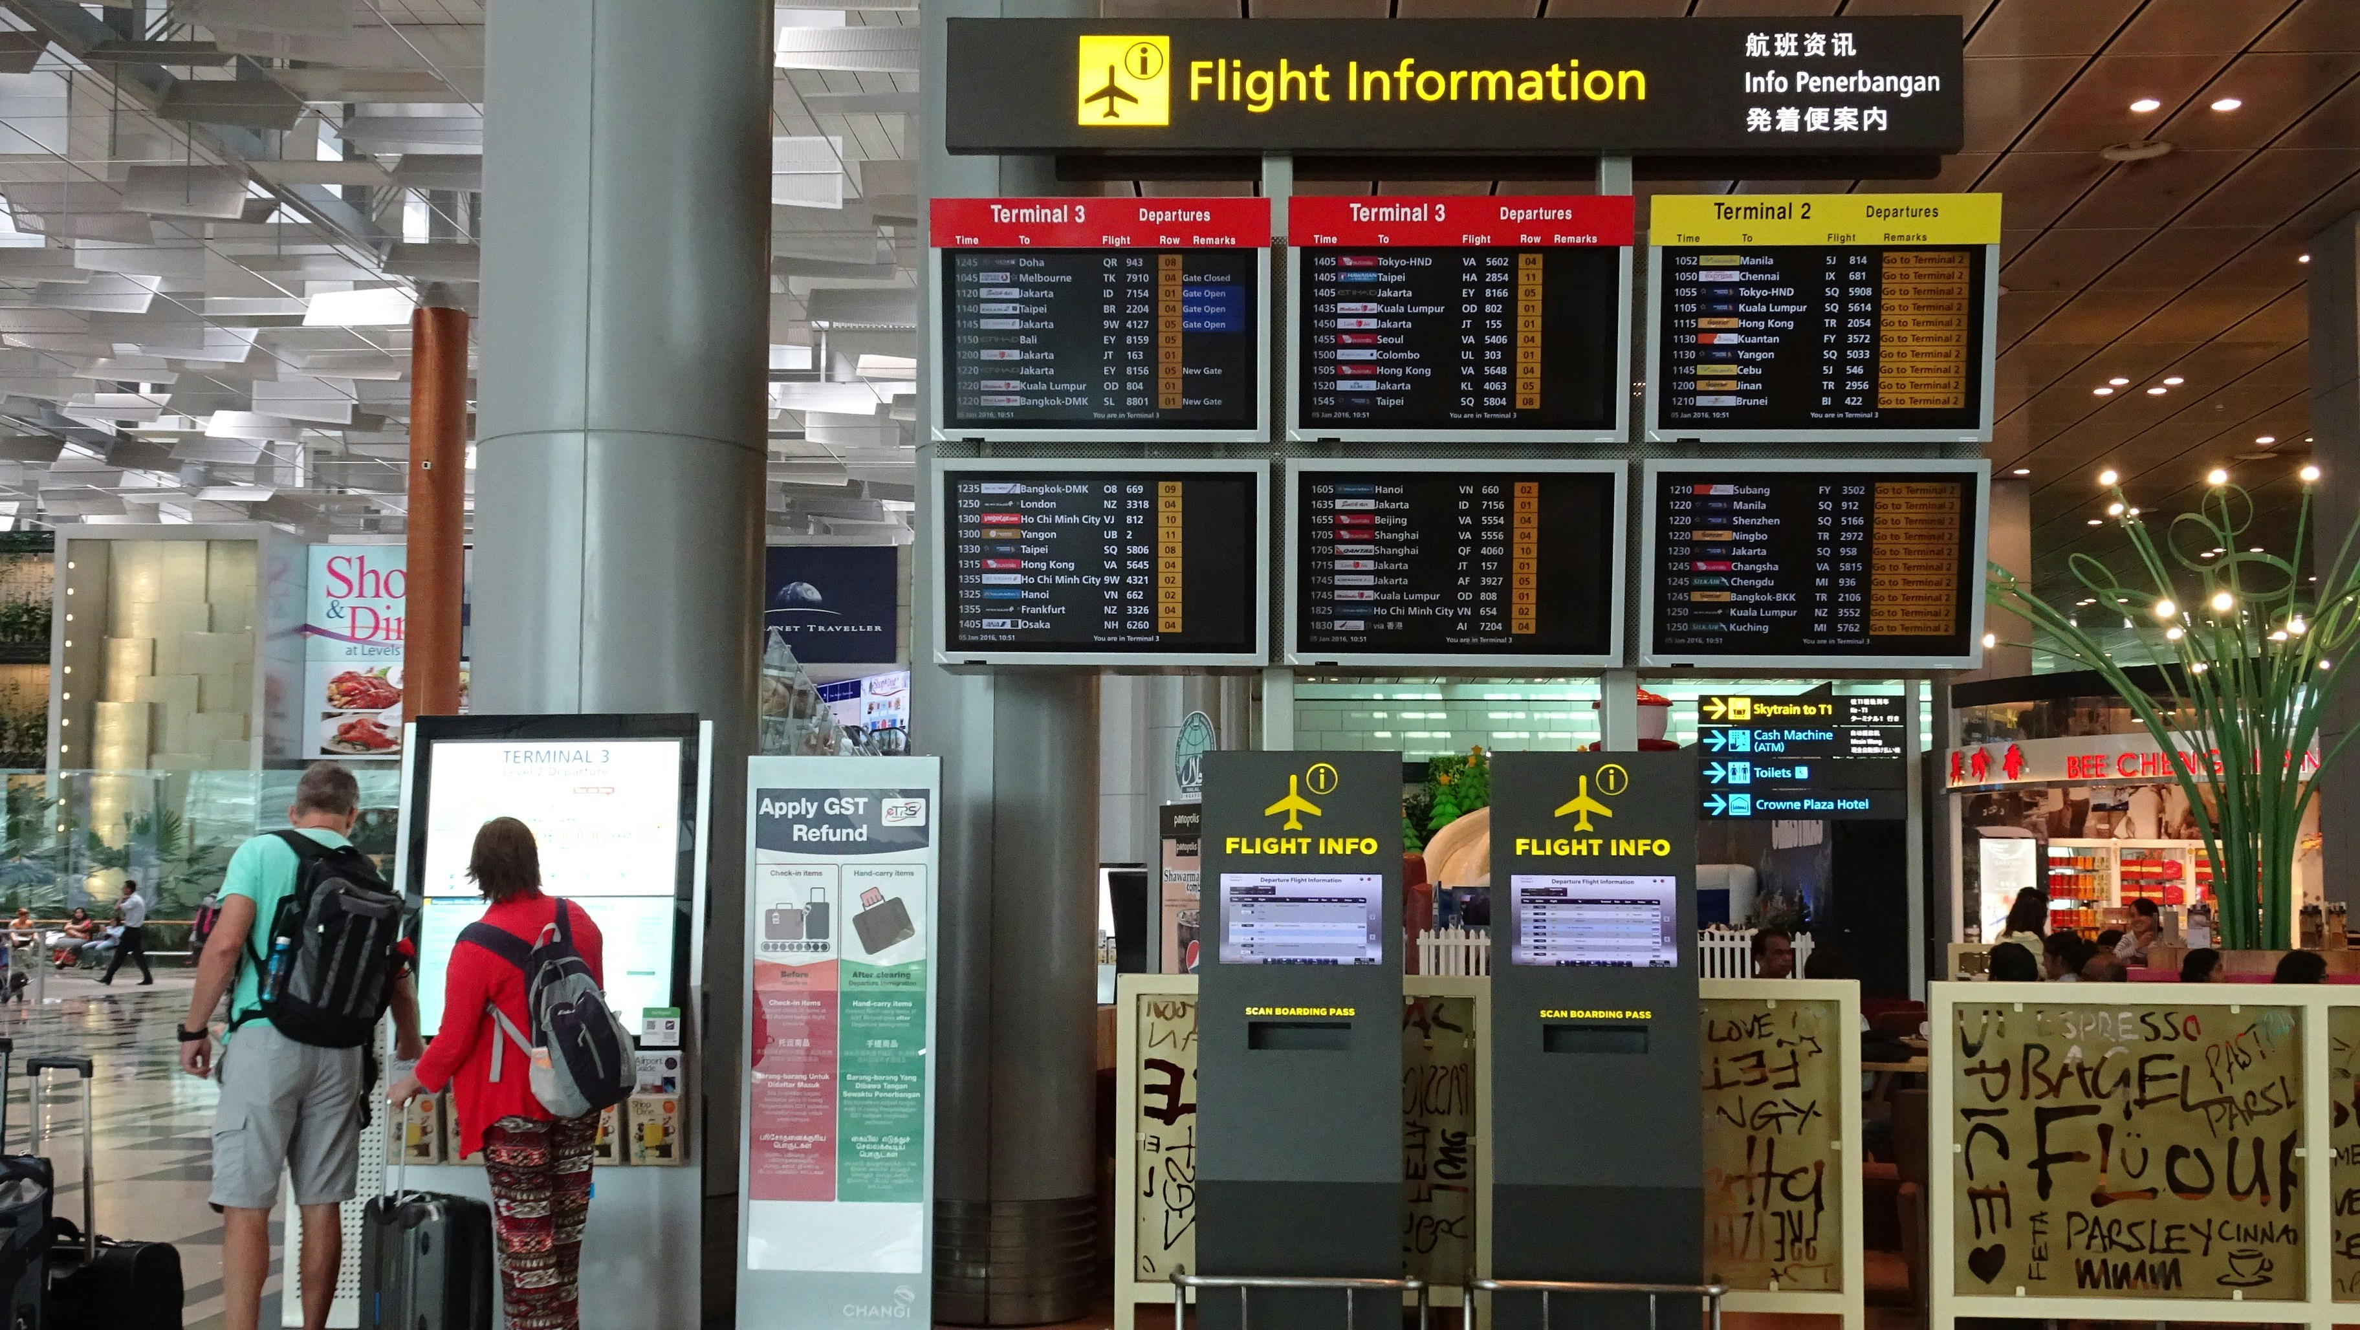
Flight Information
This flight information slide provides essential details for travelers planning their journey. Specifically, the scheduled departure date is set for May 7th, 2026, with a planned takeoff time of 16:00 hours (4:00 PM). Additionally, passengers should note that their assigned seat number is 37B, which can be used to locate their designated seating area upon boarding. The slide also indicates that the departure gate has yet to be confirmed; this information will likely be updated closer to the flight's scheduled time.
• Date: 07 May 2026
• Departure Time: 16:00
• Seat Number: 37B
• Gate: ??

Slide 4
Boarding Details
Here is the detailed description: This presentation slide outlines essential boarding details for passengers to ensure a seamless travel experience. The boarding time of 15:51 indicates when passengers should arrive at the gate to begin the boarding process. Boarding zone 11 specifies the designated area where passengers will collect their boarding passes and proceed to the aircraft. With a date of 07 May 2026, travelers can plan their day accordingly, taking into account check-in times, security screening, and any necessary connections. The sequence number, 001, signifies the passenger's position in the boarding order, allowing them to prepare for a smooth transition onto the flight.
• Boarding Time: 15:51
• Boarding Zone: 11
• Date: 07 May 2026
• Sequence Number: 001

Slide 5

Travel Information
Here is a comprehensive and detailed description for this presentation slide: "Please note that your travel plans involve departing from Terminal 1 (T1). It's essential to arrive at the correct terminal in advance of your scheduled departure time to ensure a smooth and stress-free travel experience. Keep in mind that your gate assignment may be subject to change, so it's crucial to check with airline staff or the airport's departure board regularly for updates. Additionally, please be aware that gates typically close 25 minutes prior to departure, so plan accordingly to avoid any last-minute issues or inconvenience."
• Departure Terminal: T1
• Your Departure Terminal is T1
• Note: Gate is subject to change and will close 25 minutes prior to departure

Slide 6
Summary - Summary Index (%)

Slide 7
Key Takeaways
✓ Introduction
✓ Flight Information
✓ Boarding Details
✓ Travel Information
✓ Summary

