Slide 1
Cache Memory Mapping Technique

Slide 2
Introduction
The Cache Memory Mapping Technique is a method used to optimize memory usage in computer systems. It involves mapping cache memory locations to main memory locations to improve data access efficiency. This technique is particularly useful in systems where cache memory is limited or shared among multiple processes. The goal of the Cache Memory Mapping Technique is to minimize cache misses and reduce memory access latency.
• Improves data access efficiency
• Optimizes memory usage
• Minimizes cache misses
• Reduces memory access latency
• Enhances system performance

Slide 3
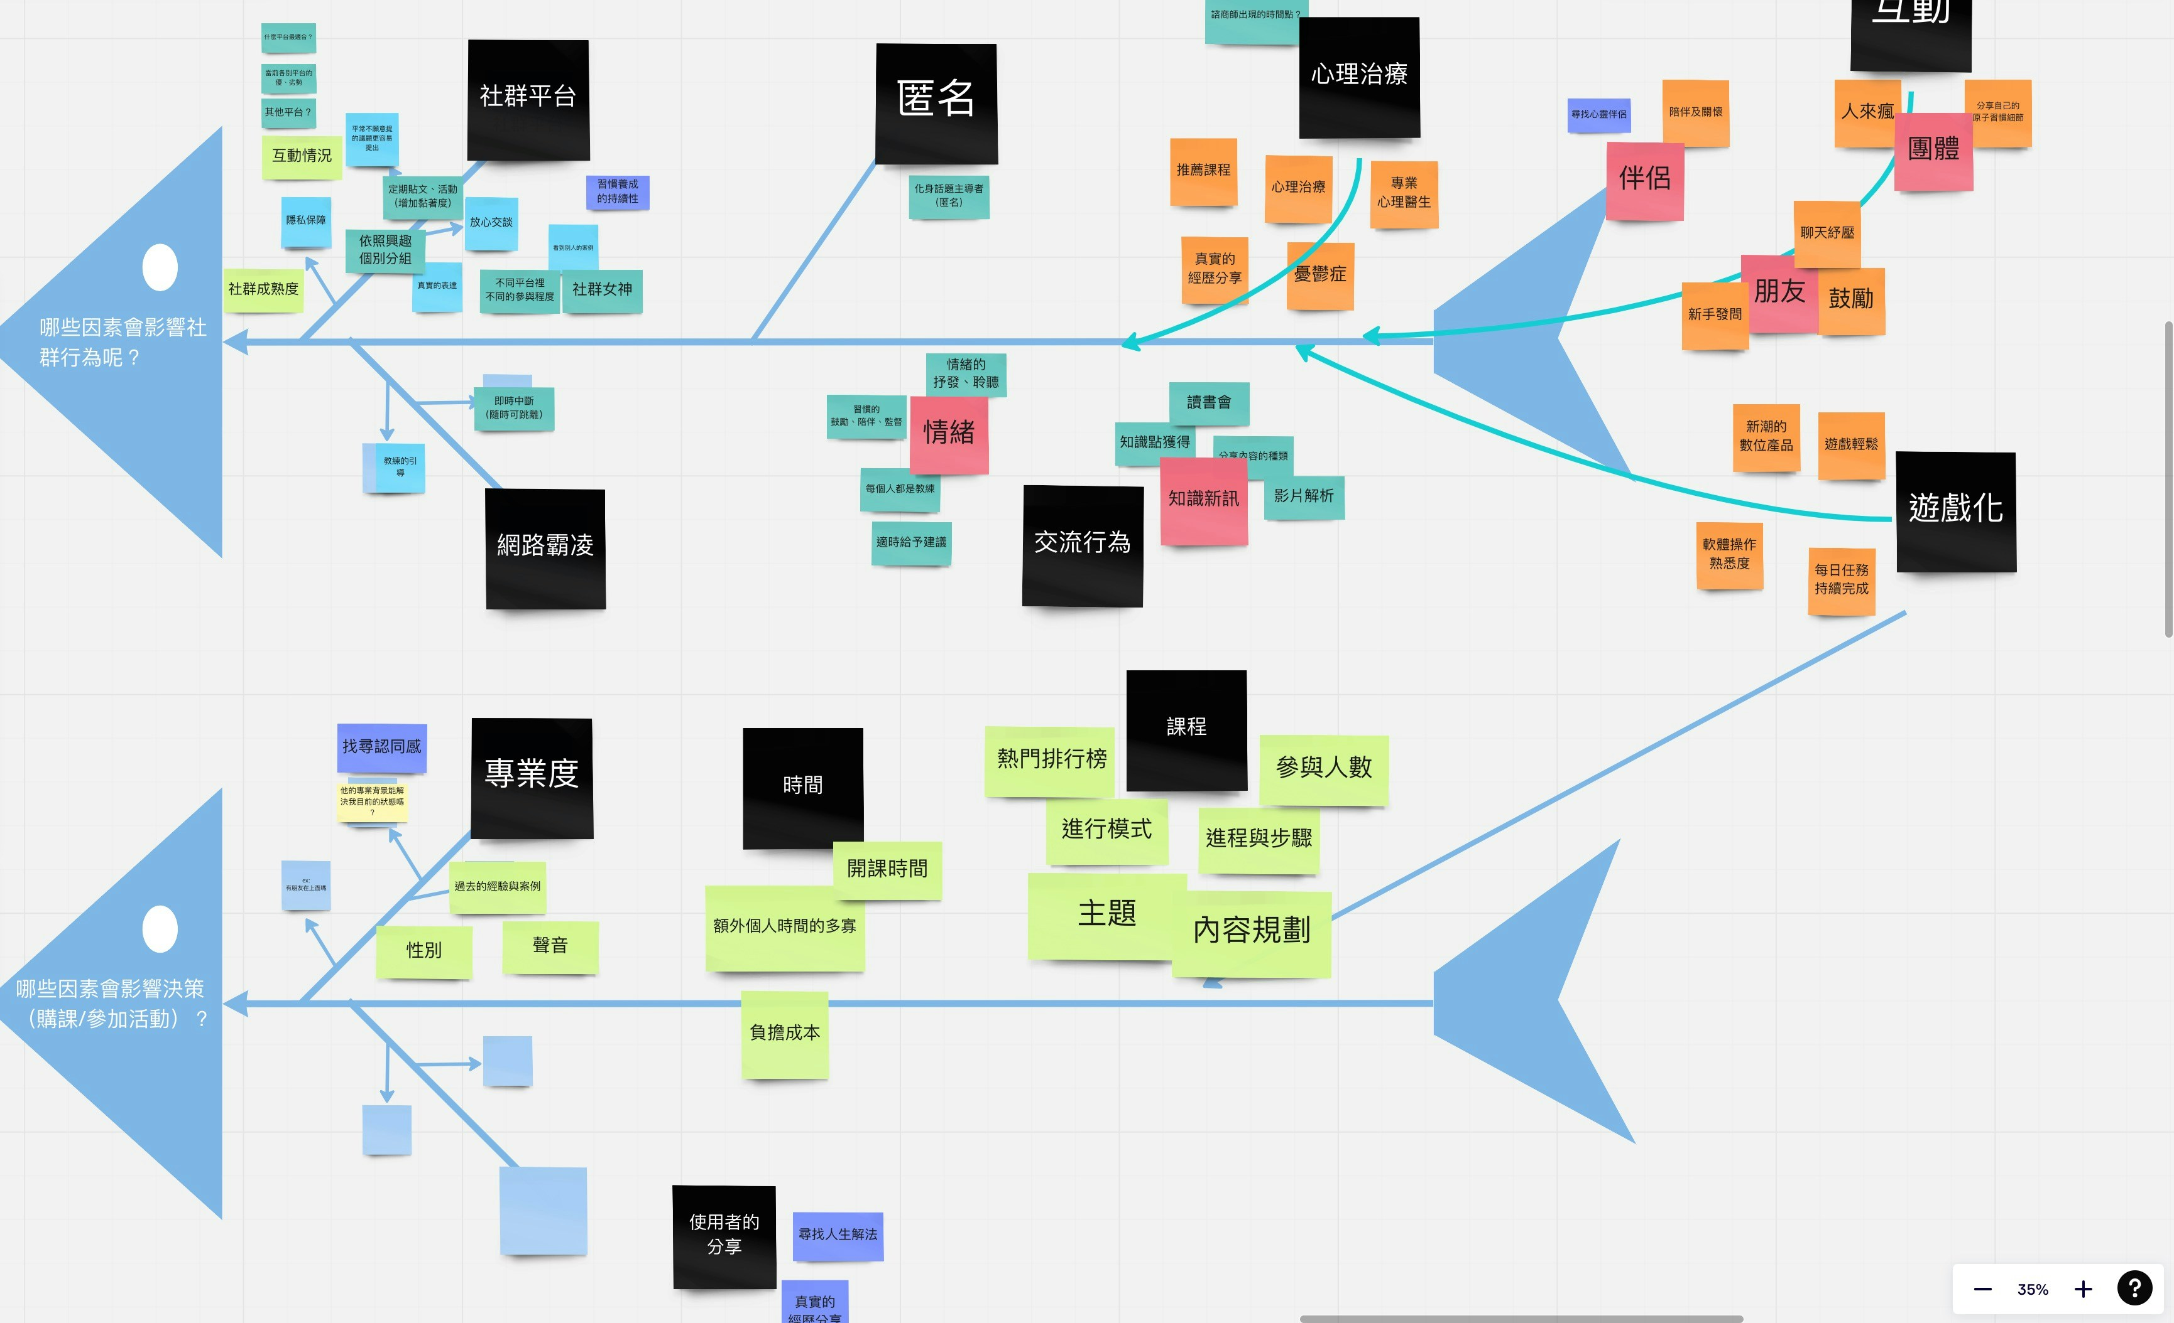
Cache Hierarchy
The Cache Memory Mapping Technique operates on a hierarchical structure of caches. This hierarchy consists of multiple levels of cache memory with varying sizes and access times. The technique maps main memory locations to the most suitable cache level based on the accessed data's frequency and recency.
• Multi-level cache hierarchy
• Variable cache sizes and access times
• Data-driven mapping decisions
• Improved cache locality
• Enhanced system performance

Slide 4
Mapping Algorithm
The Cache Memory Mapping Technique employs a specific algorithm to map main memory locations to cache memory. This algorithm takes into account the accessed data's frequency and recency, as well as the available cache space. The goal is to maximize cache hits and minimize cache misses.
• Frequency-based mapping
• Recency-based mapping
• Available cache space consideration
• Cache hit maximization
• Cache miss minimization

Slide 5
Advantages and Limitations
The Cache Memory Mapping Technique offers several advantages, including improved data access efficiency, optimized memory usage, and enhanced system performance. However, it also has limitations, such as increased complexity, higher latency for cache misses, and potential conflicts with other caching mechanisms.
• Improved data access efficiency
• Optimized memory usage
• Enhanced system performance
• Increased complexity
• Higher cache miss latency

Slide 6

Real-World Applications
The Cache Memory Mapping Technique has numerous real-world applications in various fields. For instance, it can be used to optimize database query performance, improve web page loading times, and enhance the overall user experience.
• Database query optimization
• Web page loading time improvement
• User experience enhancement
• Cloud computing optimization
• Big data analytics acceleration

Slide 7
Conclusion - Conclusion Index (%)

Slide 8
Presentation Flow
Beginning
Middle
End
Introduction
Advantages and Limitations
Conclusion

Slide 9
Key Takeaways
✓ Introduction
✓ Cache Hierarchy
✓ Mapping Algorithm
✓ Advantages and Limitations
✓ Real-World Applications

