Slide 1
Unlocking the Power of Machine Learning from Imperial Business School

Slide 2
Introduction to Machine Learning
Machine learning is a subfield of artificial intelligence that involves training algorithms on data to make predictions or take actions. At Imperial Business School, we offer courses and research opportunities in machine learning, allowing students to develop skills in this rapidly growing field. Our approach combines technical knowledge with business acumen, enabling students to drive innovation and growth in their organizations. By leveraging machine learning, businesses can gain a competitive edge and improve decision-making processes.
• What is Machine Learning?
• Applications in Business
• Why Imperial Business School?
• Curriculum Overview
• Career Opportunities

Slide 3
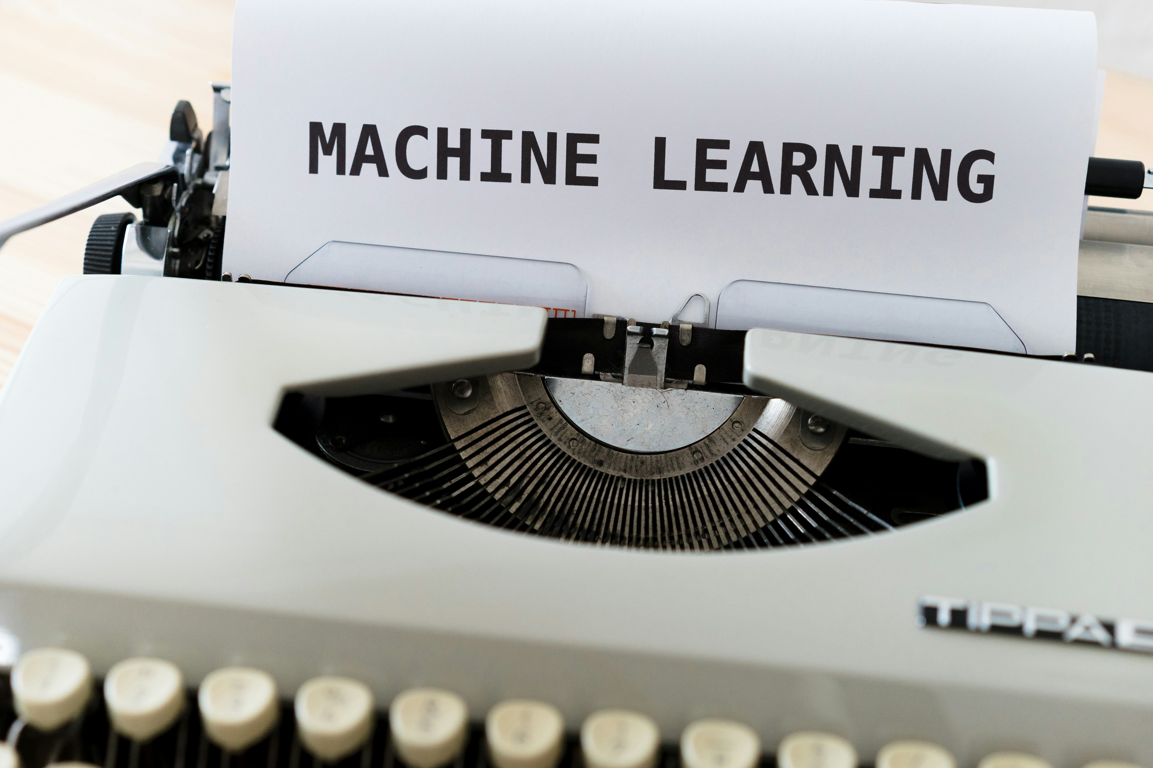
Supervised Learning Techniques
Supervised learning involves training algorithms on labeled data to make predictions or classify new instances. At Imperial Business School, we focus on developing skills in supervised learning techniques such as linear regression, decision trees, and random forests. Our students learn how to apply these techniques to real-world problems, including customer segmentation, demand forecasting, and risk assessment. By mastering supervised learning, students can develop predictive models that drive business outcomes.
• Linear Regression
• Decision Trees
• Random Forests
• Logistic Regression
• Gradient Boosting

Slide 4
Unsupervised Learning Techniques
Unsupervised learning involves training algorithms on unlabeled data to discover patterns and relationships. At Imperial Business School, we offer courses in unsupervised learning techniques such as k-means clustering, hierarchical clustering, and principal component analysis. Our students learn how to apply these techniques to real-world problems, including market segmentation, customer profiling, and anomaly detection. By mastering unsupervised learning, students can gain insights into complex data sets.
• K-Means Clustering
• Hierarchical Clustering
• Principal Component Analysis
• DBSCAN
• PCA

Slide 5
Deep Learning Techniques
Deep learning involves training neural networks on large data sets to learn complex patterns and relationships. At Imperial Business School, we offer courses in deep learning techniques such as convolutional neural networks, recurrent neural networks, and autoencoders. Our students learn how to apply these techniques to real-world problems, including image classification, natural language processing, and recommender systems. By mastering deep learning, students can develop powerful models that drive business outcomes.
• Convolutional Neural Networks
• Recurrent Neural Networks
• Autoencoders
• Generative Adversarial Networks
• Transfer Learning

Slide 6

Machine Learning Applications
Machine learning has numerous applications in business, including customer service, marketing, finance, and operations. At Imperial Business School, we focus on developing skills in applying machine learning to real-world problems. Our students learn how to develop predictive models that drive business outcomes, from improving customer engagement to optimizing supply chain management. By mastering machine learning, students can gain a competitive edge in their organizations.
• Customer Service
• Marketing Analytics
• Financial Risk Management
• Operations Optimization
• Innovation and Entrepreneurship

Slide 7
Career Opportunities in Machine Learning
Machine learning is a rapidly growing field with numerous career opportunities. At Imperial Business School, we prepare students for careers in machine learning, data science, and artificial intelligence. Our graduates go on to work at top companies, including Google, Amazon, and Microsoft, or start their own successful ventures. By mastering machine learning, students can develop skills that are in high demand across industries.
• Data Scientist
• Machine Learning Engineer
• Business Intelligence Analyst
• AI Researcher
• Startup Founder

Slide 8
Presentation Flow
Introduction to Machine Learning
Supervised Learning Techniques
Unsupervised Learning Techniques
What is Machine Learning? Applications in Business Why Imperial Business School?
Linear Regression Decision Trees Random Forests
K-Means Clustering Hierarchical Clustering Principal Component Analysis

Slide 9
Key Takeaways
✓ Introduction to Machine Learning
✓ Supervised Learning Techniques
✓ Unsupervised Learning Techniques
✓ Deep Learning Techniques
✓ Machine Learning Applications

