Slide 1
Agentic AI Development: Unlocking Human-Centered Intelligence

Slide 2
What is Agentic AI?
Agentic AI refers to artificial intelligence that exhibits human-like autonomy, self-awareness, and decision-making capabilities. This type of AI can learn from experience, adapt to new situations, and make decisions based on moral principles. By developing agentic AI, we can create intelligent systems that interact with humans in a more natural and intuitive way.
• Autonomous decision-making
• Self-awareness and introspection
• Moral reasoning and ethics
• Adaptive learning and growth
• Human-centered design

Slide 3

Benefits of Agentic AI
Agentic AI offers several benefits, including improved decision-making capabilities, enhanced user experience, and increased productivity. This type of AI can also help humans by taking over routine tasks, freeing up time for more complex and creative work. Additionally, agentic AI can learn from human feedback, improving its performance over time.
• Improved decision-making
• Enhanced user experience
• Increased productivity
• Automation of routine tasks
• Continuous learning and improvement

Slide 4
Challenges in Agentic AI Development
Developing agentic AI is a complex task that requires significant advances in areas such as machine learning, natural language processing, and cognitive architectures. Additionally, there are challenges related to ensuring the ethical alignment of agentic AI with human values and principles. Furthermore, developing agentic AI requires a deep understanding of human behavior and decision-making processes.
• Machine learning and NLP
• Cognitive architectures and frameworks
• Ethical alignment and value-based design
• Human-centered design principles
• Complexity and scalability

Slide 5
Applications of Agentic AI
Agentic AI has the potential to revolutionize industries such as healthcare, finance, and education. For example, agentic AI-powered chatbots can provide personalized support and guidance to patients or customers. Additionally, agentic AI can be used in autonomous vehicles, smart homes, and other areas where human-centered intelligence is essential.
• Healthcare and patient care
• Finance and customer service
• Education and learning
• Autonomous vehicles and transportation
• Smart homes and buildings

Slide 6
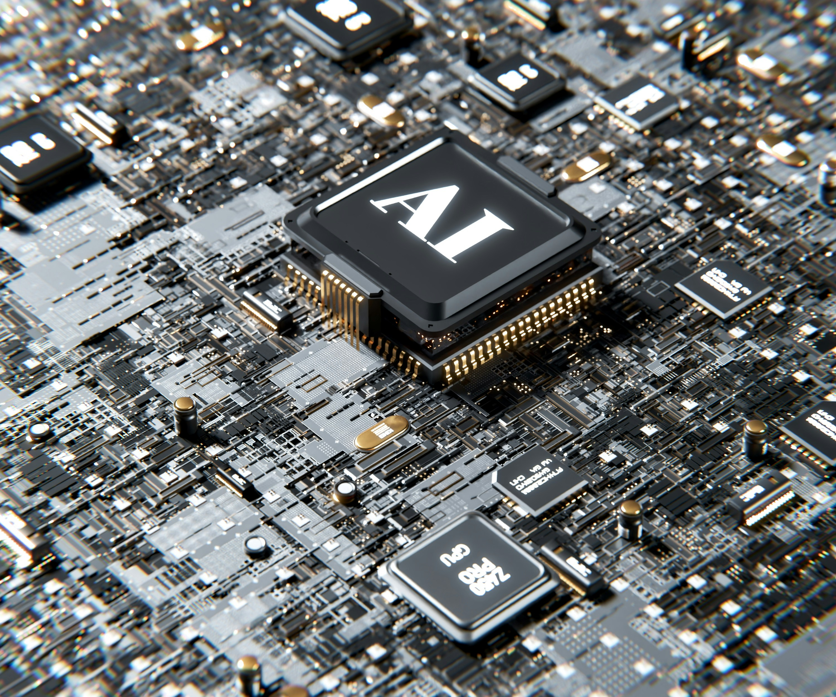
Ethical Considerations in Agentic AI Development
As agentic AI becomes increasingly sophisticated, it is essential to consider the ethical implications of its development. This includes ensuring that agentic AI systems are transparent, accountable, and aligned with human values. Additionally, there is a need for ongoing research into the social and economic impacts of agentic AI on society.
• Transparency and accountability
• Human-centered design principles
• Value alignment and ethics
• Social and economic impacts
• Ongoing research and evaluation

Slide 7
Future Directions in Agentic AI Development
What We Learned
Key Actions
What's Next
• Machine learning and NLP advancements
• Cognitive architecture innovations
• New applications and use cases
• International collaboration and standardization
• Ongoing innovation and investment
Thank you for your attention | Questions?

Slide 8
Presentation Flow
What is Agentic AI?
Benefits of Agentic AI
Challenges in Agentic AI Development
Autonomous decision-making Self-awareness and introspection Moral reasoning and ethics
Improved decision-making Enhanced user experience Increased productivity
Machine learning and NLP Cognitive architectures and frameworks Ethical alignment and value-based design

Slide 9
Key Takeaways
✓ What is Agentic AI?
✓ Benefits of Agentic AI
✓ Challenges in Agentic AI Development
✓ Applications of Agentic AI
✓ Ethical Considerations in Agentic AI Development

