Slide 1
Modern School Barakhamba Road Presentation

Slide 2
Introduction to Modern School Barakhamba Road
Located in the heart of New Delhi, Modern School Barakhamba Road is a renowned institution that has been shaping young minds for over eight decades. With a rich history and a strong emphasis on academic excellence, the school has earned a reputation for producing well-rounded students who excel in various fields. As a premier educational institution, it attracts students from diverse backgrounds, fostering a vibrant learning environment.
• Established in 1936
• Emphasizes academic and extracurricular excellence
• Diverse student body
• Strong emphasis on character building
• Committed to holistic development

Slide 3
Academics at Modern School Barakhamba Road
The school offers a comprehensive curriculum that caters to the needs of students from classes I to XII. With a focus on developing critical thinking, problem-solving, and communication skills, the academics program prepares students for a rapidly changing world. The faculty comprises experienced educators who are dedicated to mentoring students and helping them achieve their full potential.
• Curriculum designed to foster critical thinking
• Emphasis on project-based learning
• Experienced faculty mentors
• Co-curricular activities complement academics
• Strong focus on science, technology, engineering, and mathematics (STEM)

Slide 4
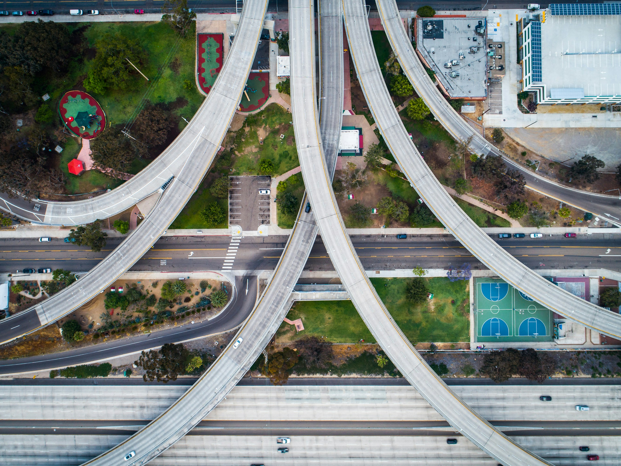
Infrastructure at Modern School Barakhamba Road
The school boasts state-of-the-art infrastructure that provides a conducive learning environment. The campus is equipped with modern facilities, including well-stocked libraries, fully equipped laboratories, and spacious classrooms. The sports facilities are designed to promote physical activity and team-building among students.
• State-of-the-art facilities
• Well-stocked libraries and laboratories
• Spacious classrooms and playgrounds
• Modern sports facilities
• Safe and secure campus

Slide 5
Extra-Curricular Activities at Modern School Barakhamba Road
The school offers a wide range of extracurricular activities that cater to the diverse interests of students. From sports teams and clubs to music and dance groups, there's something for everyone. These activities help students develop teamwork skills, build confidence, and explore their creative potential.
• Sports teams and clubs
• Music and dance groups
• Debating and quiz societies
• Literary and cultural events
• Community service initiatives

Slide 6
Admissions at Modern School Barakhamba Road
The admissions process at Modern School Barakhamba Road is designed to ensure that students are a good fit for the school's academic and extracurricular programs. The process involves an entrance examination, followed by an interview with the admissions committee. The school also offers scholarships and financial aid to deserving students.
• Entrance examination
• Interviews with admissions committee
• Scholarships and financial aid available
• Rolling admissions policy
• Academic merit-based selection

Slide 7
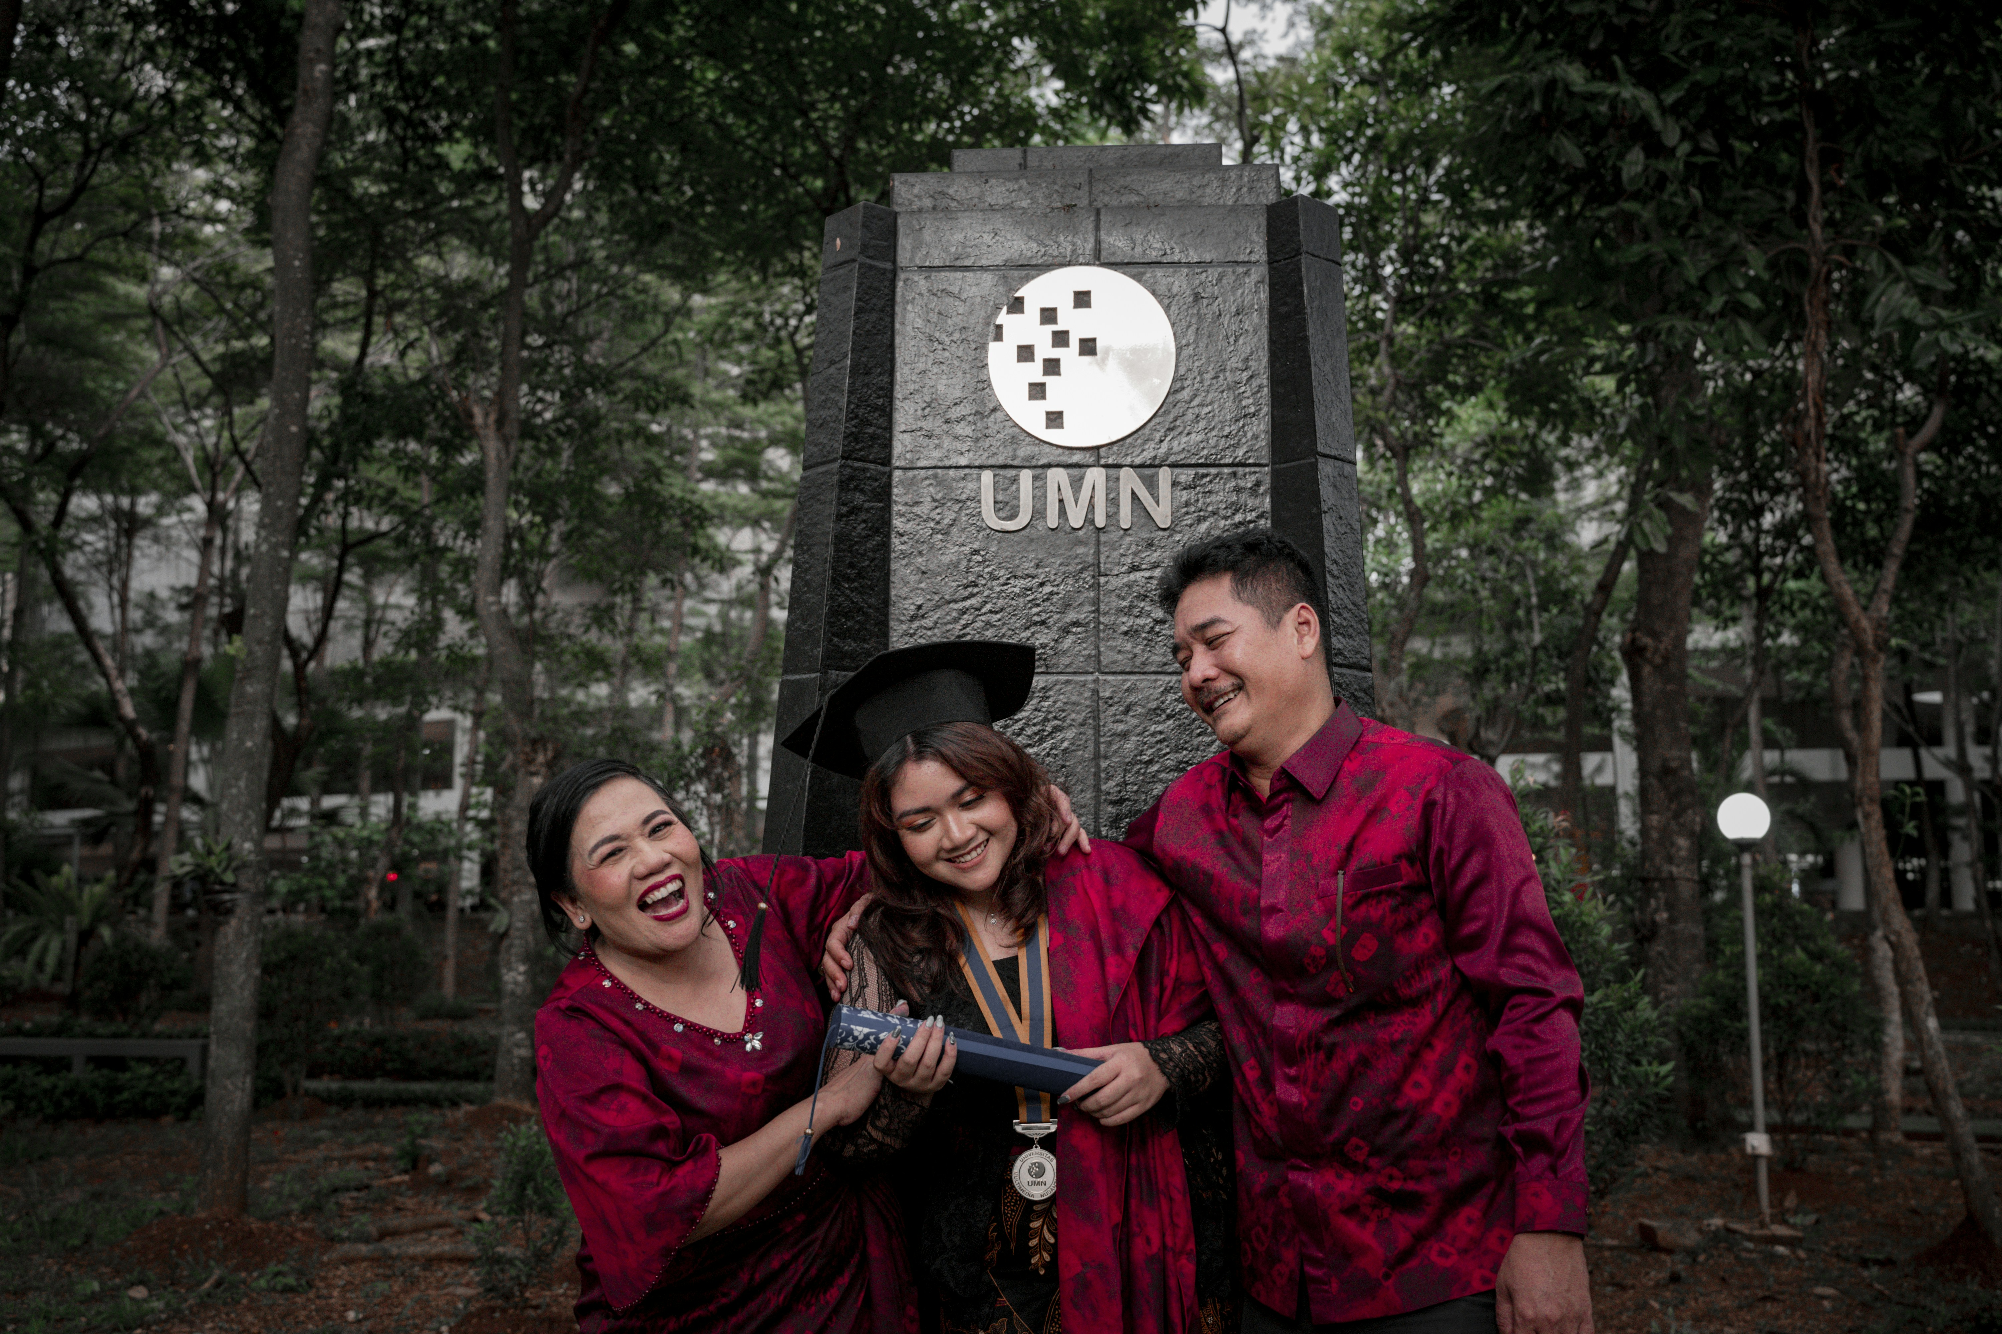
Alumni Network at Modern School Barakhamba Road
The alumni network of Modern School Barakhamba Road is a testament to the school's enduring impact on its students. With a strong presence in various fields, including business, academia, and public service, our alumni are proud ambassadors of the school's values and traditions.
• Strong global presence
• Diverse career paths
• Active community engagement
• Regular reunions and events
• Enduring legacy

Slide 8
Community Engagement at Modern School Barakhamba Road
The school is committed to giving back to the community through various initiatives and partnerships. From environmental conservation efforts to social welfare programs, we believe in empowering students to make a positive impact on society.
• Environmental conservation efforts
• Social welfare programs
• Partnerships with local organizations
• Student-led community projects
• Collaborations with government agencies

Slide 9
Conclusion: Modern School Barakhamba Road
What We Learned
Key Actions
What's Next
• Holistic education approach
• Emphasis on character building
• Strong community connections
• Highly qualified faculty
• Commitment to student success
Thank you for your attention | Questions?

Slide 10
Presentation Flow
Introduction to Modern School Barakhamba Road
Academics at Modern School Barakhamba Road
Infrastructure at Modern School Barakhamba Road
Established in 1936 Emphasizes academic and extracurricular excellence Diverse student body
Curriculum designed to foster critical thinking Emphasis on project-based learning Experienced faculty mentors
State-of-the-art facilities Well-stocked libraries and laboratories Spacious classrooms and playgrounds

Slide 11
Key Takeaways
✓ Introduction to Modern School Barakhamba Road
✓ Academics at Modern School Barakhamba Road
✓ Infrastructure at Modern School Barakhamba Road
✓ Extra-Curricular Activities at Modern School Barakhamba Road
✓ Admissions at Modern School Barakhamba Road

