Slide 1
Data Structures & Algorithms

Slide 2
Introduction to Data Structures
Data structures are a crucial part of computer programming that enables efficient storage and retrieval of data. They provide a way to organize and manipulate data in a program.
• Define data structures
• Types of data structures
• Applications of data structures
• Importance of data structures

Slide 3
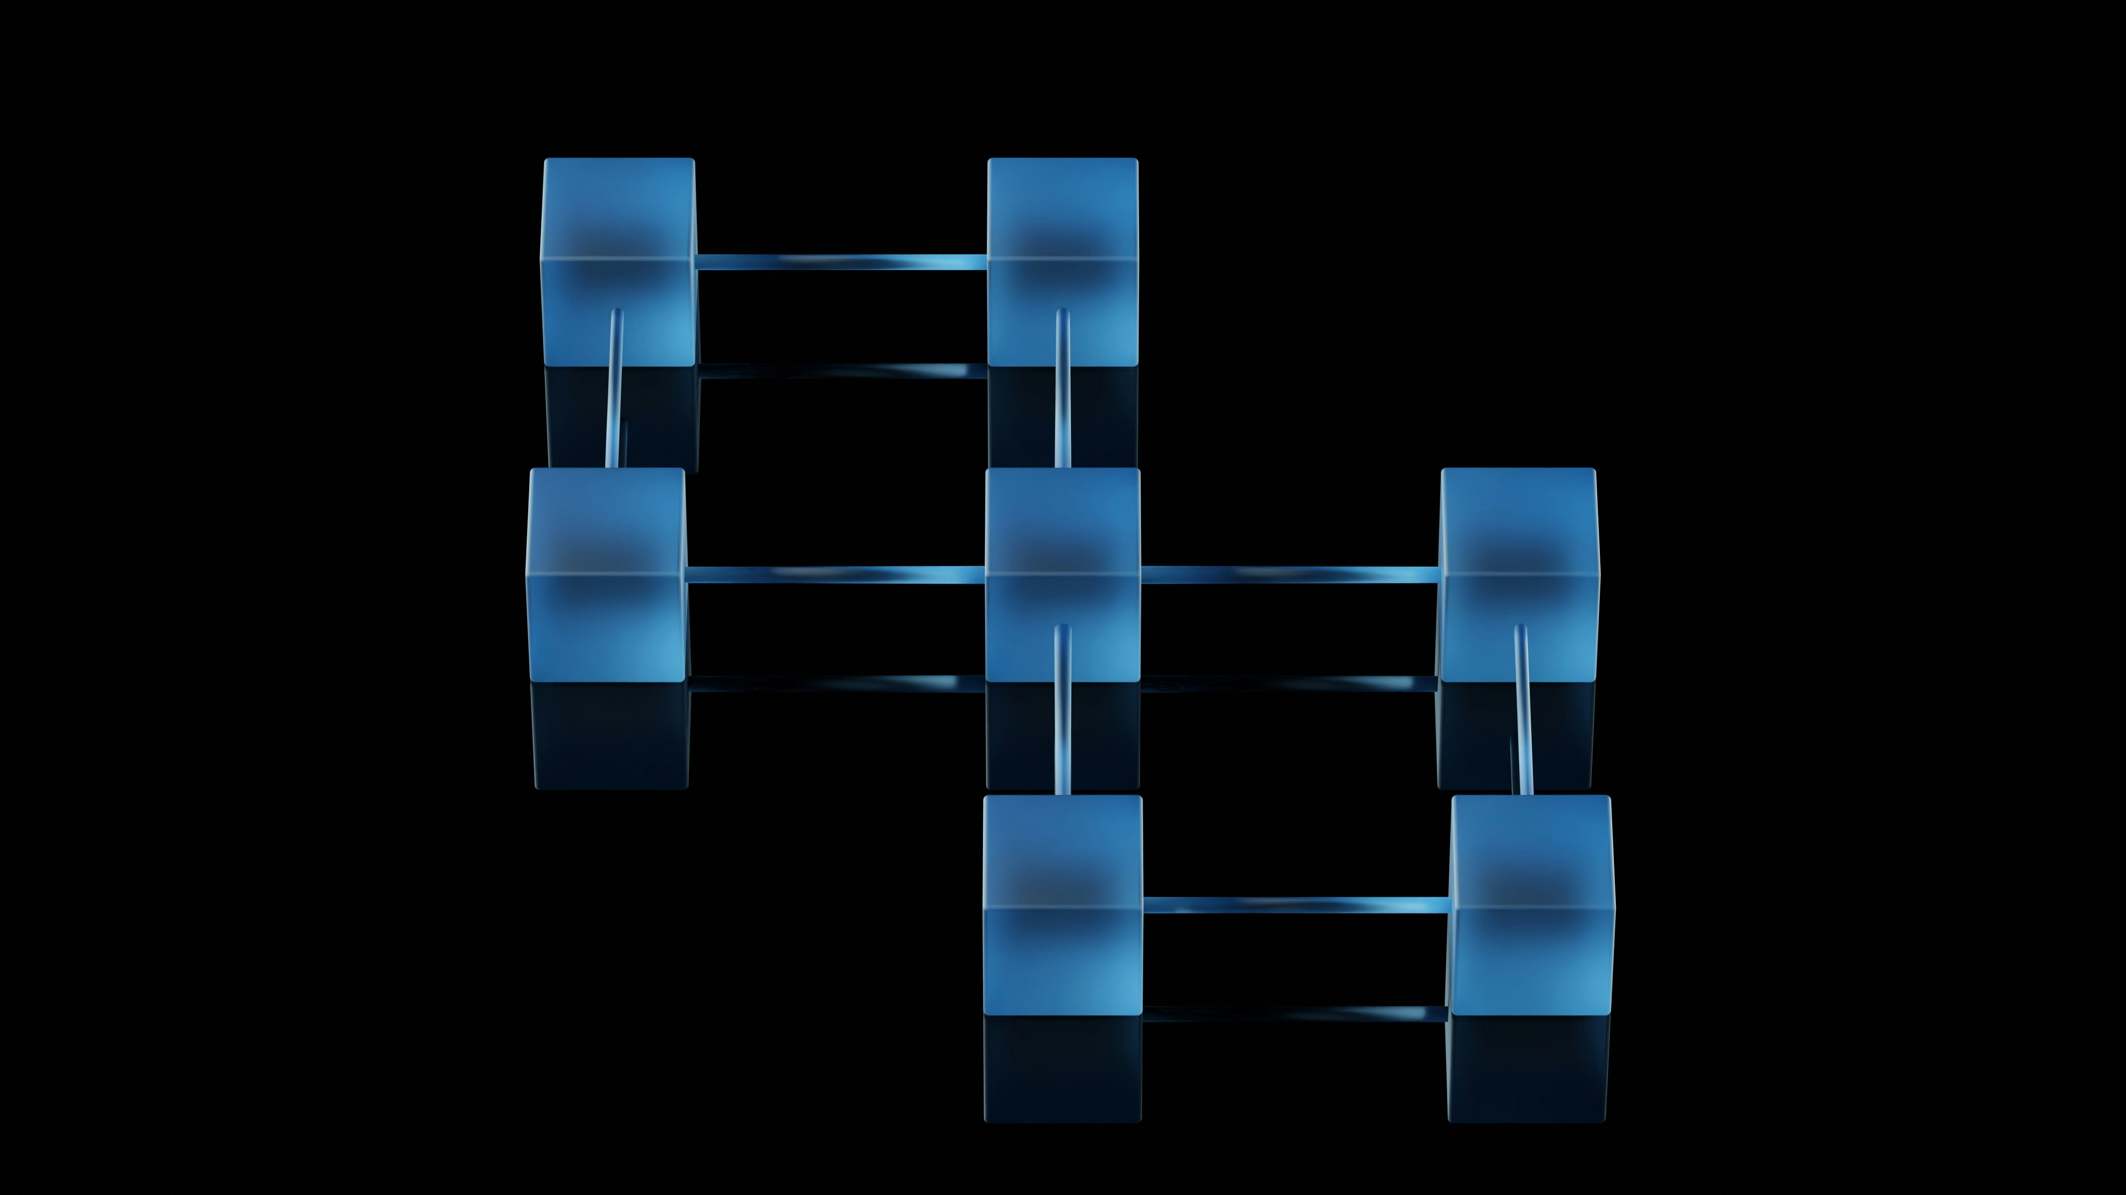
Arrays & Linked Lists
Arrays are a fundamental data structure in programming that stores elements of the same data type. Linked lists, on the other hand, are dynamic data structures where each element points to the next.
• Array characteristics
• Linked list characteristics
• Advantages of arrays
• Disadvantages of arrays

Slide 4
Stacks & Queues
Stacks and queues are two types of linear data structures that follow the Last-In-First-Out (LIFO) and First-In-First-Out (FIFO) principles, respectively. We will explore their applications in programming and compare their characteristics.
• Stack operations
• Queue operations
• Advantages of stacks
• Disadvantages of queues

Slide 5
Trees & Graphs
Trees and graphs are two types of non-linear data structures that represent hierarchical relationships between elements. We will discuss their characteristics, advantages, and disadvantages, as well as their applications in programming.
• Tree types
• Graph types
• Advantages of trees
• Disadvantages of graphs

Slide 6

Algorithms & Time Complexity
Algorithms are sets of instructions that solve a specific problem. Understanding time complexity is crucial in programming as it determines the efficiency and scalability of an algorithm.
• Sorting algorithms
• Searching algorithms
• Hashing algorithms
• Time complexity analysis

Slide 7
Conclusion & Future Directions
What We Learned
Key Actions
What's Next
• Future directions
• Trends in data structures
• Trends in algorithms
• Applications in AI & ML
• Real-world implications
Thank you for your attention | Questions?

Slide 8
Presentation Flow
1
Introduction to Data Structures
• Define data structures
• Types of data structures
• Applications of data structures
2
Arrays & Linked Lists
• Array characteristics
• Linked list characteristics
• Advantages of arrays
3
Stacks & Queues
• Stack operations
• Queue operations
• Advantages of stacks

Slide 9
Key Takeaways
✓ Introduction to Data Structures
✓ Arrays & Linked Lists
✓ Stacks & Queues
✓ Trees & Graphs
✓ Algorithms & Time Complexity

