Slide 1
M.A. in International Relation_x000D_

Slide 2
Slide 1
• Key point 1
• Key point 2
• Key point 3

Slide 3
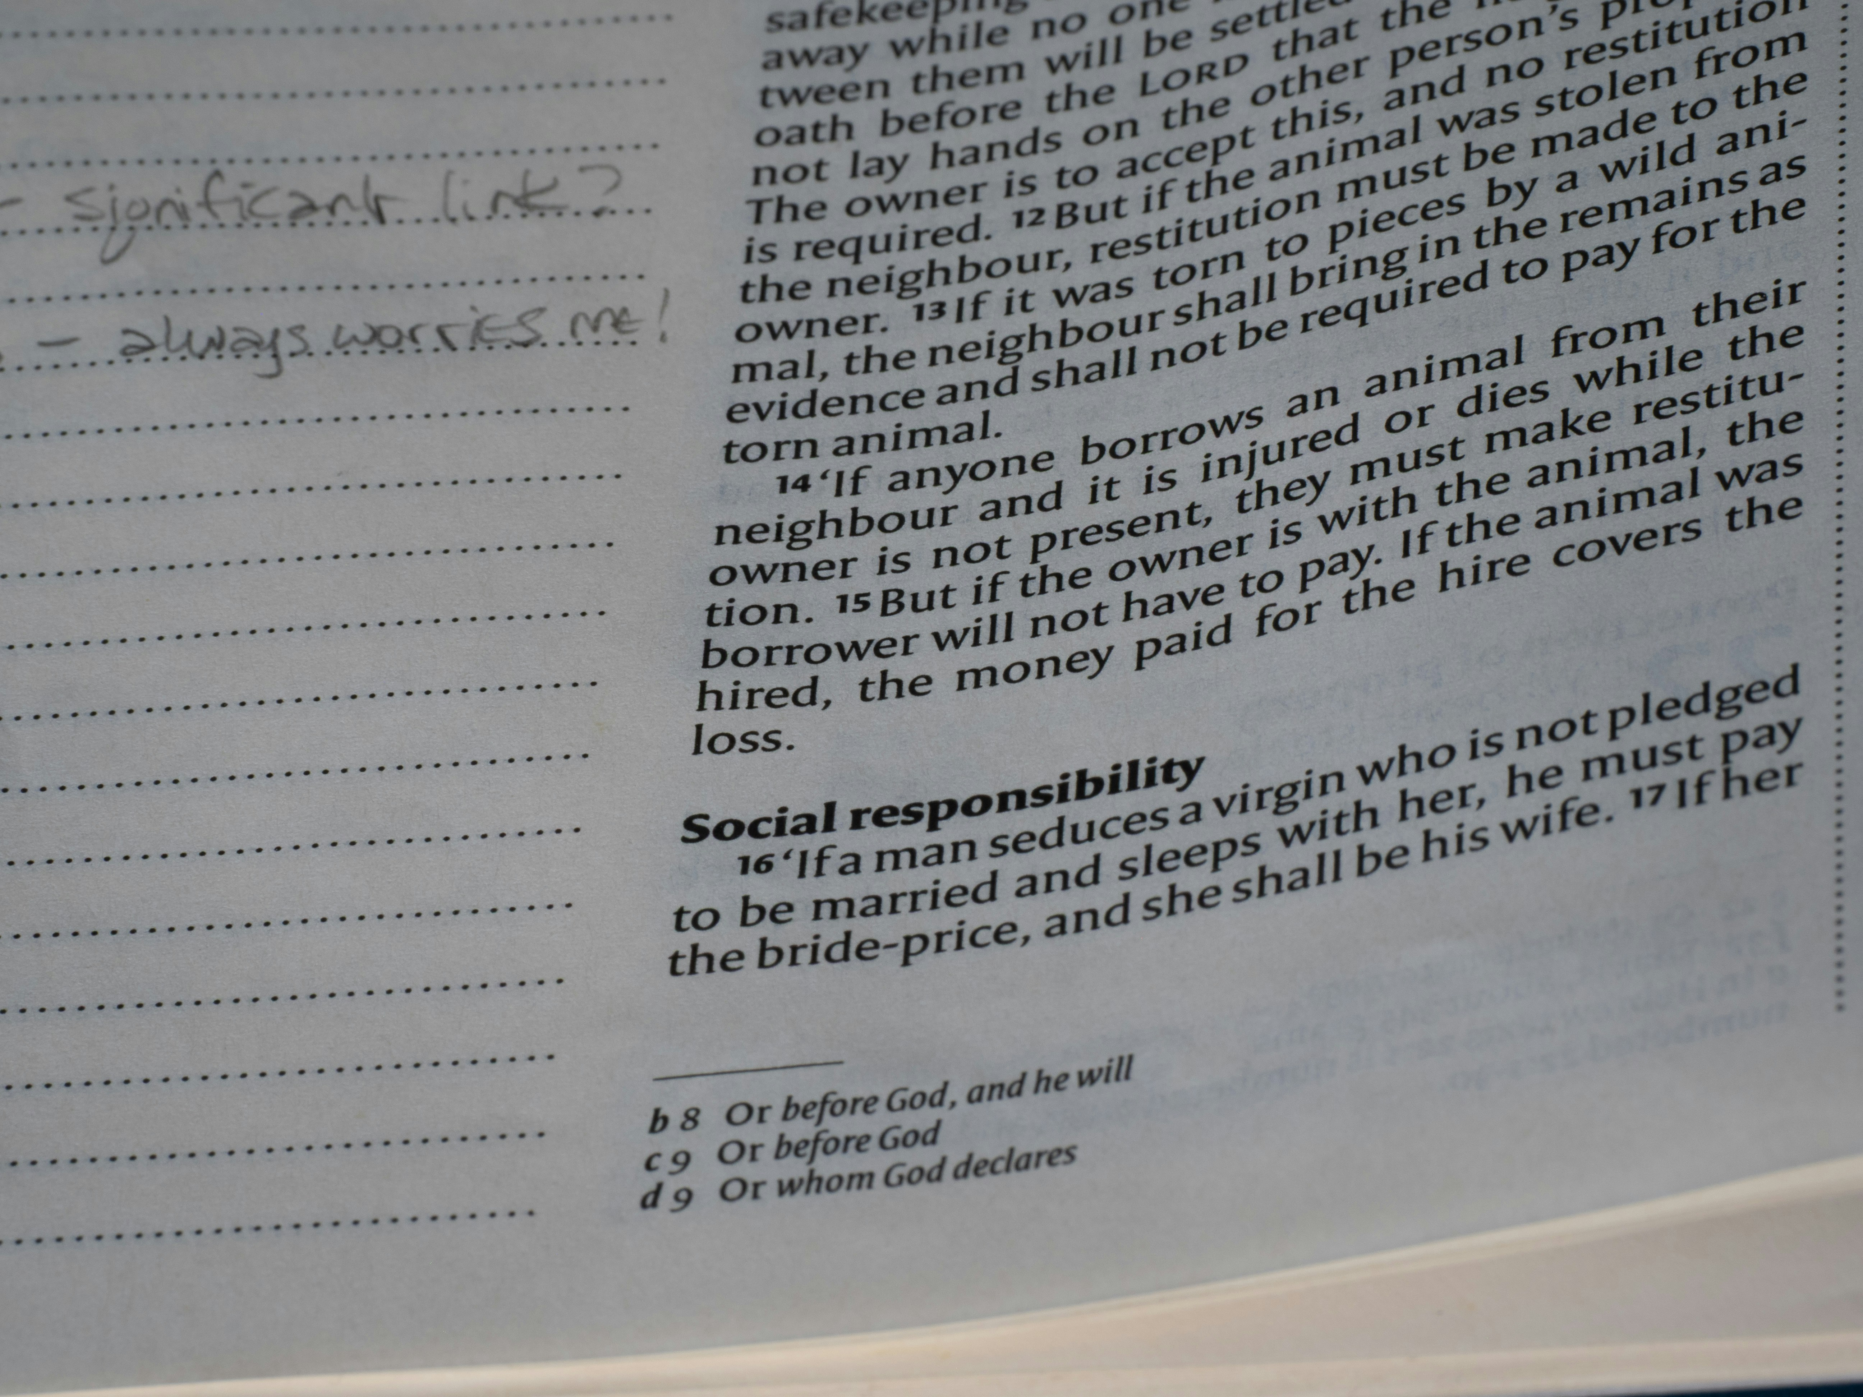
Slide 2

Slide 4
Slide 3
• Key point 1
• Key point 2
• Key point 3

Slide 5
Slide 4
• Key point 1
• Key point 2
• Key point 3

Slide 6
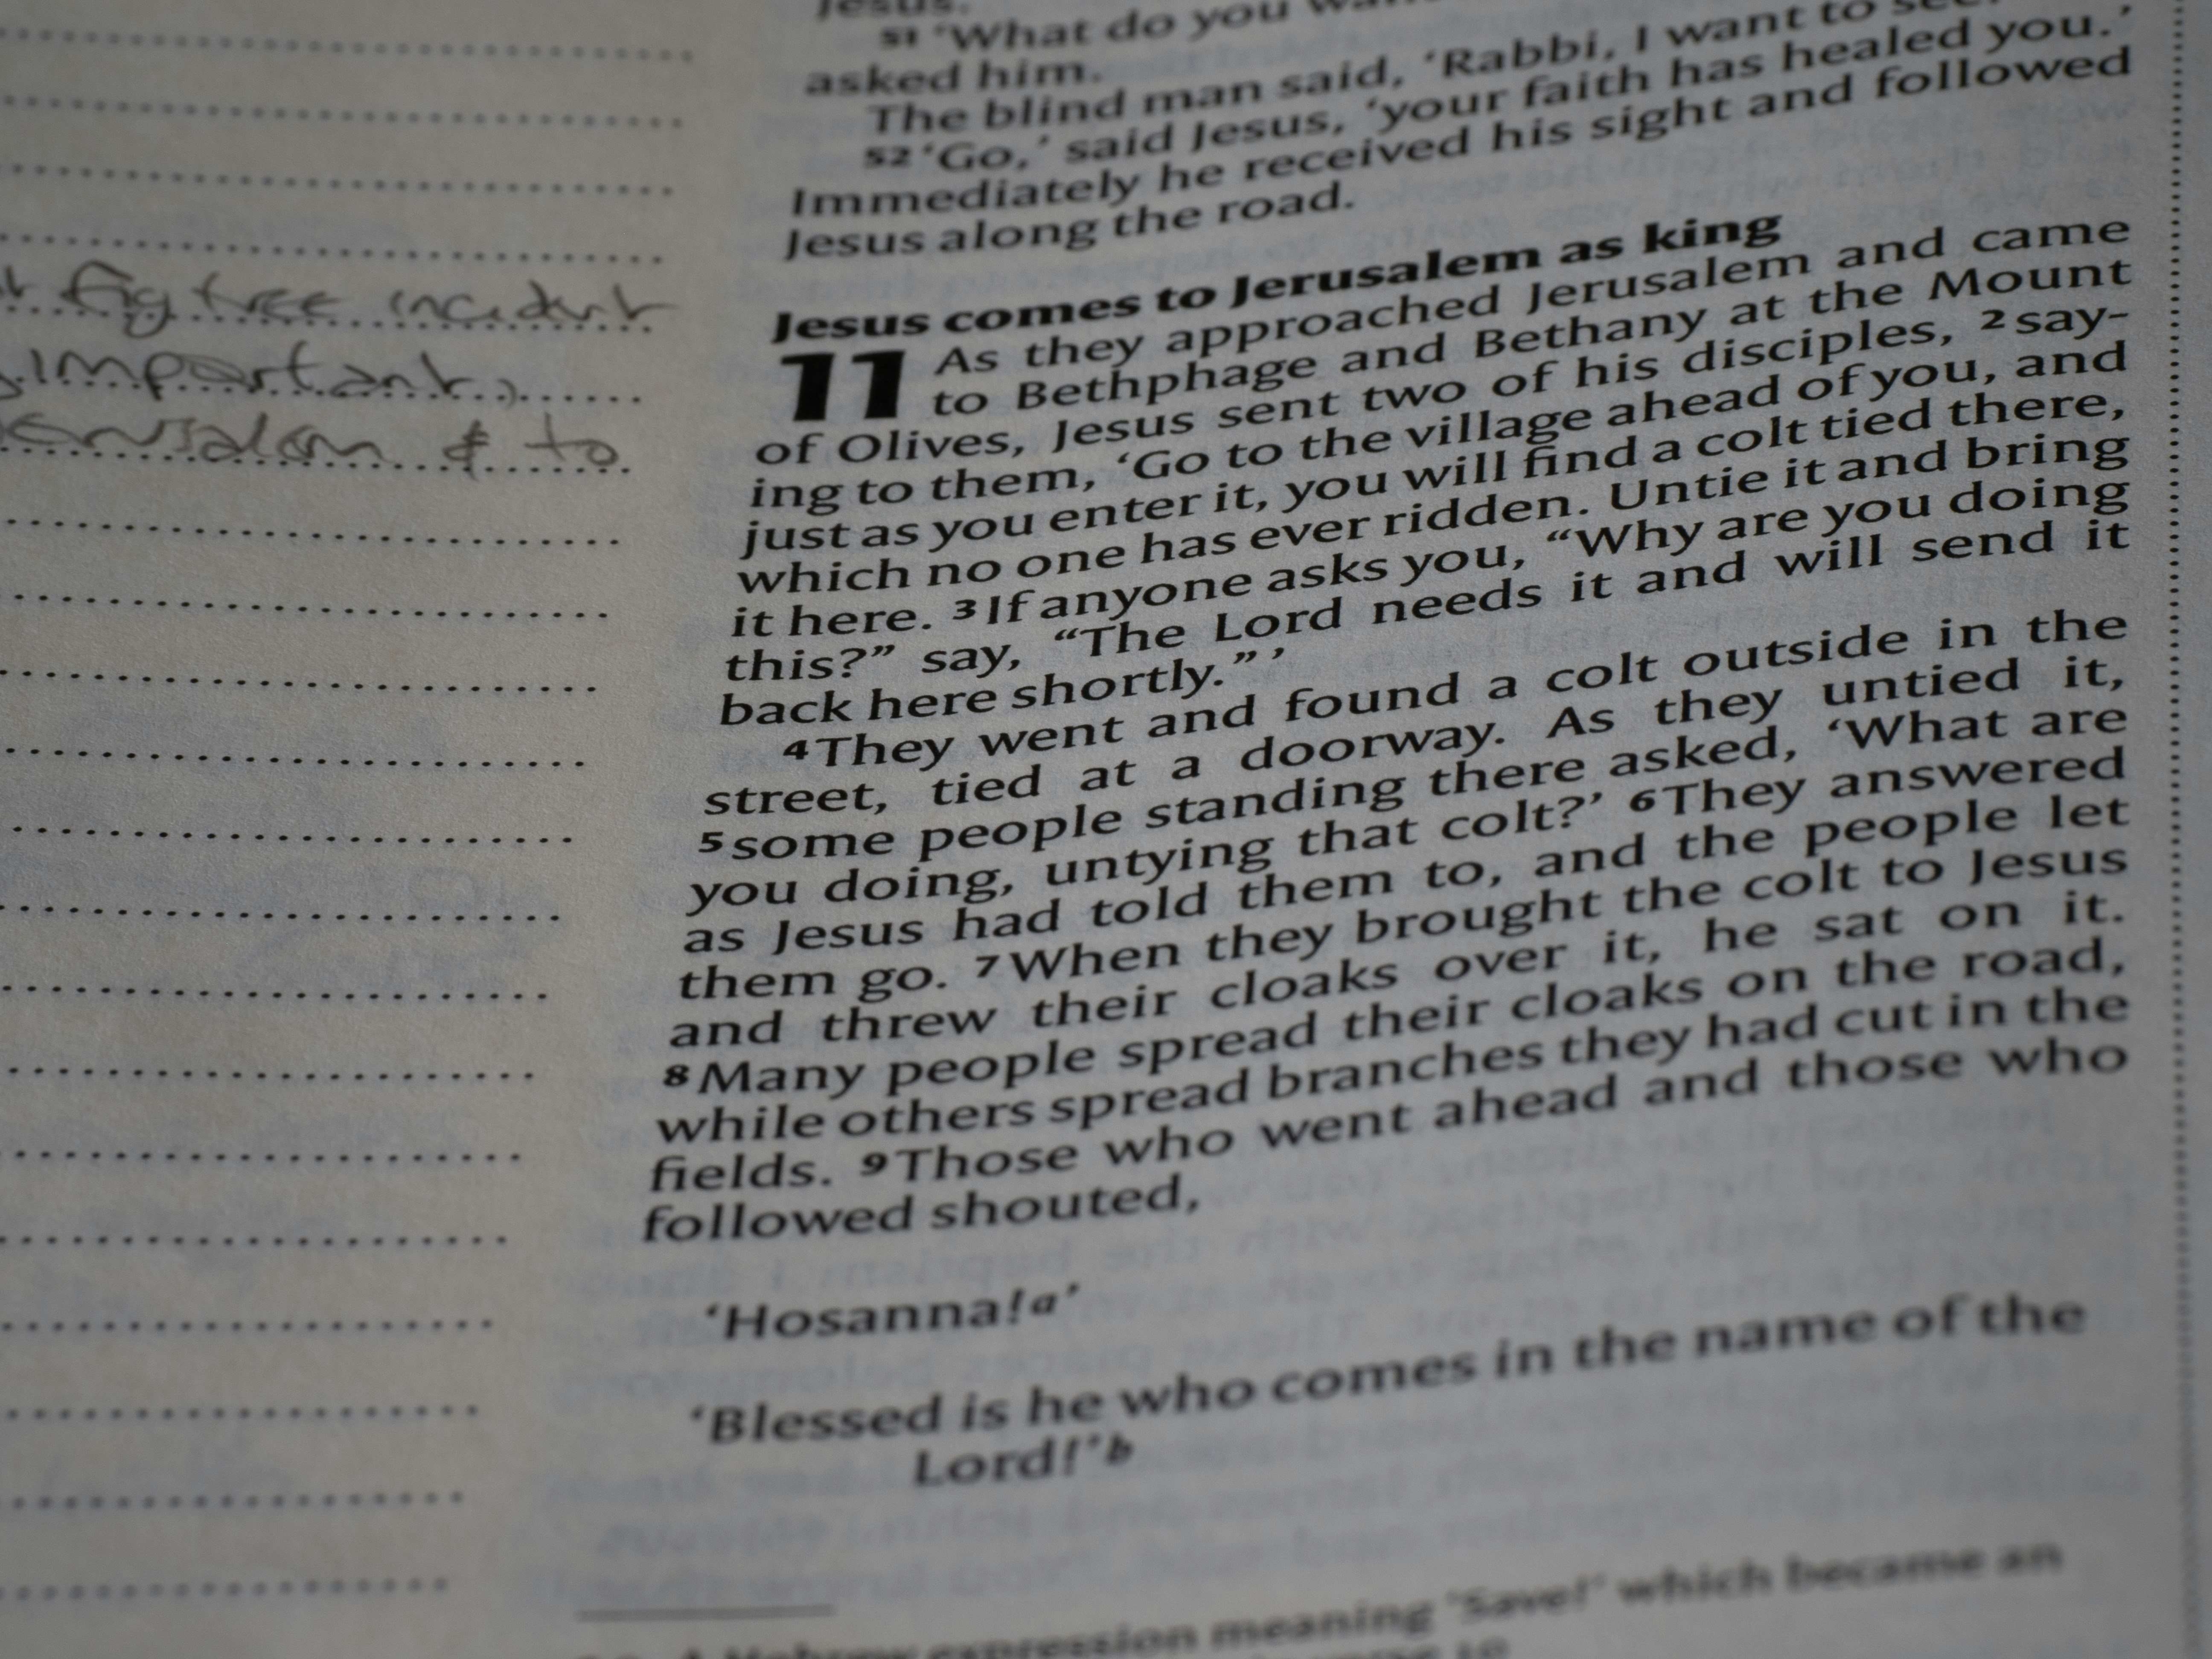
Slide 5

Slide 7
Slide 6
• Key point 1
• Key point 2
• Key point 3

Slide 8
Presentation Flow
1
Slide 1
• Key point 1
• Key point 2
• Key point 3
2
Slide 2
• Key point 1
• Key point 2
• Key point 3
3
Slide 3
• Key point 1
• Key point 2
• Key point 3

Slide 9
Key Takeaways
✓ Slide 1
✓ Slide 2
✓ Slide 3
✓ Slide 4
✓ Slide 5

