Slide 1
Clinical Supply Chain Overview

Slide 2
What is Clinical Supply Chain?
The clinical supply chain refers to the process of planning, sourcing, and delivering medical supplies and equipment to healthcare providers. This complex network involves multiple stakeholders, including manufacturers, distributors, and healthcare facilities.
• Definition
• Complexity
• Stakeholders
• Goals

Slide 3
Clinical Supply Chain Components
The clinical supply chain comprises several key components, including procurement, inventory management, transportation, and warehousing. Each component plays a crucial role in ensuring the smooth flow of medical supplies from manufacturers to healthcare providers.
• Procurement
• Inventory Management
• Transportation
• Warehousing

Slide 4

Supply Chain Risks and Challenges
The clinical supply chain faces various risks and challenges, including product recalls, inventory management issues, and transportation disruptions. These challenges can have significant impacts on patient care and healthcare provider operations.
• Product Recalls
• Inventory Management Issues
• Transportation Disruptions
• Quality Control

Slide 5
Best Practices for Clinical Supply Chain Management
To ensure optimal clinical supply chain management, healthcare providers and manufacturers can implement various best practices. These include implementing effective inventory management systems, optimizing transportation routes, and leveraging technology to improve visibility and control.
• Inventory Management
• Transportation Optimization
• Technology Leverage
• Visibility Control

Slide 6
Clinical Supply Chain Opportunities for Improvement
The clinical supply chain presents opportunities for improvement through process optimization, technology adoption, and collaboration. By streamlining processes and leveraging data analytics, healthcare providers and manufacturers can reduce costs, improve patient care, and enhance operational efficiency.
• Process Optimization
• Technology Adoption
• Collaboration
• Data Analytics

Slide 7
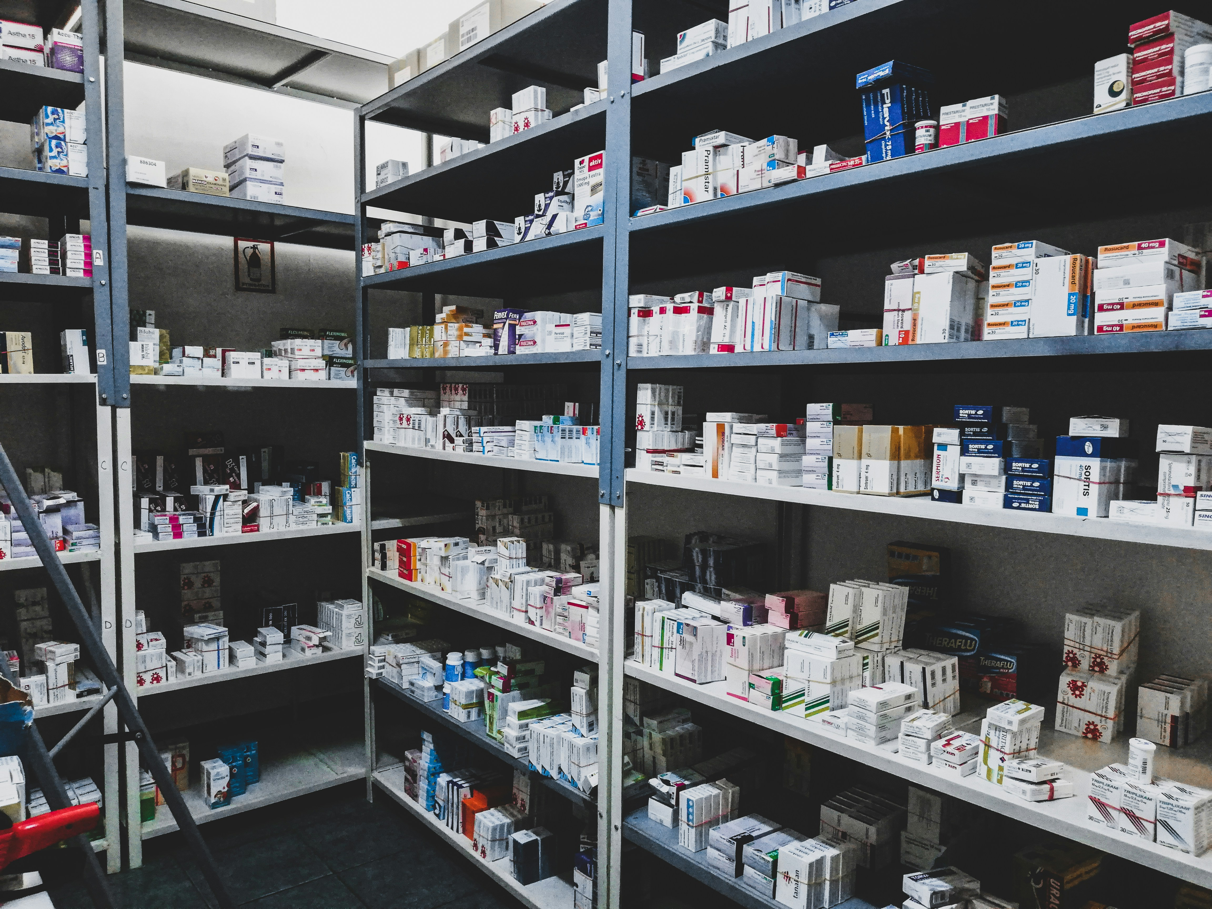
Clinical Supply Chain Strategies for Success
To achieve success in the clinical supply chain, healthcare providers and manufacturers must develop effective strategies. These include prioritizing patient care, leveraging data analytics, and fostering collaboration across the supply chain.
• Patient-Centric Approach
• Data-Driven Decision Making
• Collaboration
• Risk Management

Slide 8
Conclusion: Clinical Supply Chain Overview
What We Learned
Key Actions
What's Next
• Summary
• Key Takeaways
• Action Items
• Best Practices
• Future Directions
Thank you for your attention | Questions?

Slide 9
Presentation Flow
1
What is Clinical Supply Chain?
• Definition
• Complexity
• Stakeholders
2
Clinical Supply Chain Components
• Procurement
• Inventory Management
• Transportation
3
Supply Chain Risks and Challenges
• Product Recalls
• Inventory Management Issues
• Transportation Disruptions

Slide 10
Key Takeaways
✓ What is Clinical Supply Chain?
✓ Clinical Supply Chain Components
✓ Supply Chain Risks and Challenges
✓ Best Practices for Clinical Supply Chain Management
✓ Clinical Supply Chain Opportunities for Improvement

