Slide 1
Unlocking AI's Potential in the Pharmaceutical Industry

Slide 2
Introduction to AI in Pharma
The pharmaceutical industry is on the cusp of a revolution with the integration of Artificial Intelligence (AI). AI has the potential to transform various aspects of pharma, from drug discovery to patient care.
Enhanced decision-making
Personalized medicine
Increased efficiency
Improved patient engagement
Unlocking AI's Potential in the Pharmaceutical Industry
2

Slide 3
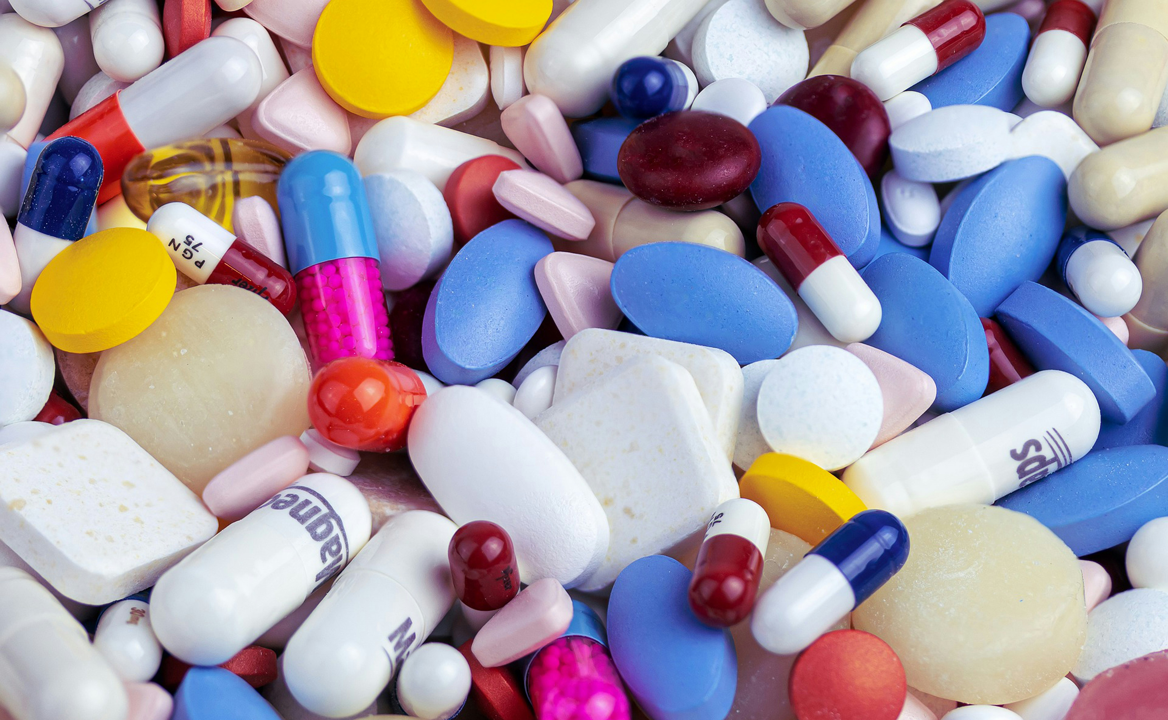
AI-powered Drug Discovery
Traditional methods of drug discovery are time-consuming and expensive. AI can accelerate the process by analyzing vast amounts of data, identifying potential leads, and optimizing chemical structures.
Faster lead identification
Improved hit-to-lead optimization
Enhanced compound design
Rapid candidate selection
Unlocking AI's Potential in the Pharmaceutical Industry
3

Slide 4
Let's Dive Deeper

Slide 5
AI-driven Clinical Trials
Clinical trials are a crucial step in the pharmaceutical development process. AI can enhance trial efficiency by streamlining patient recruitment, reducing drop-out rates, and improving data quality.
Improved patient recruitment
Enhanced data analysis
Predictive modeling
Personalized treatment plans
Unlocking AI's Potential in the Pharmaceutical Industry
4

Slide 6

AI-powered Patient Engagement
Patients are increasingly expected to be active participants in their healthcare journey. AI-powered patient engagement platforms can provide personalized health advice, track medication adherence, and offer real-time support.
Personalized health advice
Medication adherence tracking
Real-time support
Improved patient satisfaction
Unlocking AI's Potential in the Pharmaceutical Industry
5

Slide 7
Challenges and Opportunities in AI Adoption
While the potential benefits of AI in pharma are significant, there are also challenges to be addressed. These include data quality issues, regulatory hurdles, and the need for skilled professionals.
Data quality concerns
Regulatory compliance
Skilled workforce needs
Potential for cost savings
Unlocking AI's Potential in the Pharmaceutical Industry
6

Slide 8
Presentation Flow
1
Introduction to AI in Pharma
• Enhanced decision-making
• Personalized medicine
• Increased efficiency
2
AI-powered Drug Discovery
• Faster lead identification
• Improved hit-to-lead optimization
• Enhanced compound design
3
AI-driven Clinical Trials
• Improved patient recruitment
• Enhanced data analysis
• Predictive modeling

Slide 9
Key Takeaways
✓ Introduction to AI in Pharma
✓ AI-powered Drug Discovery
✓ AI-driven Clinical Trials
✓ AI-powered Patient Engagement
✓ Challenges and Opportunities in AI Adoption

