Slide 1
Sun Pharma Pvt Ltd: A Leading Pharmaceutical Company

Slide 2
Company Overview
Sun Pharma is a leading Indian pharmaceutical company that has been in operation since 1983. The company was founded by Dilip Shanghvi and has since grown to become one of the largest pharmaceutical companies in India.
Headquartered in Mumbai, India
Founded in 1983
Leading manufacturer of generic drugs
Operates globally with a strong presence in over 100 countries
Sun Pharma Pvt Ltd: A Leading Pharmaceutical Company
2

Slide 3
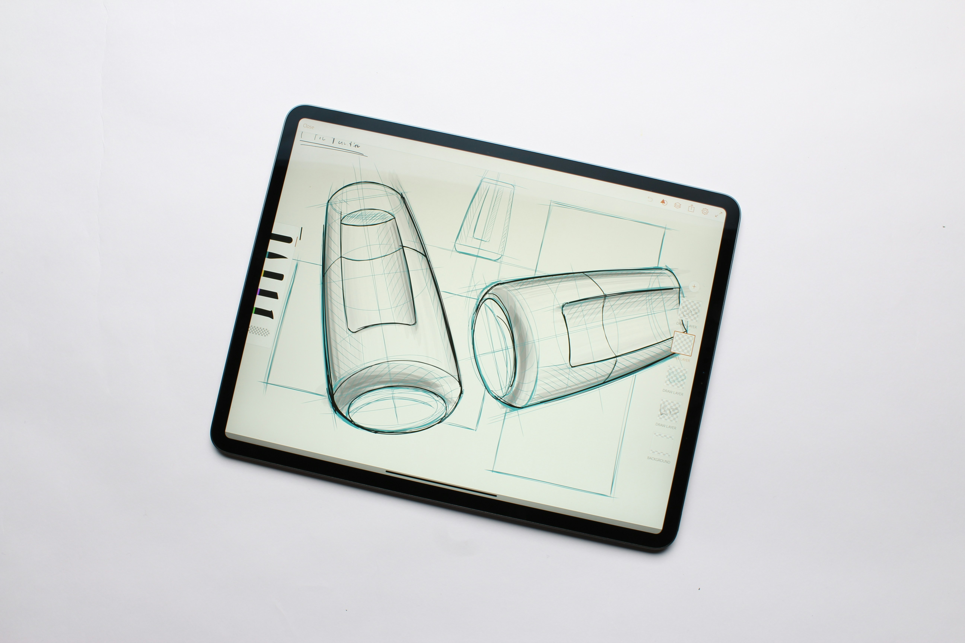
Product Portfolio
Sun Pharma's product portfolio includes a wide range of pharmaceutical products, including specialty and generic medications. The company has a strong focus on research and development, which enables it to develop innovative and effective treatments for various diseases.
Specialty generics for rare and niche indications
Innovative therapies for complex diseases
Generic versions of patented drugs
Oral solids, injectables, and topical formulations
Sun Pharma Pvt Ltd: A Leading Pharmaceutical Company
3

Slide 4
Business Operations
Sun Pharma's business operations are centered around its core strengths in research and development, manufacturing, and marketing. The company has a global presence with a strong network of distributors, wholesalers, and retail partners.
Global distribution network
State-of-the-art manufacturing facilities
Research and development partnerships
Marketing and sales strategies for targeted markets
Sun Pharma Pvt Ltd: A Leading Pharmaceutical Company
4

Slide 5

Corporate Social Responsibility
Sun Pharma is committed to giving back to the community through various corporate social responsibility initiatives. The company believes that its success is closely linked to the well-being of society and the environment.
Healthcare education programs for underprivileged communities
Patient advocacy and awareness campaigns
Environmental sustainability initiatives
Community development projects
Sun Pharma Pvt Ltd: A Leading Pharmaceutical Company
5

Slide 6
Awards and Recognition
Sun Pharma has received numerous awards and recognition for its contributions to the pharmaceutical industry. The company's commitment to innovation, quality, and patient care has earned it several prestigious awards from various organizations.
Indian Pharmaceutical Association (IPA) Award
Pharmaceutical Leadership Summit (PLS) Award
India's Most Valuable Companies (IMVCS) Award
Best Company to Work For (BCWF) Award
Sun Pharma Pvt Ltd: A Leading Pharmaceutical Company
6

Slide 7
Presentation Flow
1
Company Overview
• Headquartered in Mumbai, India
• Founded in 1983
• Leading manufacturer of generic drugs
2
Product Portfolio
• Specialty generics for rare and niche indications
• Innovative therapies for complex diseases
• Generic versions of patented drugs
3
Business Operations
• Global distribution network
• State-of-the-art manufacturing facilities
• Research and development partnerships

Slide 8
Key Takeaways
✓ Company Overview
✓ Product Portfolio
✓ Business Operations
✓ Corporate Social Responsibility
✓ Awards and Recognition

