Slide 1
University of Southern California: A Prestigious Institution

Slide 2
Introduction to USC
1880
40
Founded in
Over ,000 students
The University of Southern California (USC) is a private research university located in Los Angeles. Founded in 1880, it has evolved into one of the most prestigious institutions in the world.
Private research university
Location: Los Angeles
Premier institution
University of Southern California: A Prestigious Institution
2

Slide 3
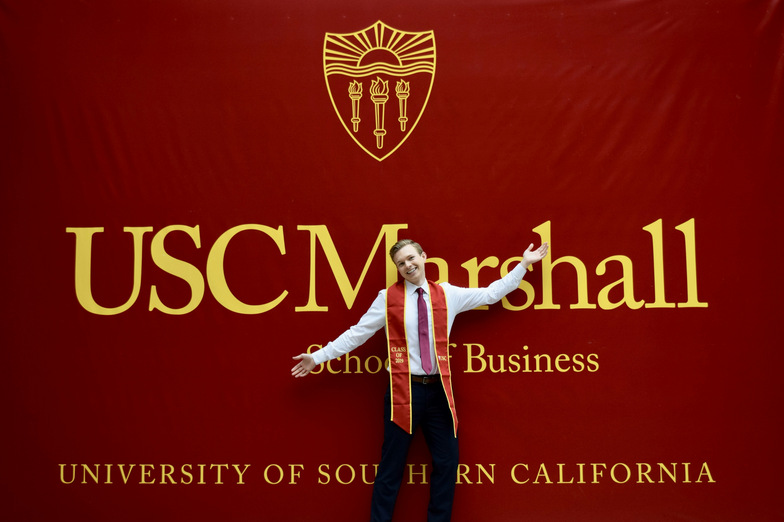
Academic Programs at USC
USC offers a wide range of academic programs across its various schools and colleges. The university is renowned for its strong programs in business, engineering, film, and journalism.
Undergraduate majors: 300+
Graduate programs: 100+
Strong programs in business
Engineering, film, journalism
University of Southern California: A Prestigious Institution
3

Slide 4
Research at USC
USC is a research powerhouse with a strong focus on interdisciplinary collaboration. The university has made significant breakthroughs in fields such as medicine, biotechnology, and environmental science.
Interdisciplinary research
Breakthroughs in medicine
Biotechnology, environmental science
Research awards and recognition
University of Southern California: A Prestigious Institution
4

Slide 5
Campus Life at USC
300
Over student organizations
USC has a vibrant campus life with over 300 student organizations. Students can engage in cultural, recreational, and community service activities.
Cultural, recreational, community service
Support services: academic advising
Mental health counseling, career guidance
University of Southern California: A Prestigious Institution
5

Slide 6

Global Reach of USC
USC has a significant global presence with students and faculty from over 100 countries. The university has partnerships with top institutions worldwide, facilitating international research collaborations and study abroad programs.
Global presence: 100+ countries
Partnerships with top institutions
International research collaborations
Study abroad programs
University of Southern California: A Prestigious Institution
6

Slide 7
Conclusion
What We Learned
Key Actions
What's Next
• World-class institution
• Unparalleled educational experience
• Strong academic programs
• Cutting-edge research
• Vibrant campus life
Thank you for your attention | Questions?

Slide 8
Presentation Flow
1
Introduction to USC
• Private research university
• Founded in 1880
• Location: Los Angeles
2
Academic Programs at USC
• Undergraduate majors: 300+
• Graduate programs: 100+
• Strong programs in business
3
Research at USC
• Interdisciplinary research
• Breakthroughs in medicine
• Biotechnology, environmental science

Slide 9
Key Takeaways
1
Introduction to USC
2
Academic Programs at USC
3
Research at USC
4
Campus Life at USC
5
Global Reach of USC

