Slide 1
Financial Performance of Google

Slide 2
Introduction to Google's Financial Performance
Google is one of the most successful and innovative companies in the world. Its financial performance has been impressive over the years, with consistent growth in revenue and profits.
Global search giant
Consistent revenue growth
Diversified business model
Strong brand recognition
Financial Performance of Google
2

Slide 3
Revenue Growth
Google's revenue has consistently grown over the years, driven by its search and advertising businesses. The company has been able to expand its reach into new markets and diversify its offerings, leading to increased revenue.
Consistent annual growth
Diversified revenue streams
Strong brand recognition drives sales
Increasing demand for digital advertising
Financial Performance of Google
3

Slide 4
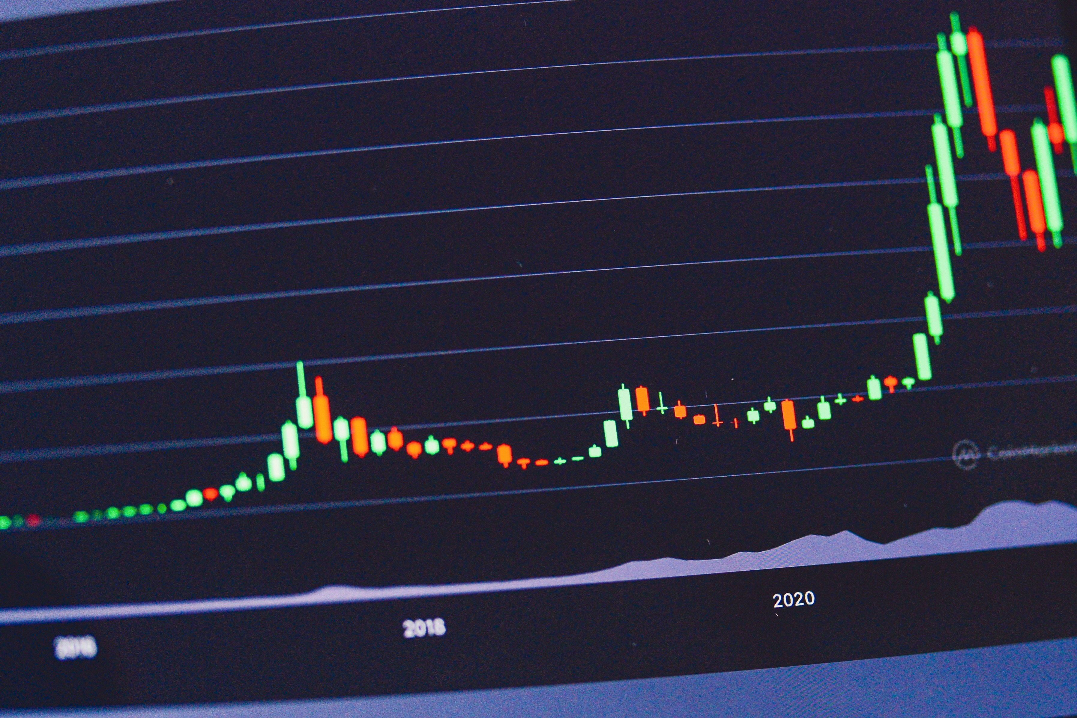
Profitability
Google's profitability has also been impressive, with the company reporting consistent profits over the years. This is due to its ability to generate significant revenue from its search and advertising businesses, while keeping costs under control.
Consistent profitability
High profit margins
Efficient operations
Strategic investments
Financial Performance of Google
4

Slide 5
Operating Expenses
Google's operating expenses have increased over the years, driven by its growing workforce and expanding business. The company has invested heavily in research and development, as well as in its sales and marketing efforts.
Increasing workforce
Strategic investments
Growing R&D expenditures
Expanding business operations
Financial Performance of Google
5

Slide 6
Capital Expenditures
Google's capital expenditures have been significant over the years, driven by its need to invest in new technologies and expand its infrastructure. The company has invested heavily in data centers, servers, and other hardware, as well as in software development.
Significant capital expenditures
Investing in new technologies
Expanding infrastructure
Maintaining market leadership
Financial Performance of Google
6

Slide 7

Return on Investment (ROI)
Google's return on investment has been impressive, with the company generating significant returns from its investments. The company's focus on innovation and efficiency has enabled it to maintain high ROI levels, driving long-term growth and profitability.
High return on investment
Strategic investments
Efficient operations
Long-term growth
Financial Performance of Google
7

Slide 8
Industry Comparison
Google's financial performance is comparable to that of its peers in the technology industry. The company has consistently outperformed many of its competitors, driven by its innovative products and services, as well as its strong brand recognition.
Comparable to industry peers
Strong brand recognition
Innovative products and services
Consistent performance
Financial Performance of Google
8

Slide 9
Conclusion
What We Learned
Key Actions
What's Next
• Consistent performance
• Strong brand recognition
• Innovative products and services
• Competitive advantage
• Long-term growth
Thank you for your attention | Questions?

Slide 10
Presentation Flow
1
Introduction to Google's Financial Performance
• Global search giant
• Consistent revenue growth
• Diversified business model
2
Revenue Growth
• Consistent annual growth
• Diversified revenue streams
• Strong brand recognition drives sales
3
Profitability
• Consistent profitability
• High profit margins
• Efficient operations

Slide 11
Key Takeaways
1
Introduction to Google's Financial Performance
2
Revenue Growth
3
Profitability
4
Operating Expenses
5
Capital Expenditures

