Slide 1
The Rise of Artificial Intelligence

Slide 2
What is Artificial Intelligence?
Artificial intelligence (AI) refers to the development of computer systems that can perform tasks that typically require human intelligence, such as visual perception, speech recognition, decision-making, and language translation. AI systems are designed to learn from data and improve their performance over time.
Machine learning
Natural language processing
Computer vision
Robotics
The Rise of Artificial Intelligence
2

Slide 3
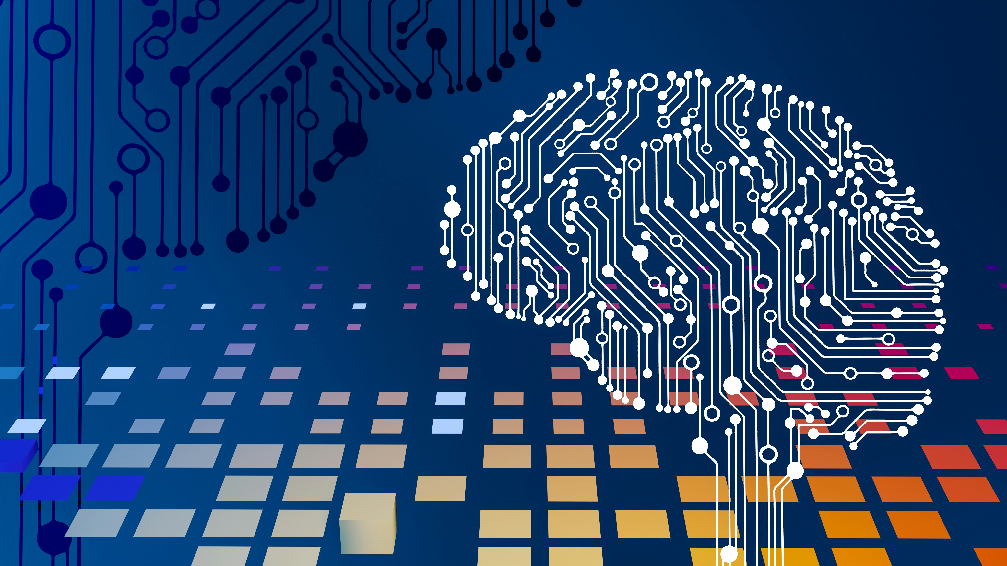
Benefits of Artificial Intelligence
The benefits of AI are numerous, including improved efficiency, accuracy, and decision-making capabilities. AI can help businesses automate routine tasks, free up human resources for more complex tasks, and provide personalized experiences for customers.
Increased productivity
Improved accuracy
Enhanced decision-making
Personalized experiences
The Rise of Artificial Intelligence
3

Slide 4
Challenges of Artificial Intelligence
While AI holds much promise, there are also challenges to consider. These include concerns about job displacement, data privacy and security, bias in algorithms, and the need for human oversight and intervention.
Job displacement
Data privacy concerns
Algorithmic bias
Human oversight needed
The Rise of Artificial Intelligence
4

Slide 5
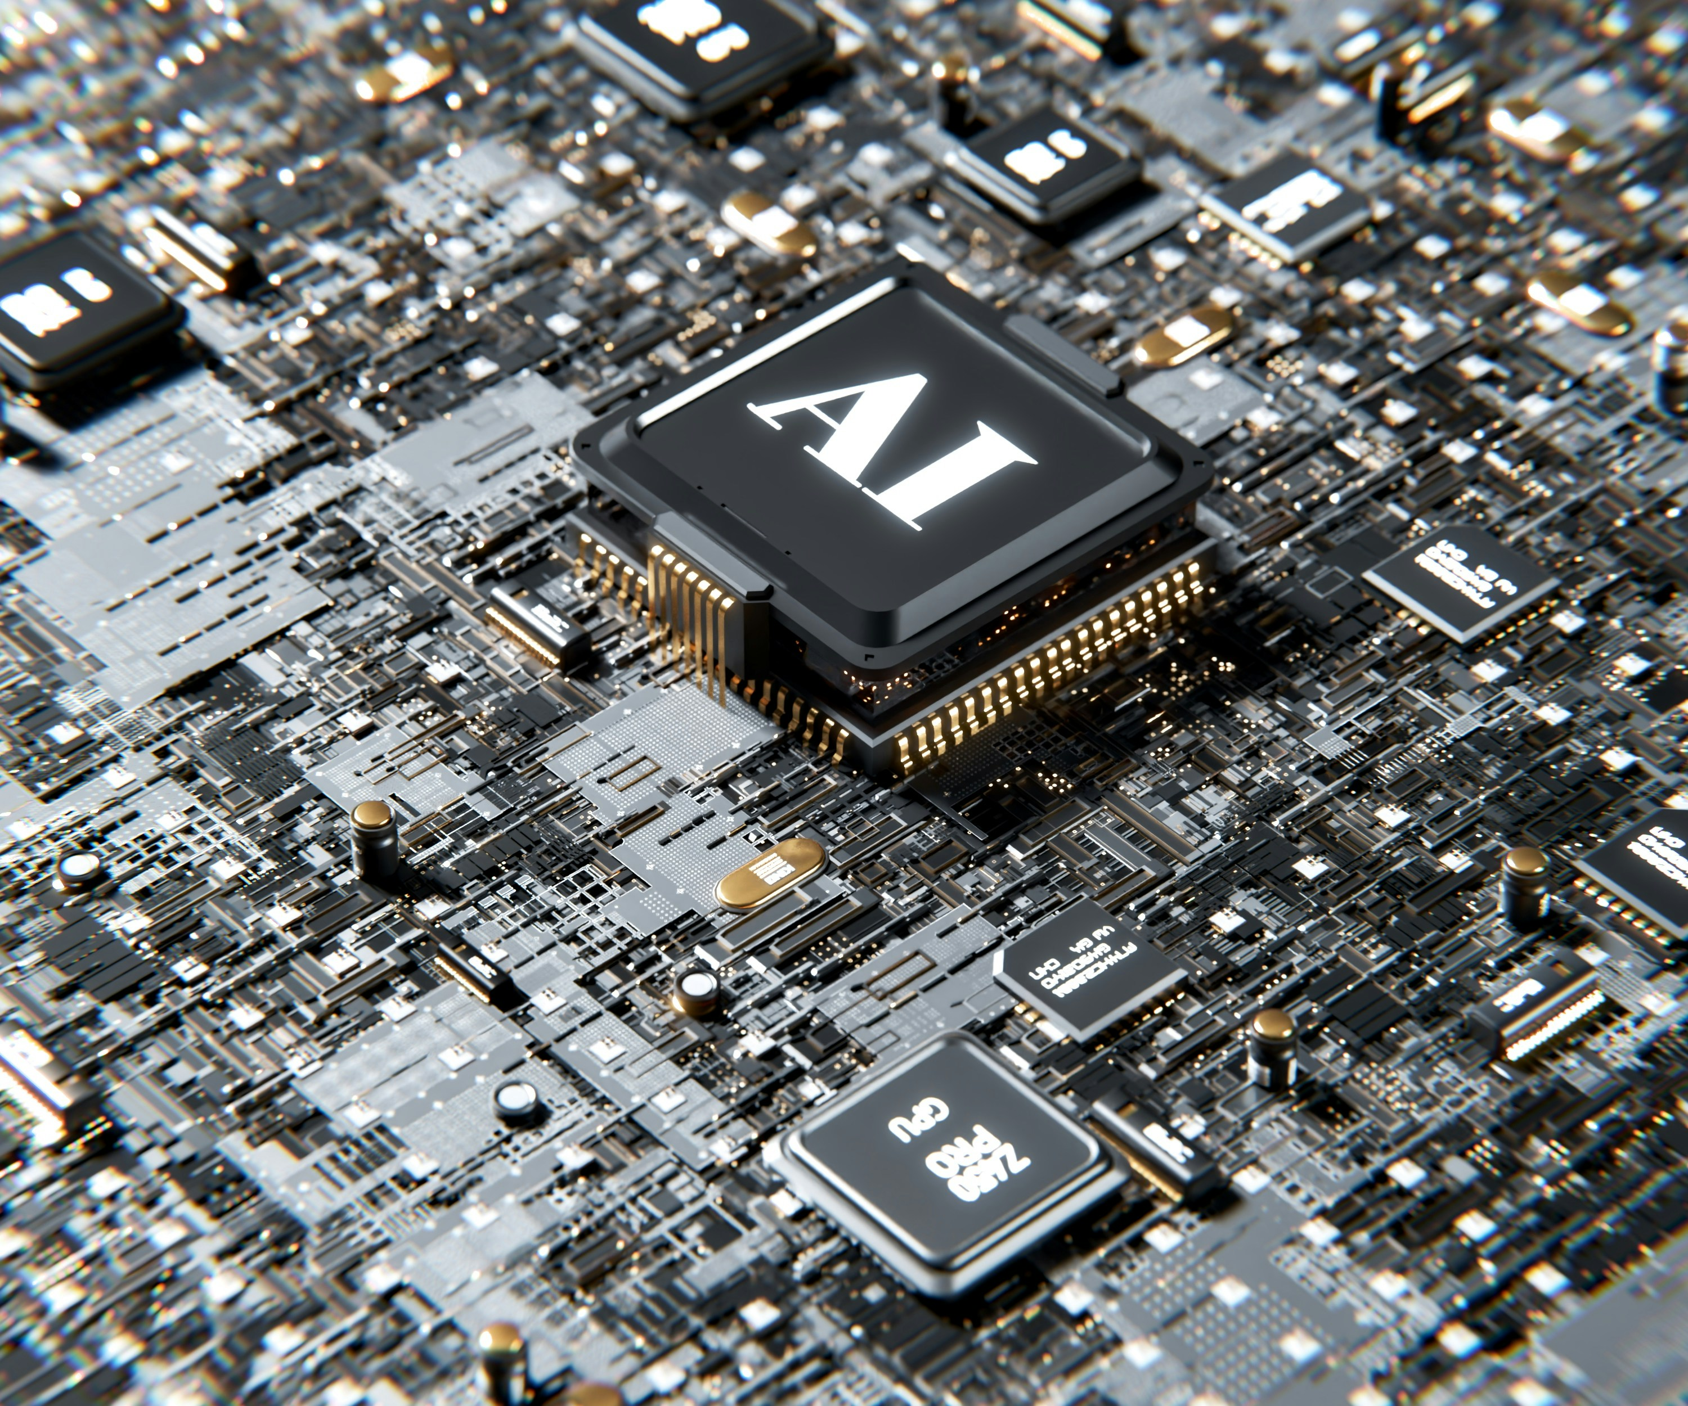
Applications of Artificial Intelligence
AI has a wide range of applications across various industries. For instance, AI-powered chatbots can improve customer service, while AI-driven analytics can help businesses make data-driven decisions.
Customer service
Data analytics
Healthcare diagnosis
Financial transaction automation
The Rise of Artificial Intelligence
5

Slide 6
Conclusion: The Future of Artificial Intelligence
What We Learned
Key Actions
What's Next
• Transformative potential
• Challenges ahead
• Investment needed
• Future applications
• Responsible development
Thank you for your attention | Questions?

Slide 7
Presentation Flow
1
What is Artificial Intelligence?
• Machine learning
• Natural language processing
• Computer vision
2
Benefits of Artificial Intelligence
• Increased productivity
• Improved accuracy
• Enhanced decision-making
3
Challenges of Artificial Intelligence
• Job displacement
• Data privacy concerns
• Algorithmic bias

Slide 8
Key Takeaways
1
What is Artificial Intelligence?
2
Benefits of Artificial Intelligence
3
Challenges of Artificial Intelligence
4
Applications of Artificial Intelligence
5
Conclusion: The Future of Artificial Intelligence

