Slide 1
Google's Revenue Growth

Slide 2
Introduction to Google's Revenue
1998
Founded in
Google's revenue growth has been remarkable over the years. Founded in 1998 by Larry Page and Sergey Brin, Google has evolved into one of the world's largest technology companies.
Primary source: Advertising
Diversified revenue streams
Remarkable growth over years
Google's Revenue Growth
2

Slide 3
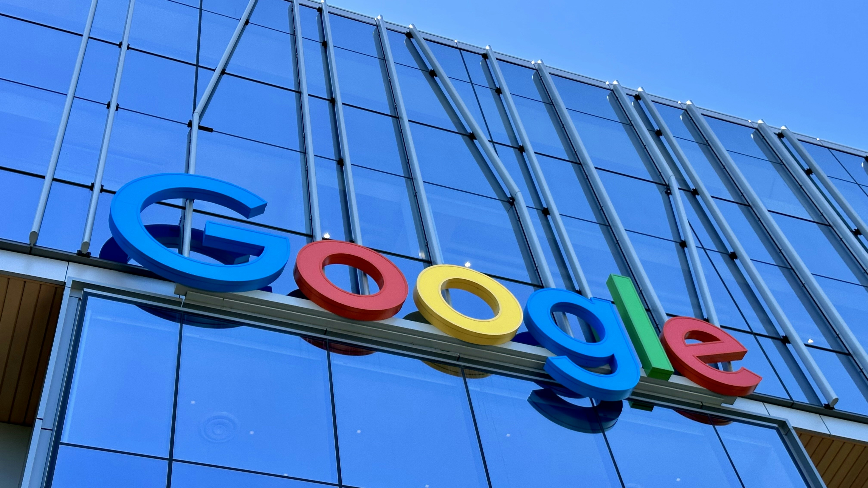
Google's Revenue Breakdown
Google's revenue breakdown is dominated by advertising, with Google Ads (formerly Google AdWords) and Google AdSense being the primary drivers. Additionally, Google's cloud computing business, Google Cloud Platform, has seen significant growth in recent years.
Advertising: 99% of revenue
Google Ads (AdWords) dominant
Google AdSense growing
Cloud Computing: rapid growth
Google's Revenue Growth
3

Slide 4
Google's Revenue Streams
Google has multiple revenue streams that contribute to its overall income. These include advertising on Google Search and other platforms, such as YouTube, Google Maps, and Google Play.
Advertising: Google Search
YouTube advertising
Google Maps advertising
Cloud Computing: GCP
Google's Revenue Growth
4

Slide 5

Challenges and Opportunities
Despite its success, Google faces challenges from emerging technologies such as artificial intelligence (AI) and the rise of social media platforms. However, these trends also present opportunities for the company to diversify its revenue streams and expand its services.
Artificial Intelligence: competition
Social Media: new advertising channels
Diversification opportunities
Expansion into new markets
Google's Revenue Growth
5

Slide 6
Conclusion: Google's Revenue Growth
What We Learned
Key Actions
What's Next
• Impressive revenue growth
• Diversified revenue streams
• Adaptability drives success
• Well-positioned for future growth
• Continuous innovation
Thank you for your attention | Questions?

Slide 7
Presentation Flow
1
Introduction to Google's Revenue
• Founded in 1998
• Primary source: Advertising
• Diversified revenue streams
2
Google's Revenue Breakdown
• Advertising: 99% of revenue
• Google Ads (AdWords) dominant
• Google AdSense growing
3
Google's Revenue Streams
• Advertising: Google Search
• YouTube advertising
• Google Maps advertising

Slide 8
Key Takeaways
1
Introduction to Google's Revenue
2
Google's Revenue Breakdown
3
Google's Revenue Streams
4
Challenges and Opportunities
5
Conclusion: Google's Revenue Growth

