Slide 1
Google Cloud Revenue Overview

Slide 2
Introduction to Google Cloud Revenue
Google Cloud is a rapidly growing segment of the company's revenue, driven by increasing adoption of cloud-based services. In recent years, the platform has seen significant growth, with revenues exceeding $13 billion in 2020.
Cloud computing market leader
Artificial intelligence focus
Machine learning capabilities
Google Cloud Revenue Overview
2

Slide 3
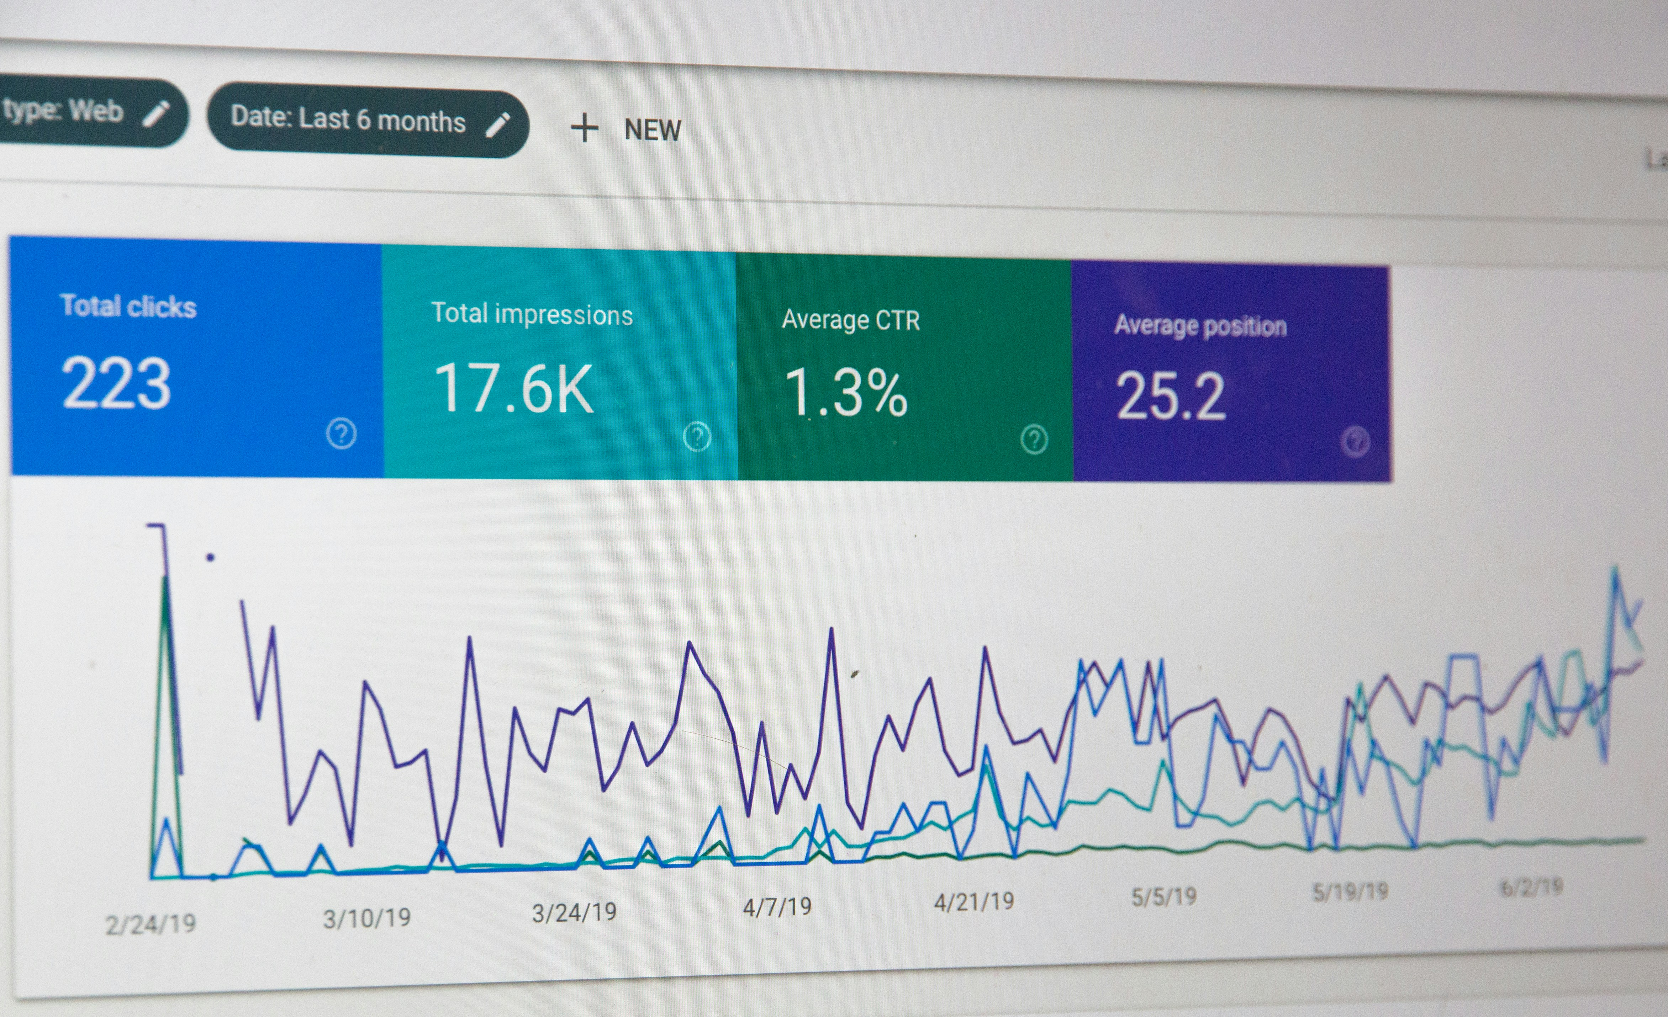
Google Cloud Revenue Breakdown
Google Cloud's revenue is primarily generated through its Infrastructure as a Service (IaaS) and Platform as a Service (PaaS) offerings. The IaaS segment, which includes Google Compute Engine, accounts for the majority of revenue.
IaaS dominates revenue
PaaS growth momentum
G Suite sales contribute
Enterprise adoption drives growth
Google Cloud Revenue Overview
3

Slide 4
Google Cloud Revenue Trends
Google Cloud's revenue has experienced consistent growth over the past few years, with a compound annual growth rate (CAGR) of over 50%. This rapid expansion is driven by increasing demand for cloud-based services, particularly among large enterprises.
Consistent revenue growth
Large enterprise adoption
Cloud demand drives growth
Google Cloud Revenue Overview
4

Slide 5
Google Cloud Revenue Forecast
As the cloud computing market continues to expand, Google Cloud is poised for continued revenue growth. According to market research firms, the company's revenue is expected to exceed $20 billion by 2025.
Revenue exceeds $20 billion
Continued growth momentum
Large enterprise adoption
Small business growth opportunities
Google Cloud Revenue Overview
5

Slide 6
Conclusion: Google Cloud Revenue
What We Learned
Key Actions
What's Next
• Growth momentum continues
• Cloud computing market leader
• Artificial intelligence focus
• Machine learning capabilities
• Global expansion strategy
Thank you for your attention | Questions?

Slide 7
Presentation Flow
1
Introduction to Google Cloud Revenue
• Cloud computing market leader
• Artificial intelligence focus
• Machine learning capabilities
2
Google Cloud Revenue Breakdown
• IaaS dominates revenue
• PaaS growth momentum
• G Suite sales contribute
3
Google Cloud Revenue Trends
• Consistent revenue growth
• Large enterprise adoption
• Cloud demand drives growth

Slide 8
Key Takeaways
1
Introduction to Google Cloud Revenue
2
Google Cloud Revenue Breakdown
3
Google Cloud Revenue Trends
4
Google Cloud Revenue Forecast
5
Conclusion: Google Cloud Revenue

