Slide 1
The Power of Artificial Intelligence

Slide 2
What is Artificial Intelligence?
Artificial intelligence (AI) refers to the development of computer systems that can perform tasks that typically require human intelligence, such as visual perception, speech recognition, and decision-making. AI has been around for decades, but recent advancements in machine learning have enabled more sophisticated applications.
Machine learning enabled
Computer systems mimicking human intelligence
Pattern recognition capabilities
Decision-making abilities
The Power of Artificial Intelligence
2

Slide 3
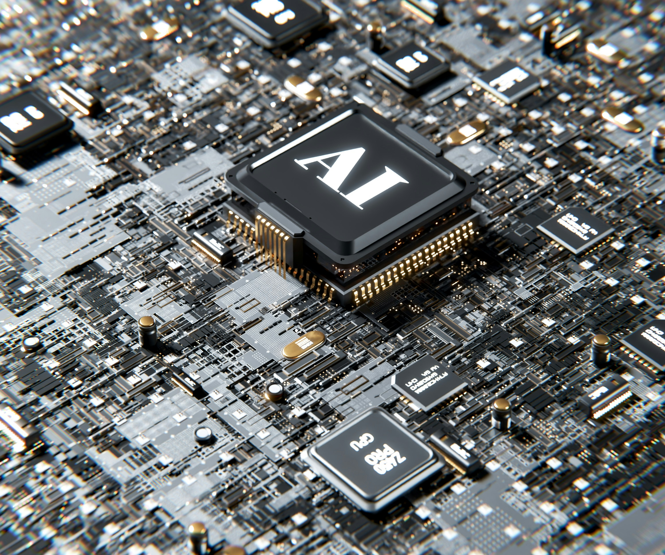
Applications of Artificial Intelligence
AI has numerous applications across various industries. In healthcare, AI-powered diagnostic tools can help doctors diagnose diseases more accurately and quickly.
Healthcare diagnosis
Financial analysis
Personalized education
Customer service chatbots
The Power of Artificial Intelligence
3

Slide 4
Benefits of Artificial Intelligence
The benefits of AI are numerous. It can improve efficiency and accuracy in various tasks, reduce costs, and provide valuable insights for decision-making.
Improved efficiency
Increased accuracy
Cost savings
Valuable insights
The Power of Artificial Intelligence
4

Slide 5
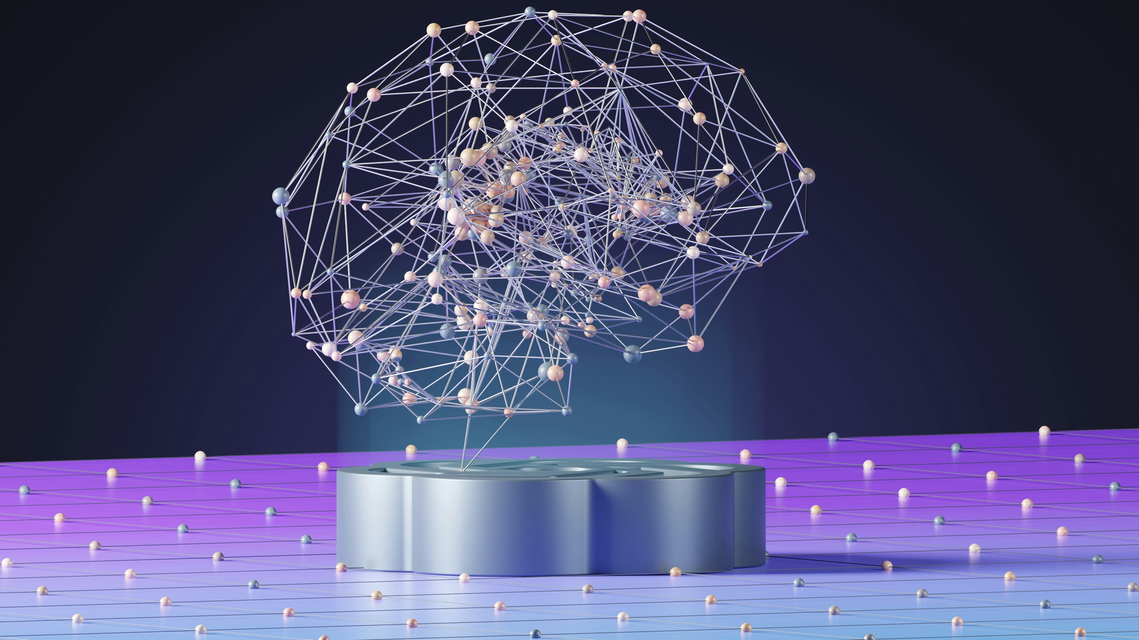
Challenges of Artificial Intelligence
While AI has numerous benefits, it also poses some challenges. One challenge is ensuring the ethical use of AI and addressing biases in algorithms.
Ethical considerations
Biases in algorithms
Infrastructure investment
Training required
The Power of Artificial Intelligence
5

Slide 6
The Future of Artificial Intelligence
What We Learned
Key Actions
What's Next
• Climate change solutions
• Poverty reduction
• Transforming industries
• New job creation
• Global impact
Thank you for your attention | Questions?

Slide 7
Presentation Flow
1
What is Artificial Intelligence?
• Machine learning enabled
• Computer systems mimicking human intelligence
• Pattern recognition capabilities
2
Applications of Artificial Intelligence
• Healthcare diagnosis
• Financial analysis
• Personalized education
3
Benefits of Artificial Intelligence
• Improved efficiency
• Increased accuracy
• Cost savings

Slide 8
Key Takeaways
1
What is Artificial Intelligence?
2
Applications of Artificial Intelligence
3
Benefits of Artificial Intelligence
4
Challenges of Artificial Intelligence
5
The Future of Artificial Intelligence

