Slide 1
Flight Information

Slide 2
Introduction
This presentation will cover the flight information details.
Flight Details
Boarding Pass
Flight Information
2

Slide 3
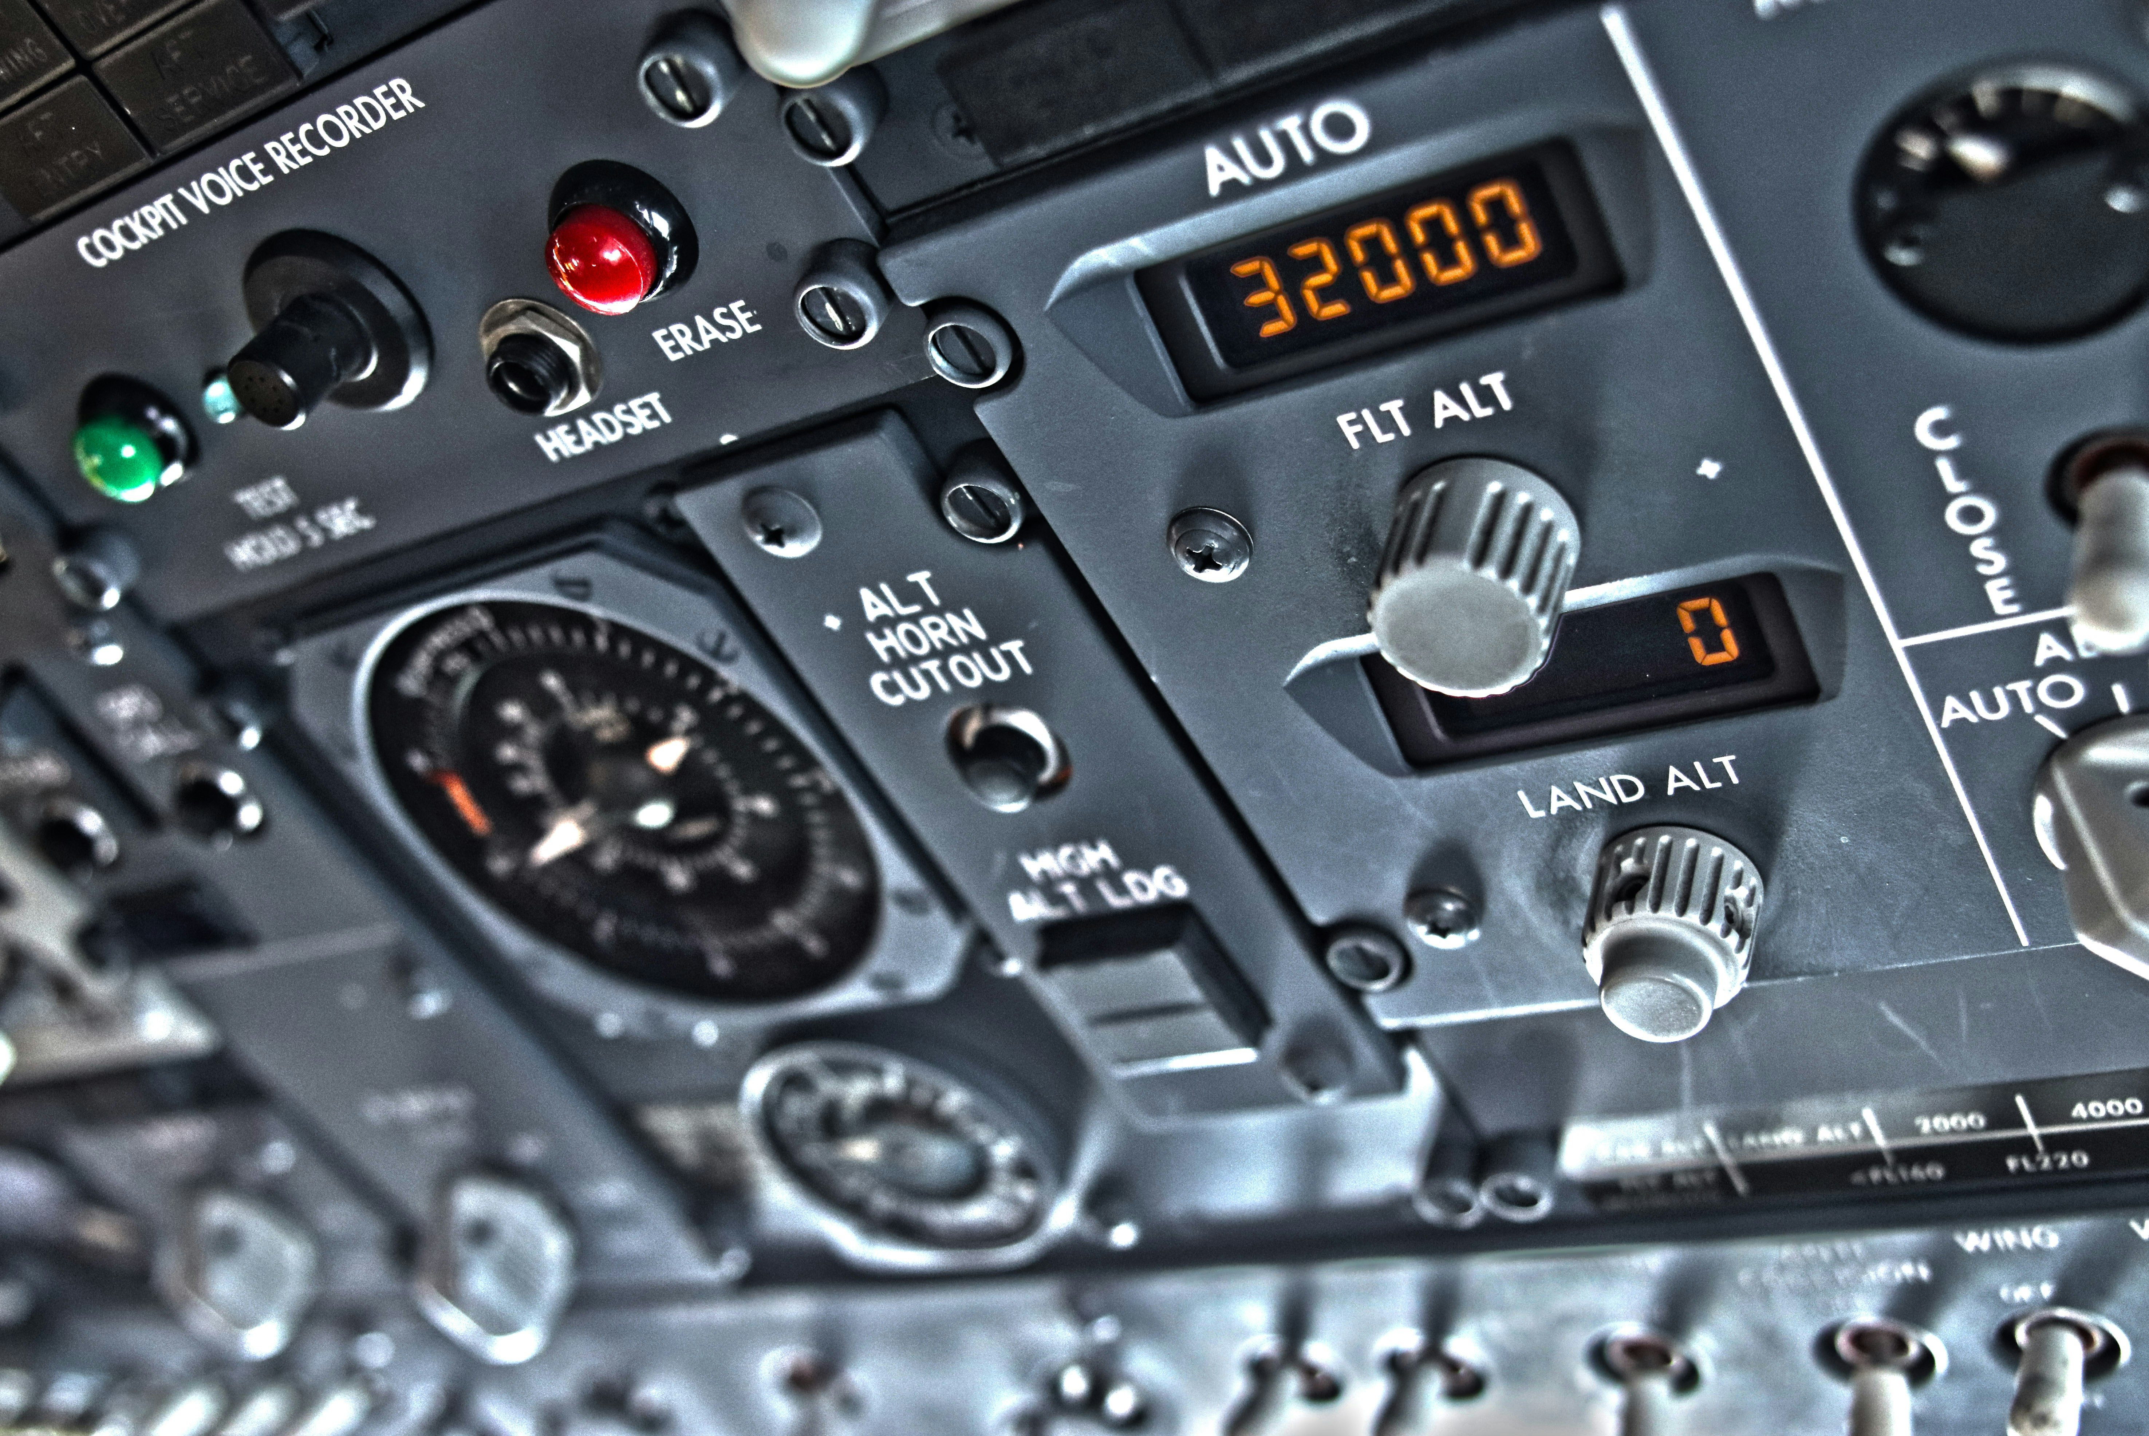
Flight Information
The flight is from Delhi (T1) to Kolkata, and it's operated by IndiGo.

Slide 4
Boarding Details
The boarding time is 15 hours, and the gate zone is 1.
Flight Information
4

Slide 5

Important Notes
Please note that the gate is subject to change, and it will close 25 minutes prior to departure.

Slide 6
Contact Information
For any queries or assistance, please visit the IndiGo website or contact their customer service.
Website: https://www.goindigo.in/checkin/print.html
Customer Service Contact
Flight Information
6

Slide 7
Presentation Flow
1
Introduction
• Flight Details
• Boarding Pass
2
Flight Information
• Flight Number: 6E 6415
• Departure Time: 16:00
• Date: 07 May 2026
3
Boarding Details
• Gate Zone: 1
• Boarding Time: 15 hours
• Seat Number: 37B

Slide 8
Key Takeaways
1
Introduction
2
Flight Information
3
Boarding Details
4
Important Notes
5
Contact Information

