Slide 1
BMW's Electric Vehicle Strategy

Slide 2
Introduction to BMW's EV Strategy
2013
BMW's first EV was i3 ()
BMW has been a pioneer in the electric vehicle (EV) market since its first introduction of the i3 in 2013. The company aims to have a significant presence in the growing EV market, with plans to expand its EV lineup and increase sales volume.
Significant investment in new tech
Expansion into growing market
Increased focus on sustainability
BMW's Electric Vehicle Strategy
2

Slide 3
Why Electric Vehicles for BMW?
As a premium automaker, BMW recognizes the importance of electric vehicles (EVs) in the future of transportation. EVs offer a unique combination of performance, efficiency, and sustainability that aligns with BMW's brand values.
Performance and efficiency
Sustainability and reduced emissions
Appealing to eco-conscious consumers
Competitive advantage in market
BMW's Electric Vehicle Strategy
3

Slide 4
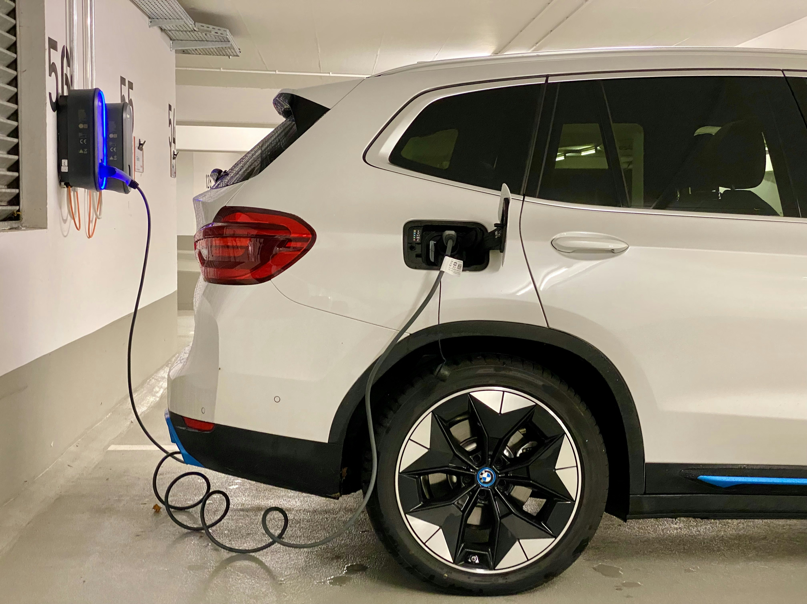
BMW's Electric Vehicle Portfolio
BMW currently offers a range of electric vehicles (EVs) across its various brands, including the i3 and X5 plug-in hybrids. The company is expanding its EV lineup with new models, such as the iX3 crossover and the i4 gran coupe.
i3 and X5 plug-in hybrids
New models: iX3 and i4
Battery-electric vehicles planned
Electric variants of existing models
BMW's Electric Vehicle Strategy
4

Slide 5
Charging Infrastructure for BMW's EVs
BMW recognizes the importance of charging infrastructure in supporting the adoption of electric vehicles. The company is investing in new charging technologies and partnering with charging networks to provide convenient and reliable charging solutions for its customers.
New charging technologies
Partnerships with charging networks
Convenient and reliable charging
Increased public charging points
BMW's Electric Vehicle Strategy
5

Slide 6
BMW's Charging Network: Ionity
Ionity is a high-power charging network that BMW has developed in partnership with other major automakers. The network provides fast and convenient charging for electric vehicles along highways and urban areas.
High-power charging
Partnership with other automakers
Fast and convenient charging
Expansion across Europe
BMW's Electric Vehicle Strategy
6

Slide 7
BMW's Electric Vehicle Strategy in China
China is a key market for BMW's electric vehicle strategy, with the company planning to introduce new EV models tailored to Chinese consumers. BMW is also investing in charging infrastructure and partnering with local companies to support the growth of its EV business.
New EV models for Chinese market
Tailored to local consumer needs
Increased investment in China
Partnerships with local companies
BMW's Electric Vehicle Strategy
7

Slide 8
The Future of BMW's Electric Vehicle Strategy
As the electric vehicle market continues to evolve, BMW is committed to staying ahead of the curve. The company plans to expand its EV lineup, improve charging infrastructure, and increase investment in new technologies to support the growth of its EV business.
Expansion of EV lineup
Improved charging infrastructure
Increased investment in new tech
Strategic partnerships and collaborations
BMW's Electric Vehicle Strategy
8

Slide 9
Conclusion: BMW's Electric Vehicle Strategy
What We Learned
Key Actions
What's Next
• Key takeaways from presentation
• BMW's competitive advantages
• Future outlook for EV market
• Conclusion and final thoughts
• Call to action
Thank you for your attention | Questions?

Slide 10
Presentation Flow
1
Introduction to BMW's EV Strategy
• BMW's first EV was i3 (2013)
• Significant investment in new tech
• Expansion into growing market
2
Why Electric Vehicles for BMW?
• Performance and efficiency
• Sustainability and reduced emissions
• Appealing to eco-conscious consumers
3
BMW's Electric Vehicle Portfolio
• i3 and X5 plug-in hybrids
• New models: iX3 and i4
• Battery-electric vehicles planned

Slide 11
Key Takeaways
1
Introduction to BMW's EV Strategy
2
Why Electric Vehicles for BMW?
3
BMW's Electric Vehicle Portfolio
4
Charging Infrastructure for BMW's EVs
5
BMW's Charging Network: Ionity

