Slide 1
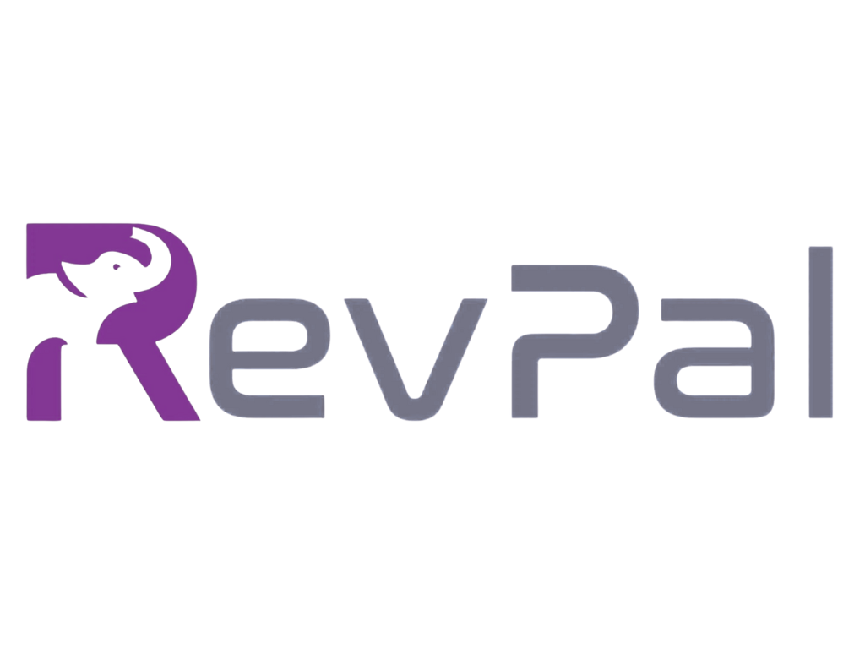
RevPal Master Template
Programmatic Style
OpsPal by RevPal
Notes:
Organization: RevPal

Slide 2
Overview

Slide 3
Executive Summary
Pipeline quality must catch up to volume.
• Revenue momentum is strong, but pipeline quality is uneven
• Automate lead routing to reduce response time and drop-off
• Focus Q2 on activation, retention,
• expansion levers
OpsPal by RevPal

Slide 4
Executive Summary
• Align cross-team metrics to remove reporting friction
OpsPal by RevPal

Slide 5
Narrative Insight
More volume, lower yield, rising response time.
• Pipeline growth outpaced conversion, creating volume without enough yield
• Response times rose as routing rules expanded across tools
OpsPal by RevPal

Slide 6
Narrative Insight
• Teams need a single source of truth for stage definitions and SLAs
OpsPal by RevPal

Slide 7
Strategy Statement
One workflow will increase speed and trust.
• Consolidate routing logic into one workflow to improve speed
• data trust
OpsPal by RevPal

Slide 8
Why RevPal
• 1 | Nail the basics: clean data, clear ownership
• 2 | Sync up, level up: shared definitions and SLAs
• 3 | Master the pipeline: faster routing, higher conversion
OpsPal by RevPal

Slide 9
KPI Snapshot
+18%
112%
QoQ Revenue Growth
Net Revenue Retention
8 months
3.2x
CAC Payback
Pipeline Coverage
OpsPal by RevPal

Slide 10
Chart Style Demos

Slide 11
Conversion Trend Line Chart
27%
24%
21%
18%
Q1
Q2
Q3
Q4
OpsPal by RevPal

Slide 12
Revenue by Segment Horizontal Chart
Enterprise
6.2
Mid-Market
3.8
SMB
1.4
Expansion
2.1
OpsPal by RevPal

Slide 13
Latest Quarter Highlight Chart
14.5
16.8
19.2
23.4
Q1
Q2
Q3
Q4
OpsPal by RevPal

Slide 14
Conversion Trend Chart With Insights
18%
21%
24%
27%
Q1
Q2
Q3
Q4
OpsPal by RevPal

Slide 15
Conversion Trend Chart With Insights
• Conversion improved each quarter as routing rules were simplified
• Q4 gain was driven by faster SLA adherence
• Enablement lifted mid-market response rates
OpsPal by RevPal

Slide 16
Diagram & Timeline

Slide 17
Routing Workflow Diagram
1
2
3
4
5
Request
Intake
Validate Fields
Route to Owner
Notify Stakeholders
Log
Outcome
OpsPal by RevPal
Notes:
Mermaid rendering unavailable; using process fallback.

Slide 18
Implementation Timeline
Full
deployment
Optimize
playbooks
Scale
and iterate
Pilot rollout
OpsPal by RevPal

Slide 19
Evidence & Quotes

Slide 20
Evidence Signal
External benchmarks confirm the lift.
• Pipeline response time improved 32% after routing cleanup
• Data-driven teams are 19x more likely to be profitable
Sources: Gartner 2023; McKinsey 2021
OpsPal by RevPal
Notes:
Sources: Gartner 2023; McKinsey 2021

Slide 21
Stakeholder Voice
"Clean routing rules cut our response time in half and restored trust in the data."
- RevOps Director
Sources: Customer Study 2024
OpsPal by RevPal
Notes:
Sources: Customer Study 2024

Slide 22
Glossary
Define the key terms once.
• SLA: Response time commitment for inbound requests
• NRR: Net Revenue Retention for existing customers
• CAC: Customer Acquisition Cost
OpsPal by RevPal

