Slide 1
ICP FINAL ASSIGNMENT
CLOSEST PAIR
Reva Laxmi Chauhan

Slide 2

Stars in the sky
Looking up at the sky at Times Square or downtown Tokyo, we would find the closest pair of stars quite easily, because you can see only a few stars there.
We can clearly see the difference in the distance of the stars so we would visually notice which star is closer or farthest from another.

Slide 3

More stars in the sky
If you are in the middle of nowhere, the infinite number of stars in the dark night sky would make it impossible to determine the pair.
Millions of tiny stars in the sky VS us trying to determine which ones are closest to another. If we were to sit down and stare all the task would be extremely difficult if not impossible.

Slide 4
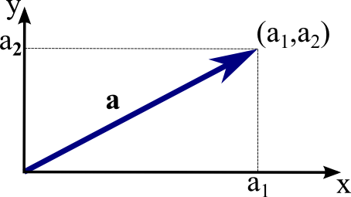
Computers and stars
It is no different for computers.
When they determine the closest pairs of points on a plane, the more points the dataset has, the longer it takes for algorithms to find the couple with the least distance.
So we have to make an algorithm that we find most efficient to compute the shortest distance between numerous points on a 2D plane

Slide 5
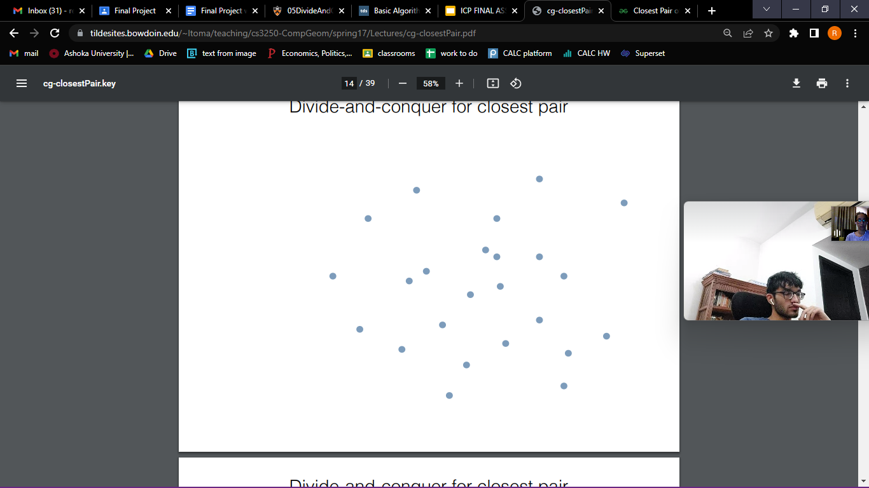
The question
Given a set of points in a plane, p = {(x₀.y₀), (x₁,y₁),.....,(x_{n-1},y_{n-1})}, consider the problem of determining the closest pair of points: i.e., pairs p_{i} = (x_{i},y_{i}) and p_{j} = (x_{j},y_{j}) such that the distance between them d_{ij} = [√(x_{i}-x_{j})² + (y_{i}-y_{j})²] is minimized.

Slide 6
Find a value x such that half the points have x_{i} <= x and half have x_{i} > x (roughly; you may partition about the median on their x coordinates to do this). On this basis split into two groups L and R.
Find the middle point in the sorted array, we can take P[n/2] as the middle point.
Divide the given array in two halves. The first subarray contains points from P[0] to P[n/2]. The second subarray contains points from P[n/2+1] to P[n-1].

Slide 7
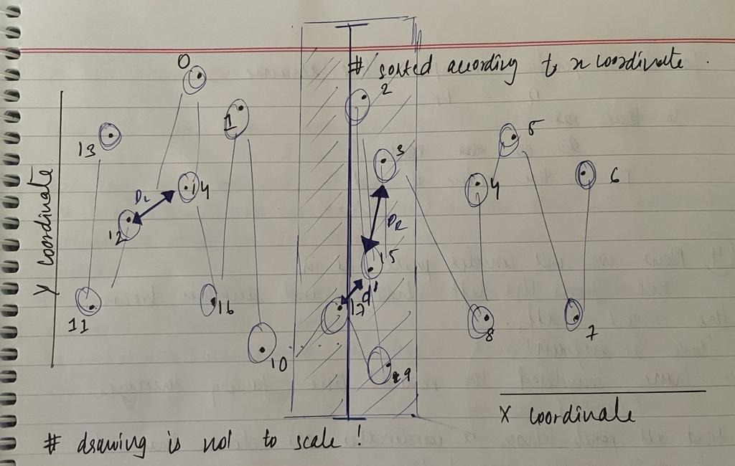
Splitting into two groups.
The x axis and Y axis denotes the 2D plane. Since its a 2D plane we know that there will be a set of points in the plane.
Looking at the diagram take the dots which have been circled and numbered from 1 to 17 to be the stars in the night sky.
So in an array those points are
P[ ] = {1,2,3,4,5,6,7,8,9,10,11,12,13,14,15,16,17}
“Note that in our code we sort the array according to the x coordinates :
(x,y)
So in the next slide we will see the order of P[ ] according to the x axis

Slide 8
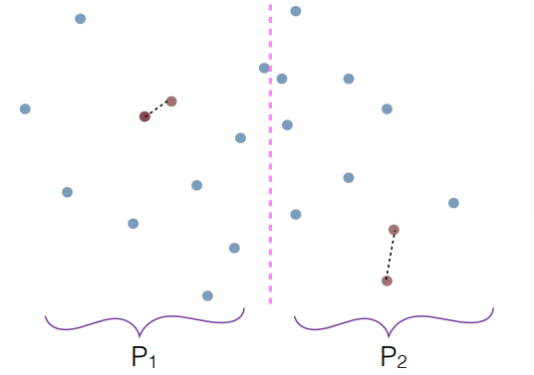

Slide 9
Splitting into two groups : Mid point
Now sorting P[ ] according to the x axis we get
P[ ]= {13,11,12,0,14,16,1,10,17,9,2,15,3,8,4,5,7,6}
The middle point is P[n/2] = P[9] = 17
I’ve highlighted the specific parts of the code related to each slide
mid = n // 2
midPoint = P[mid]

Slide 10
THE TWO halves: Pl & Pr
From here we divide the array into 2 halves. Pl and Pr.
We find that on the left side
Pl[ ]= {13,11,12,0,14,16,1,10,17}
And on the right side
Pr[ ]= {9,2,15,3,8,4,5,7,6}
#keep a copy of left and right subarrays/ sections that #we've made
Pl = P[:mid]
Pr = P[mid:]

Slide 11
Recursively compute the closest pair in L and in R. Let these pairs be p_{L}, q L ∈ L and p_{R}, q_{R} ∈ R, with distances d_{L} and d_{R} respectively. Let the smaller of these two distances be d.
Recursively find the smallest distances in both subarrays. Let the distances be dl and dr. Find the minimum of dl and dr. Let the minimum be d.

Slide 12
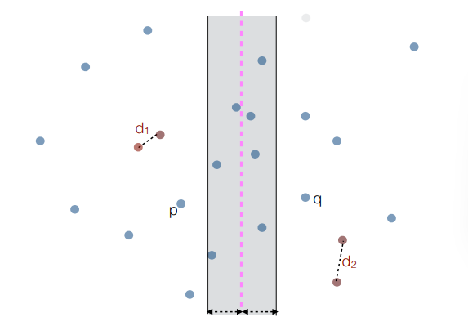

Slide 13
Distances Dl & Dr
# dist function to find the distance between two points
def dist(p1, p2):
return ((p1.x - p2.x) * (p1.x - p2.x) +(p1.y - p2.y) * (p1.y - p2.y))**0.5
# assert: A Brute Force method to return the smallest distance between two points in P[] of size n
def bf(P, n):
min_val = float('inf')
for i in range(n):
for j in range(i + 1, n):
if dist(P[i], P[j]) < min_val:
min_val = dist(P[i], P[j])
return min_val
#continued on next slide
Let the distances be Dl and Dr.
From here we will recursively find the smallest distances in both of the subarrays .
Then we will find the minimum of Dl and Dr.
So that way we’ve found the distance between the closest pairs of points in both halves separately.

Slide 14
# INV: A recursive function to find the smallest distance. The array P contains all points sorted according to x coordinate
def closestUtil(P, Q, n):
# assert: If there are 2 or 3 points, then use brute force
if n <= 3:
return bf(P, n)
# Find the middle point
mid = n // 2
midPoint = P[mid]
#keep a copy of left and right subarrays/ sections that we've made
Pl = P[:mid]
Pr = P[mid:]
# Consider the vertical line passing through the middle point calculate smallest distance dl and dr
dl = closestUtil(Pl, Q, mid)
dr = closestUtil(Pr, Q, n - mid)
# Find the smaller of two distances
d = min(dl, dr)
# assert: Build an array strip[] that contains points close (closer than d) to the line passing through the middle point
stripP = []
stripQ = []
lr = Pl + Pr
for i in range(n):
if abs(lr[i].x - midPoint.x) < d:
stripP.append(lr[i])
if abs(Q[i].x - midPoint.x) < d:
stripQ.append(Q[i])
stripP.sort(key = lambda point: point.y)
min_a = min(d, stripClosest(stripP, len(stripP), d))
min_b = min(d, stripClosest(stripQ, len(stripQ), d))
# Return the minimum of d and self.closest distance is strip[]
return min(min_a,min_b)

Slide 15
It remains to be seen if there is a point in L and a point in R that are less than d distance apart from each other.
To this end, discard all points with x_{i} < x − d and x_{i} > x + d and sort the remaining points in the central band of width 2d by their y coordinates.
From the above 3 steps, we have an upper bound d of minimum distance. Now we need to consider the pairs such that one point in pair is from the left half and the other is from the right half. Consider the vertical line passing through P[n/2] and find all points whose x coordinate is closer than d to the middle vertical line. Build an array strip[] of all such points.
Now, go through this sorted list, and for each point, compare its distance to the seven subsequent points in the list (why?). Let p_{M}, q_{M} be the closest pair found this way.
Find the smallest distance in strip[]. It can be proved geometrically that for every point in the strip, we only need to check at most 7 points after it (note that strip is sorted according to Y coordinate).

Slide 16
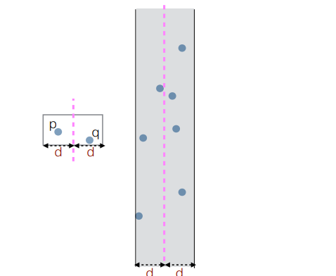
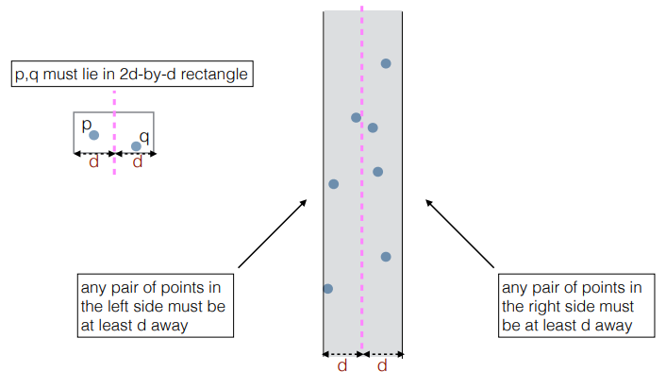

Slide 17
We sort this new array strip according to the y coordinates, Since it’s the y axis basically at least here you can visualize the order to be top to bottom.
So,
strip[] = {2,3,15,17,9}
The distances in strip[] to clarify, are the coordinates with a distance lesser than d, or “closer to d”, as other distances would be greater than d.
So in this very specific example we get the shortest distance in strip to be
d’ = distance between 15 and 17.
We create strip[ ] which has all the points whose x coordinates are closer than d to the middle vertical line and the two additional lines drawn on the right and left sides.
The array strip thus holds the values
strip[] ={17,9,2,15,3}

Slide 18
Final step
Our final step now would be to calculate the minimum distance between d and d’.
Where d is the distance between 15 and 17 and d’ is the distance between 12 and 14 (D_{L} as show in diagram)

Slide 19
The above algorithm divides all points in two sets and recursively calls for two sets. 2T(n/2)
+
After dividing, it finds the strip in O(n) time.
+
sorts the strip in O(nLogn) time. (Merge sort algorithm)
+
and finally finds the closest points in strip in O(n) time.
So we have T(n) to be O(n(logn)²)
HOW EFFICIENT IS THE ALGORITHM?

Slide 20
As it was mentioned on Google Classroom
Note on Plagiarism
Note that this is a Computer Science course and you are allowed (even expected to, at times) to consult the internet. You are allowed to refer to solutions you find online to inspire your own solutions. However, it is NOT OKAY to refer to these sources without citations. To reiterate, we will not flag you for plagiarism if your responses have citations regarding where you got external help. At ICP and at Ashoka as a whole, there is very low tolerance for Academic Dishonesty.
I am adding all the links I referred to that helped with my understanding and solving of the question.
(Hyperlinked)
Divide and Conquer: Princeton
Towards Data Science: Algorithms
Finding the closest pair
GFG Algorithms and Time Complexity

