Slide 1
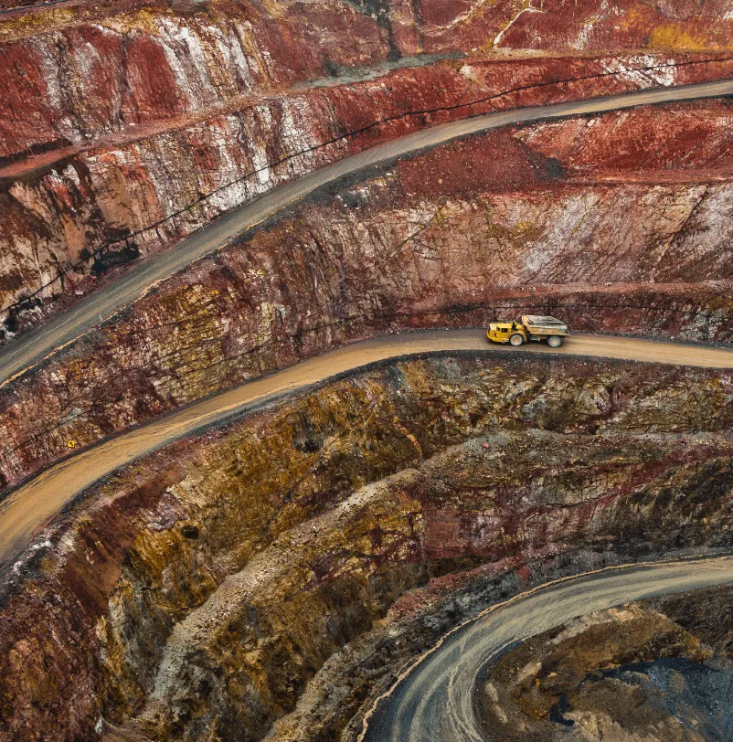
MineOps 360
Learning operational movement, dispatch logic and production execution thinking
Professional learning course
Mining movement simulation
Built to think beyond “what should be mined” — into “can the operation execute it?”
0 → system
started without field exposure
MineOps
execution learning layer
CAPEX lens
fleet stress-testing
Notes:
Introduce MineOps 360 as a learning project, not as a commercial product. The objective is professional acknowledgement: building an operational simulator to understand how mining movement, dispatch, disruptions, bottlenecks, road networks and fleet capacity interact.

Slide 2
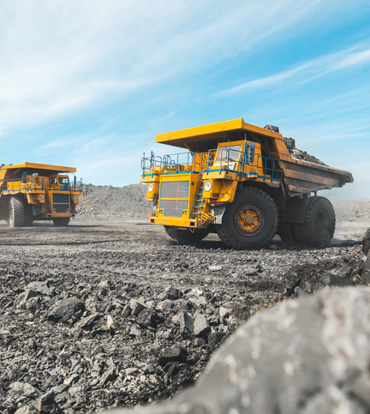
Learning journey
Why I built MineOps 360
I wanted a way to learn how real mining movement might be controlled — from plan to execution.
Started with no direct mine-dispatch or field-operation exposure.
Used assumptions, research and repeated critical thinking to build operational logic.
Goal: learn high-level role knowledge by building the decision environment, not just reading terms.
01 Learning mindset
Every new feature was added after asking: what would real production care about?
02 Capability signal
Fast learning, system thinking and practical translation of unfamiliar domain concepts.
Notes:
This slide frames the project as a learning method. It is important to say that the system is assumption-based because I am still seeking real mining exposure. The value is in how quickly the concepts were learned and translated into structured simulation logic.

Slide 3
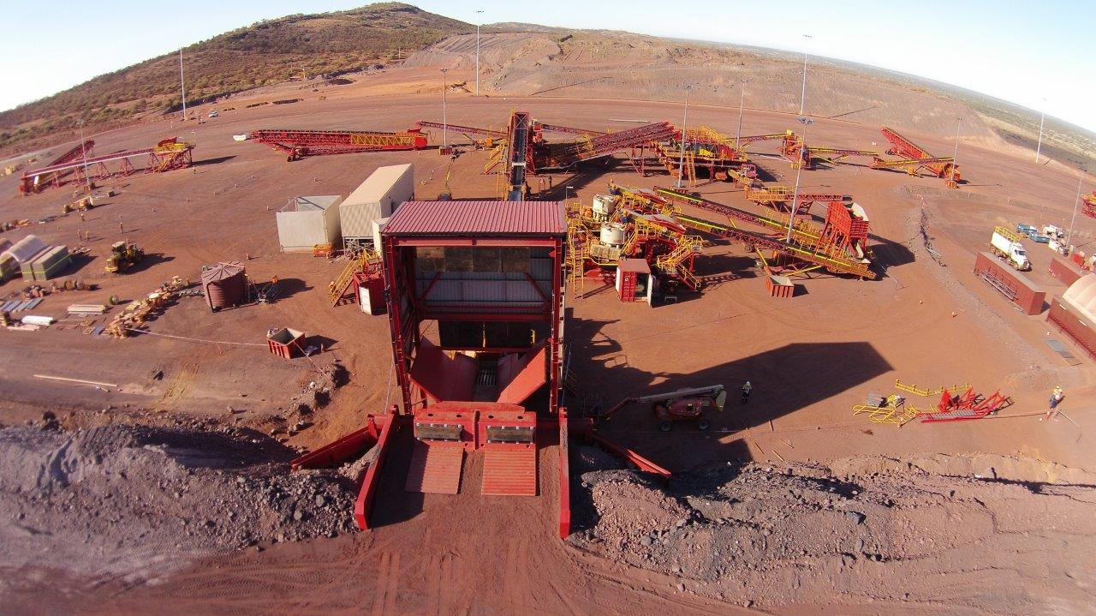
System boundary
Where MineOps fits in the mine-planning learning stack
MineValue 360
Block value • schedule • stockpile
MineOps 360
Movement • dispatch • execution
BlendFeed 360
Chemistry recipes • HPAL/RKEF
MINEOPS ROLE
Transforms MineValue’s planned faces, roads, trucks and stockpile flows into executable movement logic.
Simulates shovel loading, truck cycles, destination service time and routing performance.
Shows whether a plan is only theoretically good or operationally executable under stress.
Core question
Can the planned tonnes move through the network, with the available fleet, under imperfect conditions?
Notes:
Explain the system boundary. MineValue decides what is valuable and planned. MineOps asks whether that plan can physically be executed by fleet, roads, loading points and destinations.

Slide 4
Capabilities
What MineOps 360 does
1. Import plan authority
Loads MineValue bridge: faces, roads, trucks, stockpile/reclaim jobs and period plan.
2. Simulate movement
Runs truck cycles from parking → face/stockpile → crusher/dump → next dispatch.
3. Measure execution
Tracks attainment, tonnes moved, bottlenecks, route usage and operational exceptions.
4. Stress test decisions
Tests disruptions, truck breakdowns, road closures and plan recovery actions.
INPUT → LOGIC → OUTPUT
Plan
faces • tonnes • value
Fleet
trucks • payload • availability
Network
roads • grade • speed
Simulation
cycles • queues • routes
KPI
attainment • value • risk
Attainment planned vs moved tonnes
Value movement ore
Bottlenecks:
truck/shovel/road/destination
Recovery response to disruptions
Notes:
Summarize the capability in a simple course-like way. The key is that MineOps is an execution simulator. It lets me test whether the plan can move through the haulage system and what constraints appear during the shift.

Slide 5
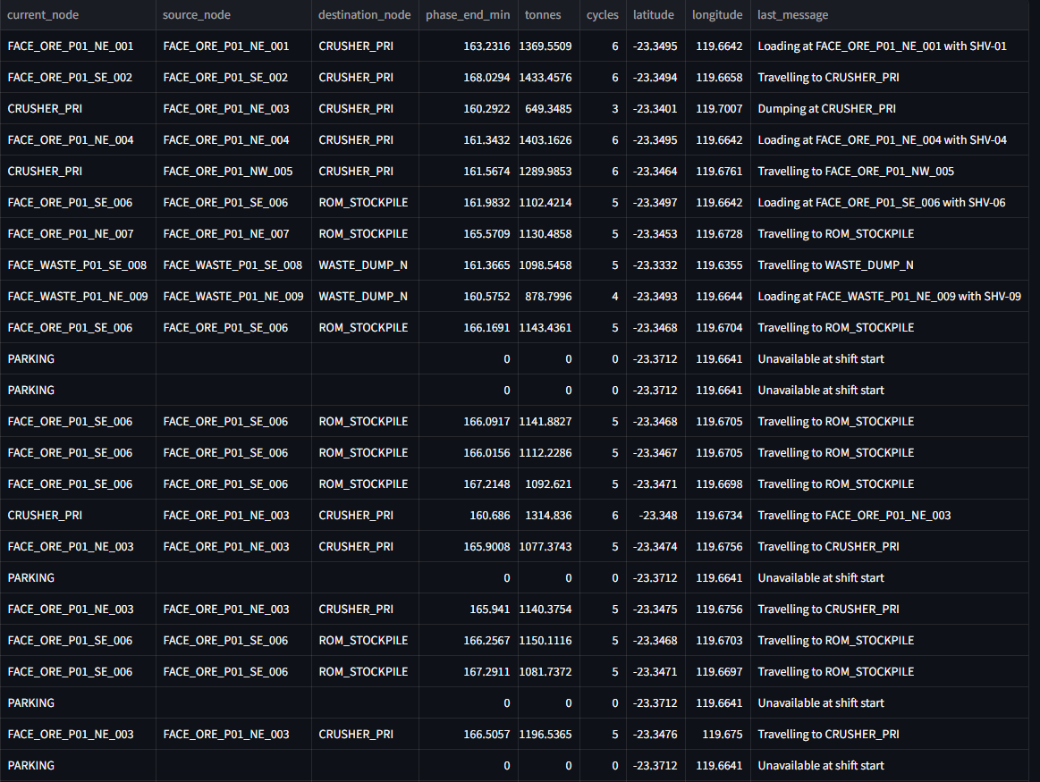
Operational thinking
Learning mine movement as a physical system
PARKING
truck dispatch
FACE / STOCKPILE
load material
HAUL ROAD
travel under grade/speed
DESTINATION
crusher • stockpile • dump
NEXT JOB
reassign or repeat
CYCLE-TIME EQUATION IN PLAIN LOGIC
PROFESSIONAL LEARNING POINT
Travel time
distance ÷ speed, adjusted by road grade and disruption factors
Movement is not only a tonnes target — it is a constrained flow through physical assets.
A good plan can fail if roads, loaders, destinations or truck availability cannot execute it.
Load + dump/service
shovel loading time + crusher/dump/stockpile service time
Productive output
payload × completed cycles × availability
Notes:
Use this slide to explain how MineOps helped translate abstract production targets into physical truck cycles. The main mental model is that tonnes move through a network and every node/road can become a constraint.

Slide 6
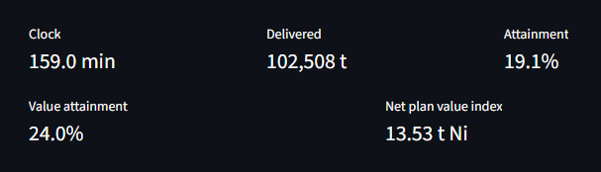
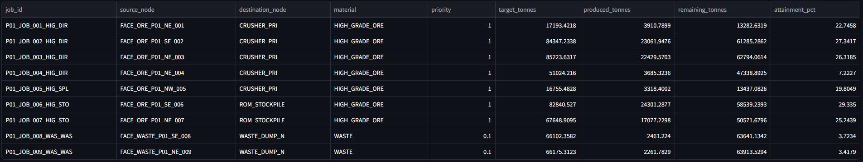
Operational KPI logic
Beyond hitting tonnes: value-aware movement
A high attainment score can be misleading if the movement is waste-heavy and the plant is not protected with ready ore.
WHAT I ADDED TO THE THINKING
Movement target: did trucks move enough tonnes?
Material target: was it ore, waste, reclaim or stockpile build?
Value target: did movement improve plant feed readiness and economic priority?
Stockpile target: is ROM stockpile ready to feed the plant when current mining is disrupted?
Waste-heavy risk
90% movement attainment can still be weak if the plant has insufficient ore feed.
Operational value
MineOps links tonnes moved with material class, grade/value and destination intent.
Notes:
This is a key professional insight: hitting tonnes is not enough. The system should distinguish between waste movement, ore movement, stockpile build and reclaim because they have different operational value.

Slide 7
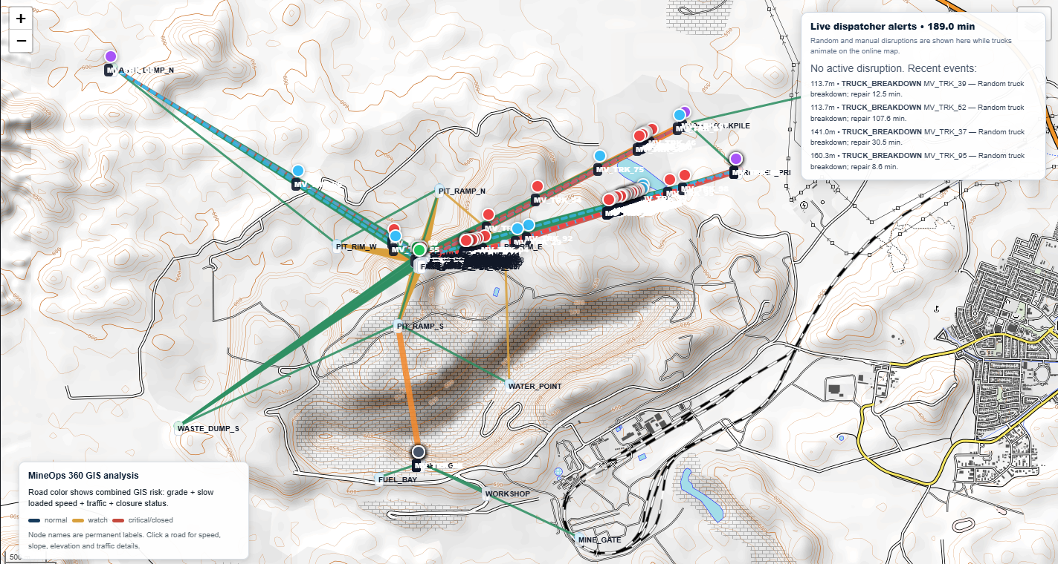
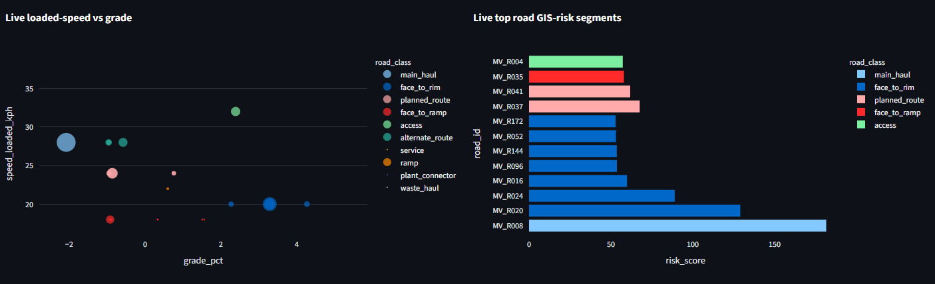
Haul-road exposure
Road grade: why route design changes output
WHAT THE PROJECT TAUGHT ME
Road grade changes loaded speed, empty return speed, cycle time and fuel pressure.
A short route is not always the best route if grade or closure risk creates delays.
Risk is not only safety — it can also be production volatility, queue exposure and recovery difficulty.
SIMPLIFIED IMPACT CHAIN
Higher grade
Lower speed
Longer cycle
More queues
Lower tph
More trucks?
Notes:
Explain that MineOps helped me think about road design and route risk. Road grade does not just make a nice map attribute; it directly affects truck speed, cycle time, throughput and fleet requirements.

Slide 8
Diagnostics
Bottleneck risk: where the plan loses throughput
Truck bottleneck
Not enough available payload/cycles to meet jobs within shift time.
Shovel bottleneck
Loading time, availability or assignment limits reduce completed cycles.
Road bottleneck
Grade, closure, speed or congestion creates network delays.
Destination bottleneck
Crusher, dump or stockpile service time limits truck unloading.
HOW I LEARNED TO READ RESULTS
DASHBOARD LOGIC
If every truck is busy but target is missed → fleet or route capacity problem.
If trucks are queuing at loading → shovel loading bottleneck.
If trucks are queuing at crusher/dump → destination service bottleneck.
If target misses only during disruptions → resilience and contingency planning problem.
Utilization
asset working intensity
Queue time
lost time at nodes
Attainment
job completion vs target
Risk
road + disruption exposure
Value moved
ore/value priority delivered
Actions
reassign / reroute / recover
Notes:
The purpose of this slide is to show that MineOps is not only a truck simulator. It is a way to learn operational diagnostics: where the bottleneck is and what kind of management response might be needed.

Slide 9
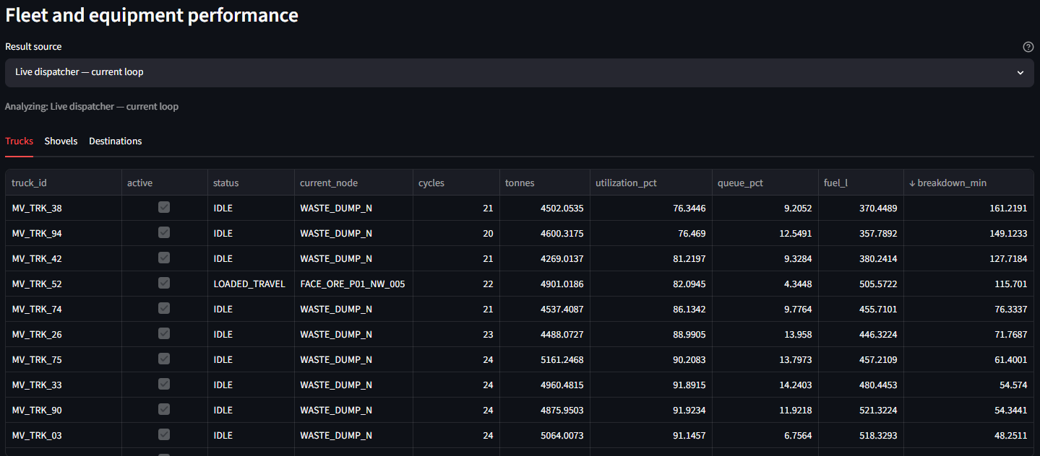
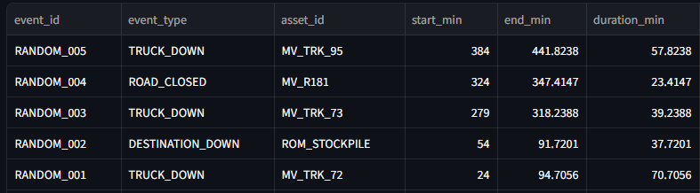
Stress testing
Unexpected events: learning operational resilience
SIMULATED DISRUPTION SCENARIOS
Truck down
A truck becomes unavailable; dispatch must recover with remaining fleet.
Road closed
Route must shift to an alternate path; cycle time and risk change.
Crusher/service delay
Destination queue grows and trucks may need different assignments.
Weather slowdown
Road speed factor falls; shift plan may no longer be feasible.
PROFESSIONAL LEARNING POINT
A plan should not only pass under ideal conditions.
Resilience is measured by how quickly the dispatcher can protect critical jobs after disruption.
MineOps helps compare planned target vs stressed execution, not just normal-case output.
Notes:
Explain the difference between static planning and live operational thinking. MineOps simulates disruptions so I can learn how production systems behave when reality is not perfect.

Slide 10
Thinking like a dispatcher
Live manual dispatcher loop
The live loop was built to learn how a dispatcher might monitor, pause, reassign and recover the shift.
MONITOR
truck status • job attainment
PAUSE
when event or gap appears
REASSIGN
truck/job/route decision
PLAY
continue simulation
LEARN
KPI impact
EXAMPLE DECISION LOGIC
If Truck 07 is down, reassign Truck 03 from a near-complete job to a lagging high-priority ore job.
If one destination is congested, reroute lower-priority movement to stockpile/dump where appropriate.
If a job’s attainment is far below target, increase available fleet allocation before the end of shift.
Learning outcome
Manual loop turns the system into a practice environment for operational judgment, not only a static calculation.
Notes:
This slide is very important: the live manual loop is the part that lets me think like a dispatcher. It is not only about automation; it is a learning environment for making decisions when production conditions change.

Slide 11
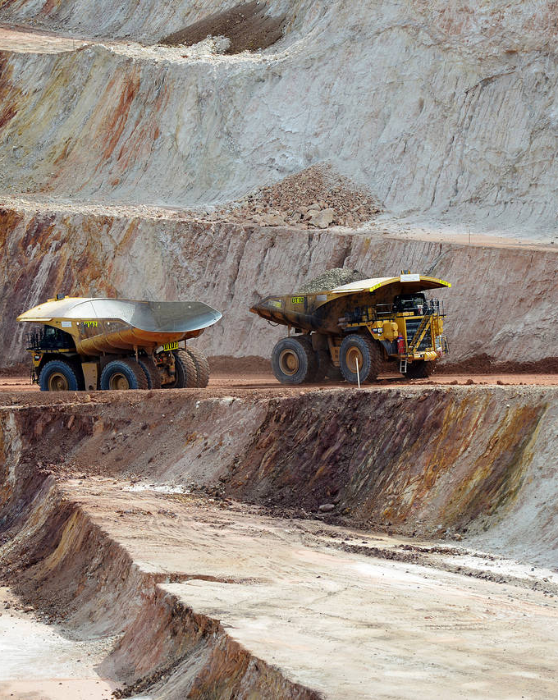
Strategic interpretation
From simulation results to CAPEX thinking
A dispatcher simulation can become a practical lens for fleet-sizing and CAPEX trade-off thinking.
EXAMPLE INTERPRETATION
Stress-test result
Highest-tonnage period can be completed by 80 trucks in 15 hours despite disruption.
Option 1
Reduce truck count, accept longer process time, potentially reduce CAPEX.
Option 2
Increase fleet or redundancy, shorten recovery time, improve production reliability.
Management question
Which trade-off creates the best balance between CAPEX, production assurance and risk?
Fleet size
CAPEX lever
Shift hours
time lever
Resilience
risk lever
Notes:
This slide links technical simulation to higher-level business thinking. The point is not that the numbers are final engineering advice, but that the system helped me understand how dispatch simulation can inform fleet-sizing and CAPEX discussion.

Slide 12
Professional acknowledgement
What this project helped me learn
Movement execution
Truck cycles, payload, shift time, route logic and destination service constraints.
Operational uncertainty
Breakdowns, road closure, weather slowdown, queue formation and recovery actions.
Dispatch management
Manual reassignment, live loop monitoring and protecting lagging priority jobs.
Value-aware movement
Ore vs waste, stockpile readiness, plant-feed protection and value-weighted attainment.
MINE PLANNING PROJECT ROADMAP
MineValue 360
block value & schedule
MineOps 360
movement & dispatch
BlendFeed 360
chemistry recipe
…..
Coming Soon.
MineOps 360 is not a claim of operational expertise — it is proof of serious learning, structured curiosity and execution discipline.
Notes:
Close by positioning MineOps 360 as a professional learning artifact. Emphasize humility: the system is assumption-based and built for learning. It shows fast learning, creative thinking and critical thinking in an unfamiliar domain.

