Slide 1
CSCI 205 Team 8 Final Project
Tsugunobu Miyake, Doruk Ozar, Reva Sharma, and Kit Jackson
Notes:
Kit

Slide 2
Team Members and Roles:
Team Members: Tsugunobu Miyake, Doruk Ozar, Reva Sharma, and Kit Jackson
Majors: We’re all Computer Science & Engineering majors!
SCRUM Master: Tsugunobu Miyake
Product Owner: Kit Jackson
Developers: Doruk Ozar, Reva Sharma
Notes:
SCRUM Master - Tsugu (Sophomore) - roles included creating tasks and divvying up assignments on AIECode to different group members.
The Product Owner was Kit (Junior) - roles included communicating with our client Brandon Burkett about any progress we were making and any issues that arose from week-to-week.
Finally, me (Reva) and Doruk were lead developers in this project and our job was mainly focussed on spearheading the design and implementation of the classes.

Slide 3
User Interface & Design: Doruk and Tsugunobu mostly worked on the User Interface and Design.
Game logic: Reva and Kit mostly worked on the game logic and backend development of the project.
We all worked together on connecting the 2 and writing up the documentation
Notes:
Kit

Slide 4
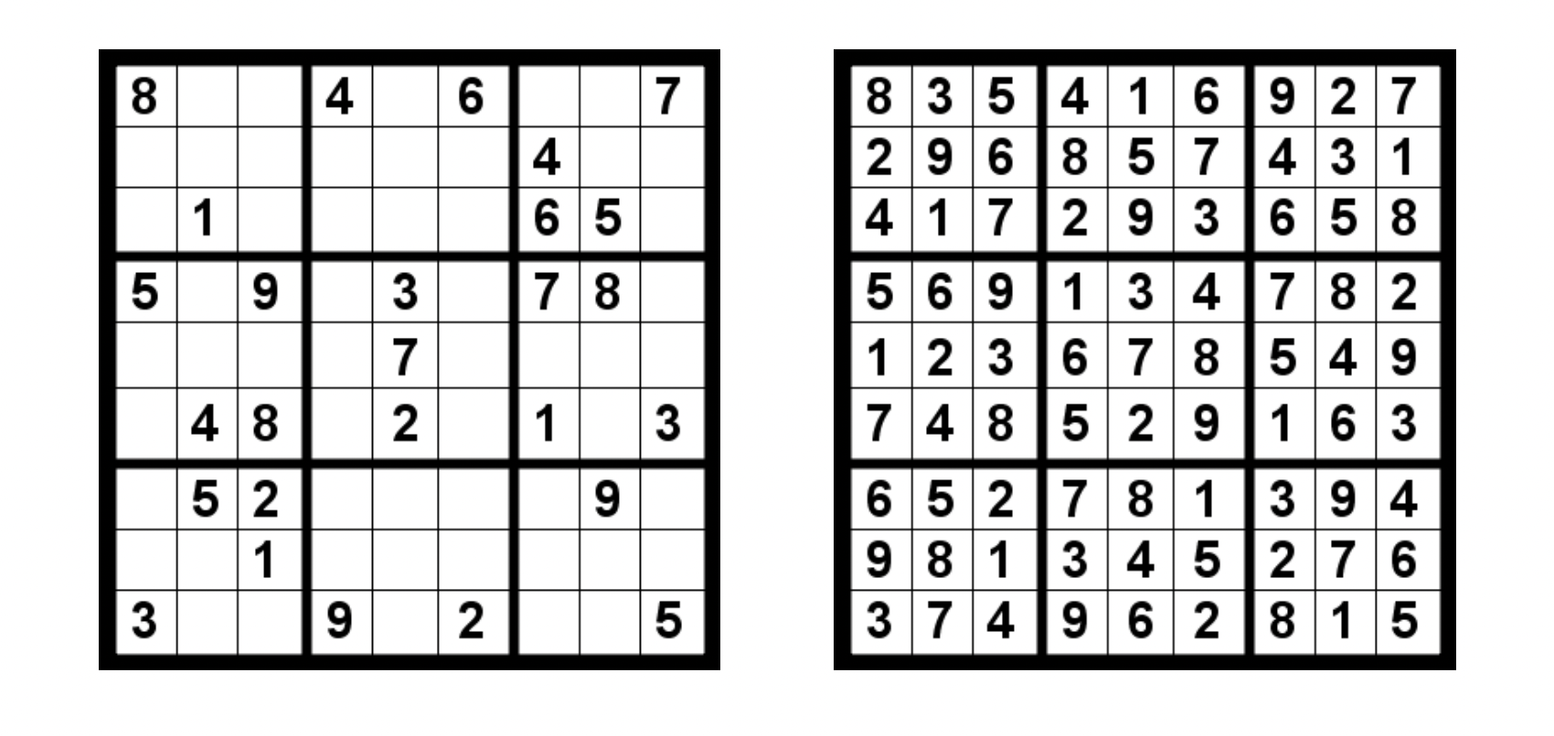
Background/Motivation:
Always knew we wanted to build a game
Selected Sudoku as after research we realized that rules are complex but not too difficult
Popular game so there is a demand for it
This particular implementation would make apt use of our teams’ strengths
Notes:
Reva

Slide 5
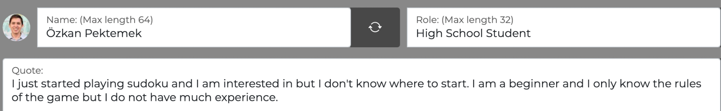
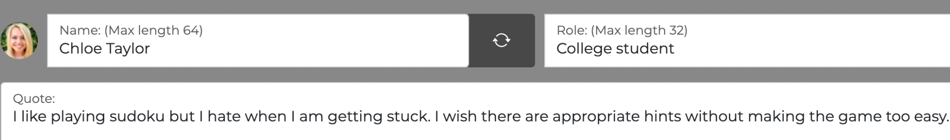
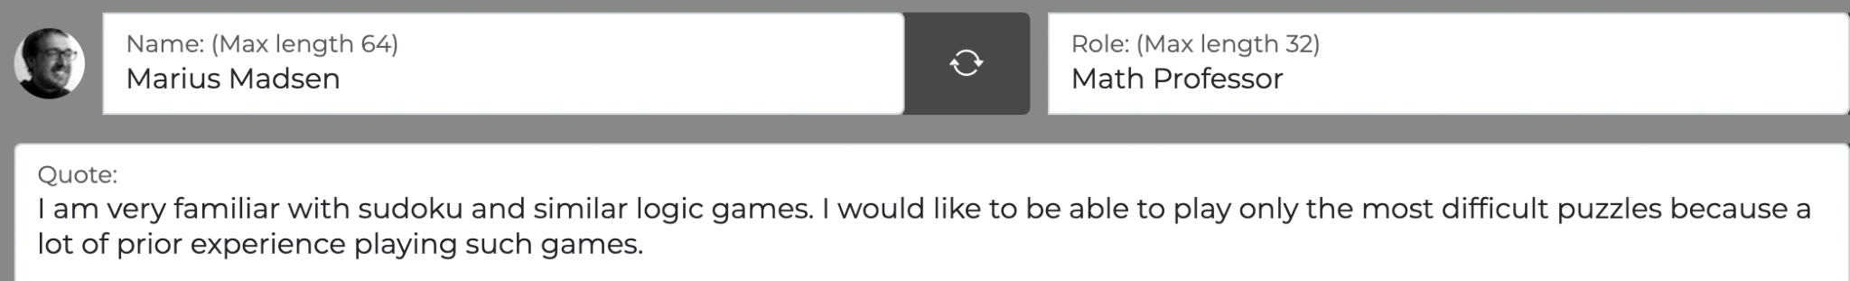
Özkan Pektemek: (Complete)
Chloe Taylor: (Complete)
Marius Madsen: (Incomplete)
Notes:
Reva

Slide 6
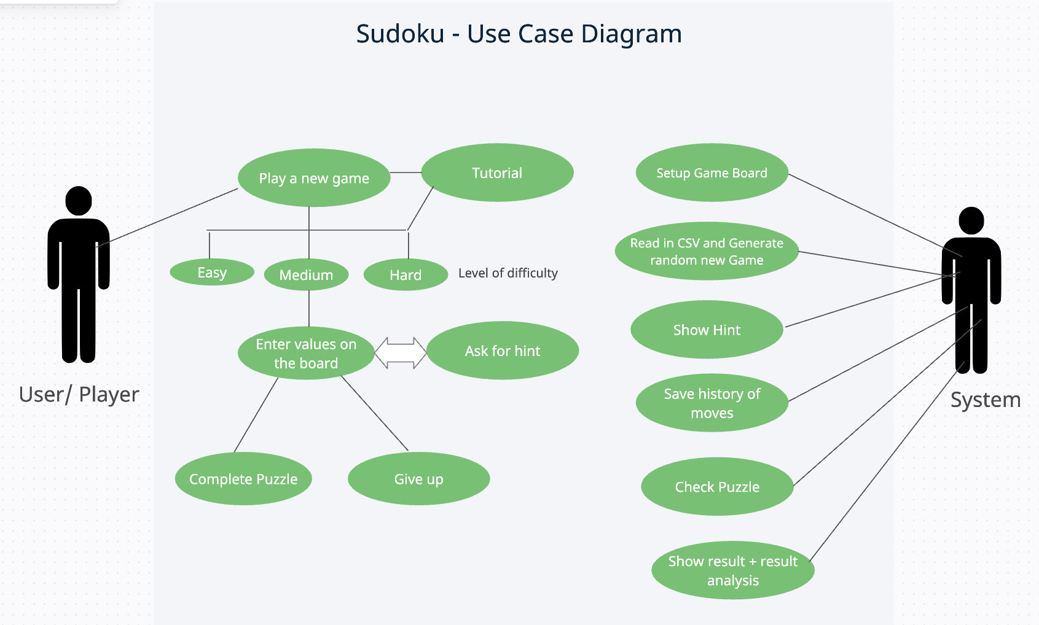
Notes:
Reva

Slide 7
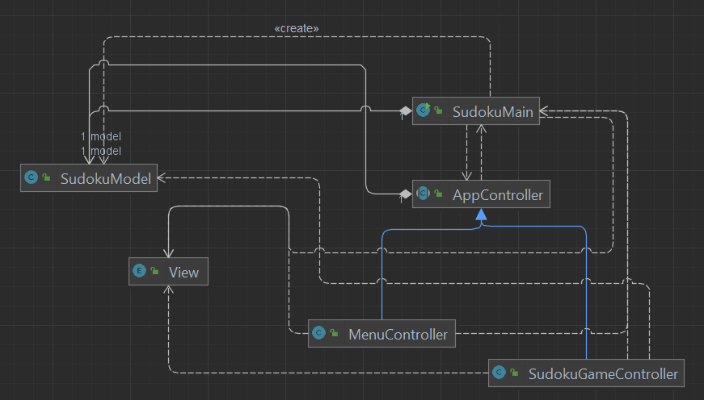
Discuss your design
Notes:
What important objects in your project were being encapsulated, and what did your class abstractions look like for those objects? Present only significant, important parts of your UML class diagram, and only show the box with class names and important relationships. Make sure its readable on your video! And more importantly, make sure you can clearly explain it! Keep unnecessary details out, such as fields and methods. If it's helpful, you may include only those fields and methods that are an integral part of your design and are relevant for your presentation.
The team is encouraged to use UML state and sequence diagrams to help discuss challenging parts of their design.

Slide 8
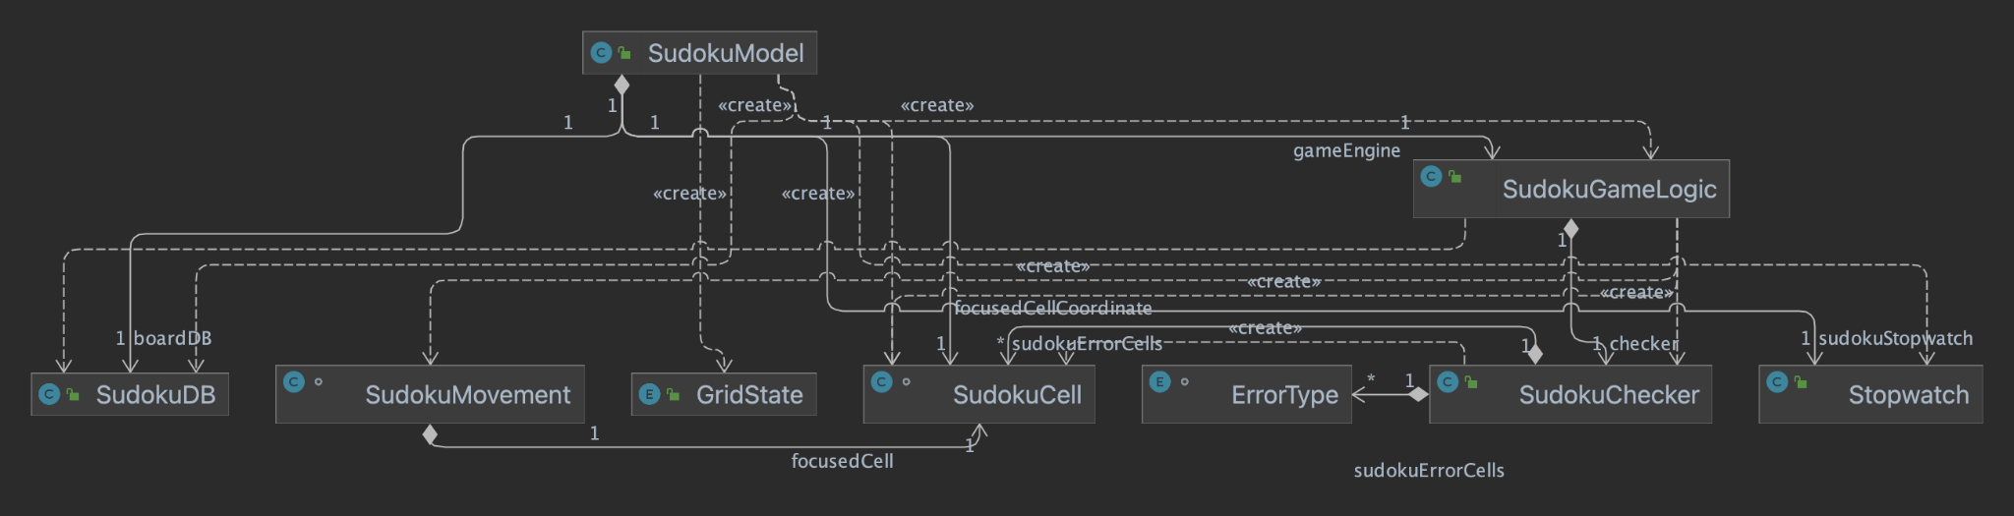
Discuss your design
Notes:
What important objects in your project were being encapsulated, and what did your class abstractions look like for those objects? Present only significant, important parts of your UML class diagram, and only show the box with class names and important relationships. Make sure its readable on your video! And more importantly, make sure you can clearly explain it! Keep unnecessary details out, such as fields and methods. If it's helpful, you may include only those fields and methods that are an integral part of your design and are relevant for your presentation.
The team is encouraged to use UML state and sequence diagrams to help discuss challenging parts of their design.

Slide 9
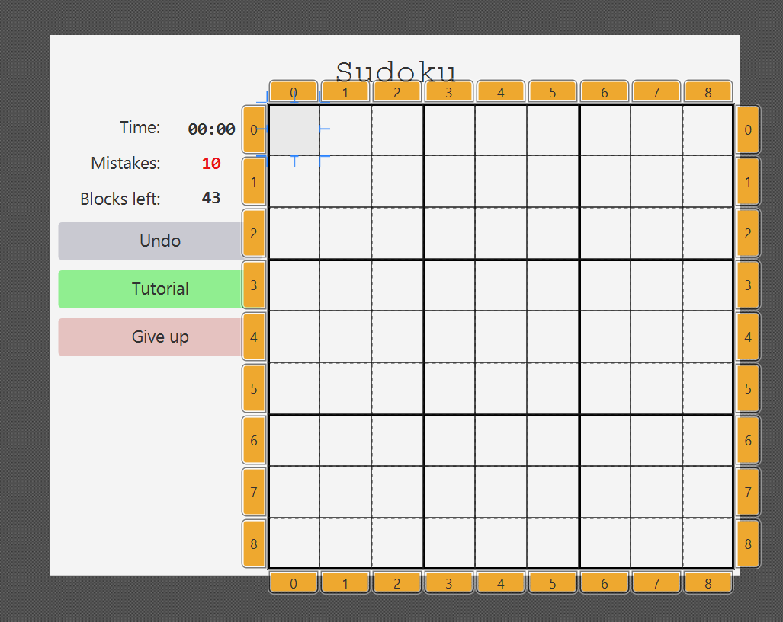
Implementation:
Scene Builder
GridPane/CSS
GridState ObjectProperty to highlight Sudoku cells
Notes:
tsugu
Discuss any interesting data structure or critical algorithms used that you're particularly proud of. (e.g. if you implemented a computer player, how did you govern how the computer plays? Did you apply any AI algorithms? Or brute force? What rules did you use?)
Discuss any tools (e.g. SceneBuilder, Gradle, etc.) or anything else used to help design the UI o Discuss any advanced libraries used beyond Java and JavaFX you used and why.

Slide 10
Demonstration:
Menu
Play button
Exit button
Resizing
Sudoku game
Input validation
Timer
Blocks left
Errors made
Undo button
Give up button
Tutorial button
Completion
Notes:
Doruk

Slide 11
Reflection:
Daily Scrums
What we would do differently next time?
Major Successes
Time estimation
Notes:
Doruk/Reva

Slide 12
Conclusion
Major accomplishments:
Implemented Sudoku Game
Reading data from CSV
Board highlighting
Resizing the Logo
Future Considerations:
Different levels
Saving progress
Notes:
Kit

Slide 13
THANK YOU!

