Slide 1
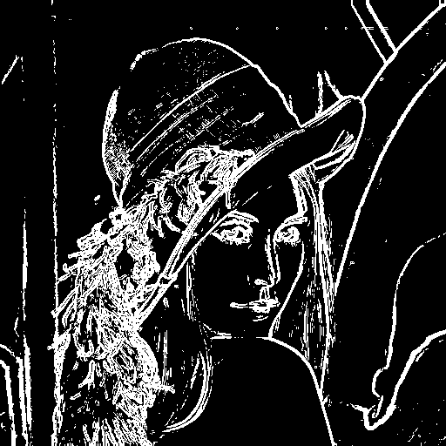
EDGE DETECTION LOG
REVAAN.J.R

Slide 2
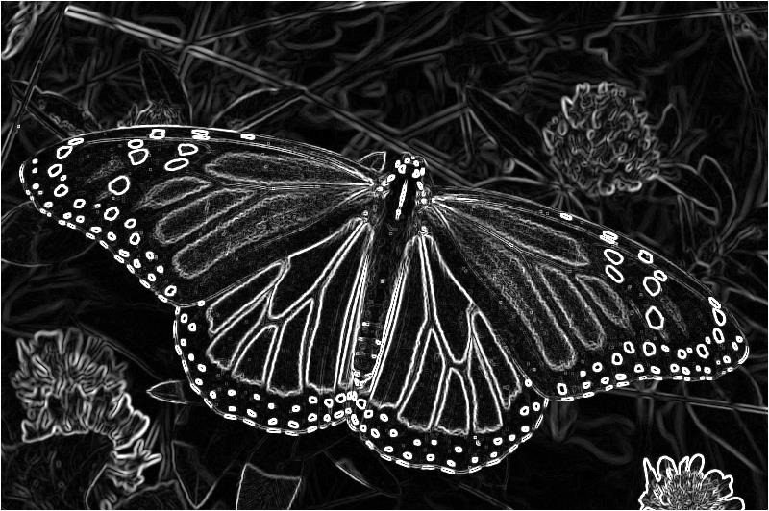
WHAT IS EDGE DETECTION IN LOG ?
Edge detection in LoG (Laplacian of Gaussian) is a method that first smooths an image to reduce noise using a Gaussian filter, then applies the Laplacian (a second derivative) to find edges by detecting zero-crossings — points where intensity changes sharply.
IS THIS USEFUL ?

Slide 3
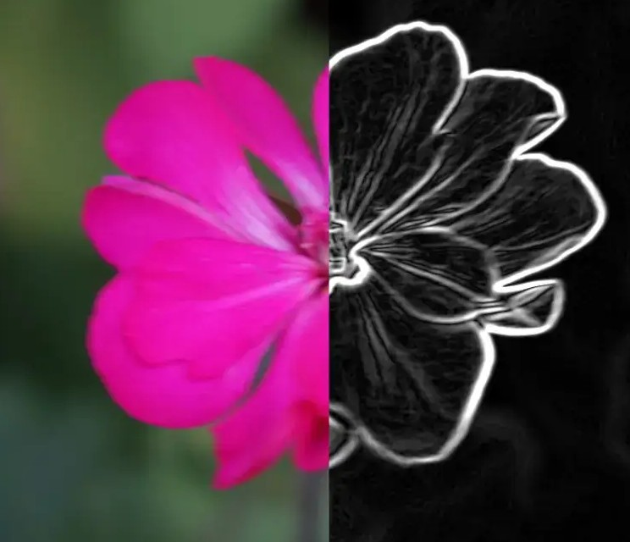
Why LOG is important in image processing ?
Accurate Edge Detection LoG identifies edges by detecting sudden intensity changes and highlights them clearly, which is essential for understanding shapes and boundaries in an image.
Noise Reduction Before detecting edges, LoG uses a Gaussian filter to smooth the image, making it less sensitive to random noise — a common problem in real-world images.
Better than Simple Methods Unlike basic edge detectors (like Sobel or Prewitt), LoG reduces noise first and then detects edges, resulting in cleaner and more accurate edge maps.

Slide 4
COMPONENTS OF LOG
Components of LoG (Laplacian of Gaussian)
1. Gaussian Filter (Smoothing)
Purpose: Reduces noise and smooths the image.
How it works: Applies a Gaussian blur to average pixel values.
Effect: Prevents false edge detection caused by small variations or noise.
2. Laplacian Operator (Edge Detection)
Purpose: Highlights regions of rapid intensity change.
How it works: Computes the second derivative of the image.
Effect: Detects edges by finding areas where intensity changes sharply.
3. Zero-Crossing Detection
Purpose: Final step to locate edges.
How it works: Identifies points where the Laplacian result changes sign (from positive to negative or vice versa).
Effect: Marks precise edge locations in the image.

Slide 5

Working of log
🔄 Working of Laplacian of Gaussian (LoG)
Convert Image to Grayscale
The first step is to convert the image to grayscale, as edge detection typically works on intensity values, not color information.
Apply Gaussian Filter
The Gaussian filter is applied to the image to smooth out noise. This helps reduce random variations in pixel intensity, which could lead to false edge detection.
Formula for Gaussian kernel:
This step blurs the image, smoothing out small intensity fluctuations.

Slide 6

Working of log
Compute the Laplacian
The Laplacian operator is applied to the smoothed image. It calculates the second derivative of the image, highlighting regions of rapid intensity change (edges).
The Laplacian is typically represented as a kernel:
Detect Zero-Crossings
After applying the Laplacian, zero-crossings are identified, where the Laplacian output changes sign (positive to negative or vice versa). These zero-crossings are used to locate the edges in the image.
Zero-crossings indicate the transition between different regions of the image.
Final Edge Map
The detected zero-crossings are marked as edges, creating the final edge map that outlines the boundaries in the image.

Slide 7
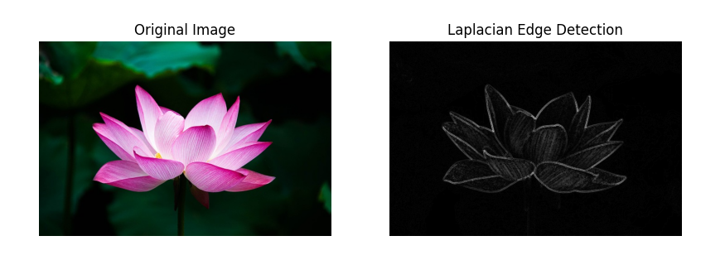
Processed log image

Slide 8
Advantages and limitations
✅ Advantages of LoG
Removes Background Noise Example: In medical X-rays, LoG helps reduce grainy textures while still detecting bone edges.
Detects Clean Edges Example: In industrial quality control, LoG clearly outlines edges of products for defect detection.
Highlights Meaningful Boundaries Example: In facial recognition, it helps identify important facial features like eyes, nose, and jawline with clarity.
⚠️ Limitations of LoG
Time-Consuming for Large Images Example: Processing high-resolution satellite images can be slow due to heavy computation.
One Filter Doesn’t Fit All A LoG tuned for small details might miss large objects, and vice versa — like trying to detect both veins and organs in a CT scan with the same settings.
Can Detect Unwanted Edges Example: May highlight textures (like clothing folds or shadows) that are not actual object boundaries.

Slide 9
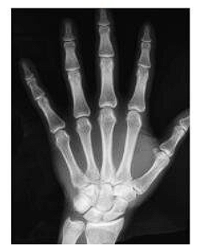
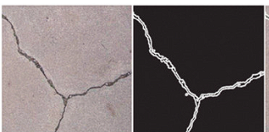
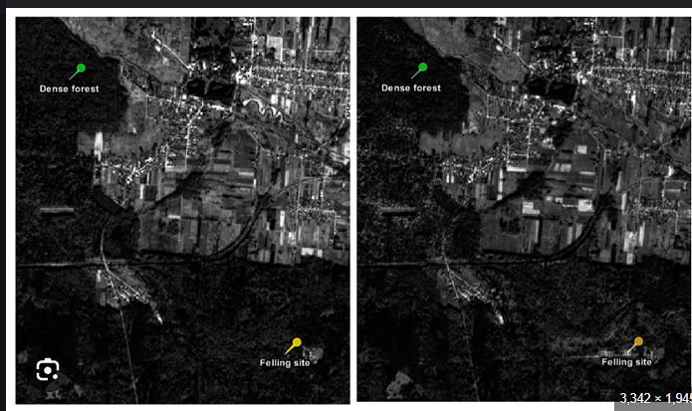
Real world applications
Medical Imaging: Used to detect tumors, fractures, and organ outlines in X-rays and MRIs.
Autonomous Vehicles: Helps self-driving cars detect lane markings, road signs, and pedestrians.
Security Systems: Enhances edges in facial recognition software for accurate identification.
Satellite Image Analysis: Used to extract features like rivers, roads, and buildings from aerial imagery.
Product Quality Inspection: Detects cracks or alignment issues in factory production lines using machine vision.

Slide 10
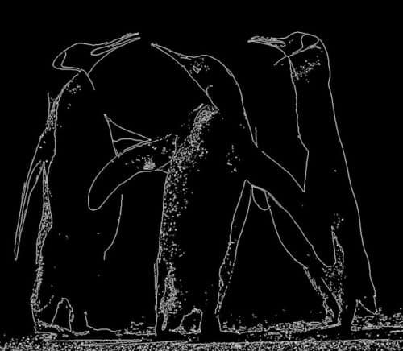
Thank you

