Slide 1
Project Presentation of Industry-Oriented Hands-On Experience (22CS422)
On
High Performance Rubik’s Cube Solver using
Optimized Search Algorithms
Ravneet Kaur - 2210990720
Ansh Oberoi - 2210990138
Supervised By
Dr. Shikha Tuteja
Department of Computer Science and Engineering,
Chitkara University, Punjab

Slide 2
Introduction
The Rubik’s Cube is a classic combinatorial problem in computer science, known for its extremely large state space of approximately 4.3 × 10¹⁹ possible configurations.
Solving such a problem efficiently is challenging because traditional brute-force or exhaustive search methods become computationally expensive in terms of both time and memory as the complexity increases.
To address this issue, heuristic and optimized search algorithms are required that can intelligently explore the state space.
In this work, we focus on designing an efficient Rubik’s Cube solver by modeling the cube as a state-space graph and applying advanced search techniques such as BFS, IDDFS, and IDA* to analyze their performance and efficiency.
2

Slide 3
Problem Statement
The Rubik’s Cube can be modeled as a state-space search problem where each configuration represents a unique state and each valid move corresponds to a transition between states. The primary challenge lies in the extremely large state space, consisting of approximately 4.3 × 10¹⁹ possible configurations , which makes exhaustive search computationally infeasible. Additionally, there exists a trade-off between memory usage and execution time—algorithms that guarantee optimal solutions often require excessive memory, while memory-efficient methods tend to increase computation time.
Therefore, the problem is to design an efficient solving approach that minimizes both time and memory while still producing optimal or near-optimal solutions.
3

Slide 4
Objective
The objective of this work is to design and implement an efficient Rubik’s Cube solver using optimized search algorithms.
The cube is modeled as a state-space graph, and algorithms such as Breadth-First Search (BFS), Iterative Deepening Depth-First Search (IDDFS), and Iterative Deepening A* (IDA*) are applied to solve it.
The study aims to compare these algorithms based on execution time, memory usage, and solution optimality, in order to identify the most effective approach for solving large-scale combinatorial problems while maintaining a balance between computational efficiency and resource utilization.
4

Slide 5
Algorithms Implemented
1) Breadth-First Search (BFS)
Explores all states level-by-level
Guarantees shortest path solution
High memory usage due to storing all nodes
2) Iterative Deepening DFS (IDDFS)
Combines BFS completeness + DFS memory efficiency
Repeats depth-limited search
Reduces memory but increases time
3) Iterative Deepening A* (IDA*)
Uses heuristic function to guide search
Explores only promising states
Reduces time and memory usage significantly
Most efficient for higher-depth solutions
5

Slide 6
Methodology
The methodology of this work is based on modeling the Rubik’s Cube as a state-space graph, where each configuration represents a node and each valid move corresponds to a transition between states.
A compact cube representation is used to reduce memory usage and enable faster state comparisons.
BFS performs level-wise exploration to guarantee optimal solutions, while IDDFS reduces memory usage through depth-limited searches.
IDA* incorporates a heuristic function to guide the search towards promising states, significantly reducing the number of explored configurations.
Input Cube → State Representation → Apply Algorithm → Solution Output
6

Slide 7
Results
1) Performance Evaluation -
Performance evaluated using execution time, memory usage, and solution efficiency
Algorithms tested across increasing scramble depth (3–10)
2) Key Observations –
BFS :
Fast at lower depths.
Fails beyond depth 7 due to exponential memory growth
IDDFS :
Reduces memory usage.
Slower due to repeated state exploration
IDA* :
Uses heuristic pruning
7

Slide 8
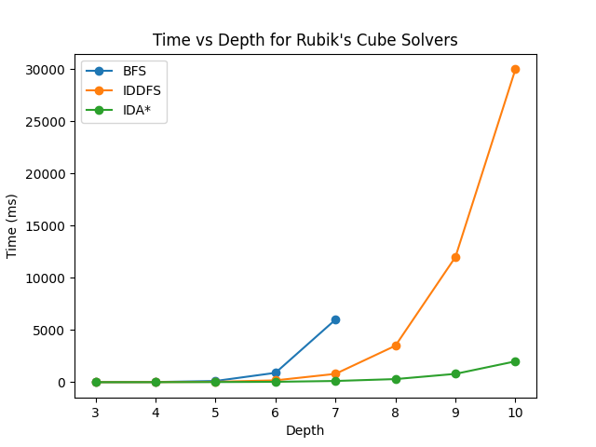
Results
Explores fewer states
Performs efficiently even at higher depths
3) Graph: Time v/s Depth –
8

Slide 9
Conclusion
This study presented the design and implementation of a Rubik’s Cube solver using BFS, IDDFS, and IDA* algorithms.
The comparative analysis shows that while BFS provides optimal solutions at lower depths, it becomes inefficient due to high memory requirements.
IDDFS improves memory efficiency but increases computational time because of repeated searches.
Among all approaches, IDA* demonstrates the best performance by utilizing heuristic-based pruning, which significantly reduces the number of explored states.
Therefore, IDA* proves to be the most efficient and scalable algorithm for solving complex Rubik’s Cube configurations.
9

Slide 10
Thank You
10

