Slide 1
Case Study Lending Club
Revan Datta Parimi

Slide 2
Topics
Important Factors for accepting an application
Cleaning the Data Set and Statistics
Analysis of Fully Paid Applicants
Analysis for Loan Amount, Grade, Annual Income, Purpose and Interest Rate
Distribution Plots
Contents in Jupyter Plots

Slide 3
Important Factors for accepting an application
loan_status – Loan Status
loan_amnt – Loan Amount
term – Term for Instalments
int_rate – Interest Rate
grade – Grade of Applicant
sub_grade – Sub Grade of Applicant
annual_inc – Annual income
purpose – Purpose of Loan
dti – ratio of monthly debt to total debt
emp_length – Employee Experience
last_pymnt_d – Last Payment Date
home_ownership – Home Ownership
verification_status – Verification Status

Slide 4
Cleaning the Data Set
First we have dropped down the rows with missing values.
Dropped the rows with irrelevant category like
Home Ownership is 'NONE’
Loan Status is 'Current’
Converting the string to numeric values like
“36 months” to 36
“10.65%” to 10.65
Removed the Outliers (Extreme max and min values)
Now the rows reduced from 39,717 to 34,293 (13.6% rows are cleaned)

Slide 5
Data Set Statistics
 | loan_amnt | term | int_rate | annual_inc | dti | emp_length
count | 37475.000000 | 37475.000000 | 37475.000000 | 3.747500e+04 | 37475.000000 | 37475.000000
mean | 11124.050033 | 41.918185 | 11.959722 | 6.944315e+04 | 13.286631 | 5.168859
std | 7352.633429 | 10.344776 | 3.682582 | 6.472065e+04 | 6.659910 | 3.888199
min | 500.000000 | 36.000000 | 5.420000 | 4.000000e+03 | 0.000000 | 0.000000
25% | 5500.000000 | 36.000000 | 8.940000 | 4.100000e+04 | 8.160000 | 2.000000
50% | 10000.000000 | 36.000000 | 11.830000 | 6.000000e+04 | 13.390000 | 4.000000
75% | 15000.000000 | 36.000000 | 14.420000 | 8.300000e+04 | 18.550000 | 9.000000
max | 35000.000000 | 60.000000 | 24.400000 | 6.000000e+06 | 29.990000 | 11.000000

Slide 6
Analysis of Fully Paid Applicants
Out of all the categories, we need to check the applicants with loan status
Fully Paid – Low Risk Applicants
Current – Cannot be considered as Fully Paid or Charged Off, so removed in data cleaning
Charged Off – High Risk Applicants as they have a history of not paying on time.
The Complete Analysis depends on the comparison of applicants category details based on ‘Fully Paid” and “Charged Off” loan status

Slide 7
Loan Amount
Loan 0 - 5000 = 86.78%
Loan 5000 - 10000 = 87.4%
Loan 10000 - 15000 = 86.38%
Loan 15000 - 20000 = 82.38%
Loan 20000 - 25000 = 80.44%
Loan 25000 - 30000 = 78.83%
There is a proportional decrease with the increase in Loan
Assumption
80% being the margin of risk
Loan Beyond 25k is risk

Slide 8
Grade
Grade A - 94.13%
Grade B - 88.07%
Grade C - 83.13%
Grade D - 78.3%
Grade E - 73.71%
Grade F - 68.46%
Grade G - 67.01%
We can see there is an proportional decrease from Grade A Applicants to Grade G Applicants
Assumption
70% as the safer risk Margin
Grade A to E are good to process loans

Slide 9
Annual Income
Annual Income 0 - 20000 = 81.8%
Annual Income 20000 - 40000 = 82.73%
Annual Income 40000 - 60000 = 85.04%
Annual Income 60000 - 80000 = 87.35%
Annual Income 80000 - 100000 = 89.28%
Annual Income 100000-120000 = 90.58%
Annual Income 100000+ = 90.25%
We can see Gradual increase of Fully Paid customers
Assumption
85% being the same margin
Annual income more than 40,000 is preferred

Slide 10
Purpose
Car 89.1%
Credit Card 89.74%
Debt Consolidation 85.22%
Educational 83.88%
Home Improvement 87.87%
House 84.24%
Major Purchase 89.85%
Medical 84.44%
Moving 84.44%
Other 84.38%
Renewable Energy 82.14%
Small Business 73.53% (Risk)
Vacation 85.5%
Wedding 90.57%

Slide 11
Interest Rate
Interest Rate 5 - 10 % = 93.48%
Interest Rate 10 – 15% = 85.44%
Interest Rate 15 – 20 % = 75.54%
Interest Rate 20 – 25 % = 61.14%
We can the Proportion to Low Interest Rate
Assumption
75% as margin of safer risk
Interest rate beyond 20 is applicable for higher Annual Income and Grade

Slide 12
Factors Analysis
Effecting the Risk (Proportional)
Loan Amount
Grade
Sub Grade
Annual Income
Purpose
Low or No Risk (Not Proportional)
Term
Dti
Employment Length
Last Payment Date
Home Ownership
Verification Status

Slide 13
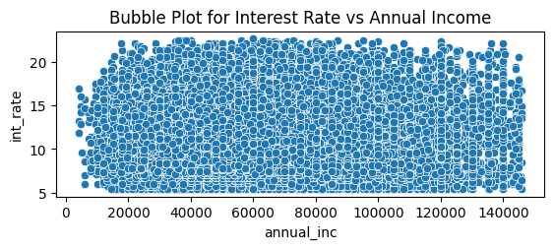
Interest Rate vs Annual Income
We can see many Applicants are comfortable between Annual Income of 40,000 to 1,00,000+ for higher interest rates of more than 20%

Slide 14
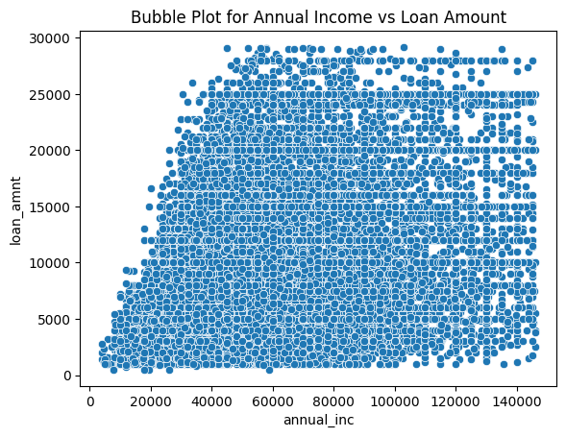
Annual Income vs Loan Amount
Applicants with Annual Income more than 60,000 are comfortable at Higher loan of 25,000+

Slide 15
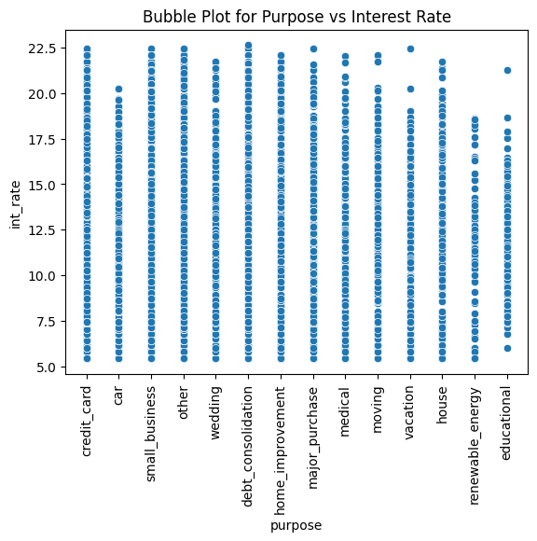
Purpose vs Interest Rate
Applicants pay higher interest rates for
Credit Card
Small Business
Debt Consolidation
Other
Home Improvement

Slide 16
Contents in Jupyter Plots
All the initial slides given with percentages for proportionate factors have Plots for
Univariate and Bivariate(Distribution Plots) Analysis using Histogram plots
Interesting relationship between Loan Amount, Interest rate, Annual Income and Purpose are designed using Bubble Plots.

Slide 17
Summary
Applicant’s Interest rate to be less than 15% for safe risk for low grades.
Applicants with annual income from 40,000 to 1,00,000+ for higher interest rates of more than 20%
Applicants are comfortable with higher Interest Rate for
Credit Card
Small Business
Debt Consolidation
Other
Home Improvement

