Slide 1
Indoor Navigation using Augmented Reality
BY :
Y. Manoj Kumar Reddy (2451-19-737-132)
P. Likhith Patala (2451-19-737-158)
K. Revan (2451-19-737-178)
Under the guidance of :
CH. Vijaya Bhaskar, Assistant Professor

Slide 2
Abstract
Introduction
Problem Statement
Literature Survey
Existing Systems & Drawbacks
Proposed System
Module Split-up
System Requirements
System Architecture
UML Diagram
Design Methodology
Implementation
Results
Conclusion
References
Contents

Slide 3
ABSTRACT
GPS-based navigation technology has been widely used in most of the commercial navigation applications nowadays. However, its usage in indoor navigation is not as effective as when it is used at outdoor environment. The aim of this project is to present a simple and cost-effective indoor navigation system. The proposed system uses the existing built-in sensors embedded in most of the mobile devices to detect the user location, integrates with AR technology to provide user an immersive navigation experience. In this project, an indoor navigation mobile application was developed.

Slide 4
INTRODUCTION
Indoor navigation is not as common as outdoor navigation due to the incompatibility of GPS signals inside complex multi-floor buildings. As a result, unlike outdoor navigation, there are relatively lesser development on commercial indoor navigation systems. This project proposes an efficient and cost-effective method by using the built-in sensors of mobile devices and the augmented reality (AR) technology to provide real-time indoor navigation. This method does not require installation of additional hardware, the user’s current position is detected by using the mobile devices’ magnetic field, Wi-Fi signals and inertial sensor and the route to destination is calculated based on A* algorithm to provide navigation guidance. AR technology is used to replace the traditional map to provide an immersive virtual navigation direction. A mobile application prototype was developed in this project to provide navigation within MVSR campus.

Slide 5
PROBLEM STATEMENT
Navigating inside any large buildings is a difficult process because of complexity of buildings and due to present of multifloors in buliding Gps technology also does not work.

Slide 6
LITERATURE SURVEY
S.no | Title | Author | Description | Limitation
1. 2. | Indoor navigation using BLE (Bluetooth Low Energy) Beacons Indoor navigation using Wi-Fi | Shailaja Patil Anukush A. Kalbandhe Tran Trong Khanh VanDung Nguyen | They made use of Bluetooth beacons and a central gateway in order to achieve indoor navigation. This system works by defining coordinates using Wi-Fi access points that can transmit certain data. Using the RSSI (received signal strength indicator) and MAC-address, the system can define exactly the current location of the user’s device using the multilateration approach. | The bluetooth based system requires an external device for all real-time processing which makes it expensive and inconvinent. Wi-Fi client based positioning is not possible with ios devices. It is relatively inaccurate.

Slide 7
EXISTING SYSTEM
The popular techniques include GPS, Wi-Fi-based positioning, BLE beacon-based positioning, magnetic field-based positioning.
DRAWBACKS
GPS - Weak signal strength indoors
Wi-Fi - Multipath effect
BLE Beacon - Weather interference

Slide 8
PROPOSED SYSTEM
To develop and implement an indoor navigation system comprising of a smartphone based augmented reality android application for new visitors to a particular building, by searching and navigating through the places of interests.

Slide 9
MODULE SPLIT-UP
Admin : Responsible for rendering, updating and deletion of indoor maps.
User : End user who navigates the desired location using the application.
Database : The location in which all the necessary map information, navigation algorithms, and code files are located.

Slide 10
SYSTEM REQUIREMENTS
Software
Unity version 2020.3.23f1 or higher
Visual Studio Code
Microsoft Paint
Adobe QR Code generator
Android Version 7.0 or higher
Hardware
Android Mobile Phone

Slide 11
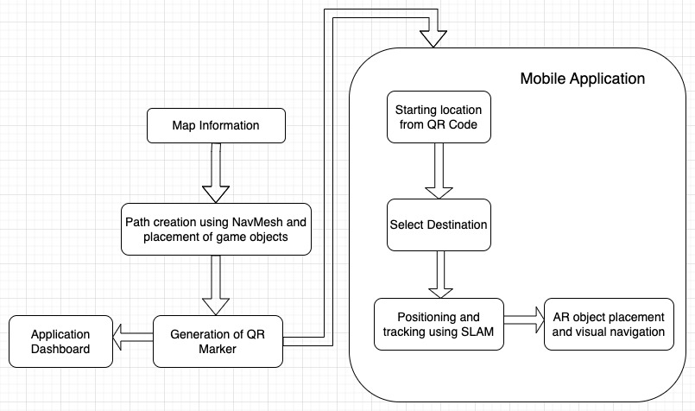
SYSTEM ARCHITECTURE

Slide 12
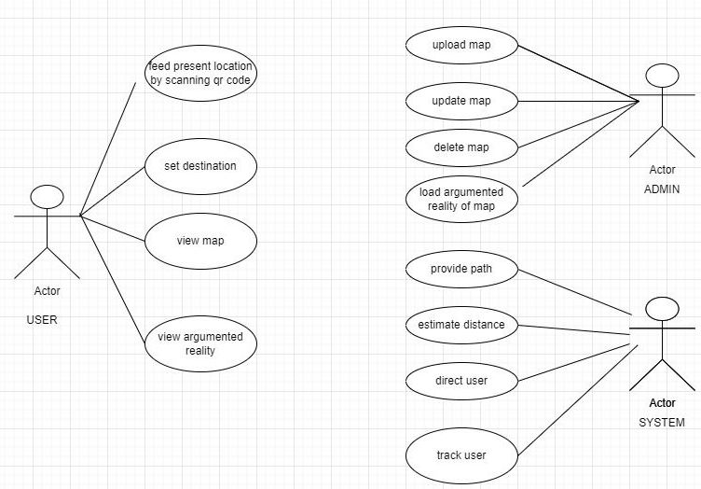
USE CASE DIAGRAM

Slide 13
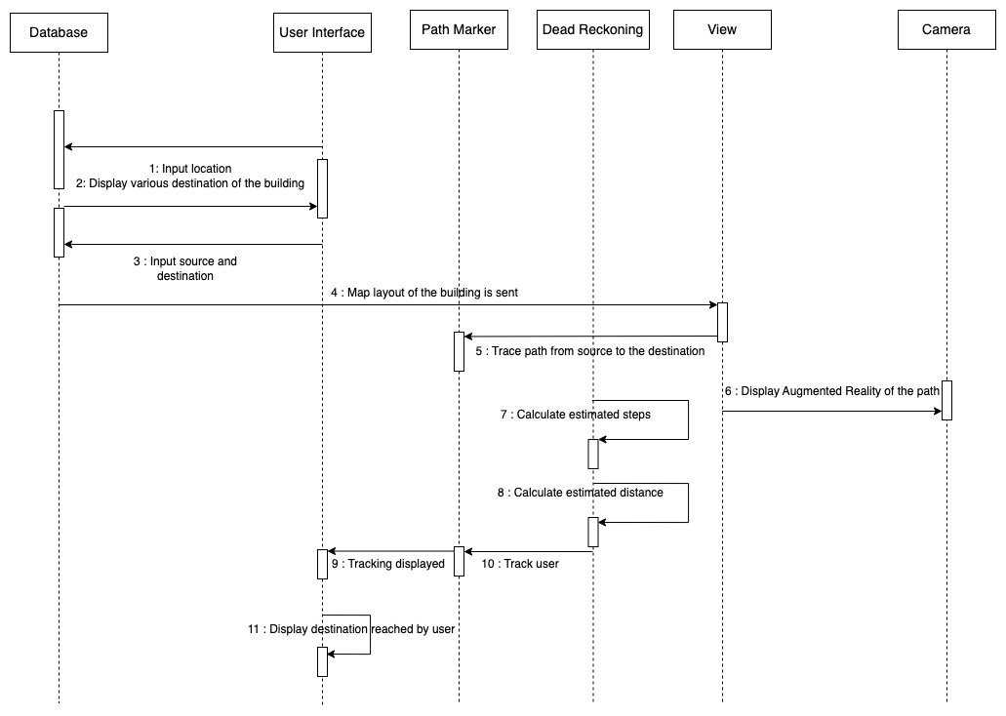
SEQUENCE DIAGRAM

Slide 14
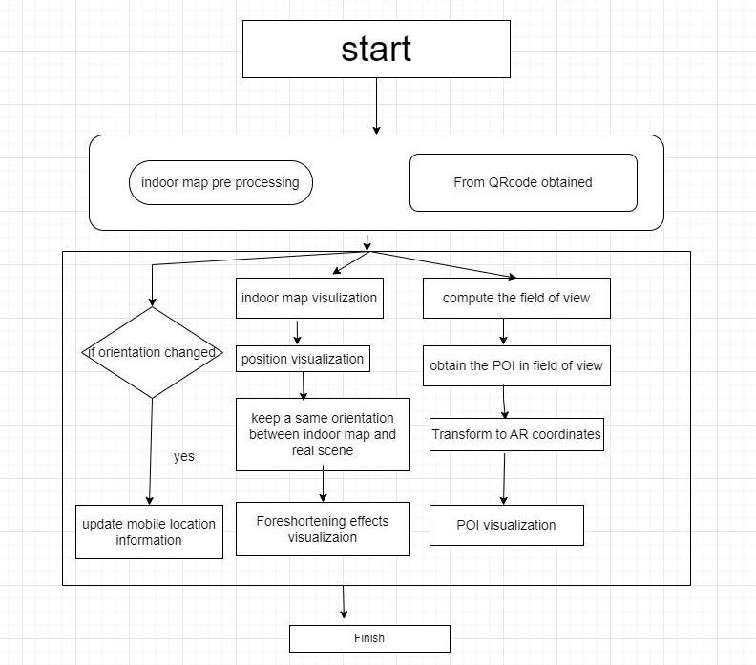
ACTIVITY DIAGRAM

Slide 15
DESIGN METHODOLOGY
COMPONENTS
ARCore Localisation :
ARCore handles motion tracking and environmental understanding so that they can be used more conveniently. Along with all those features, ARCore can create a better augmented reality navigation system which will be accurate and efficient.
QR-Code Repositioning :
QR codes are used in the system in order to get location data from the user. QR codes will be pasted in all necessary locations throughout the building to obtain the information needed for the proposed system. The mobile application scans the QR codes to give accurate indoor navigation to the user. This is the QR code positioning method.

Slide 16
DESIGN METHODOLOGY
Unity NavMesh navigation :
The NavMesh component is one of the functionalities in unity.
As the user moves through the building, there is a chance that he or she will run into obstacles or hindrances in the way of the actual path. So the NavMesh properties will help to identify these obstacles and can provide an alternate path to the runtime by changing the position of these augmented reality objects, like directing arrows.
Augmented Reality path showing :
The major goal of this part is to produce an arrow in front of the user that guides them in the direction they need to go after a destination is chosen.
There exists a defined mesh surrounding the arrow and every time the blue dot exits the mesh, the previous arrow (AR-object) gets removed and a new one comes in before the user appears at the exact angle.

Slide 17
DESIGN METHODOLOGY
ALGORITHM
A* Algorithm :
A* is an informed search algorithm, or a best-first search, meaning that it is formulated in terms of weighted graphs: starting from a specific starting node of a graph, it aims to find a path to the given goal node having the smallest cost.
It does this by maintaining a tree of paths originating at the start node and extending those paths one edge at a time until its termination criterion is satisfied.

Slide 18
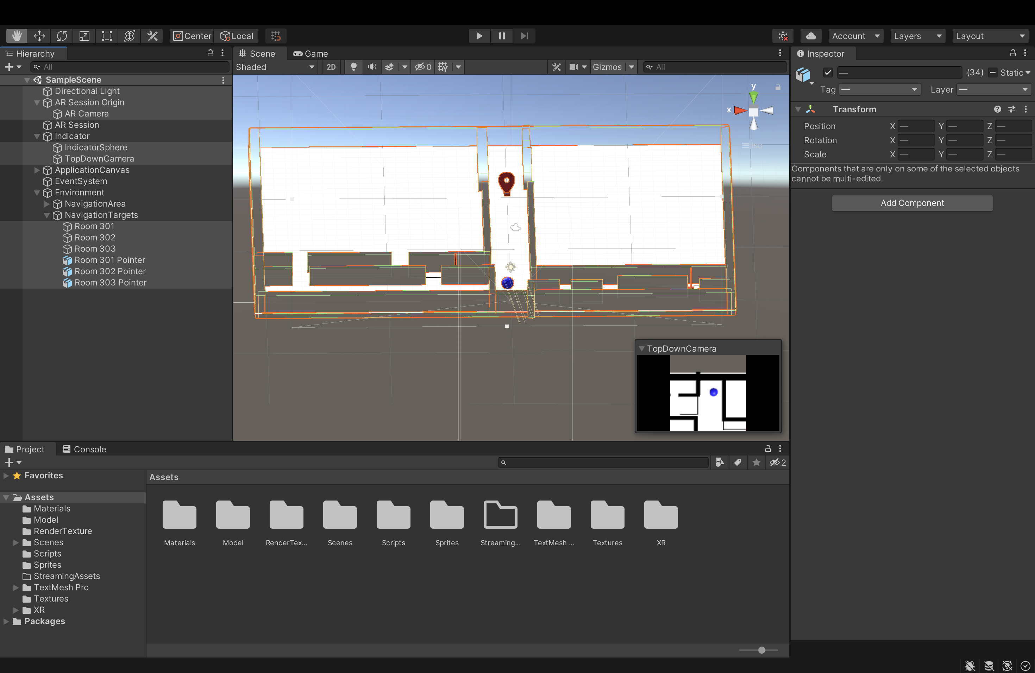
IMPLEMENTATION

Slide 19
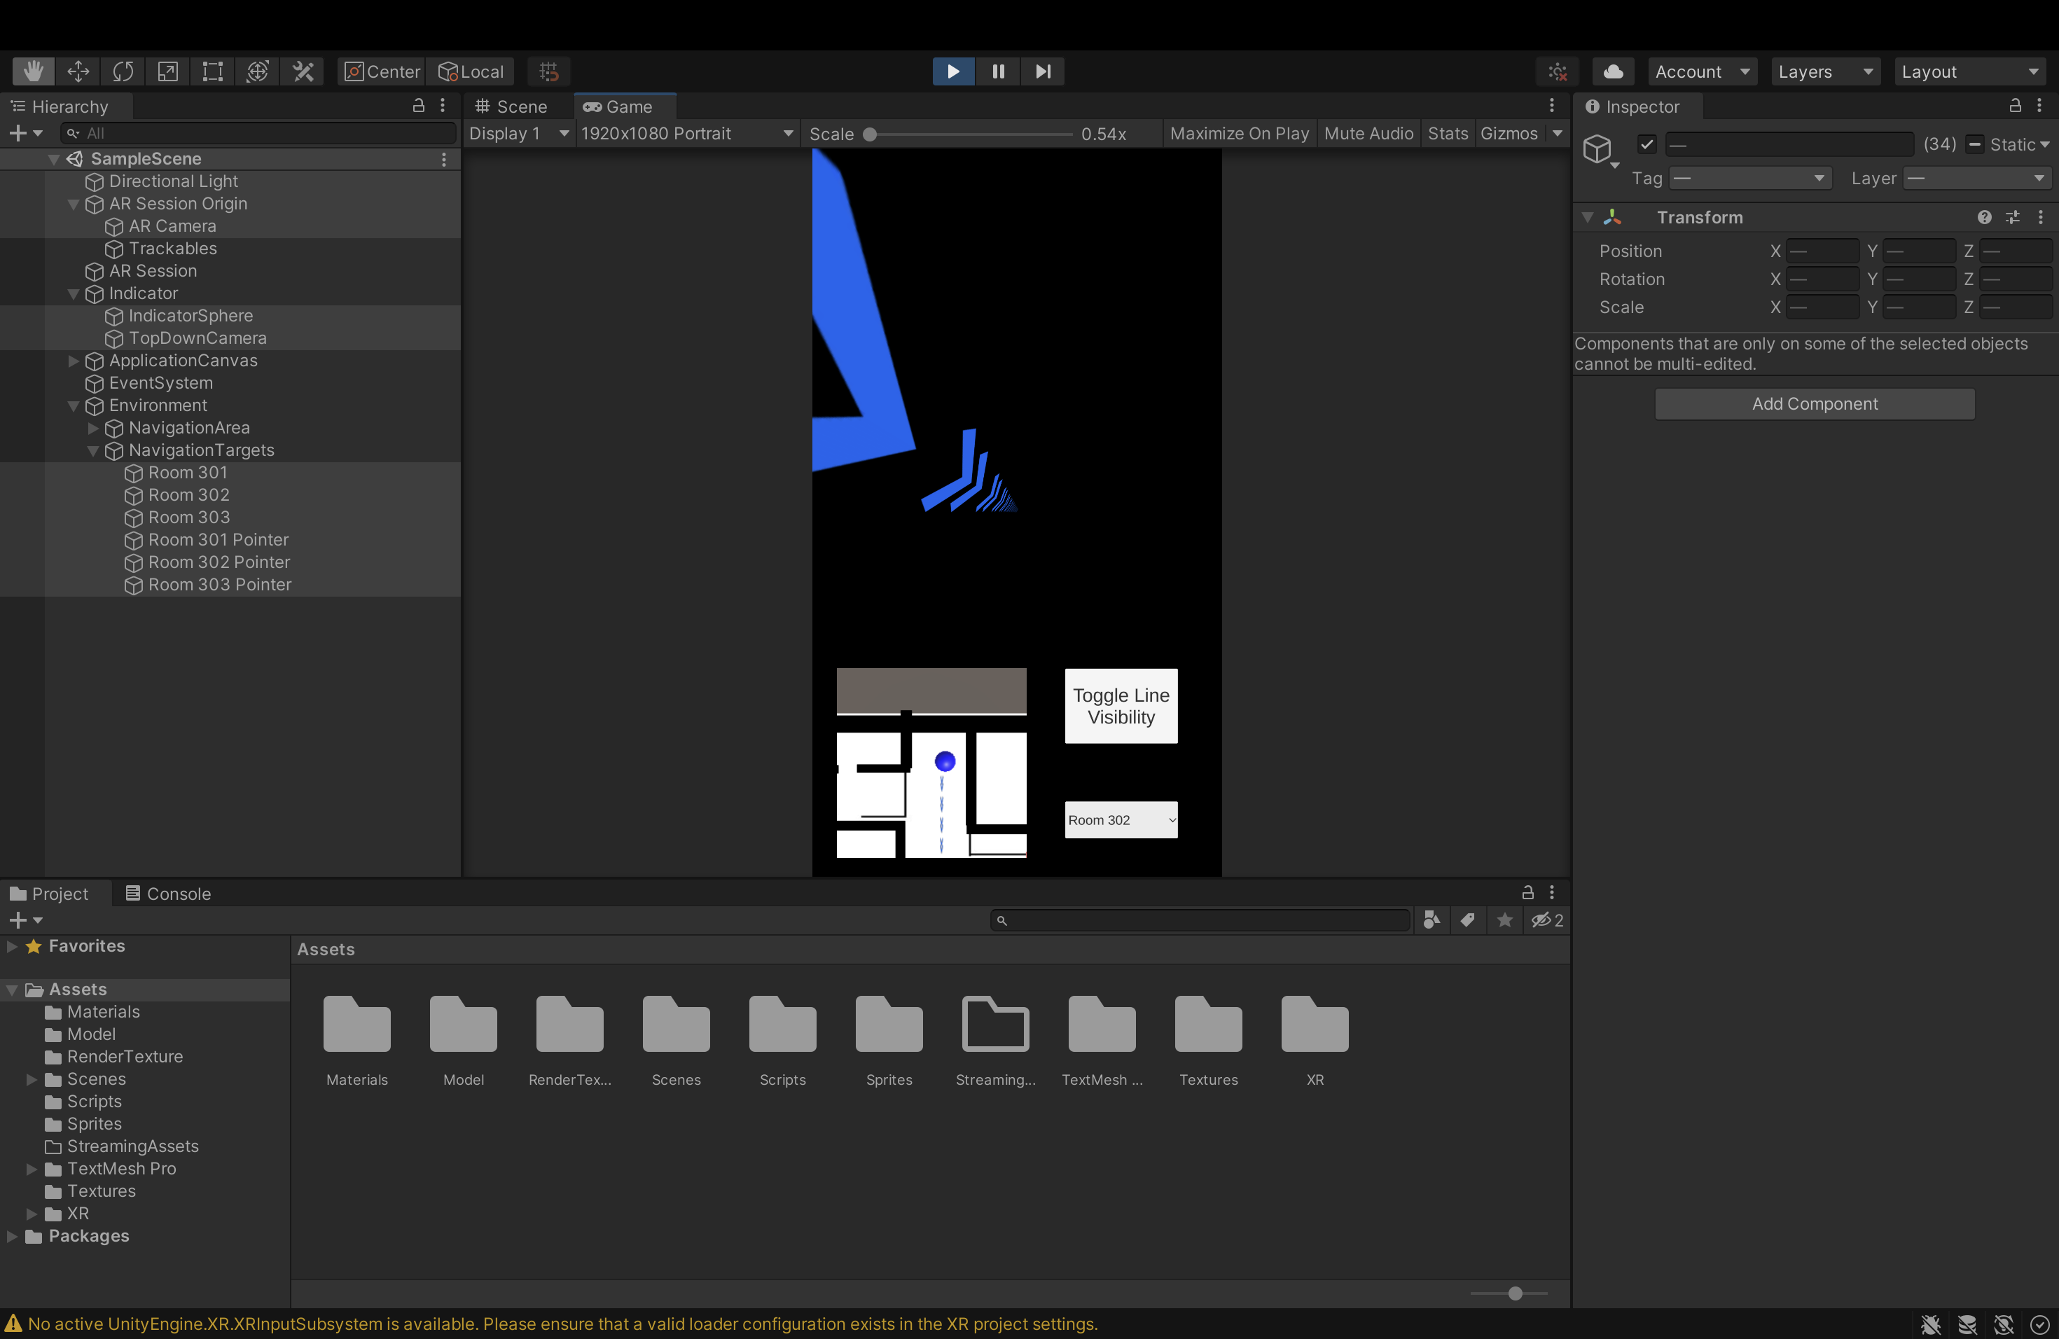
IMPLEMENTATION

Slide 20
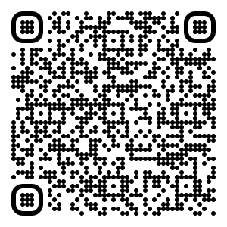
RESULTS – QRCode to install the application

Slide 21
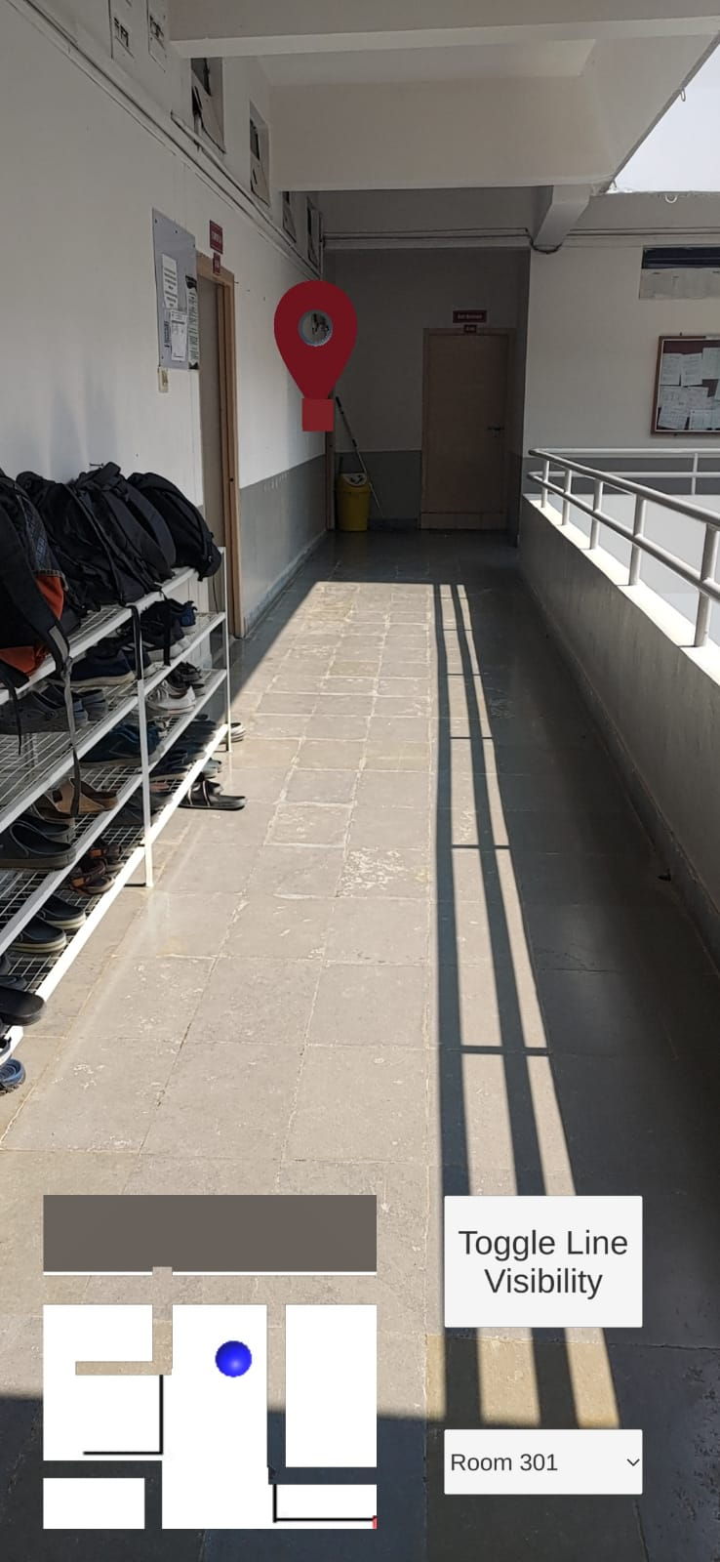
RESULTS – Selecting point of interest

Slide 22
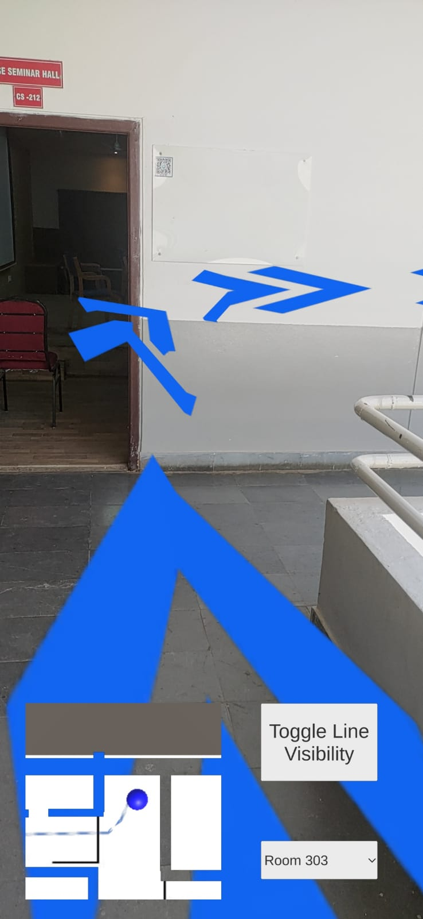
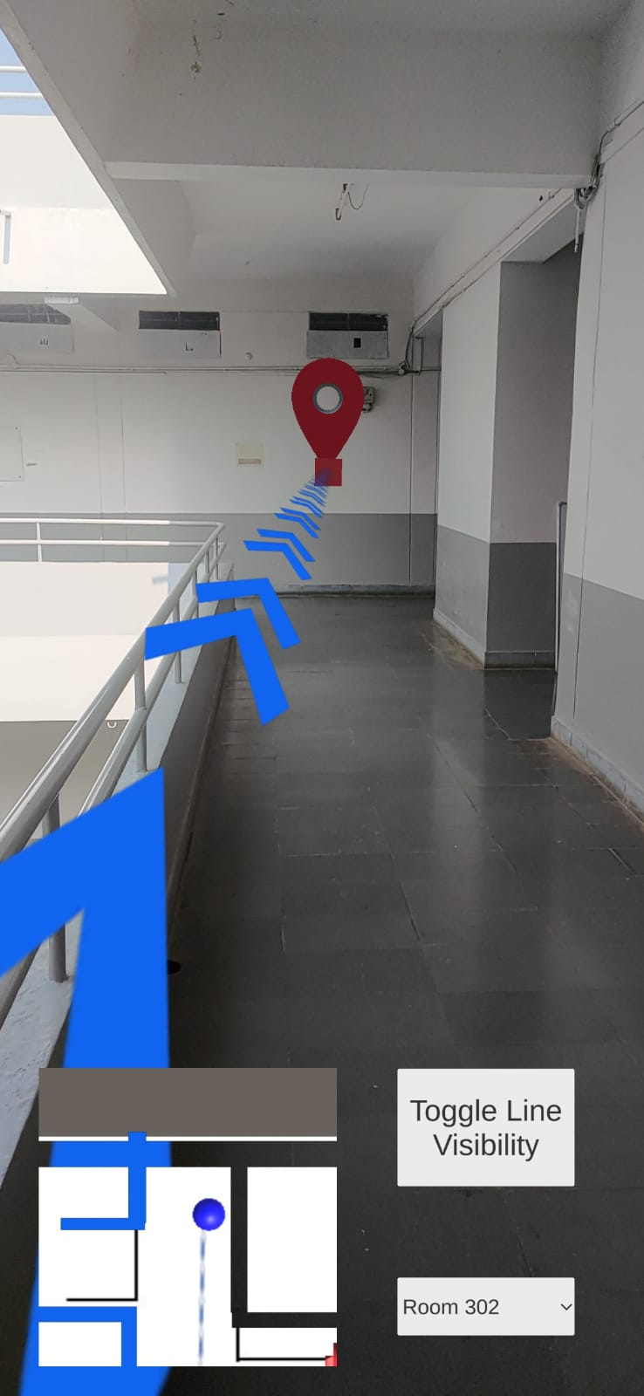
RESULTS – Path shown by the application

Slide 23
CONCLUSION
As GPS based Indoor navigation is unreliable, we have come up with an Android application that implements Augmented Reality for Indoor navigation through complex buildings.

Slide 24
REFERENCES
M. B. Kjærgaard, H. Blunck, T. Godsk, T. Toftkjær, D. L. Christensen, and K. Grønbæk, “Indoor Positioning Using GPS Revisited,” in Pervasive 2010.
D. Macias-Valadez, R. Santerre, S. Larochelle, and R. Landry, “Improving vertical GPS precision with a GPS-over-fiber architecture and real-time relative delay calibration,” GPS Solutions, vol. 16, no. 4, pp. 449–462, 2012.
C. Yang and H. R. Shao, “WiFi-based indoor positioning,” IEEE Communications Magazine, vol. 53, no. 3, pp. 150–157, 2015.

Slide 25
THANK YOU

