Slide 1
WIFI JAMMER
USING IOT
-BY
K. REVAN 2451-19-737-178
V. YOGESH 2451-19-737-180
N. SUSHMA 2451-19-737-313
UNDER THE GUIDANCE OF
CH. SRUJANA, Assistant Professor
Department of I.T.

Slide 2
CONTENTS
1. Abstract
2. Introduction
3. Problem Statement
4. Hardware & Software requirements
5. Block Diagram
6. Implementation
7. Results
8. Applications
9. Drawbacks
10. Conclusion
11. References

Slide 3
ABSTRACT
We live in a scary time if we are someone who values privacy. We no longer know who is looking at what we search and who they are selling that information to. With the advent of cell phones and drones, it has become difficult to even go outside without the potential existing that we are being filmed or watched. This jammer is designed to be carried around in our pocket, it provides 10 meters of protection no matter where we are. This jammer is effective if we are working with sensitive data away from work or our home, like a hotel or some other more public space.

Slide 4
INTRODUCTION
❖ Whether it is the wrong place or perhaps the wrong time, someone may feel that they do now want to have digital communication enabled.
❖ Wifi jamming is not simply for convenience, there are tactical uses for it. Since a great deal of sensitive data is stored digitally, it can be stolen undetected over a wifi network.
❖ By jamming wifi signals in the area, the owner of the data can make sure that no one is accessing it after hours.

Slide 5
PROBLEM STATEMENT
Such a powerful tool like the internet needs limitations. It is a great channel for work and pleasure, allowing you access to almost anything you can imaging with just a few clicks. On the other hand, it is also a huge risk to your privacy, security, and authority at work and home. WiFi can be abused , and it often is. Obtaining and using a WiFi Jammer can be the answer to all of your concerns.

Slide 6
HARDWARE & SOFTWARE REQUIREMENTS
HARDWARE CONFIGURATION -
Node Mcu - ESP8266
Data transfer cable - Type A to micro usb
SOFTWARE CONFIGURATION -
Operating System : Windows 7/8/10
IDE : Arduino

Slide 7
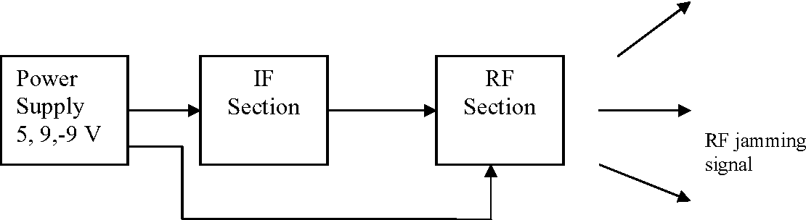
BLOCK DIAGRAM

Slide 8
IF SECTION - INTERMEDIATE FREQUENCY
The WiFi jammer is a device that transmits the signals to the same frequency. The jamming section is successful when the area of the mobile phone signal is disabled if the jammer is on.
RF SECTION - RADIO FREQUENCY
The RF section is the heart of the mobile jammer because the output of the RF section is interacting with the mobile. There are three main sections in the RF section which are voltage controlled oscillator, power amplifier and antenna.

Slide 9
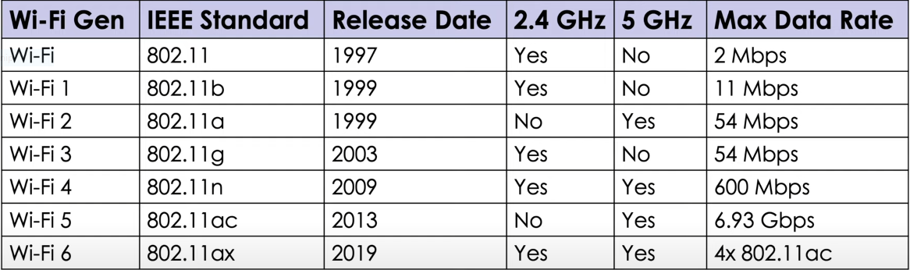

Slide 10
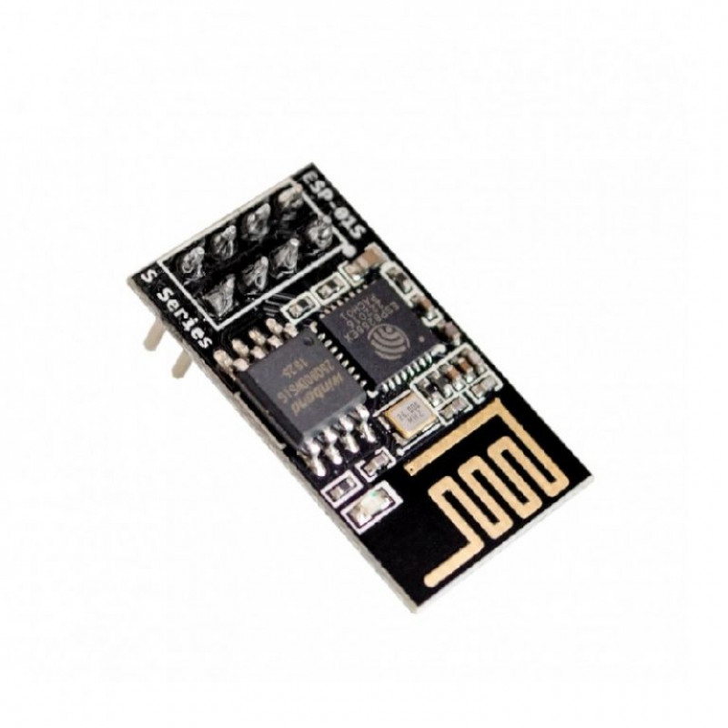
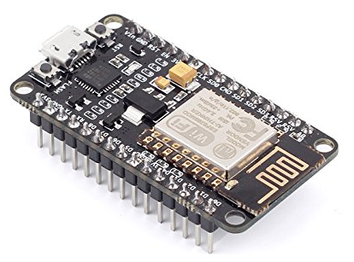
IMPLEMENTATION
Node Mcu & ESP8266
The ESP8266 is a low-cost WiFi chip with full TCP/IP stack and MCU (microcontroller unit) capability produced by Shanghai-based Chinese manufacturer, Espressif Systems.
NodeMCU is an open source IOT platform. It includes firmware which runs on the ESP8266 Wi-Fi SoC from Espressif Systems, and hardware.
ESP 8266 Node MCU

Slide 11
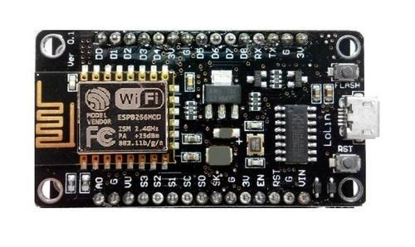
Node MCU
The NodeMCU (Node MicroController Unit) is an open source software and hardware development environment that is built around a very inexpensive System-on-a-Chip (SoC) called the ESP8266.
The ESP8266, designed and manufactured by Espressif Systems, contains all crucial elements of the modern computer: CPU, RAM, networking (wifi), and even a modern operating system and SDK.
Through its pins we can read inputs - light on a sensor, a finger on a button, or a Twitter message -and turn them into an output - activating a motor, turning on an LED, publishing something online.

Slide 12
APPLICATIONS OF WiFi JAMMER
🞈 Confidential Meetings
🞈 Ensure Peace and Quiet
🞈 Stop Distractions
🞈 Minimize Cyber Attacks
🞈 Disconnect Unwanted Devices
🞈 Prevent Cheating (exams)
🞈 Parental Control

Slide 13
DRAWBACKS OF WiFi JAMMER
🞈 Precision Is Difficult
🞈 Massive Collateral Damage
🞈 Federal Restrictions And Concerns
🞈 Other Complications

Slide 14

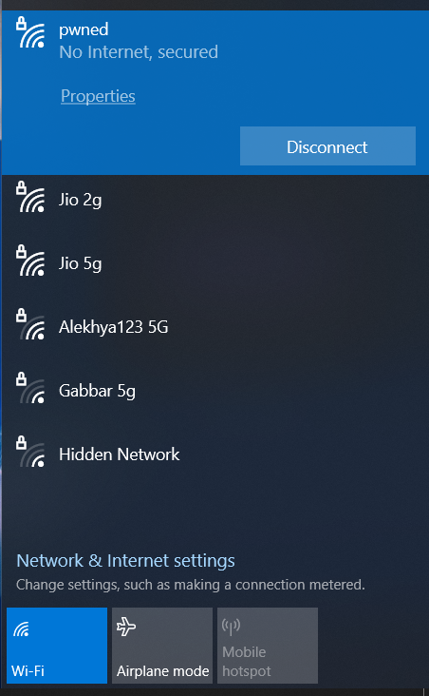
RESULT

Slide 15
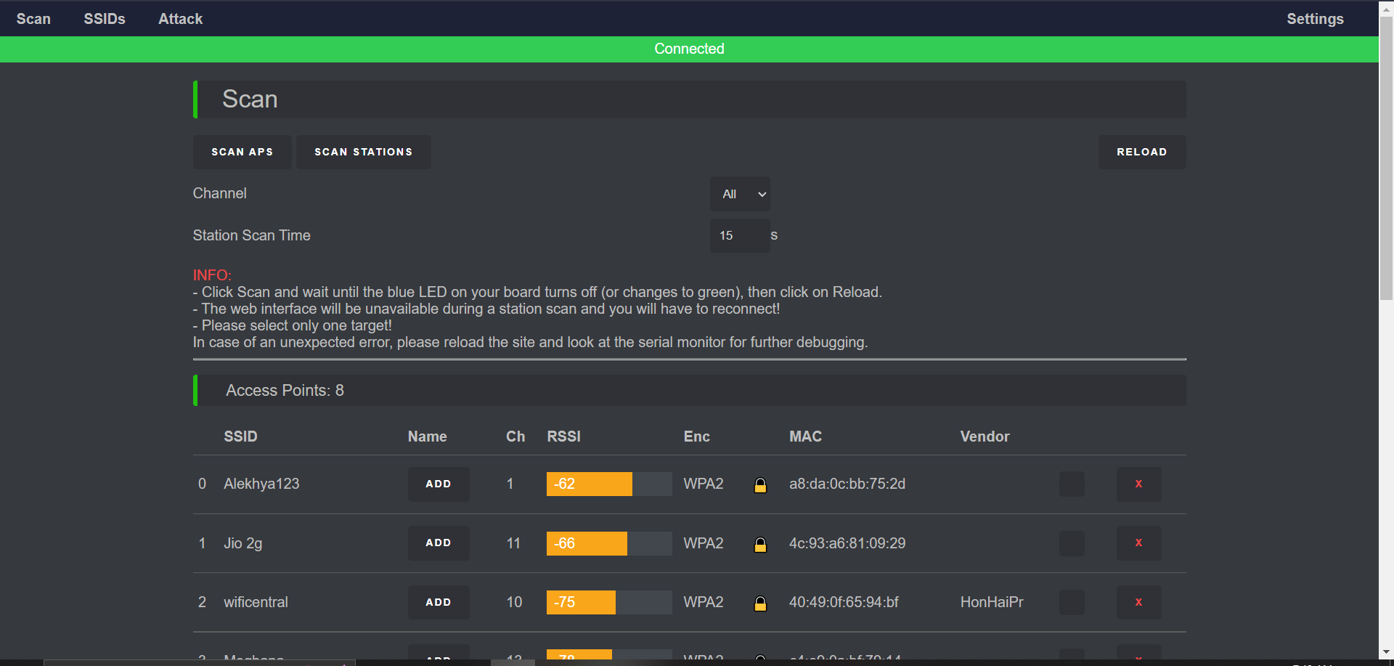
SCANNING NETWORKS

Slide 16
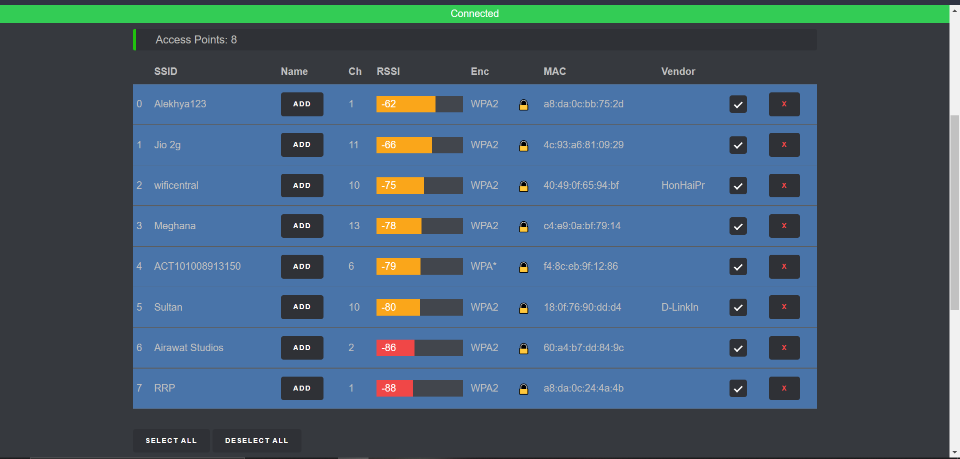
SELECTING NETWORKS

Slide 17
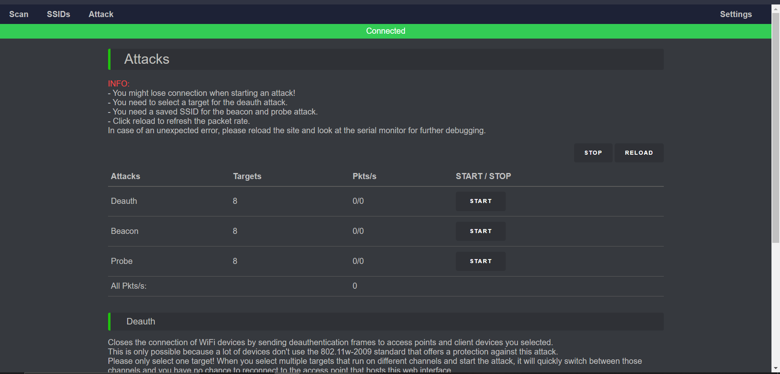
SELECTING ATTACK TYPE

Slide 18


DEAUTH ATTACK

Slide 19
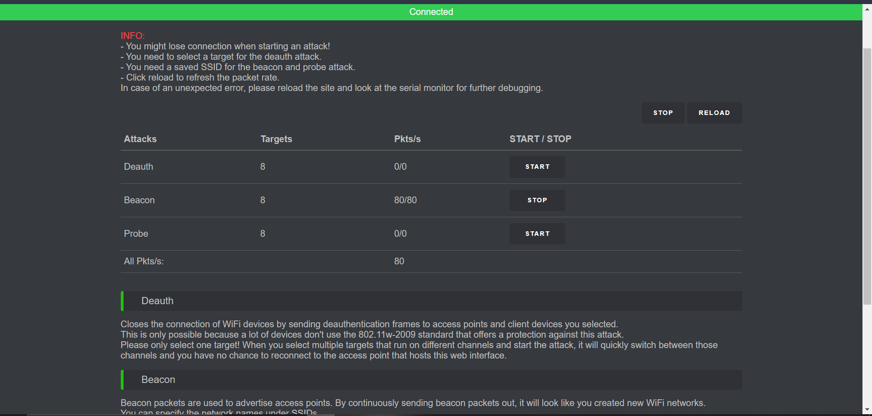
BEACON ATTACK

Slide 20
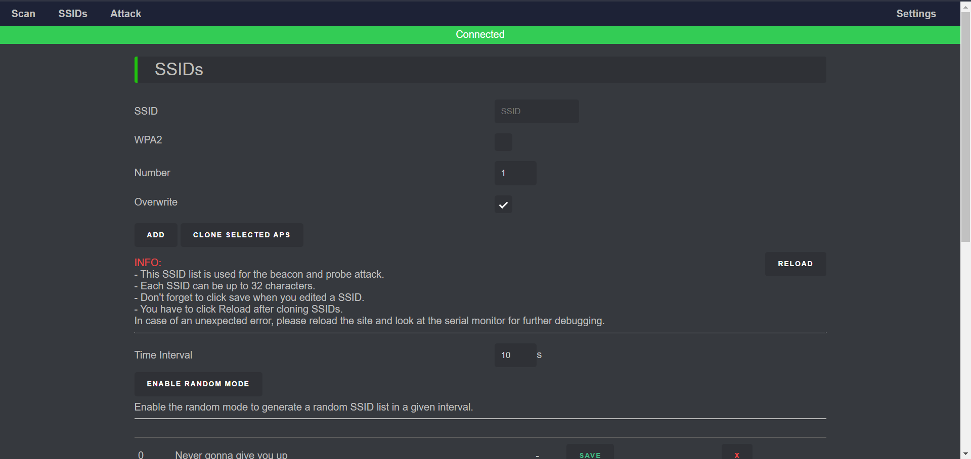
CLONING EXISTING SSIDs

Slide 21
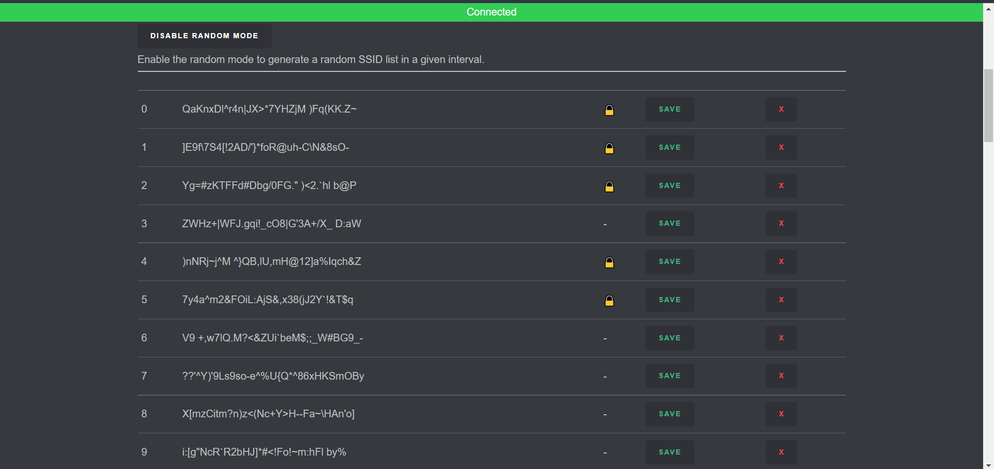
ENABLING RANDOM SSIDs GENERATION

Slide 22
CONCLUSION
Such a powerful tool like the internet needs limitations. It is a great channel for work and pleasure, allowing access to almost anything you can imagine with just a few clicks. On the other hand, it is also a huge risk to your privacy, security, and authority at work and home.
WiFi can be abused, and it often is. Obtaining and using a WiFi Jammer can be the answer to all concerns. Whether we need to regain control of our life, our workplace, or children, blocking WiFi will bring you peace of mind.

Slide 23
FUTURE SCOPE
Such a powerful tool like the internet needs limitations. It is a great channel for work and pleasure, allowing access to almost anything you can imagine with just a few clicks. On the other hand, it is also a huge risk to your privacy, security, and authority at work and home.

Slide 24
REFERENCES
https://www.researchgate.net/publication/224249602_Analysis_of_Jamming_Effects_on_IEEE_80211_Wireless_Networks
https://www.researchgate.net/publication/221551521_Short_Paper_Reactive_Jamming_in_Wireless_Networks-How_Realistic_is_the_Threat
https://arxiv.org/pdf/2101.00292.pdf
https://www.hindawi.com/journals/scn/2018/7670939/
https://kalitut.com/nodemcu-esp8266-wifi-jammer/

Slide 25
THANK YOU

