Slide 1
Problem Definition
To develop an AI-enabled voice based mobile application for digital transactions with regional language support for illiterate, rural people and people with disabilities.
Lack of Awareness
In the existing scenario, people manually go to the bank to get the banking service like money transactions. People get assistance through the Bheem app, Google pay, and phone pay, which is helpful for only literate people. That is not for those who do not know read and write.
Social Impact
Especially in India, where the literacy rate is low, the significant population is unaware of using computers and the internet. Then in such a case, how can we expect such people to use the applications developed in those environments?
Alternatives Shortcomings
Traditional digital payment is a reliable method, but it necessitates constant checking of account numbers, cross-checking among applications, among other things.
Alternative options do not offer voice payments to their customers. They do not support Indian regional language making it inconvenient and unhandy experience.

Slide 2
Market Sizing
Top Down Approach
Total Available Market (TAM):-
Market size of Digital Payments is 7.4 billion in india expected to grow at 19 compound annual growth rate to 32 billion by 2032
Serviceable Available Market (SAM):-
Our target customer is people in regional areas of India who speaks native languages only, illiterate and physically impared people, which comprises to 90% of the given market size comes around 6.66 billion.
Serviceable Obtainable Market (SOM):-
We consider that 20 percent of that will consider having desire for online home health care system, which equals to around 1.33 billion
TAM
7.4 Billion
SAM
6.66 billion
SOM
1.33 billion

Slide 3
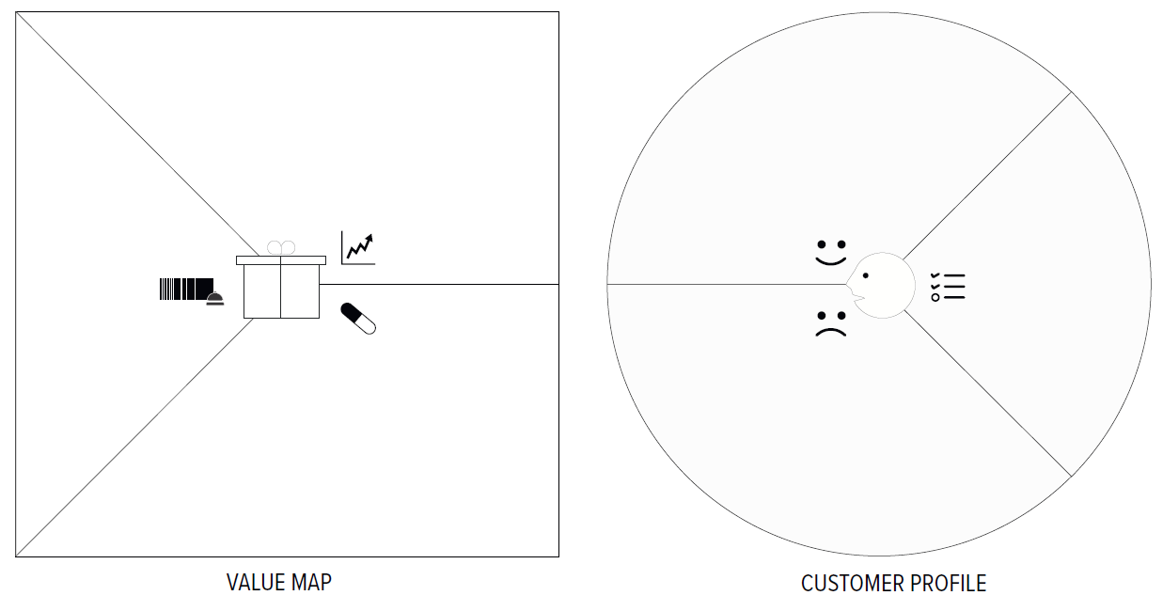
Value Proposition Canvas (Banks)
Gain Creator
Voice is the emerging payment avenue that traditional financial institutions and payment services providers need to harness.
Voice-based payment systems is creating a next-level customer experience.
Gains
An efficient and convenient way to make the banking service like money transactions easier.
A single platform by which bank can increase their reach, improve customer engagement, and improve their services.
Products and Services
An AI-enabled voice based mobile application for digital transactions.
​
Jobs-to-be-Done
Streamlined Banking: improving user experience by integrating voice technology into their apps.
Increased Accessibility: Voice -based Mobile apps made banking more accessible than ever.
Pain Reliever
A voice-based application presents a feasible service like transferring money, balance inquiry, etc., to the end-users.
Voice-enabled payments can be part of that new experience or used as another method for authenticating transactions.
Pains
Don't have any platform for regional language speakers and people with disabilities
The services do not cover wider population of rural india.

Slide 4
Value Proposition Canvas (Common People)
Gain Creator
Beneficial for people affected by blindness and vision impairments as it allows them to manage their money accessible and independently.
mobile banking is already in place, voice technology makes it more accessible on the go, as touch is not required.
Voice based application is a key enabler for a large percentage of the population to go on board with digital payments.
Gains
a quick and convenient method to make the transaction through voice in regional language.
Asking a voice assistant to transfer money is more accessible than typing in account numbers, IBANS, and double-checking between apps
Products and Services
A user-friendly mobile application for digital payments in local languages.
​
Jobs-to-be-Done
Anywhere and anyone can use its services.
Making banking transactions efficient and fast.
Pains
Difficult for the visually challenged people and rural people to make transaction in their regional language.
One has to type bank details making daily operations slow.
Pain Reliever
A single stop platform where all kinds of people literate or illiterate or blind can make payment efficiently.
Customers can get the best services without the exhausting typing bank details..​

Slide 5
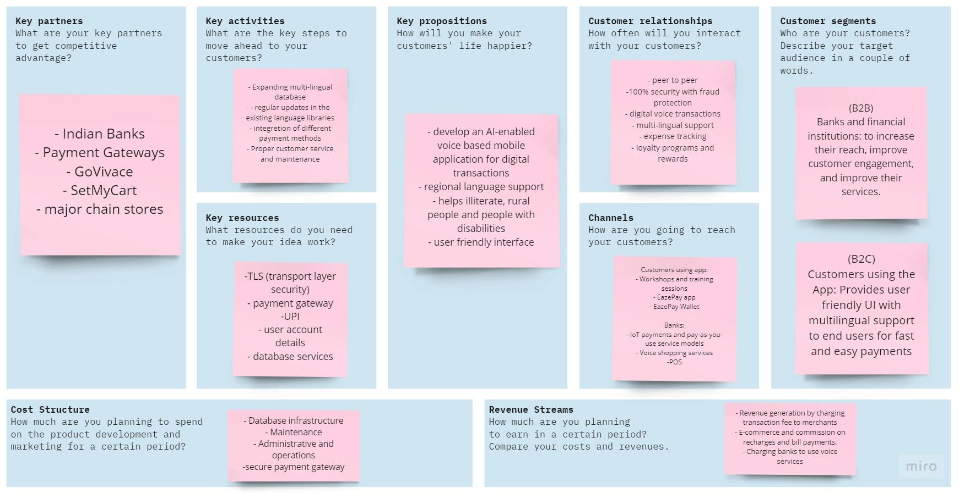
Business Model Canvas
‹#›

Slide 6
Financial planning
PFA : Financial planning Excel Sheet

