Slide 1


SMART INDIA HACKTHON 2025
JurisMind
Problem Statement ID – 25035
Problem Statement Title- Sentiment Analysis of comments received through E-consultation website
Theme- Miscellaneous
PS Category- Software
Team ID-
Team Name- Lunox

Slide 2
JurisMind
Lunox
→Problem Statement:
E-Consultation portals collect thousands of citizen comments, but manual analysis is inefficient and slow. Policymakers face difficulty extracting structured insights from large volumes of unorganized feedback.
→Proposed Solution:
A hybrid system that uses both ML/DL models and APIs to perform sentiment analysis, summarization, and word cloud generation. This ensures both high accuracy and real-time scalability for processing comments.
→Innovative Features:
Dual approach: custom models (LegalBERT, T5) + APIs (LegalParam, Gemini).
Sentiment classification into positive, negative, neutral categories.
Summarization of individual comments for quick understanding.
Word Cloud visualization for keyword emphasis and trending topics.
Integration of ROUGE score evaluation to measure summary quality.
Fast deployment with API-based pipelines for large-scale use.
→Uniqueness:
The system is unique as it combines research-grade transformers with scalable APIs in a single workflow. This dual-layer design ensures accuracy, speed, and usability, while providing insights through sentiment, summaries, and keyword visualization.
@SIH Idea submission- Template

Slide 3
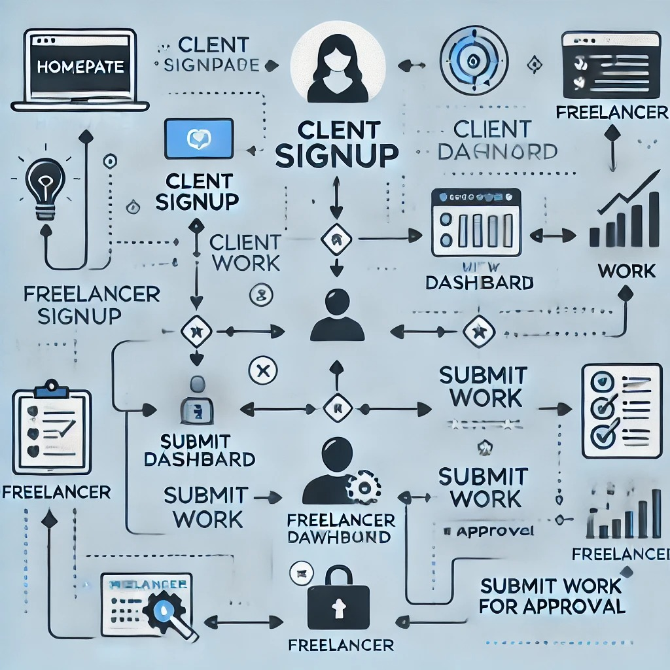
TECHNICAL APPROACH
Lunox
Technologies used
→Programming Languages:
Python (for preprocessing, ML/DL, Word Cloud).
→Frameworks & Libraries:
Transformers (LegalBERT, T5)
PyTorch / TensorFlow (model training)
Scikit-learn (ML baselines)
WordCloud (keyword visualization)
→APIs & Tools:
LegalParam API (sentiment analysis)
Gemini API (summarization)
WorkFlow
@SIH Idea submission- Template

Slide 4


FEASIBILITY AND VIABILITY
Lunox
Analysis of Feasibility of Idea:
The demand for automated text analysis is rapidly growing in government and policy-making sectors, making the project highly practical. E-Consultation portals in India receive thousands of comments, and applying AI-driven sentiment and summarization tools makes analysis efficient and impactful.
The integration of transformer models (LegalBERT, T5) with APIs (LegalParam, Gemini) ensures both accuracy and scalability. The system can be deployed at scale with minimal manual intervention while delivering high-quality insights.
Future Scope:- Text to voice as well as language translation of summaries of each comment will also be added later on.
Challenges:
Handling large volume of comments in real time
Ensuring high accuracy of sentiment classification across diverse opinions
Avoiding low-quality summaries due to long and complex sentences
Managing API limitations such as request rate, cost or downtime
Strategies:
Hybrid Approach:- Using ML/DL models for training accuracy+ APIs for real time speed(Dual methodology)
Performance Evaluation:- Measure summarization using ROGUE scores for quality
Scalability Solution:- Optimize preprocessing and API calls for bult comment handling
Visualization Tools:- Provide Word Clouds and sentiment dashboards for clarity
Fallback Mechanisms:- Switch between models and APIs if one fails or underperforms
@SIH Idea submission- Template

Slide 5


IMPACT AND BENEFITS
Lunox
IMPACT:
Expands access to valuable insights from large volumes of public feedback aiding for faster policy making.
Improves decision-making efficiency and summarization of citizen comments.
Encourages Transparency and citizen engagement by providing clear sentiments and summary info on comments.
Supports scalable operations allowing analysis of thousands of comments.
BENEFITS:
Connects policymakers with actionable insights derived from public opinion.
Reduces time and effort spent on manual comment review and reporting.
Ensuring higher accuracy of sentiment detection and summary quality and summary quality using hybrid ML/DL+API approaches
Provides a robust framework that can be adapted for multiple e-consultation platforms
Visualizations like Word Clouds make key trends easy to interpret at a glance.
@SIH Idea submission- Template

Slide 6


RESEARCH AND REFERENCES
Lunox
REFERENCES:
Analyzed research papers and articles on sentiment analysis and summarization of citizen feedback from e-consultation portals.
Studied transformers-based models like LegalBERT and t5 to understand their application in legal and policy text analysis.
Explored API-based solutions such as LegalParam and Gemini for real-time processing and scalability
Referred to tutorials and Documentation for python libraries including Transformers,PyTorch, TensorFlow and WordCloud for implementation
LINKS:
Source 1: https://www.mdpi.com/2076-3417/13/12/7111.
Source 2: https://www.sciencedirect.com/science/article/pii/S2949719124000189#sec3.
Source 3:https://arxiv.org/abs/2010.02559
Source 4: https://huggingface.co/bharatgenai/LegalParam
Source 5: https://pmc.ncbi.nlm.nih.gov/articles/PMC8011436/
Source 6:https://huggingface.co/describeai/gemini
@SIH Idea submission- Template

