Slide 1



{ 150 }
Problem Statement Title:- Project Enrollment & Allocation System
Team Members:
Ragi Harshith Reddy
Parna Revanth Kumar
Vishwanath
Abhishek
CBIT Hacktoberfest 2025
Notes:
3

Slide 2
150
{ Proposed Solution }
Compared to the existing traditional project allocations,Ours propose a solution that overcome all of the following challenges:-
->Time consuming review process
->No standardized skill assessment for project matching
->Certification forgery and Credential Fraud
->Lack of transparency in Decision making
->Poor optimization of resumes leading to missed opportunities
Our Solution:-
Our proposed Solution is an Intelligent-Automated Platform that combines AI-matching , blockchain verification as well as on-spot collaboration for optimal project allocation. It transforms the error-prone process into an intelligent,transparent,optimal system.
Key Features:-
Multi-Tenant Architecture(Super Admins manage companies, Admins post, review applications, etc)
AI powered Matching(Smart Project Recommendation, ATS-optimized resume, Skill-based filtering)
Company-Student Collaboration(Dedicated communication channels, Secure company-scoped workspaces)
Reliable
CBIT Hacktoberfest 2025
Notes:
3

Slide 3
150
{ Tech Stack }
Our Tech-Stack is as follows:-
Frontend: React 18 with Tailwind CSS, Framer Motion, and Recharts for modern, animated, data-driven UI; Socket.IO Client for real-time updates.
Backend: Node.js + Express powering REST APIs with MongoDB (via Mongoose), Redis for caching/sessions, and Socket.IO for live communication.
Security & Communication: JWT for authentication, Nodemailer for emails, and Twilio for SMS notifications.
Blockchain & Storage: Polygon for smart contracts, IPFS/Infura for decentralized file storage, Web3.js for blockchain integration, and PDFKit for digital certificates.
DevOps: Docker with multi-stage builds for lightweight containers, managed via Nginx as a reverse proxy.
CBIT Hacktoberfest 2025
Notes:
3

Slide 4
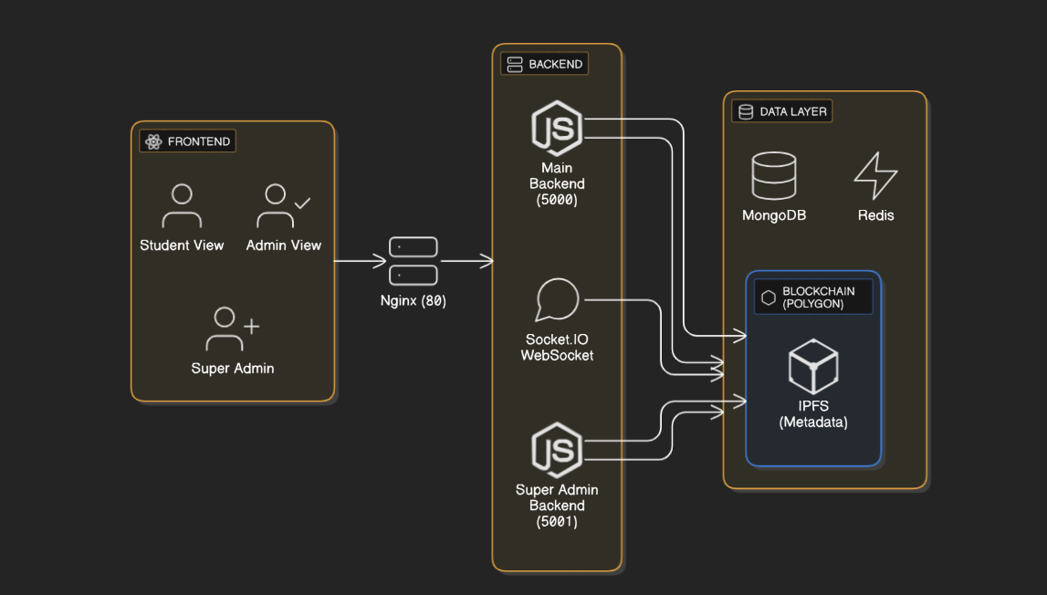
Team no
{ System Architecture }
Unique Features:-
->Companies are isolated from one another(Can’t see another’s work)
->Students must join approved companies
->Super Admin has overall access and is the company entity.
->Admin sees the context of an answer instead of a single word
->Case Study questions for real life problem solving
->Timer based assessment with anti-cheat monitoring.
CBIT Hacktoberfest 2025
Notes:
3

Slide 5
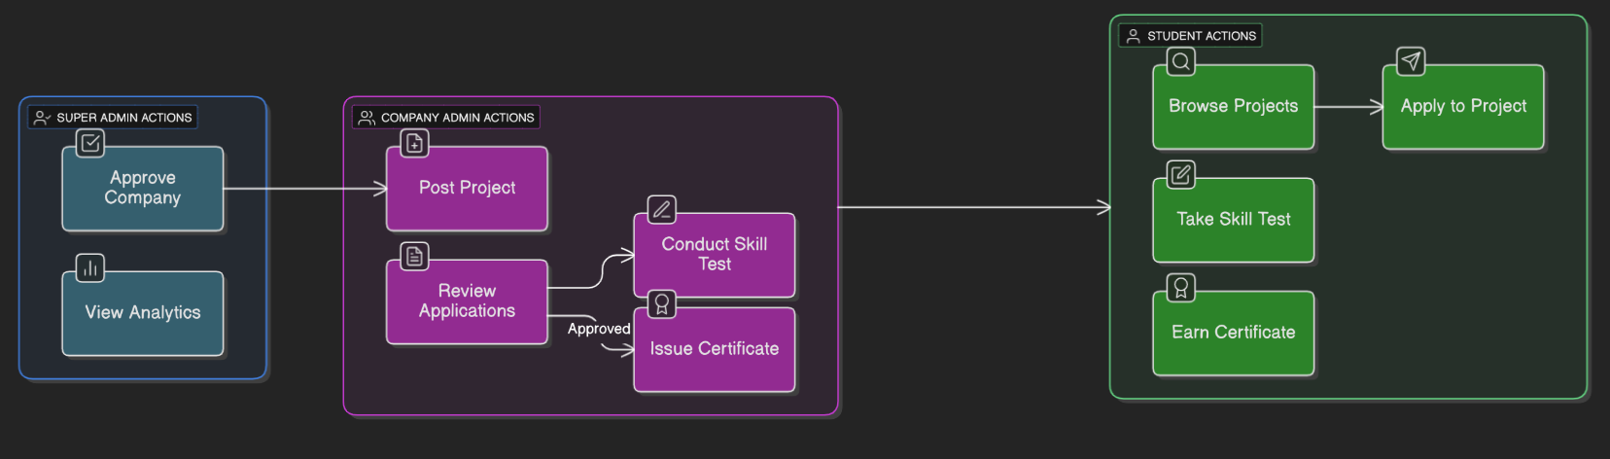
{ Implementation }
150
1. Docker Multi-Container Setup
Services: MongoDB, Redis, Main Backend (5000), Super Admin (5001), Frontend (3000), Nginx (80)
✅ One-command deploy: docker-compose up
2. Database Design
7 Models: User, Company, Project, Application, Resume, TestAttempt, Certificate
Compound indexes for speed & auto data seeding
3. API Development
50+ REST APIs with auth & RBAC
Input validation (Joi/Express-Validator), central error handling
4. Frontend State Management
React Context (auth), React Query (server state)
LocalStorage (UI prefs), Socket.IO (real-time updates)
CBIT Hacktoberfest 2025
Notes:
3

Slide 6
150
{ Challenges and Outcomes }
1. Multi-Tenant Isolation
Problem: Cross-company data leak
Fix: companyId in all models + auto filter middleware + super admin bypass
2. Real-Time Test Monitoring
Problem: Multiple tab cheating
Fix: Socket.IO rooms, tab-switch & network tracking, 3-strike ban
3. Resume ATS Scoring
Problem: Complex scoring logic
Fix: Keyword extraction, weighted scoring, live suggestions
4. Blockchain Integration
Problem: High Ethereum gas fees
Fix: Moved to Polygon, batch minting, IPFS metadata
5. Responsive Sidebar Layout
Problem: Hidden content on expand
Fix: Flexbox layout, smooth CSS transitions, saved sidebar state
6. PDF Generation in Docker
Problem: Puppeteer Chromium issue
Fix: Switched to PDFKit → faster, lighter, no browser dependency
CBIT Hacktoberfest 2025
Notes:
3

Slide 7
150
{ Impact & Use Cases }
Impact
Students: 50% faster applications, 80%+ ATS scores, verified blockchain certificates, AI project matches, transparent tracking.
Company Admins: 70% less review time, automated skill tests, chat & analytics, real-time updates.
Super Admins: Centralized control, system analytics, secure workflows, usage insights.
Use Cases
Universities: Auto shortlisting, blockchain certificates.
Corporates: Cross-department upskilling with tracked progress.
Open Source: Public projects & blockchain proof of contribution.
Freelance: Verified skill-based matching.
Hackathons: AI team formation & instant certification.
CBIT Hacktoberfest 2025
Notes:
3

