Slide 1

Community Project Review 2 Branch: CSE- IoT, Cybersecurity with Blockchain Technology Department: Data Engineering Semester: V Regulation: R23 Course Code: R23MSCSP001
Project Title: Voice ED: Inclusive Exams For All
Batch Number: 10
SS. No | Register Number | Student Name
1 | 23331A4714 | EDAM REVANTH
2 | 23331A4722 | KARNA PARDHASARADI REDDY
3 | 23331A4734 | MEESALA KOMALI
4 | 23331A4738 | NADUPURU VENKATA CHARU VARDAN
Guide Name: N.Sowjanya kumari
Designation:Assistant Professor
Project Coordinator: Mr. V. Manikanta
Designation: Assistant Professor
Head of the Department: Dr. V. Jyothi
Designation: Associate Professor

Slide 2
Abstract
The project Voice Ed: Inclusive Exams for All aims to eliminate the barriers faced by visually impaired students in online examinations. Traditional exam platforms often lack screen-reader compatibility and require mouse or keyboard input, creating accessibility challenges. Voice Ed introduces a voice-driven online examination system powered by Text-to-Speech (TTS) and Speech-to-Text (STT) technologies. The system allows students to listen to questions, speak answers, and navigate exams through simple voice Commands. The platform also enables teachers to create and grade exams in an accessible environment, thereby promoting digital inclusivity and independent learning for all.

Slide 3
Introduction
Core Challenge: Visually impaired students struggle with traditional online exams due to incompatibility with assistive tools and complex navigation.
Key Issues:
Lack of screen-reader support.
Over-dependence on proctors for assistance.
Reliance on mouse/keyboard navigation.
Low accessibility awareness in existing platforms.
Our Solution: Voice Ed provides a fully voice-enabled and accessible exam portal using speech technologies and web accessibility standards.
Project Focus: Creating an inclusive digital examination system that ensures equal learning opportunities for differently-abled students.

Slide 4
Project Objectives
To develop a voice-controlled online examination system.
To integrate Text-to-Speech (TTS) for reading questions aloud.
To implement Speech-to-Text (STT) for capturing answers.
To ensure keyboard-free, voice-based navigation.
To design accessible exam creation and grading tools for teachers.
To promote inclusive education through universal accessibility standards.

Slide 5
Problem Statement
Existing online exam platforms are not designed for visually impaired users.
Problems Identified:
Lack of compatibility with screen readers.
Difficulty in navigating interfaces.
Dependence on human assistance during exams.
Reduced independence and privacy for students.
Limited awareness of accessibility tools among educators.

Slide 6
Project Scope
Core Product: A web-based voice-enabled online exam system with TTS and STT support.
Accessibility:
Fully screen-reader compatible.
Adjustable text size, color contrast, and audio feedback.
Supports multiple regional languages.
Target Users:
Visually impaired students.
Teachers conducting inclusive exams.
Additional Scope:
Tools for accessible exam creation and grading.
Cloud-based deployment for scalability and availability.

Slide 7
Literature Review/ Background Study
Research shows a significant gap in digital inclusivity within current educational systems.
Popular LMS platforms (like Moodle and Google Classroom) lack voice-first interaction.
Speech recognition and web accessibility standards (WCAG, ARIA) open new possibilities.
According to WHO, over 250 million people worldwide are visually impaired — highlighting the need for such inclusive systems.

Slide 8
Data used
User feedback from visually impaired students and teachers.
Accessibility standards:
WCAG 2.1, ARIA Guidelines.
Speech API benchmarks:
Google Speech API, Web Speech API, Azure STT.
Survey data on assistive technologies (NVDA, VoiceOver, etc….).

Slide 9
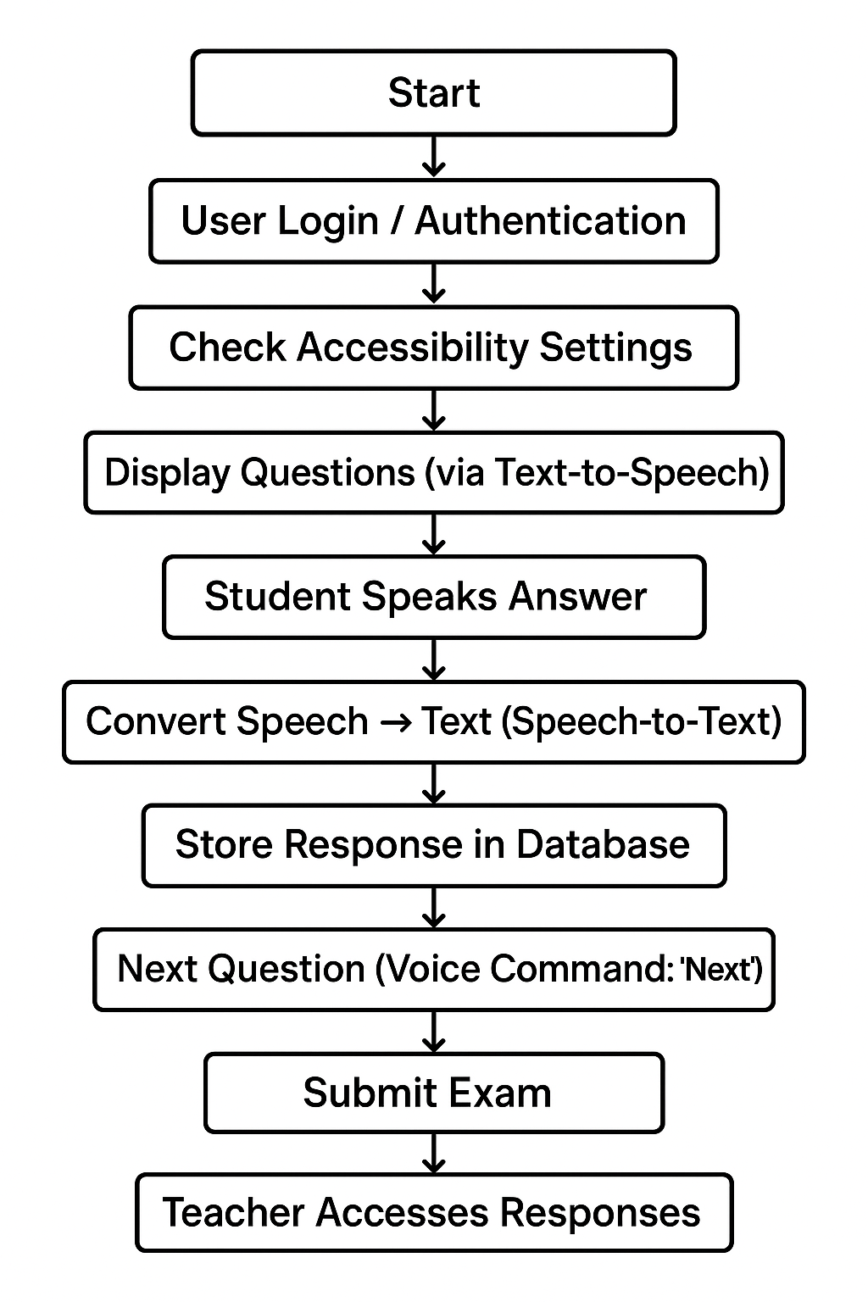
Methodology and Proposed Solution
Flowchart:
Input:
User text/voice, functional requirements, accessibility needs. Processing:
Frontend/backend development, TTS & STT integration. Recognition:
STT speech recognition, accessibility testing, user feedback analysis. Output:
Audio/text responses, accessibility reports, deployed system with user guides.

Slide 10
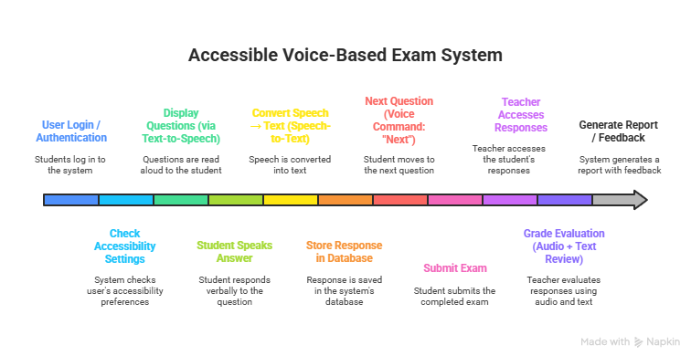
Methodology and Proposed Solution(cont.)
Block Diagram

Slide 11
Implementation
Link to code: https://github.com/23331a4722/voiceed.git, https://iijayfukdbujy8mloqt7.share.dreamflow.app/
Key snippet:
Tech Stack Diagram
Frontend (Client App)
Framework: Flutter
Language: Dart
UI Toolkit: Material Design
Pages: Dashboard Page, Landing Page
Backend (Services Layer)
Auth Service: Handles user login and authentication
Voice Service: Manages Text-to-Speech (TTS) and Speech-to-Text (STT
Exam Service: Manages exam data
Question Service: Loads and manages questions
Exam Attempt Service: Tracks student attempts and responses
Infrastructure
Theme Management: light Theme / dark Theme setup
Async Initialization: Widgets Flutter Binding + async service setup
Navigation: Decides between Dashboard Page or Landing Page based on login status

Slide 12
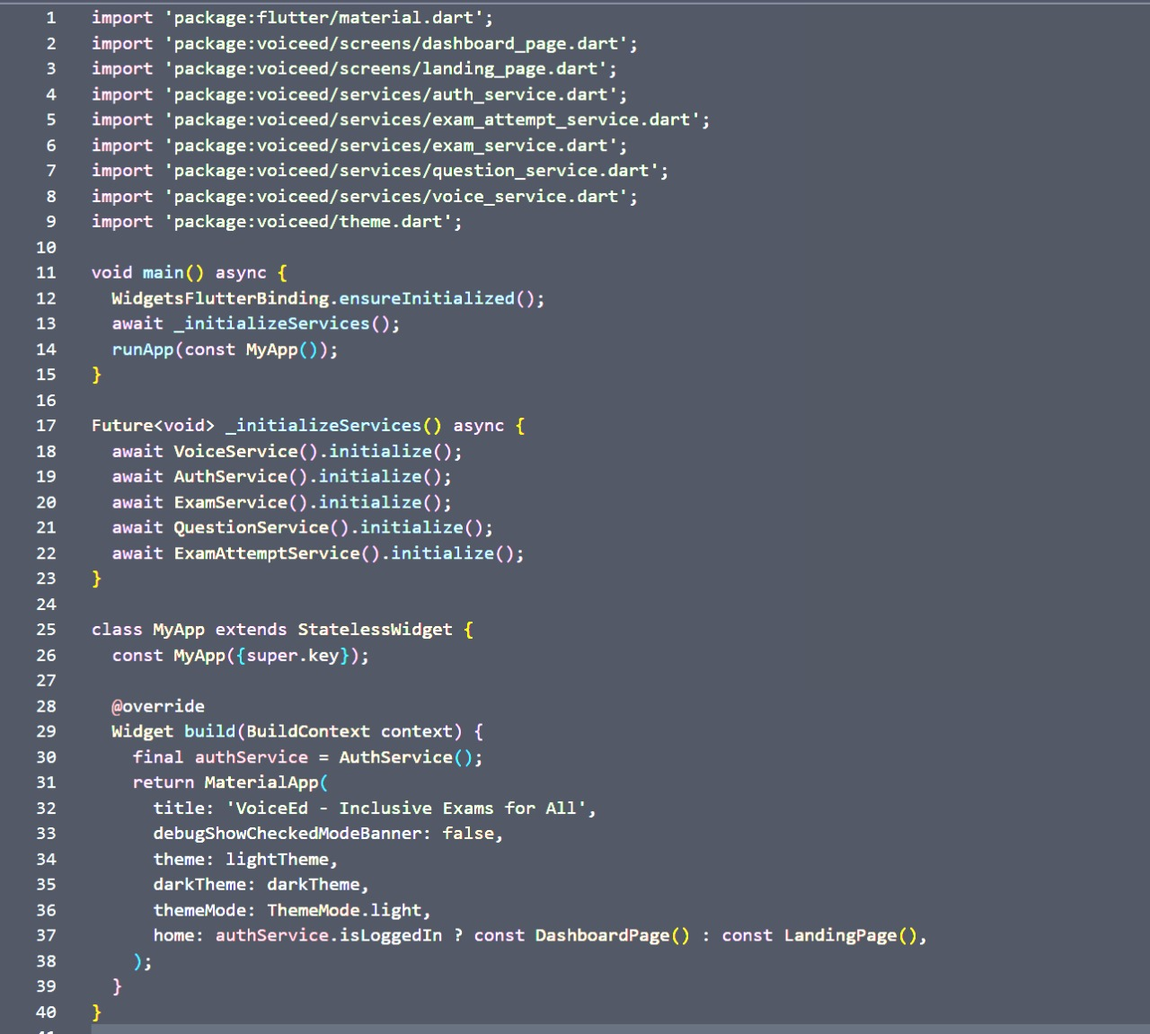
Implementation

Slide 13
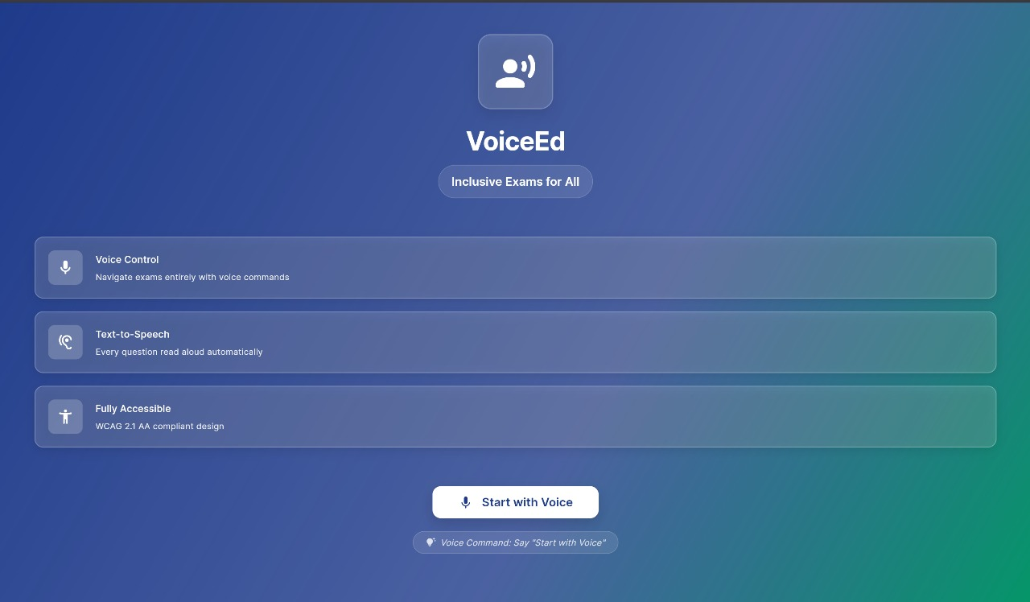
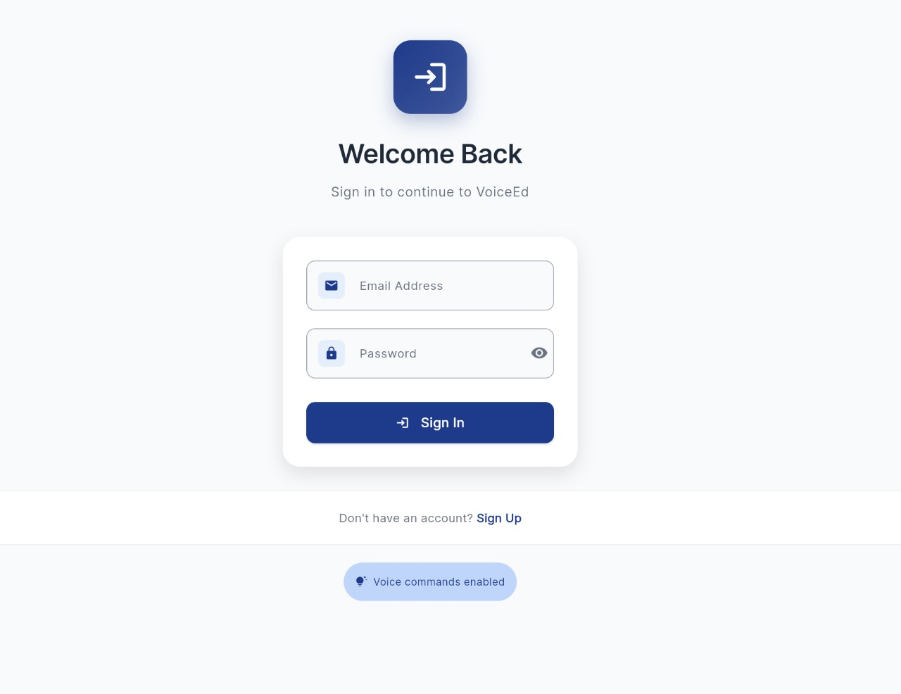
Results (Full) / Screenshots

Slide 14
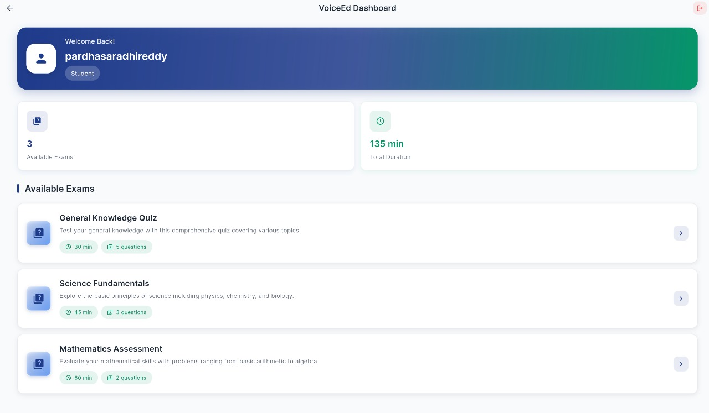
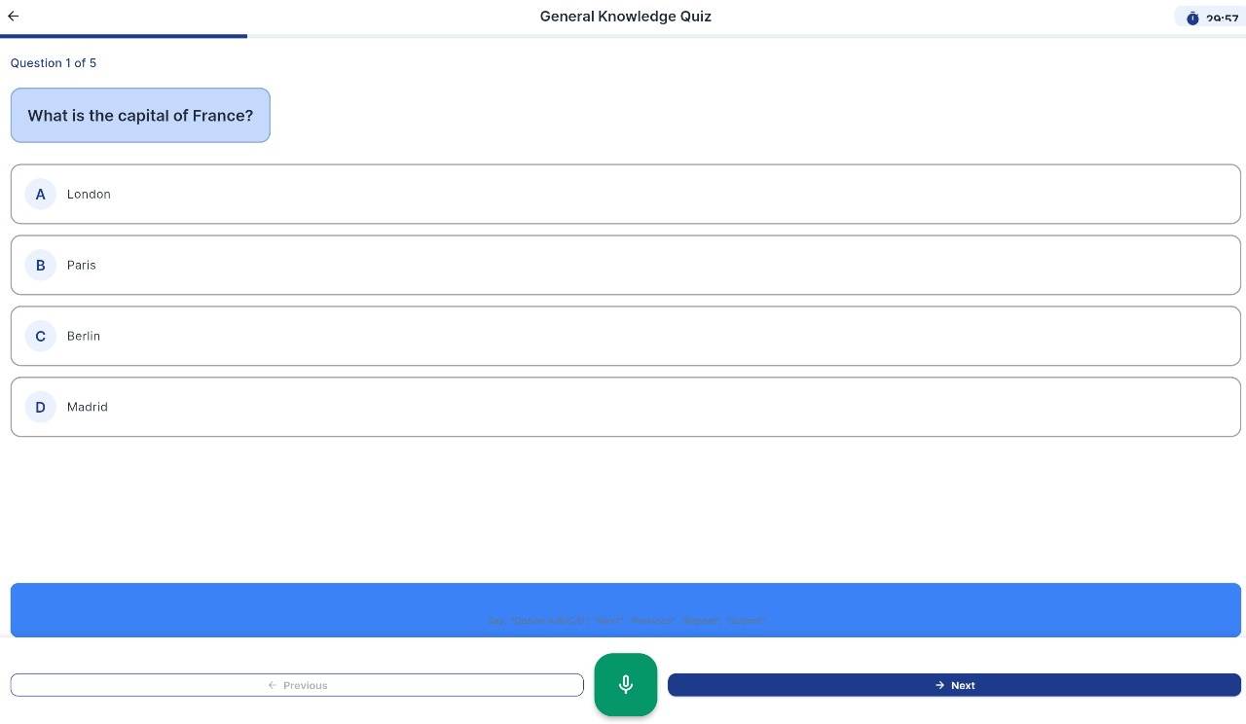
Results (Full) / Screenshots

Slide 15
Impact Assessment
Qualitative Impact:
Promotes inclusivity and equality in education.
Reduces dependency on external help.
Encourages adoption of accessible design in academic systems.

Slide 16
Challenges Faced
Technical Challenges:
Synchronizing TTS and STT responses.
Ensuring multi-browser accessibility.
Managing latency in voice processing.
Operational Challenges:
Collecting feedback from diverse user groups.
Training teachers to use accessibility tools.

Slide 17
Future Work
Add AI-driven speech error correction for improved STT accuracy.
Integrate regional language support (Telugu, Hindi, etc.).
Develop a mobile application version for easier access.
Collaborate with educational institutions and NGOs for implementation.

Slide 18
Conclusion
The Voice Ed project demonstrates how voice technologies can transform online learning for visually impaired students.
By combining speech recognition, accessibility standards, and inclusive design, Voice Ed offers a practical, empowering, and scalable solution to make exams accessible for everyone.

Slide 19
References
World Health Organization (WHO) – Visual Impairment Statistics.
Web Content Accessibility Guidelines (WCAG 2.1).
Google Cloud Speech-to-Text API Documentation.
Mozilla Accessibility Developer Tools.

Slide 20
Any Queries/ Questions?

