Slide 1
Mutual Fund Analytics Platform
Bluestock Fintech Capstone Project
Prepared by: Peethala Revanth

Slide 2
Problem Statement
Investors face difficulty comparing mutual fund schemes across different fund houses and categories.
Mutual fund information is distributed across multiple sources, making analysis time-consuming.
Evaluating returns, risk, expense ratios, and portfolio performance manually is challenging.
A unified analytics platform is required to provide data-driven investment insights.
Solution: Developed an end-to-end Mutual Fund Analytics Platform using Python, SQLite, SQL, and Power BI.

Slide 3
Objectives
Develop an end-to-end Mutual Fund Analytics Platform.
Automate data ingestion and data cleaning.
Perform Exploratory Data Analysis (EDA).
Evaluate mutual fund performance using financial metrics.
Build an interactive Power BI dashboard.
Support data-driven investment decisions.

Slide 4
Project Architecture
Raw Datasets
Data Ingestion
Data Cleaning
SQLite Database
EDA
Performance Analytics
Advanced Analytics
Power BI Dashboard
Insights & Recommendations

Slide 5
Dataset Overview
Total Datasets: 10
Mutual Fund Master Data
NAV History
Scheme Performance
Investor Transactions
Portfolio Holdings
Benchmark & Industry Statistics

Slide 6
Key Information
Dataset | Records
Fund Master | 40
NAV History | 46,000
Transactions | 32,778
Holdings | 322
Benchmark Records | 8,050
Comprehensive dataset covering mutual fund performance, investor transactions, and portfolio holdings.
The datasets provide a strong foundation for analytics, visualization, and investment decision-making.

Slide 7
Data Ingestion & Cleaning
Data Ingestion
Imported all CSV datasets using Pandas.
Validated dataset structure using head(), shape(), and info().
Verified data consistency before preprocessing.
Data Cleaning
Removed invalid and inconsistent records.
Converted date columns to datetime format.
Validated numerical fields.
Exported cleaned datasets for further analysis.

Slide 8
Exploratory Data Analysis(EDA)
Key Analyses
Daily NAV Trend Analysis
Fund House Analysis
Risk Category Analysis
Key Findings
Most mutual fund schemes showed positive long-term NAV growth.
Multiple leading AMCs were represented in the dataset.
Most schemes belonged to Moderate and High-risk categories.
Outcome:
EDA helped identify key trends, fund characteristics, and investment patterns, providing the foundation for further performance analysis.

Slide 9
Performance Analytics
Metrics Analyzed
Return Analysis
Risk-Adjusted Performance
Volatility Analysis
Key Insights
Higher long-term returns
Better risk-adjusted funds
Lower volatility in debt funds
Outcome:
Performance analytics enabled comparison of mutual fund schemes based on returns, risk, and stability, helping identify better investment opportunities

Slide 10
Advanced Analytics
Techniques Used
Sharpe Ratio
Value at Risk (VaR)
Conditional Value at Risk (CVaR)
Mutual Fund Recommendation System
Key Insights
Better risk-adjusted returns
Estimated downside risk
Extreme loss analysis
Personalized fund selection
Outcome:
Advanced analytics provided deeper insights into fund performance, investment risk, and personalized mutual fund recommendations.

Slide 11
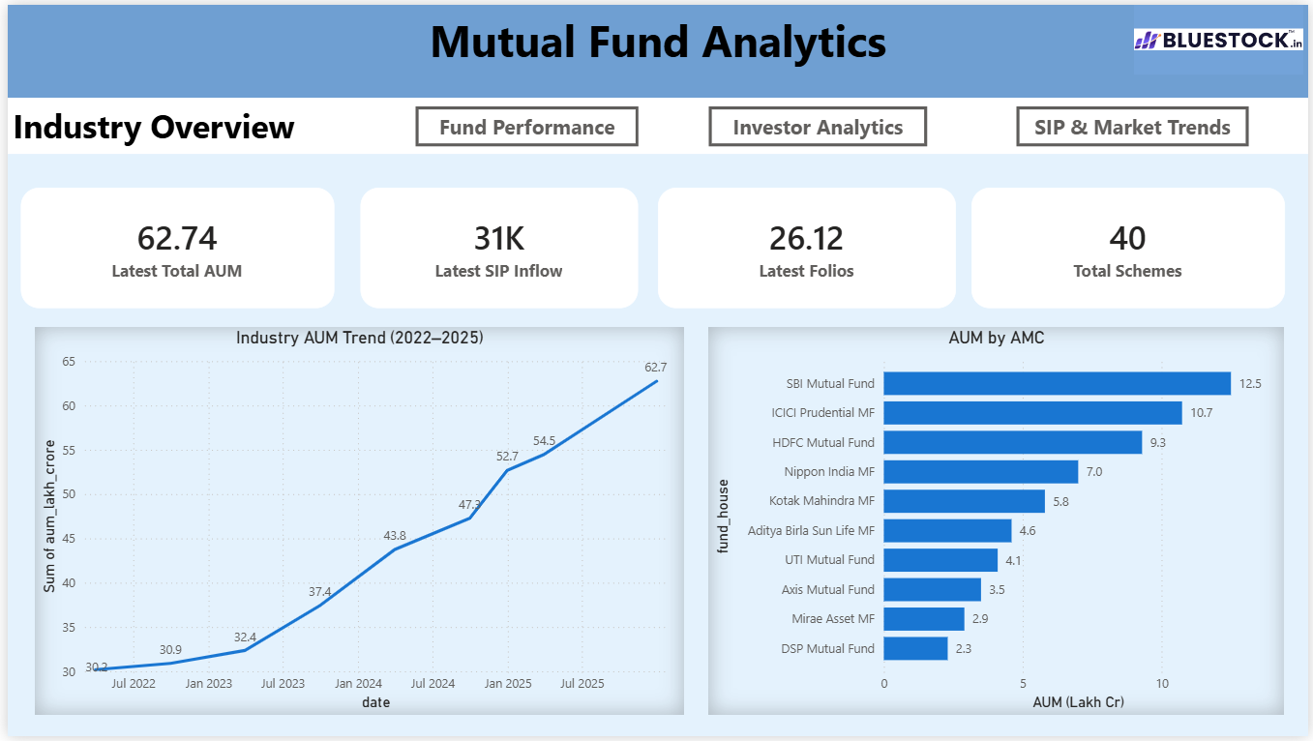
Power BI Dashboard
An interactive Power BI dashboard was developed to visualize mutual fund performance, portfolio statistics, and investment trends.

Slide 12
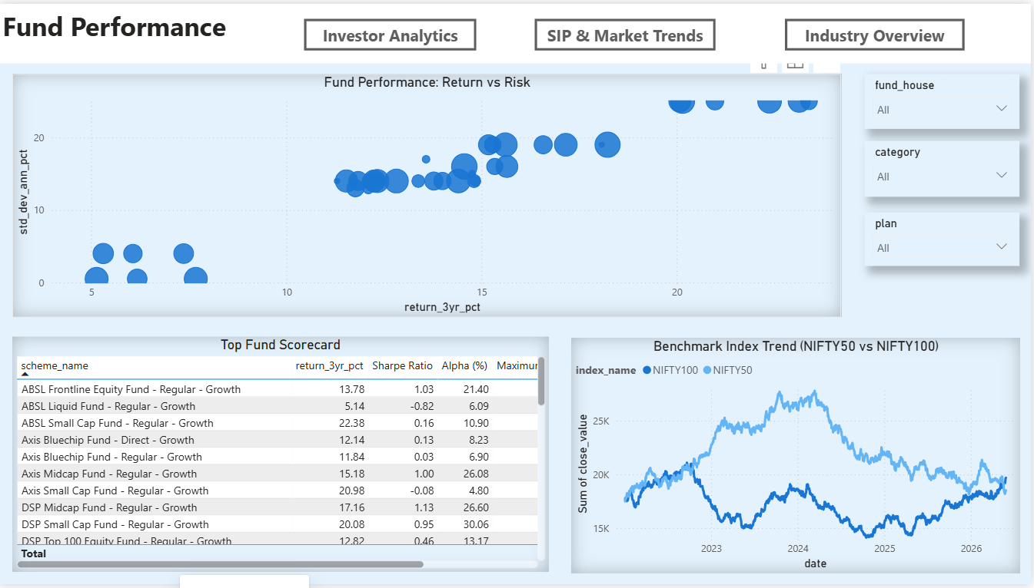

Slide 13
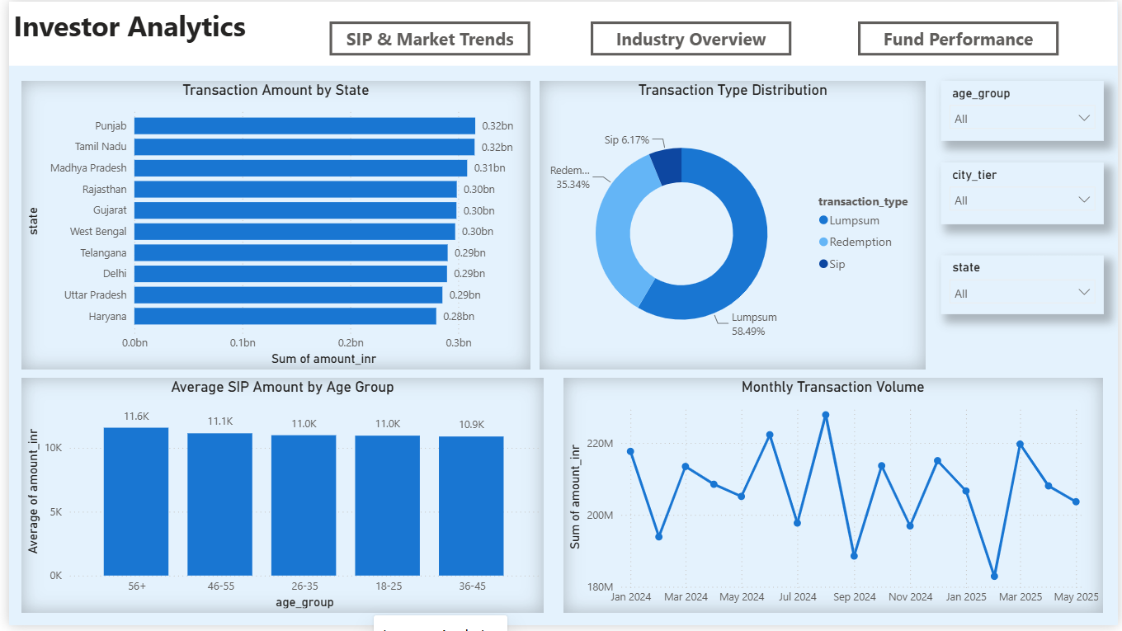
Interactive dashboard developed using Power BI for mutual fund performance analysis.

Slide 14
Dashboard Features
Interactive KPI Cards
Fund-wise Performance Analysis
Risk Category Analysis
NAV Trend Visualization
Dynamic Filters and Slicers
Key Insights
Identified top-performing mutual fund schemes.
Compared returns across fund categories.
Simplified investment analysis through interactive visuals.

Slide 15
Technologies Used
Technology | Purpose
Python | Data Processing & Analysis
Pandas | Data Cleaning & Manipulation
SQLite | Database Management
SQL | Data Querying
Power BI | Dashboard & Visualization
Git & GitHub | Version Control
Jupyter Notebook | Development Environment
Integrated modern data analytics tools to build an end-to-end Mutual Fund Analytics Platform.

Slide 16
Conclusion
Successfully developed an end-to-end Mutual Fund Analytics Platform.
Automated data ingestion, cleaning, analysis, and visualization.
Built an interactive Power BI dashboard for investment insights.
Applied advanced analytics to evaluate mutual fund performance.
Future Scope
Integrate live NAV data using APIs.
Apply Machine Learning for return prediction.
Enhance the recommendation system using AI.
Deploy the platform as a web application.

Slide 17
Thank You!
Questions?

