Slide 1

r
You
Diabetes Prediction using KNN
r
You
Diabetes Prediction using KNN
er
You
Diabetes Prediction using KNN
REVANTH P
Nmid: CCEE040BD7034328855496B2631A6422
Madras Institute of Technology campus, Anna University
Final Project
Diabetes Prediction using KNN
(Diabetes dataset)

Slide 2
PROJECT TITLE
Diabetes Prediction using KNN (Diabetes dataset)
3/21/2024 Annual Review

Slide 3


AGENDA
Despite its simplicity and effectiveness, KNN has limitations. It can be computationally expensive, especially for large datasets, as it requires comparing distances with all training data points. Additionally, KNN is sensitive to noisy data and outliers, which can adversely affect its performance. Nonetheless, understanding these fundamentals is essential for effectively applying KNN in diabetes prediction and other classification tasks.
3/21/2024 Annual Review

Slide 4
PROBLEM STATEMENT
Diabetes is a chronic condition that affects millions of people worldwide, with early detection and management being crucial for preventing complications. In this context, the task is to develop a predictive model to accurately identify individuals at risk of diabetes using machine learning techniques.
The challenge lies in building a model that The dataset used for this task consists of various features such as glucose level, blood pressure, BMI, age, etc., collected from individuals along with labels indicating whether they have diabetes or not.
3/21/2024 Annual Review

Slide 5
PROJECT OVERVIEW
Collect a dataset comprising medical data attributes such as glucose level, blood pressure, BMI, and age, along with corresponding diabetes status labels.
Preprocess the dataset by handling missing values, outliers, and scaling features. Split the dataset into training and testing sets.
Experiment with different machine learning algorithms such as K-Nearest Neighbors (KNN), Logistic Regression, and Decision Trees to determine the most suitable model for diabetes prediction.
3/21/2024 Annual Review

Slide 6

WHO ARE THE END USERS?
Healthcare Professionals
Individuals and Patients
Healthcare Professionals:
Utilizing Predictive Insights
Supporting Clinical Decision Making
Individuals and Patients:
Empowering Personal Health Management
Accessing Personalized Risk Assessment
3/21/2024 Annual Review

Slide 7
YOUR SOLUTION AND ITS VALUE PROPOSITION
Accurate Predictive Model: Our predictive model utilizes sophisticated machine learning algorithms trained on comprehensive datasets to provide accurate predictions of diabetes risk. By analyzing various medical attributes such as glucose levels, blood pressure, BMI, and age, our system offers personalized risk assessments tailored to individual patients.
Proposed Model Accuracy:
Accuracy: 0.11688311688311688
Scalability and Adaptability: Built on scalable and adaptable technology infrastructure, our solution can accommodate diverse healthcare settings and patient populations. Whether deployed in hospitals, clinics, or integrated into telehealth platforms, our system delivers consistent performance and reliability, ensuring widespread access to predictive analytics for diabetes prevention and management
3/21/2024 Annual Review

Slide 8
THE WOW IN YOUR SOLUTION
Hyper-Personalized Precision: Our solution delivers hyper-personalized predictions, leveraging advanced algorithms to provide highly accurate risk assessments tailored to each individual's medical profile.
Real-time Actionable Insights: Healthcare professionals access instant, actionable insights at the point of care, enabling prompt intervention and proactive management of diabetes risk during patient consultations.
Continuous Learning and Improvement: Our solution continuously learns from new data, evolving to improve predictive accuracy over time. By staying dynamic and adaptive, it ensures ongoing optimization and effectiveness in predicting diabetes risk.
3/21/2024 Annual Review

Slide 9
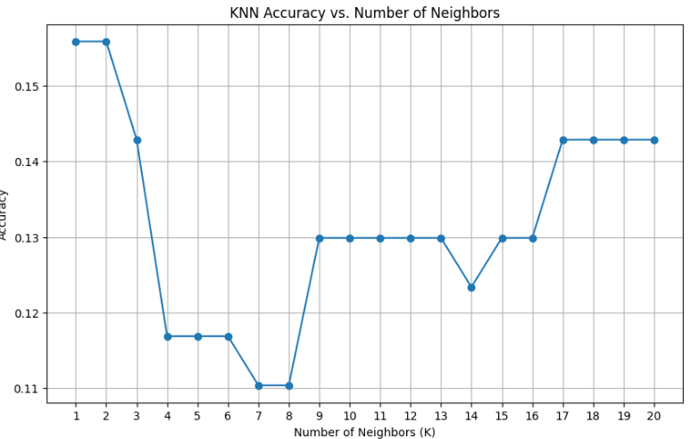
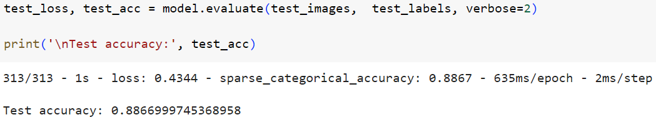
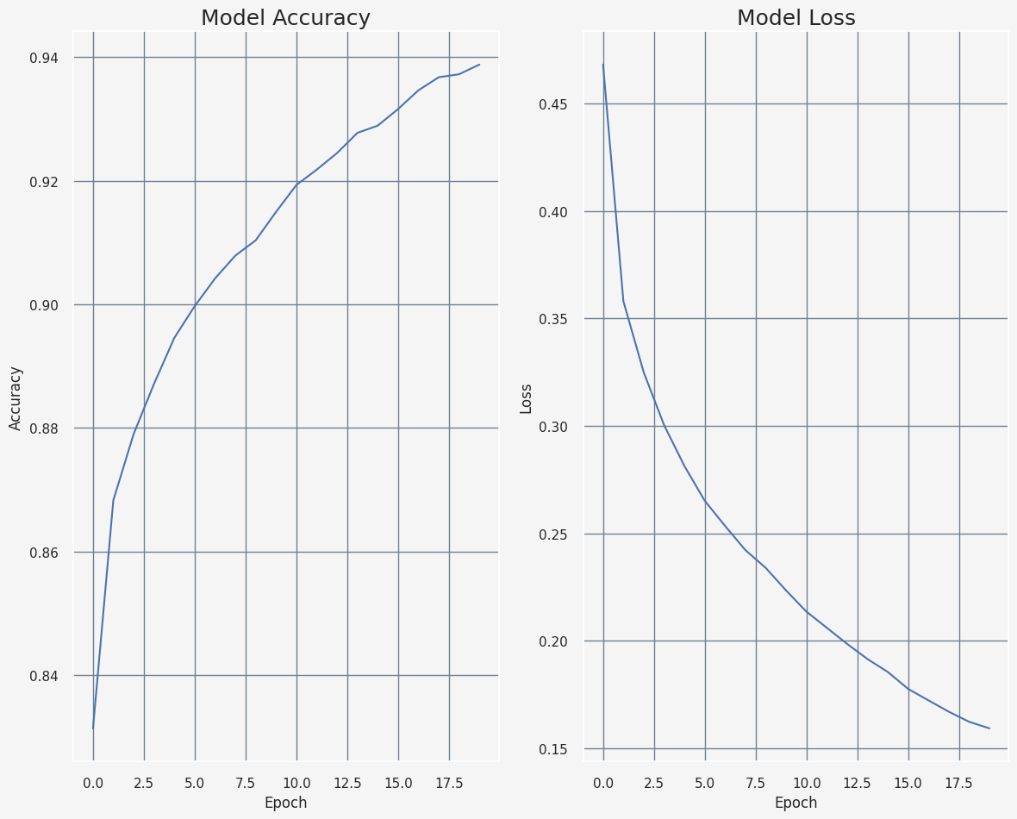
Accuracy of the model

