Slide 1
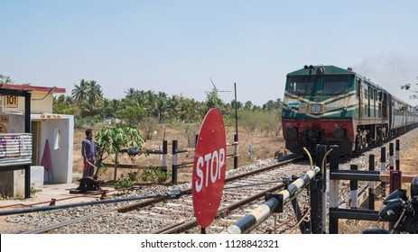
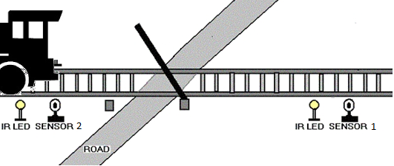
Automatic railway gate CONTROLLERsystem UNDER THE ESTEEMED GUIDANCE OF MR.K.JANAKIRAM ASSISTANT PROFESSOR
Submitted By,
D. Harsha VARDHINI 201FA05010
V. Lakshmi REVANTH KUMAR 201FA05043
B.RAHUL 201FA05059
G.BALAJI 211LA05021

Slide 2
ABSTRACT
There has been a increase in the road traffic as well as the rail traffic, accidents at level crossing has increased and this has caused the concern for the Bangladesh railways. In this project we are proposing a simple solution for the level crossing in which we fix the IR sensing system for detecting the train. By employing the automatic railway gate control at the level crossing the arrival of the train is detected by the sensors placed near to the gate. Hence, the time for which it is closed is less compared to the manually operated gates.

Slide 3
introduction
Level crossing is the area where the rail line intersects with the road which is used by transportation or other vehicles.
To prevent accidents and to reduce the risk of human errors ,we are introducing the automated safety system named “Level Crossing” has been developed which help in automatically opening and closing the railway gate upon detecting arrival or departure of the train.
Manual control, where the railway gate or level crossing is opened or closed by a gateman who was informed from the nearest railway station about the arrival of a train is not errors free.

Slide 4
OBJECTIVES
To develop an automated level crossing system.
To reduce human error.
To reduce maintenance cost.
To reduce accident.
To increase the reliability of the level crossing system.
To reduce operation time

Slide 5
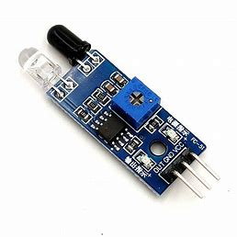
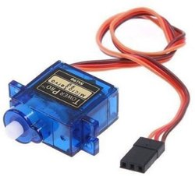
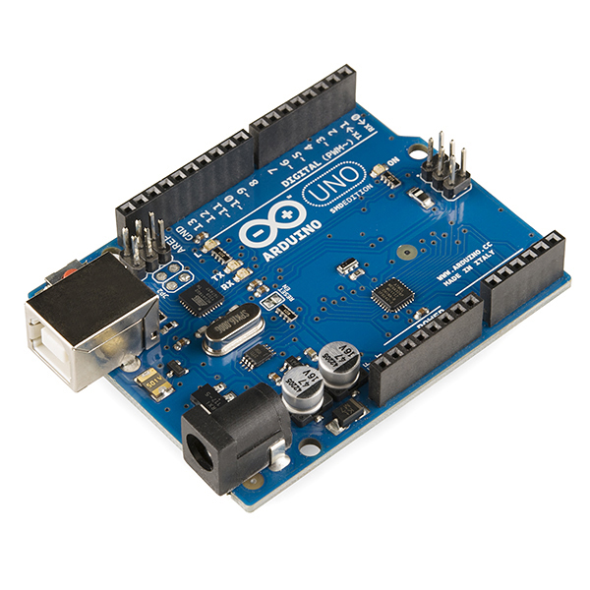
hardware used in this project
Arduino UNO
IR Sensor
Servo Motor
Power Supply
LEDs (red and green)
Breadboard
Connecting Wires
Train Kit

Slide 6
IR SENSOR
IR technology is used in a wide range of wireless applications which includes remote controls and sensing. The infrared part in the electromagnetic spectrum can be separated into three main regions: near IR, mid-IR & far IR. The wavelengths of these three regions vary based on the application. For the near IR region, the wavelength ranges from 700 nm- 1400 nm, the wavelength of the mid-IR region ranges from 1400 nm – 3000 nm & finally for the far IR region, the wavelength ranges from 3000 nm – 1 mm.
The near IR region is used on fiber optic & IR sensors, the mid-IR region is used for heat sensing and the far IR region is used in thermal imaging. The range of frequency for IR is maximum as compared to microwave and minimum than visible light.

Slide 7
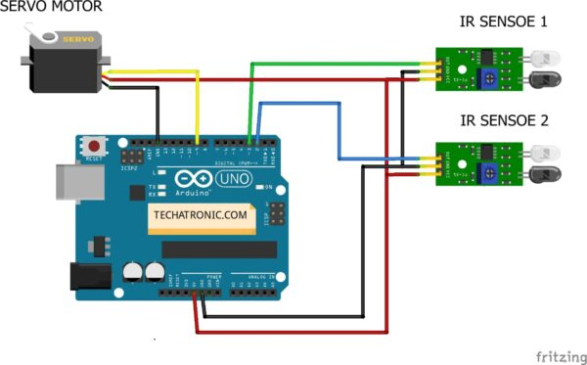
CIRCUIT CONNECTIONS
Arduino Uno

Slide 8
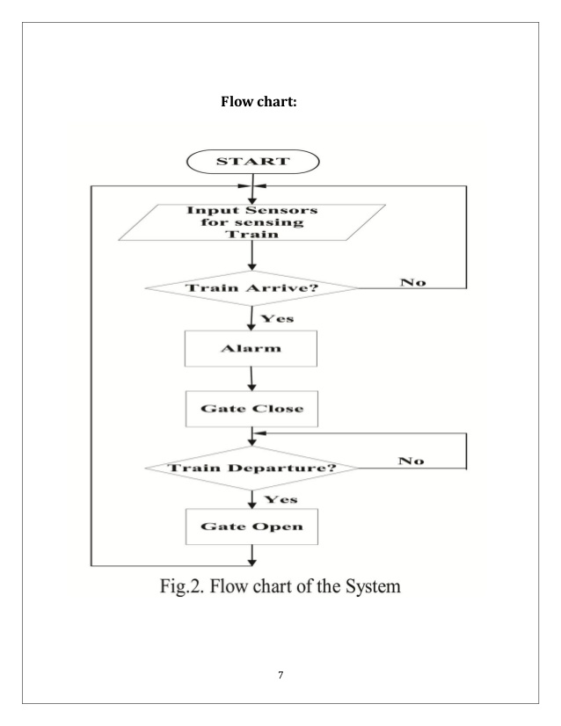
FLOWCHART

Slide 9
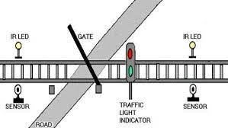
WORKING PRINCIPLE OF SYSTEM
Two IR sensors are used to detect the train arrival and departure.
When the sensor 1 detect the arrival of train, it will send the data to the Arduino. The received data will be used as input to the Arduino and the output is used to drive servo motors down and for glowing Red Light(LED).
The buzzer signal is activated to indicate the arrival of train to everybody at the level crossing end.
When the train will leave, the sensor 2 at the other end will detect the departure and send the data using wire connection which will cause the level crossing(servo motor) to go up and to glow green Light(LED).

Slide 10
APPLICATIONS
This Circuit can be used in Railway near Railway Gate.
This Can be also used in car parking areas.
This can be used security areas like military and also in own apartment.

Slide 11
advantages
Prevention of accident inside the gate.
Reduction of the time to wait vehicle.
No need for gatekeeper.
The mechanism of simple and easy to operate.
Human intervention at level crossings can be removed with the help of this project and many railway level crossing accidents can be prevented.

Slide 12
CONCLUSION
In this project, we have used simple equipment that is more economic rather than the system which is available in the current railway gate controlling system.
Since the design is completely automated it can be used in remote villages where no station master or line man is present. Railway sensors are placed at two sides of gate. It is used to sense the arrival and departure of the train.
Automatic gate control system offers an effective way to reduce the occurrence of railway accidents. This system can contribute a lot of benefit either to the road users or to the railway management.

Slide 13
REFERENCES
[1] J.Banuchandar , V.Kaliraj , P.Balasubramanian, S.Deepa, N.Thamilarasi , “AUTOMATED UNMANNED RAILWAY LEVEL CROSSING SYSTEM”. International Journal of Modern Engineering Research (IJMER) www.ijmer.com Vol.2, Issue.1, Jan-Feb 2012 pp-458-463 ISSN: 2249-6645.
[2] Ahmed Salih Mahdi, Al-Zuhairi, “Automatic Railway Gate and Crossing Control based Sensors & Microcontroller” International Journal of Computer Trends and Technology (IJCTT) – volume 4 Issue 7–July 2013.
[3] Subrata Biswas, Rafiul Hoque Bhuiyan, Samiul Hoque, Robiul Hasan, Tanzila Nusrat Khan, “Pressure Sensed Fast Response Anti-Collision System for Automated Railway Gate Control, " American Journal of Engineering Research (AJER) e-ISSN : 2320-0847 p-ISSN : 2320-0936 Volume02, Issue-11, pp-163-173.
[4] Sandhya gautam, sandip nemade, teena sakla. simulation of an anti-collisionsystem on same track for railways. International Journal of Engineering and Technology, vol. 2(9), page 4832-4837,2010.

Slide 14
Thank You

