Slide 1

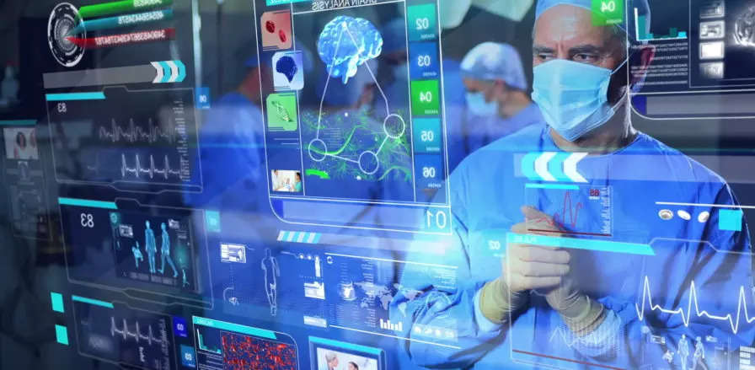
PATIENT HEALTH MONITORING SYSTEM USING RASPBERRY PI
INTER DEPARTMENTAL PROJECT-II
Presented By -
Guidance of
Mr. K. Janaki Ram., M. Tech(Ph.D.)
201FA05010-D.Harsha Vardhini
201FA05043-V. Lakshmi Revanth Kumar
201FA05059-B.Rahul
211LA05021-G.Balaji
Batch No: IDPEC22-AL19

Slide 2
CONTENTS
Objective
Introduction
Circuit Diagram
Components
Block Diagram
Advantages
Applications
Conclusion
Future Scope
References

Slide 3
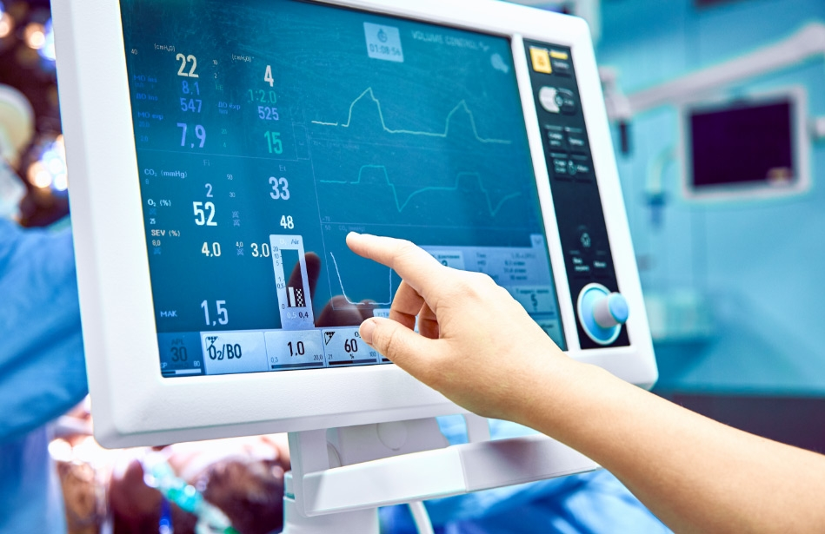
OBJECTIVE
The goal of our project is to analyze body temperature and heart rate in order to accurately diagnose the patient's condition and provide a better treatment as quickly as possible. These analyses can wirelessly transmit data to the doctor's location, and we collect data from people of various ages, with the data being stored in ThingSpeak.
Fig1: Health monitoring system

Slide 4
INTRODUCTION
Formerly, it was hard for doctors to monitor patients in remote places during critical conditions. So we developed a mechanism that continuously monitors the patient's state and automatically send the data to thing speak cloud, allowing the doctor to view the data at all times and informing carers when the patient is in critical condition. With prior systems, patient monitoring was only possible by utilizing various devices for different metrics.
The project on health monitoring system is real time and made using Raspberry pi, ThingSpeak cloud , Raspberry pi OS and circuit.io.

Slide 5
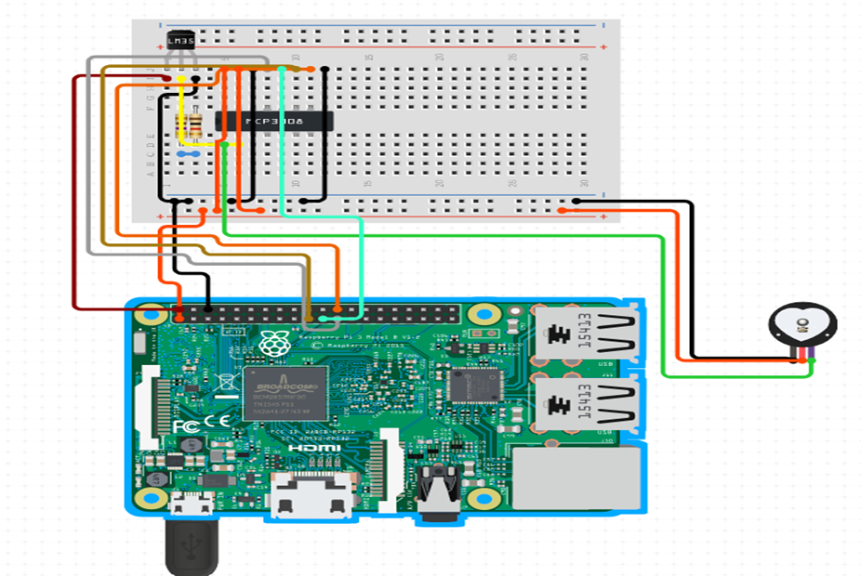
HARDWARE DESIGN
Fig2: Circuit Diagram of Patient Monitoring System

Slide 6
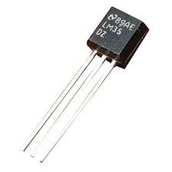
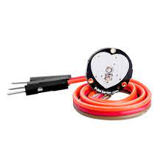
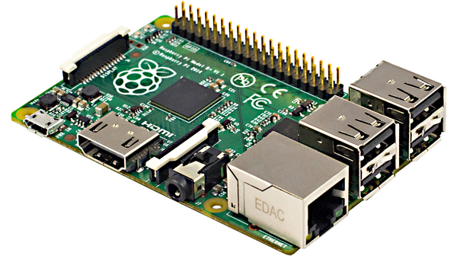
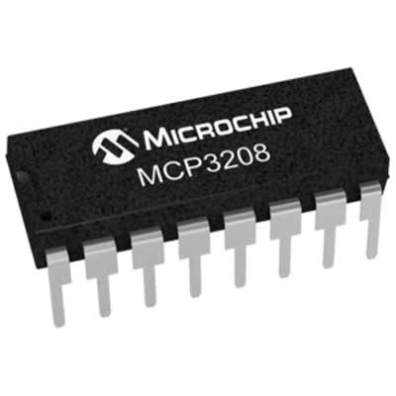
COMPONENTS REQUIRED
Hardware Requirements:
Fig5: LM35 Temperature Sensor
Fig4: pulse sensor
Fig3: Raspberry pi
Fig6: MCP3208 ADC

Slide 7
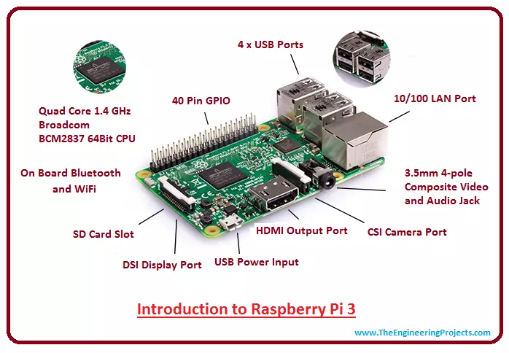
Raspberry pi
The Raspberry Pi is a low-cost, credit-card-sized computer that connects to a computer display or television and operates with a regular keyboard and mouse.
It is a competent tiny gadget that allows individuals of all ages to experiment with computing and learn to write in languages such as Scratch and Python.
They have a variety of input and output interfaces, including HDMI, USB, Ethernet, and GPIO pins, making it simple to connect to numerous devices and sensors.
Fig7: Raspberry pi

Slide 8
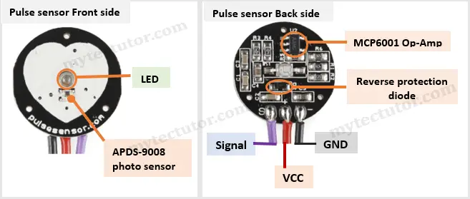
Heart beat sensor
Heart beat sensor provides a simple way to study the function of the heart which can be measured based on the principle of psycho-physiological signal used as a for the virtual for the stimulus for the virtual reality system.
The sensor shines are light low (a small very bright LED) through the ear or finger and measures the light that get transmitted to the LDR.
Fig8: pulse sensor

Slide 9
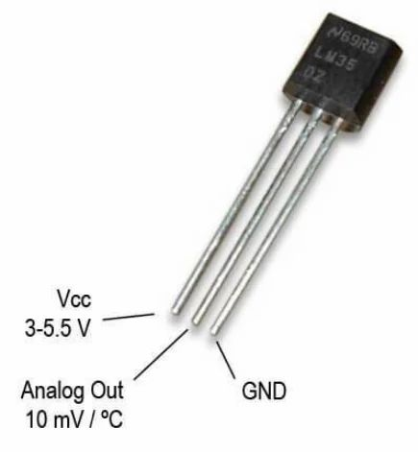
Temperature sensor
LM35 sensor measure temperature more accurate than a using a thermistor since it is industrial temperature sensor, therefore it is accurate and economical.
It generate higher output voltage than thermocouple so no need to amplify the output voltage. The output voltage is directly proportional to the Celsius temperature.
The LM35 does not require any external calibration
Fig9: LM35

Slide 10
MCP3208
One of the well-known A/D converter ICs is the MCP3208. This chip will give your microcontroller or microcomputer project 8 channels of 12-bit analogue input. Only 4 pins are needed because it utilises SPI and is really simple to operate. Since the Raspberry Pi does not have an ADC but does have exciting analogue inputs, we thought this chip would be a perfect addition to the Pi.
Fig10: MCP3208 ADC

Slide 11
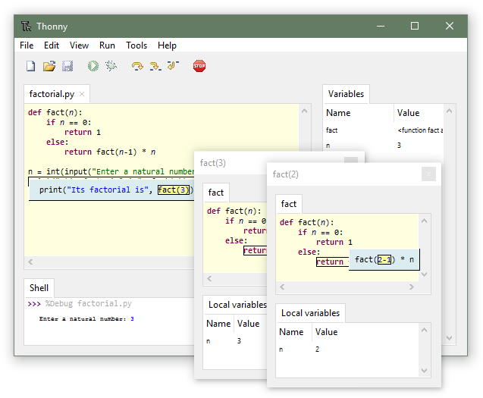
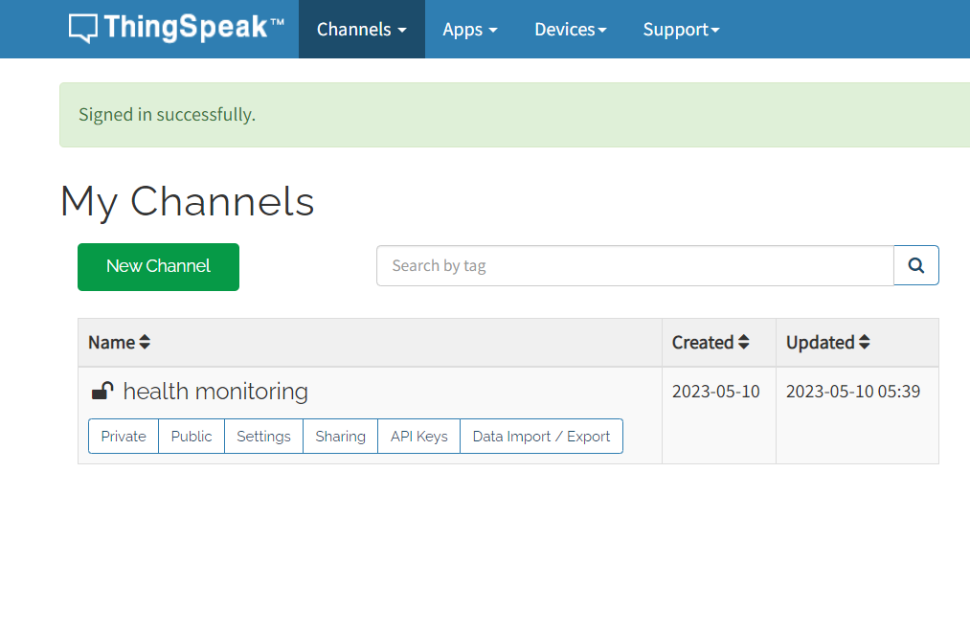
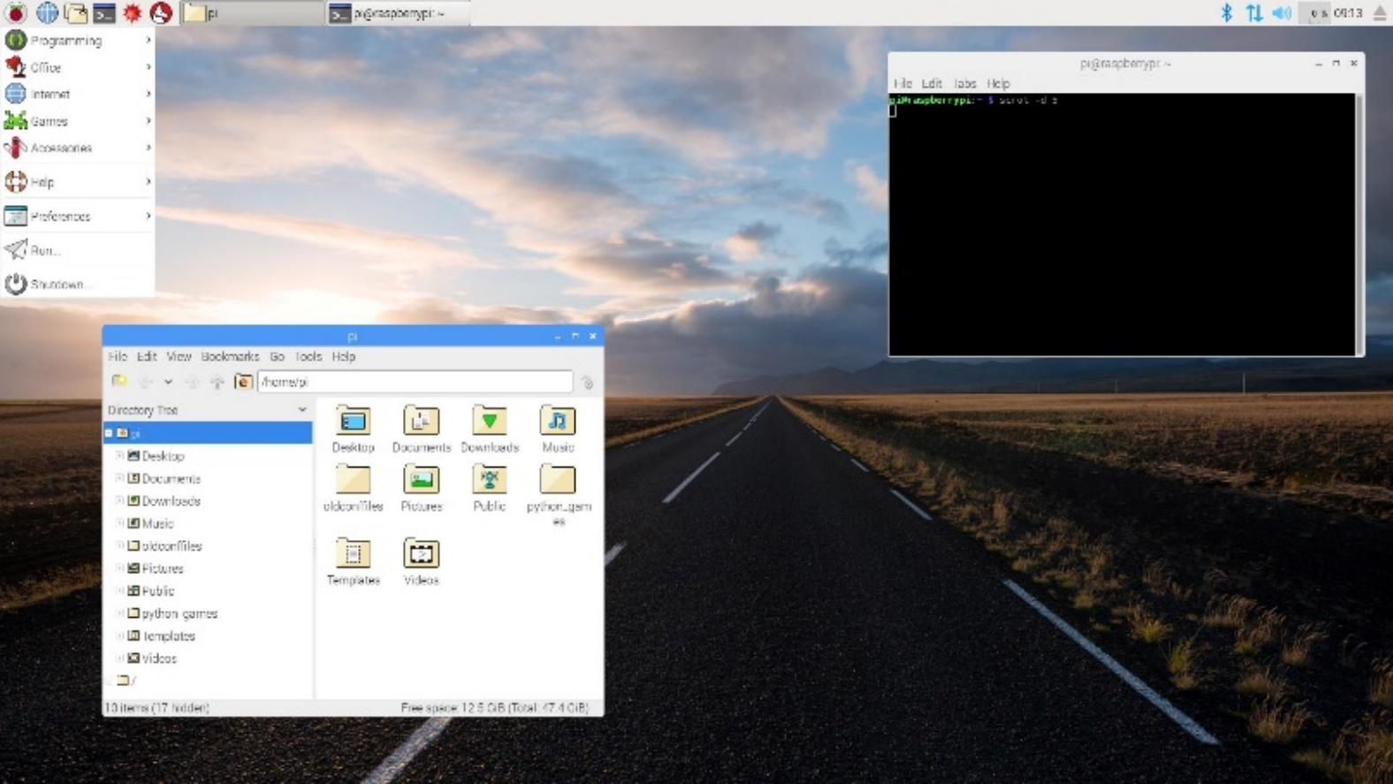
Software Requirements:
Fig12: Thonny IDE
Fig11: Raspberry pi OS
Fig13: ThingSpeak

Slide 12
Block Diagram
POWER SUPPLY
RASPBERRY
PI
PULSE SENSOR
ThingSpeak
MCP3208 A/D
LM35
WIFI
Fig14: Block Diagram of Patient Monitoring System

Slide 13
Advantages
Easy to monitor
Used for both personal and hospital
Doctor need not to touch the patient physically
We can monitor continuously
It is mechanism can be understand by every one

Slide 14
Applications
It can be used in ICUs, operation theatres etc for monitoring the health condition of the patient.
It can also be used in old age homes to monitor the various parameters of a sick person.
It can be used in daily life to maintain a healthy life style.

Slide 15
Conclusion
Conclusion of our project is that is very much essential to measure the human body parameter which is in critical situation ,without analysing we can’t the identify the exact problem and if we analyse the data then we can treat patient more accurately more efficiently and as soon as possible.

Slide 16
Future Scope
We have to interface Blood Pressure, ECG, SpO2 and collect the information from different age group people and that data from different people so that data is accessible to doctor directly.
The whole health monitoring system, which we have proposed can be integrated into a small compact unit as small as a cell phone.
This will help the patients to easily carry this device with them wherever they go.

Slide 17
References
V. B. Shalini, "Smart Health Care Monitoring System based on Internet of Things (IOT)," 2021 International Conference on Artificial Intelligence and Smart Systems (ICAIS), Coimbatore, India, 2021, pp. 1449-1453, Doi: 10.1109/ICAIS50930.2021.9396019.
M. Navale, S. Damare, R. Chavan, R. Dube and S. Patil, "Android Based Heart Monitoring and Reporting System", International Journal of Advanced Research in Computer and Communication Engineering, vol. 3, no. 5, May 2017.
Manisha Shelar, Jaykaran Singh, Mukesh Tiwari, “Wireless Patient Health Monitoring System”, International Journal of Computer Applications (0975 – 8887) Volume 62– No.6, January 2018.
A. D. Acharya and S. N. Patil, "IoT based Health Care Monitoring Kit," 2020 Fourth International Conference on Computing Methodologies and Communication (ICCMC), Erode, India, 2020, pp. 363-368, Doi: 10.1109/ICCMC48092.2020.ICCMC-00068.

Slide 18


