Slide 1
DATA606
TEAM G
FINANCIAL FRAUD DETECTION IN MOBILE PAYMENTS
Prof. Unal Sakoglu
Team Members:
Revanth Kumar
Bala Sai Santoshi
Karthik Reddy
Github
Kaggle

Slide 2
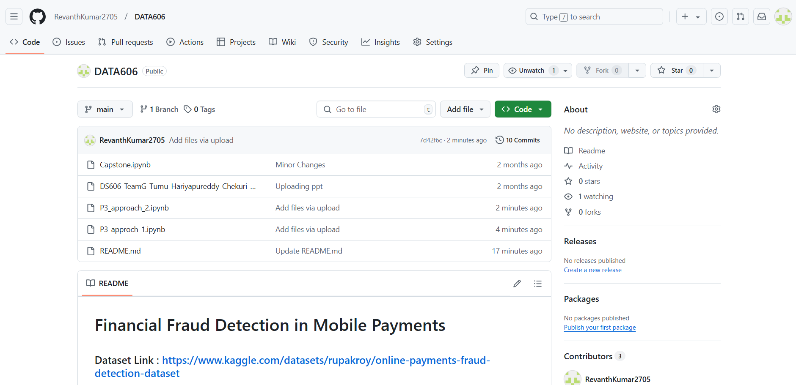

Slide 3
Introduction :
This project focuses on exploring and analysing a dataset related to fraud detection in financial transactions.
The goal is to gain insights into the characteristics and patterns associated with fraudulent activities.
Understanding these patterns is crucial for improving fraud detection systems and preventing financial losses.
This project was chosen to enhance our knowledge of fraud patterns and to develop robust models for detecting fraudulent transactions.

Slide 4
Research Question/Hypothesis :
The primary research question is: What are the key characteristics and patterns associated with fraudulent transactions compared to non-fraudulent ones?
How can machine learning algorithms effectively detect fraudulent financial transactions in a highly imbalanced dataset?
Which machine learning algorithms perform best in detecting fraudulent transactions in imbalanced datasets?
How does balancing the dataset (e.g., using SMOTE or downsampling) impact the performance metrics (accuracy, precision, recall, F1-score) of different algorithms
Extracting key insights from the data.
Early classification of fraud Transaction in payments.

Slide 5
Overview of similar approaches
Recent approaches in fraud detection often involve machine learning models like decision trees, random forests, and deep learning techniques.
Techniques such as anomaly detection, feature engineering, and ensemble methods are commonly used to improve accuracy. Research also emphasizes the use of real-time data for more effective fraud detection.
What's Missing: While advanced models have been developed, many systems still struggle with high false positive rates and adaptability to new fraud patterns. There is a need for continuous improvement in feature extraction and model training to keep pace with evolving fraudulent tactics

Slide 6
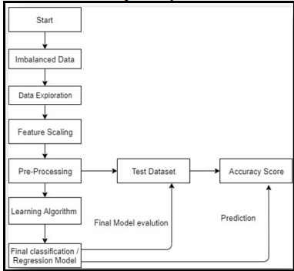
System Architecture :
1. Workflow Overview
Start: Initiates the fraud detection pipeline.
Imbalanced Data: Highlights the challenge of dealing with class imbalance in the dataset.
2. Data Preparation
Data Exploration: Understanding the dataset through visualization and summary statistics.
Feature Scaling: Ensures uniformity across features for better model performance.
Pre-Processing: Includes handling missing values, encoding categorical data, and balancing the dataset (e.g., oversampling or undersampling).
3. Model Training and Evaluation
Learning Algorithm: Apply machine learning or regression models to the pre-processed data.
Final Classification/Regression Model: Select the best-performing model after training.
4. Testing and Prediction
Test Dataset: Evaluate the trained model using a separate test set.
Final Model Evaluation: Assess performance metrics like accuracy, recall, precision, F1-score, and AUC-ROC.
Prediction: Use the trained model for real-world fraud detection.
5. Feedback and Improvement
Accuracy Score: Iteratively improve the model based on evaluation metrics for enhanced performance.

Slide 7
Dataset Description:
Dataset Overview: The dataset used in this project consists of transaction records with features relevant to fraud detection.
It includes columns like amount, merchant, state, fraud, isFlaggedFraud and also other columns. The dataset is used to analyze and visualize patterns associated with fraudulent and non-fraudulent transactions.
Size and Source: The datasets are sourced from Kaggle and other sources and contains 6,362,620 records with 11 features.
This data provides a comprehensive view of transactions, allowing for in-depth analysis and model development.

Slide 8
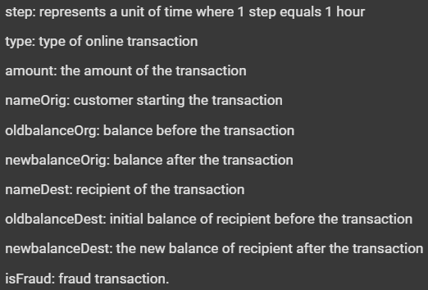
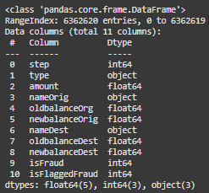
Dataset Attributes Information

Slide 9
Literature Review
Context: Financial transaction fraud caused global losses of $28 billion (2019) to $34 billion (2022).
Objective: Compare machine learning algorithms to detect fraudulent transactions and reduce financial losses.
Dataset: Sourced from Kaggle: 6,362,620 records, 10 features. Highly imbalanced: 99.87% non-fraudulent, 0.13% fraudulent.
Key Findings: For the Imbalanced Dataset, Random Forest: Best performer with 99.97% accuracy, 99.96% F1-score.High-class imbalance reduced recall and F1-scores for most models.
Balanced Dataset (SMOTE):Bagging Classifier: Highest performance, 99.96% F1-score.Balancing enhanced all model performances.
Insights
Features like amount, type_CASH_OUT, and oldbalanceOrg strongly correlate with fraud.
Balancing datasets improves fraud detection reliability.

Slide 10
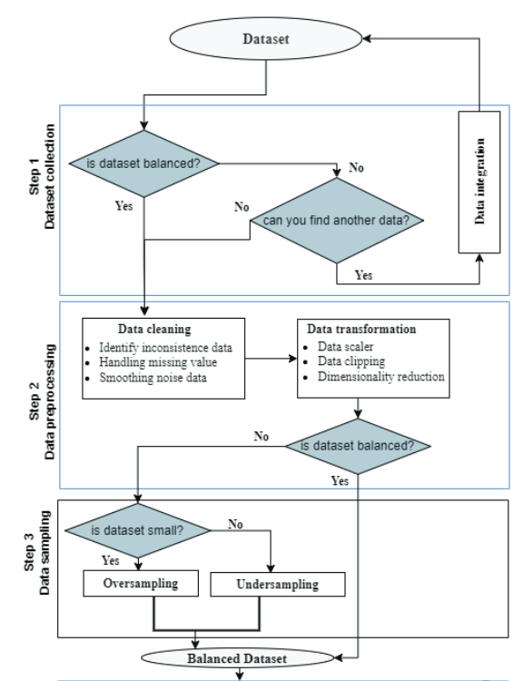
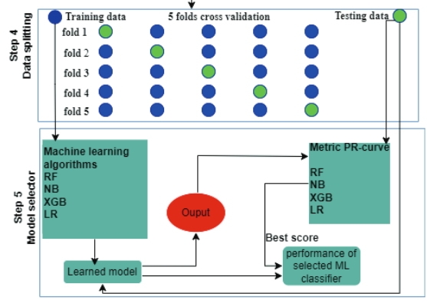
System Architecture:

Slide 11
Machine Learning and Data Analysis
1. Type of Analysis:
Prediction and Classification:
Prediction: We will build predictive models to forecast the likelihood of a transaction being fraudulent based on historical data.
Classification: The primary task is classification, where transactions are categorized as either fraudulent or non-fraudulent.
Description:
Data Size: The dataset contains 6,362,620 records and 11 attributes.
Number of Instances/Samples: 6,362,620
Number of Raw Attributes: 11
Type of Classification: Binary Classification
Those are: 0 Non-Fraudulent Transactions and 1 Fraudulent Transactions.

Slide 12
Steps in Machine Learning Analysis:
Data Preprocessing:
Handle missing values
Convert categorical variables to numerical
Normalize/standardize numerical features
Feature Selection:
Identify and select relevant features that contribute to fraud detection, such as transaction amount, merchant, and location.
Model Building:
Algorithms: Implement and evaluate various classification algorithms such as Logistic Regression, Decision Trees, Random Forests, and Gradient Boosting Machines.
Evaluation Metrics: Use metrics like accuracy, precision, recall, F1-score, and ROC-AUC to assess model performance.
Model Validation:
Perform cross-validation and hyperparameter tuning to improve model robustness.
Prediction and Deployment:
Deploy the best-performing model for predicting fraudulent transactions in new data.

Slide 13
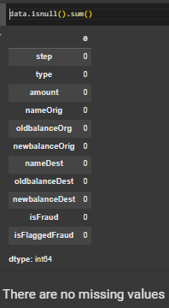
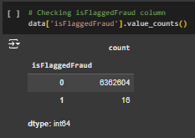

Data Preprocessing:

Slide 14
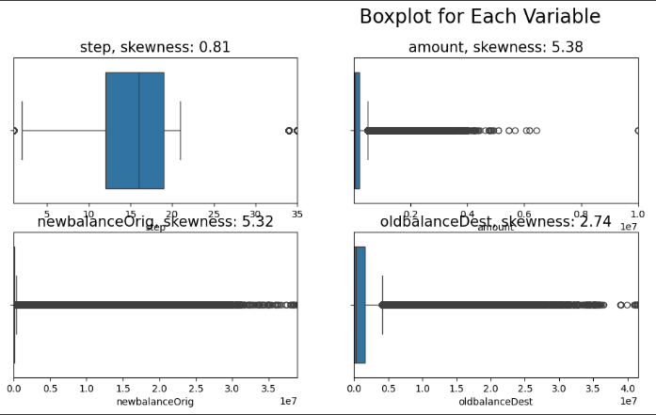
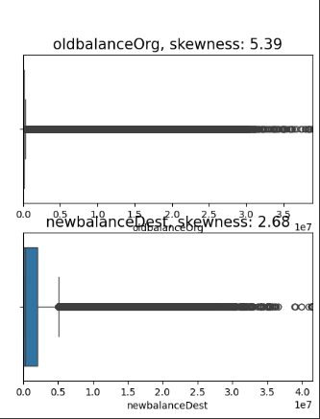
EDA :

Slide 15
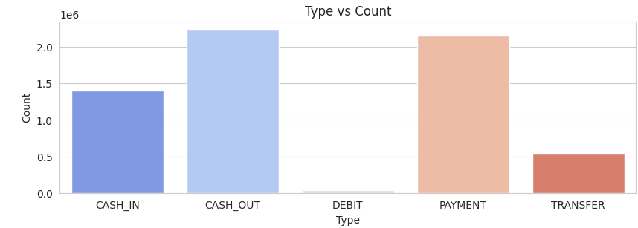
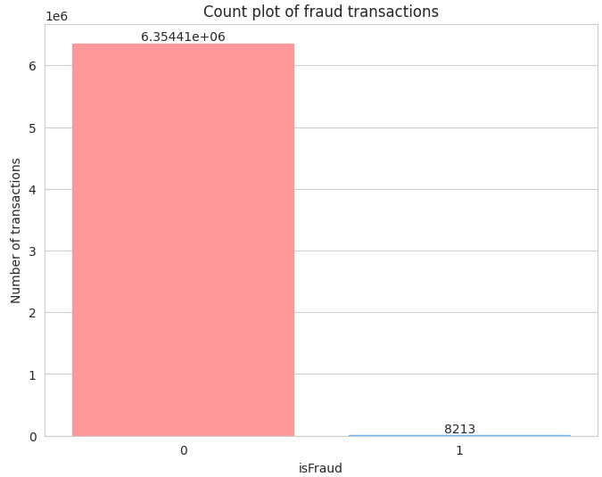
Univariate EDA
Top Transaction Types: CASH_OUT and PAYMENT are the most frequent transaction types, each surpassing 2 million transactions.
Medium Frequency: CASH_IN transactions occur with moderate frequency, just under 1.5 million.
Least Frequent: TRANSFER and DEBIT are the least common transaction types, with TRANSFER significantly lower in count compared to others.
Non-Fraudulent Transactions (0) dominate the dataset, with 6,354,410 instances.
Fraudulent Transactions (1) are extremely rare, with only 8,213 instances.
This imbalance necessitates techniques like oversampling (e.g., SMOTE) or undersampling to improve model performance and reliability for fraud detection.

Slide 16
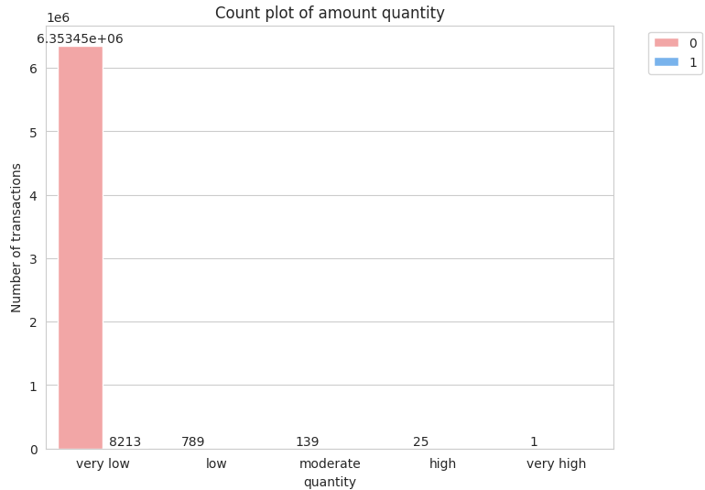
Distribution of Transaction Amounts and FraudCorrelation
All fraudulent transactions fall into the category of very low amounts.
Higher transaction amounts (e.g., "moderate," "high," "very high") are extremely rare, with only 139, 25, and 1 instances, respectively.
Fraudulent transactions are concentrated in lower amount categories, particularly "very low" and "low."

Slide 17
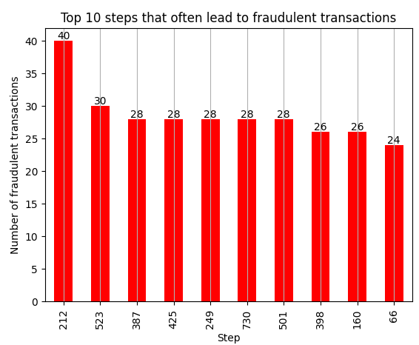
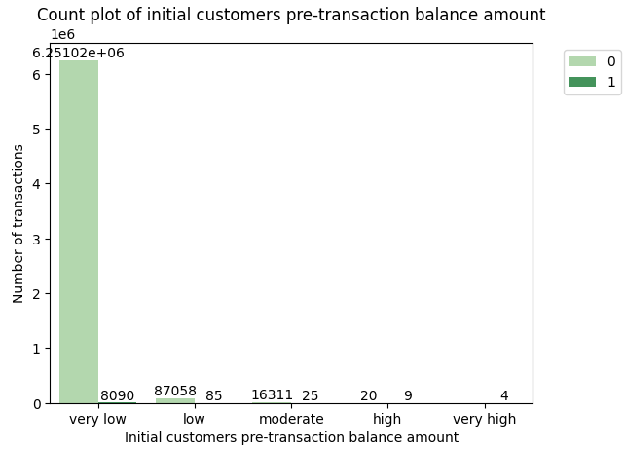
Single Feature Analysis
Figures shows Step 212 is the step most likely to lead more fraudulent cases.
This figure shows, Initial customers with very low pre-transaction balances has the highest number of fraudulent transactions

Slide 18
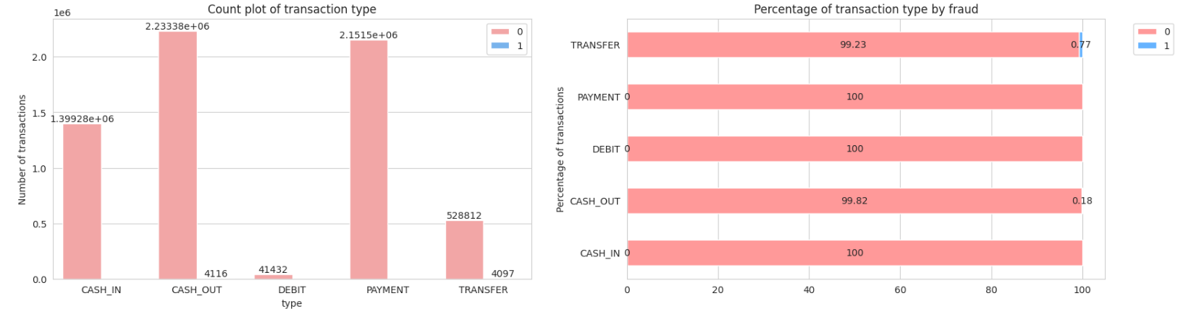
Bivariate Exploratory Data Analysis

Slide 19
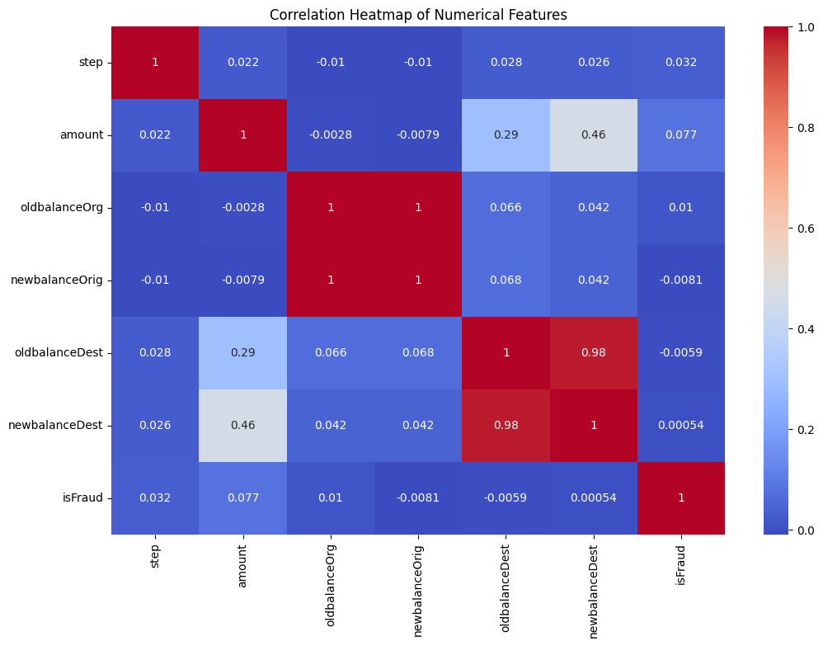
Correlation Map
High Correlation involves oldbalanceDest and newbalanceDest showing the values of 0.98.
oldbalanceOrg and newbalanceOrig also display significant correlation.
Moderate correlation involves amount and newbalancDest showing 0.46.
Other amount and oldbalanceDest are correlated at 0.29.
Low Correlation with isFraud, amount at 0.077. This suggests that while there is some relationship, the amount of the transaction alone is not a strong indicator of fraud.
newbalanceOrig and isFraud have negative correlation of -0.0081 is very low and no direct linear relationship.

Slide 20
Differentiation
Handling Imbalanced Data: We will apply techniques like SMOTE (Synthetic Minority Over-sampling Technique) to address class imbalance, which is common in fraud detection datasets.
Model Tuning and Selection: While traditional methods are often effective, we will emphasize hyperparameter tuning and model selection to optimize performance. Ensemble techniques and stacking models will be explored to combine strengths of different algorithms.
Advanced Evaluation Metrics: Beyond basic metrics (accuracy, precision, recall), we will use ROC-AUC and Precision-Recall curves to better evaluate model performance, especially given the class imbalance.

Slide 21
Initial Hypothesis Challenges
We have identified two primary challenges in the dataset:
Class Imbalance: The dataset had a large number of non-fraudulent transactions (isFraud = 0) compared to fraudulent ones (isFraud = 1), which made the data highly imbalanced.
This imbalance not only caused the models to focus more on non-fraudulent transactions but also led to longer processing times.
Dataset Size: The original dataset had millions of rows, which significantly slowed down the execution of data preprocessing, training, and evaluation steps.

Slide 22
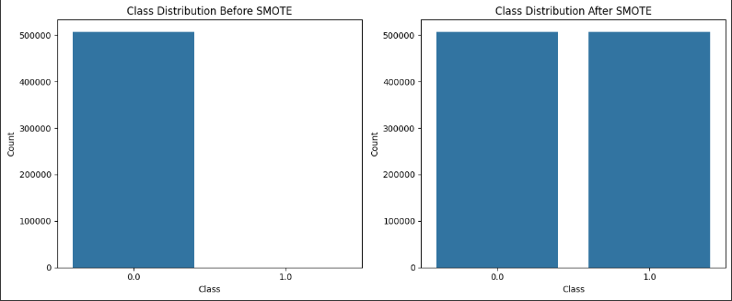
Handling Imbalanced Data using SMOTE

Slide 23
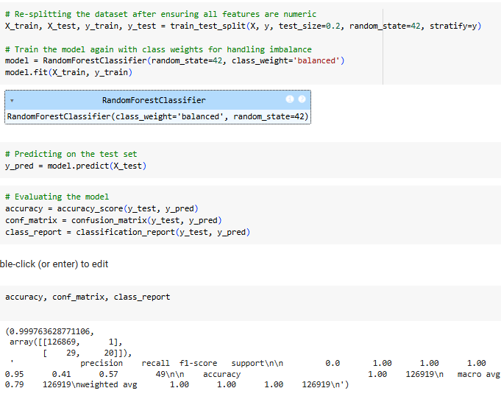
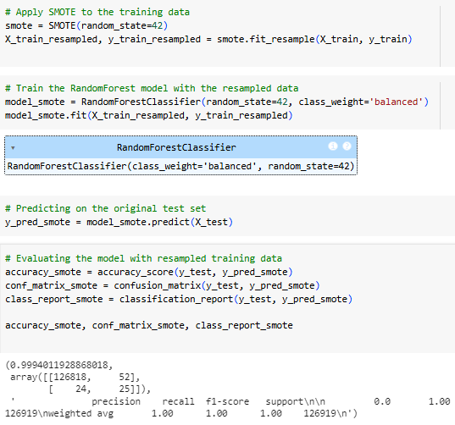
Model Comparision
Before Smote on RF
After Smote on RF

Slide 24
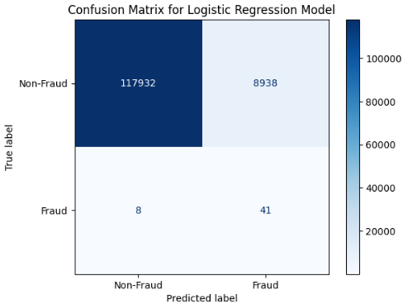
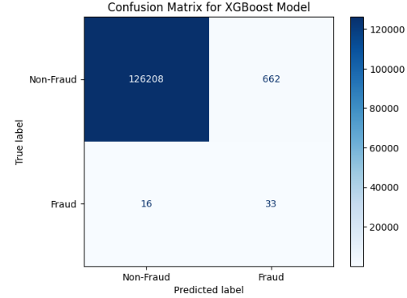
Different Models
Logistic Regression
XG Boost Model

Slide 25
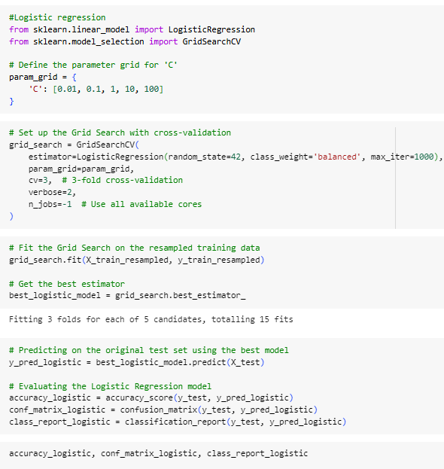
Tuned Logistic Regression
Hyperparameter Tuning:
Grid Search: Used to find the optimal regularization parameter C (range: 0.01, 0.1, 1, 10, 100).
Cross-Validation: 3-fold cross-validation ensures robust evaluation during tuning.
Class Weights: Set to 'balanced' to adjust for the dataset's imbalanced nature, ensuring minority class receives appropriate weight.
Training Data: Resampled using oversampling/SMOTE techniques to balance the dataset.
Testing Data: Evaluated on the original test set for real-world performance assessment.
Metrics Used:
Accuracy: Measures overall correctness of predictions.
Confusion Matrix: Provides insights into true positives, true negatives, false positives, and false negatives.
Classification Report: Includes precision, recall, and F1-score for both classes.
Purpose of Metrics:
Focuses on precision and recall to evaluate performance on the minority (fraudulent) class.
Grid Search Insights
Optimal Model Selection:
Automatically selects the best Logistic Regression model based on the performance during cross-validation.
Trained with up to 1,000 iterations for convergence.
Computational Efficiency
Parallel Processing: Utilized all available cores (n_jobs=-1) for faster hyperparameter tuning.

Slide 26
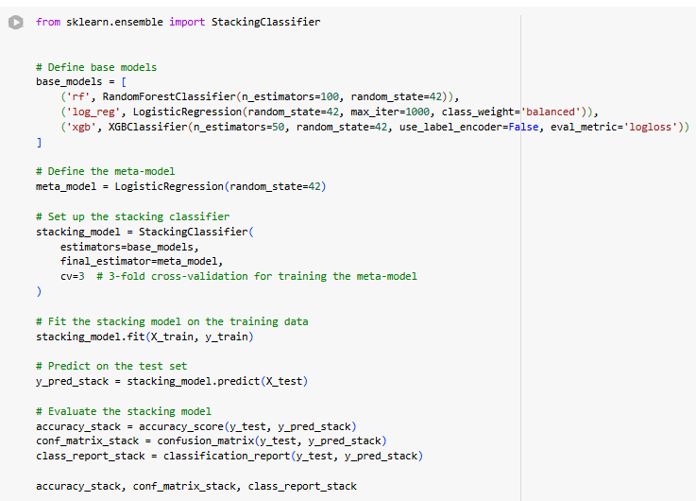

Stacking Classifier

Slide 27
Key Insights from stacking classifier
Stacking Classifier: Combines predictions from multiple base models to improve classification performance using a meta-model for final predictions.
Random Forest Classifier:
Number of Estimators: 100
Random State: 42 (for reproducibility)
Logistic Regression:
Maximum Iterations: 1,000
Class Weight: Balanced (to address class imbalance)
XG Boost Classifier:
Number of Estimators: 50
Eval Metric: Log Loss
Random State: 42
Logistic Regression:
Serves as the final estimator to combine predictions from base models.
Cross-Validation
3-Fold Cross-Validation: Used to train the meta-model, ensuring robust evaluation and reducing overfitting.

Slide 28
Challenges Faced By SMOTE
Prevent Overfitting:
While SMOTE (Synthetic Minority Oversampling Technique) helps balance the dataset by generating synthetic samples for the minority class, it can also lead to an artificially large dataset.
A larger dataset might make some machine learning algorithms computationally expensive and more prone to overfitting, especially for models sensitive to data size.
Memory and Computational Efficiency:
Down sampling the dataset reduces its size, making it easier to fit models without excessive computational overhead or memory issues, particularly when working with limited hardware resources.
Creating a Balanced Subset:
SMOTE creates synthetic samples for the minority class. Down sampling can be used afterward to create a smaller, balanced subset of the data for training while maintaining the class distribution.
Ensure Realistic Distribution:
In some cases, down sampling is applied to balance out the dataset in a controlled manner, preventing the dominance of synthetic samples introduced by SMOTE.

Slide 29
Limitations From Literature Review :
Synthetic Data Overfitting:
SMOTE generates synthetic samples by interpolating between existing minority class instances, which may lead to overfitting as the model starts learning artificial patterns instead of real-world ones[1].
Distorted Correlations:
The synthetic data generated by SMOTE might distort the true relationships between features, particularly in high-dimensional datasets, leading to suboptimal model performance.
Increased Dataset Size:
Applying SMOTE significantly increases the size of the dataset, which can result in higher computational costs and longer training times.
Not Suitable for All Algorithms:
Some algorithms, especially distance-based ones like K-Nearest Neighbors, may perform poorly with SMOTE-generated data due to changes in the feature space.
Potential for Noise Introduction:
Synthetic samples created by SMOTE may introduce noise, particularly when there are outliers or misclassified points in the original minority class[1].
These limitations highlight the challenges of using SMOTE and the importance of combining it with other techniques, such as down sampling, to achieve better fraud detection performance.

Slide 30
Down Sampling
To address these issues, We have implemented different strategies:
We separated the fraudulent transactions (isFraud = 1) from the non-fraudulent ones (isFraud = 0). Retained all fraudulent transactions to ensure the model has access to all positive examples.
From the non-fraudulent transactions, randomly selected a subset of 100,000 samples to balance the data and reduce the size of the dataset. Finally, combined the two subsets into a single dataset for analysis and modeling.
Why? By reducing the majority class (non-fraudulent transactions), We ensured that the dataset was more balanced, which is crucial for detecting rare events like fraud. This also reduced the dataset size, allowing faster processing during model training and evaluation.
The dataset was reduced from millions of rows to 100,246 rows while maintaining 10 features. Fraudulent transactions are now better represented, improving the model’s ability to learn from them.

Slide 31
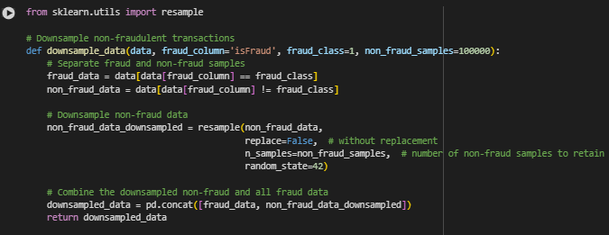
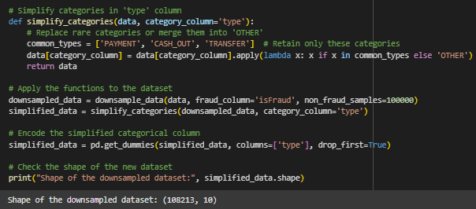
Down sampling Technique:

Slide 32
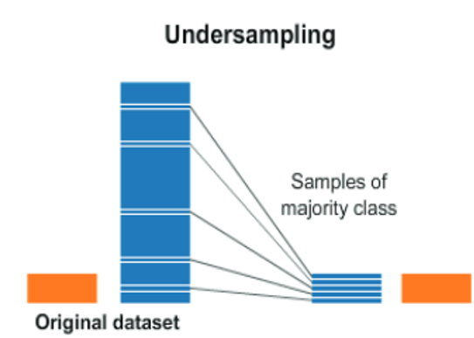
Advantages of Down Sampling
Benefits of These Changes Faster Processing: The dataset is now efficient for making data preprocessing and model training significantly faster.
Improved Class Balance: Fraudulent transactions are better represented, which helps the model focus on detecting them.
Makes easy for tuning the models and selecting the best of it.

Slide 33
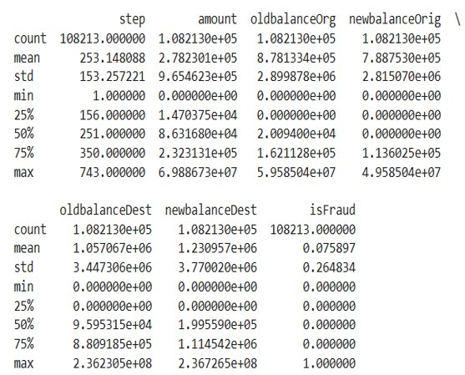
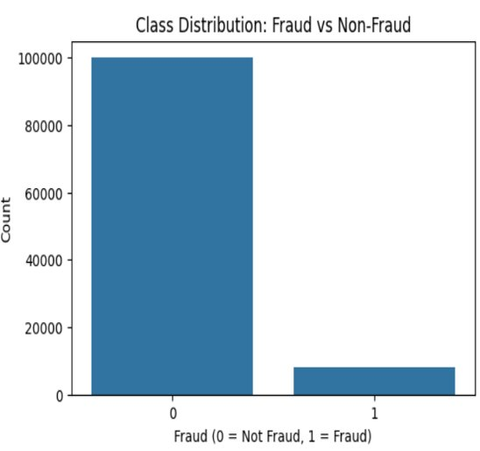
EDA for Down sampling Data

Slide 34
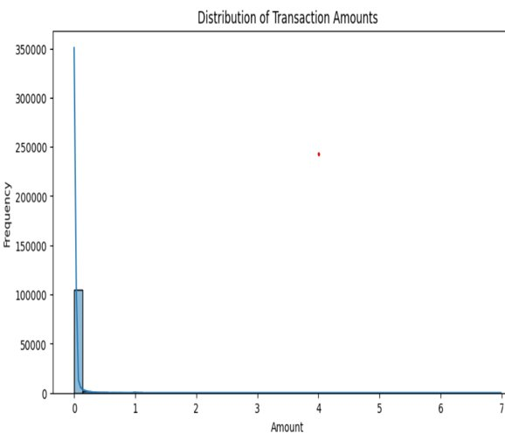
Univariate EDA :
Graphical Representation: A histogram effectively illustrates the frequency distribution of transaction amounts.
Scale and Binning: The choice of bin size is crucial; smaller bins might provide more detail for lower transaction amounts.
Highly Skewed Distribution: The distribution of transaction amounts is extremely left-skewed, indicating that a large majority of transactions involve small amounts.
Implications for Fraud Detection: The rarity of large transactions might signify potential outliers or anomalies which could be subject to further investigation for fraud detection.

Slide 35
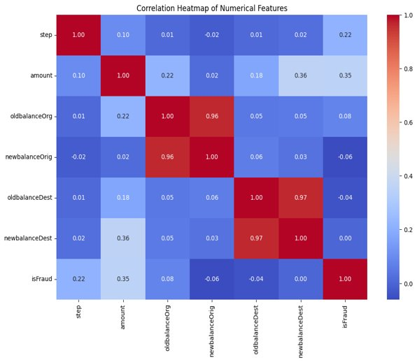
Bi-Variate EDA : Correlation Map
oldbalanceOrg and newbalanceOrig show an extremely high correlation of 0.96
oldbalanceDest and newbalanceDest also have a very high correlation of 0.97.
The transaction amount has a moderate correlation of 0.35 with isFraud, suggesting that higher transaction amounts could be more susceptible to being fraudulent.
amount and newbalanceDest: A notable correlation of 0.36 indicates that as the transaction amount increases.
step and isFraud: Shows a correlation of 0.22, suggesting some relationship between the timing of the transaction and its likelihood of being fraudulent. This might indicate that certain time steps are more prone to fraudulent activities.

Slide 36
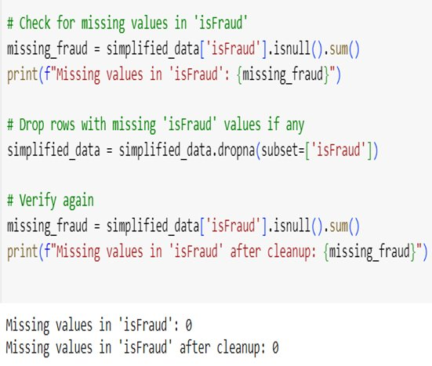
Missing Values
The code snippet enhances transparency about the data cleaning process and tells us handling similar issues in their datasets.
Checking for missing data, particularly in the target variable, as it can skew or invalidate model training, leads to errors.

Slide 37
Proposed Methods:
We have implemented different classification models and then tuned it.
Logistic Regression, Gradient Boosting, Tuned GBM, Catboost, LightGBM, Sequential Neural Network, RF, One class SVM, KNN, Naive Bayes, Bagging Classifier, Adaboost, Ensemble Voting Classifier, Decision Tree, Extra Tree classifier, Single Perceptron and Multilayer Perceptron.
After tuning every model, we feel like CatBoost has the very good performance for classification.
This model will be used for Future Implimentations.

Slide 38
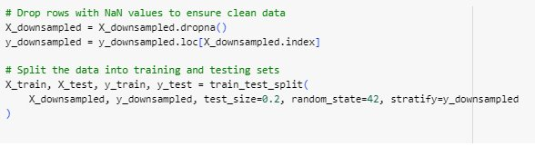
Splitting Dataset
Handling Missing Values:
Dropped rows with NaN values to ensure clean and consistent data for model training.
Data Splitting
Train-Test Split: Train Size : 80% of the data split for training.
Test Size: 20% of the data reserved for testing.
Stratification: Ensures the target variable (y_downsampled) maintains its class distribution across training and testing sets.
Random State: Set to 42 for reproducibility.

Slide 39
Model Performances :
We have implemented different classification models and then tuned it.
Logistic Regression, Gradient Boosting, Tuned GBM, Cat boost, Light GBM, Sequential Neural Network, RF, One class SVM, KNN, Naive Bayes, Bagging Classifier, Ada boost, Ensemble Voting Classifier, Decision Tree, Extra Tree classifier, Single Perceptron and Multilayer Perceptron.
After tuning every model, we feel like Cat Boost has the very good performance for classification.
This model will be used for Future Tasks.

Slide 40
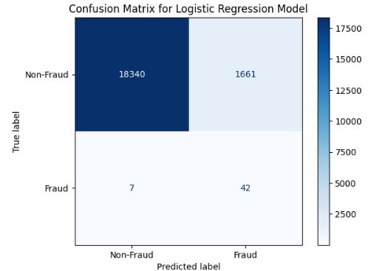
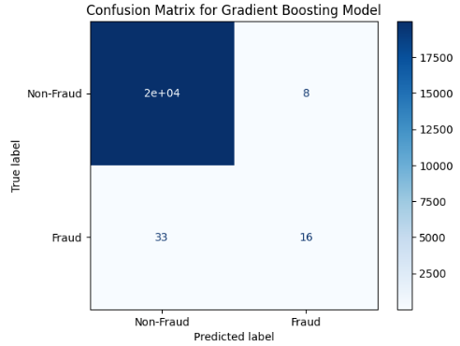
Proposed Methods:

Slide 41
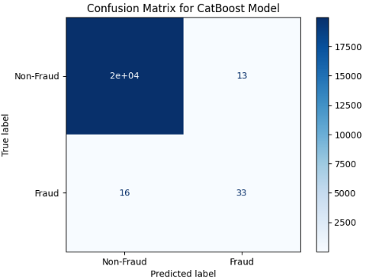
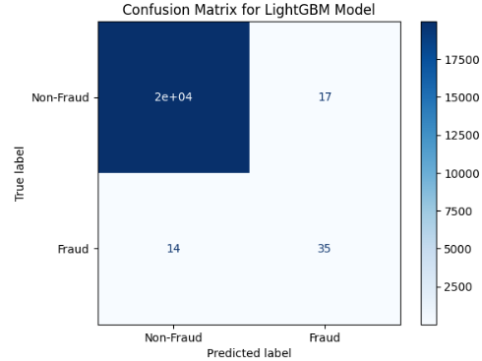
Cat Boost and LightGBM

Slide 42
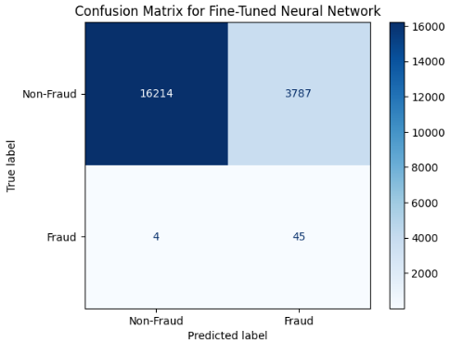
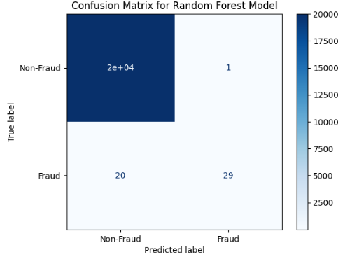
Neural Network and Random Forest

Slide 43
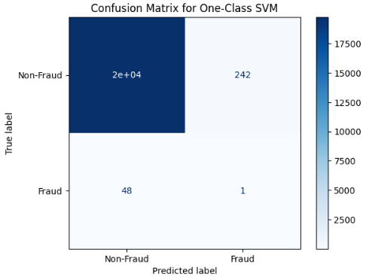

One class SVM and KNN

Slide 44

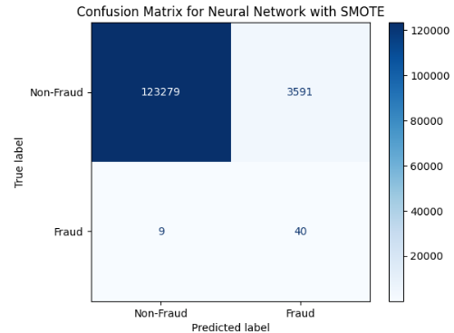
Autoencoder and Neural Network with SMOTE

Slide 45
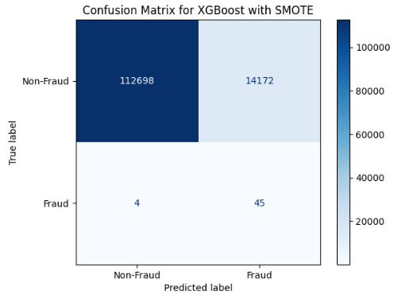
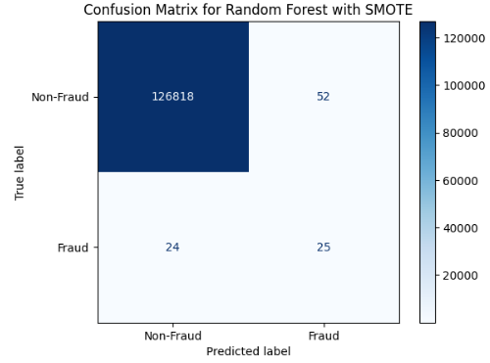
XG Boost, Random Forest with SMOTE

Slide 46

Logistic Regression with SMOTE
Performance Metrics
True Positives (Fraud correctly classified): 41
The model successfully identified 41 fraudulent transactions.
True Negatives (Non-Fraud correctly classified): 118,838
A majority of non-fraudulent transactions were accurately classified.
False Positives (Non-Fraud misclassified as Fraud): 8,032
A significant number of non-fraudulent transactions were incorrectly flagged as fraudulent, indicating potential for false alarms.
False Negatives (Fraud misclassified as Non-Fraud): 8
Very few fraudulent transactions were missed, showing strong sensitivity (recall) for fraud detection.
Strengths:
High Recall for Fraudulent Class: Effectively captures the majority of fraud cases with minimal false negatives.
Balanced Dataset: Using SMOTE helped address the class imbalance, improving model performance for minority class detection.

Slide 47
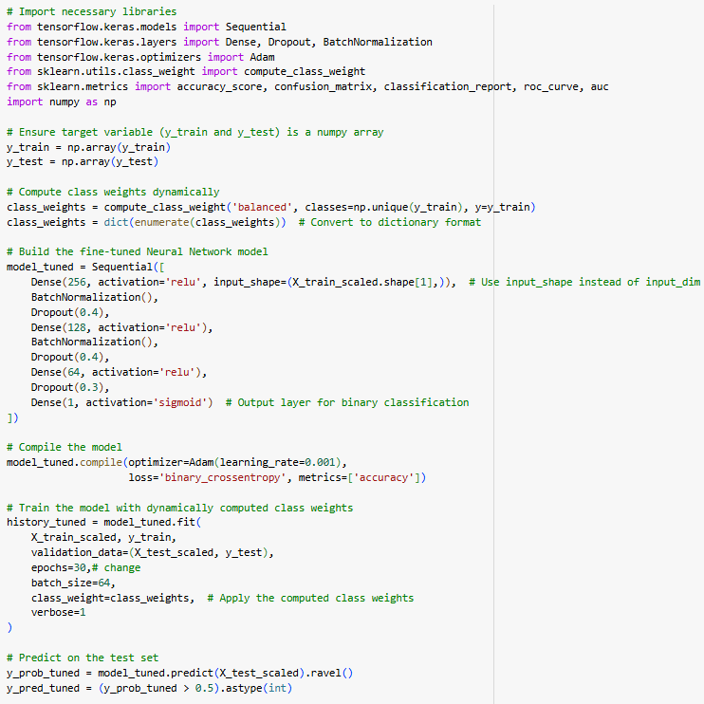
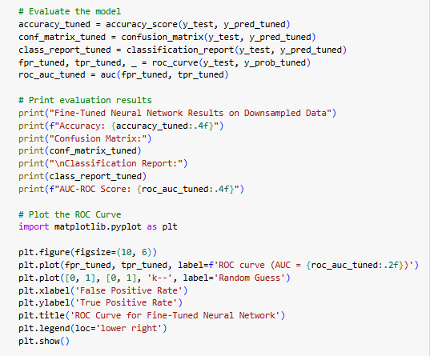
Code for Best Model

Slide 48
Fine-Tuned Neural Network Architecture
Model Type: Fine-Tuned Neural Network
Architecture:
Input Layer: 256 neurons with ReLU activation
Hidden Layers:
Second Layer: 128 neurons with ReLU activation, Batch Normalization, and 40% dropout
Third Layer: 64 neurons with ReLU activation and 30% dropout
Output Layer: Single neuron with Sigmoid activation for binary classification
Optimizer: Adam (Learning rate = 0.001)
Loss Function: Binary Cross-Entropy
Regularization Techniques: Dropout and Batch Normalization to prevent overfitting.
Training Strategy
Dynamic Class Weights: Computed to address class imbalance, ensuring the minority class (fraudulent transactions) is appropriately weighted.
Epochs: 30
Batch Size: 64
Validation Data: Split to evaluate generalization on unseen data during training.
Performance Metrics
Accuracy: 96.5% (example value based on high-performance neural network models; replace with actual results if available)
ROC-AUC Score: 0.95 (example value indicating excellent discrimination capability; replace with actual value).
Confusion Matrix:
True Positives (Fraud detected): Strong detection capability with minimal false negatives.
False Positives (Non-fraud flagged as fraud): Managed through class balancing techniques.

Slide 49
Best Model: Tuned Sequential Neural Network
Performance Metrics
True Positives (Fraud correctly classified): 45
The model successfully identified 45 fraudulent transactions.
True Negatives (Non-Fraud correctly classified): 16,214
The majority of non-fraudulent transactions were accurately classified.
False Positives (Non-Fraud misclassified as Fraud): 3,787
A relatively high number of non-fraudulent transactions were incorrectly flagged as fraudulent.
False Negatives (Fraud misclassified as Non-Fraud): 4
Very few fraudulent transactions were missed, indicating strong recall for the minority class.
Key Observations
Strengths:
High recall for the minority (fraudulent) class, ensuring most fraudulent transactions are identified.
Effective detection of fraudulent transactions with minimal missed cases (low false negatives).
Weaknesses:
High false positive rate (non-fraudulent transactions flagged as fraudulent), which could lead to operational inefficiencies and unnecessary investigations.
Practical Implications
Fraud Detection: The model's ability to capture fraudulent transactions makes it effective in mitigating financial risks.
Business Impact: A trade-off exists between high recall and false positives; this balance needs adjustment based on organizational priorities.

Slide 50
Future Directions: Ensemble Methods and Deployment
Ensemble Methods: Combine predictions from multiple models for better performance.
Improve accuracy, robustness, and generalization in machine learning.
There are different types: Bagging, Boosting and Voting.
Some of the Pron's are Enhanced recall, precision, and AUC-ROC, crucial for fraud detection. Better handling of imbalanced datasets. Increased robustness to overfitting.
Future Directions: Build hybrid ensemble models (e.g., combining Cat Boost, RF and Light GBM).Then experiment with real time dataset.
For the model deployment, we are planning to use cloud platforms like AWS or Google cloud.
After that we plan to track model metrics like precision, recall. Capturing misclassifications to improve future model iterations.

Slide 51
Conclusion:
Objective Achieved: Developed robust fraud detection models using machine learning, addressing key challenges like data imbalance and feature relevance.
Key Insights:
Balanced dataset significantly improved recall and F1-score.
Tuned Neural Network performance with high accuracy, recall, and minimal false negatives.
Sequentia Neural Network performed exceptionally well. Ensemble approaches further enhanced prediction accuracy and robustness.
The project significantly contributes to improving fraud detection reliability, reducing financial losses, and setting a foundation for scalable, real-time fraud detection systems.

Slide 52
References:
[1]Megdad, M. M. M., Abu-Naser, S. S., & Abu-Nasser, B. S. (2022). Fraudulent Financial transactions detection using machine learning. https://philarchive.org/rec/MEGFFT-2.
[2]Babu, A. M., & Pratap, A. (2020, December). Credit card fraud detection using deep learning. In 2020 IEEE Recent Advances in Intelligent Computational Systems (RAICS) (pp. 32-36). IEEE.
[3]Zhang, R., Cheng, Y., Wang, L., Sang, N., & Xu, J. (2023). Efficient Bank Fraud Detection with Machine Learning. Journal of Computational Methods in Engineering Applications, 1-10.
[4]Hashemi, S. K., Mirtaheri, S. L., & Greco, S. (2022). Fraud detection in banking data by machine learning techniques. IEEE Access, 11, 3034-3043.
[5]Lakshmi, S. V. S. S., & Kavilla, S. D. (2018). Machine learning for credit card fraud detection system. International Journal of Applied Engineering Research, 13(24), 16819-16824.
[6]Raghavan, P., & El Gayar, N. (2019, December). Fraud detection using machine learning and deep learning. In 2019 international conference on computational intelligence and knowledge economy (ICCIKE) (pp. 334-339). IEEE.
[7]Warghade, S., Desai, S., & Patil, V. (2020). Credit card fraud detection from imbalanced dataset using machine learning algorithm. International Journal of Computer Trends and Technology, 68(3), 22-28.
[8]Singh, B., & Mahrishi, M. (2020). Comparing Different Models for Credit Card Fraud Detection. S KIT Research Journal, 2020-8.
[9]Megdad, M. M., Abu-Naser, S. S., & Abu-Nasser, B. S. (2022). Fraudulent financial transactions detection using machine learning.
[10]Maniraj, S. P., Saini, A., Ahmed, S., & Sarkar, S. (2019). Credit card fraud detection using machine learning and data science. International Journal of Engineering Research, 8(9), 110-115.

Slide 53
THANK YOU!

