Slide 1

FINANCIAL FRAUD DETECTION IN MOBILE PAYMENTS
Team G:
Bala Sai Santoshi Tumu
Karthik Reddy Hariyapureddy
Revanth Kumar Chekuri
Github: https://github.com/RevanthKumar2705/DATA606.git
Kaggle: https://www.kaggle.com/datasets/rupakroy/online-payments-fraud-detection-dataset/data

Slide 2
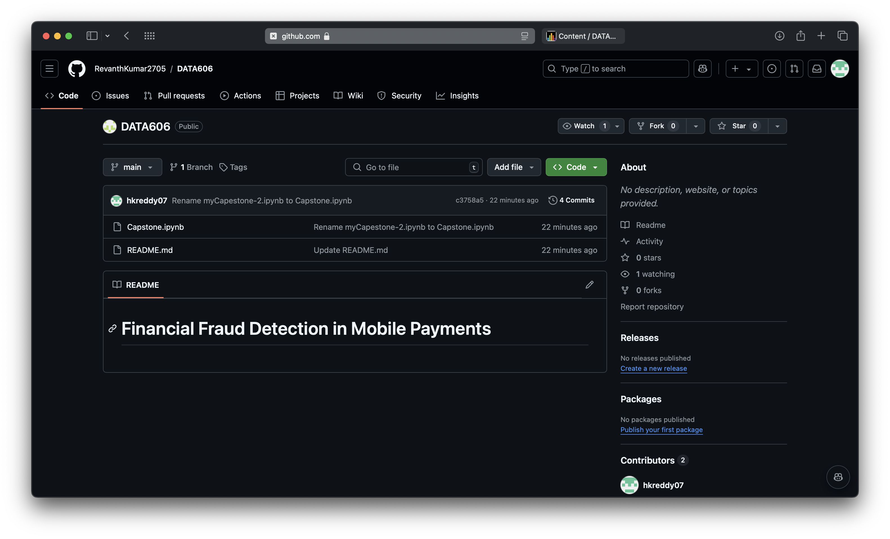

Slide 3

INTRODUCTION
This project focuses on exploring and analyzing a dataset related to fraud detection in financial transactions.
The goal is to gain insights into the characteristics and patterns associated with fraudulent activities.
Understanding these patterns is crucial for improving fraud detection systems and preventing financial losses.
This project was chosen to enhance our knowledge of fraud patterns and to develop robust models for detecting fraudulent transactions.

Slide 4

Research Question/Hypothesis
The primary research question is: What are the key characteristics and patterns associated with fraudulent transactions compared to non-fraudulent ones?
The hypothesis is that specific features in the dataset (such as transaction amount, merchant type, and location) are indicative of fraudulent behavior.

Slide 5
overview of similar approaches
Recent approaches in fraud detection often involve machine learning models like decision trees, random forests, and deep learning techniques.
Techniques such as anomaly detection, feature engineering, and ensemble methods are commonly used to improve accuracy. Research also emphasizes the use of real- time data for more effective fraud detection.
What's Missing: While advanced models have been developed, many systems still struggle with high false positive rates and adaptability to new fraud patterns. There is a need for continuous improvement in feature extraction and model training to keep pace with evolving fraudulent tactics

Slide 6

Introduction to Dataset
Dataset Overview: The dataset used in this project consists of transaction records with features relevant to fraud detection.
It includes columns like amount, merchant, state, fraud, isFlaggedFraud and also other columns. The dataset is used to analyze and visualize patterns associated with fraudulent and non-fraudulent transactions.
Size and Source: The datasets are sourced from Kaggle and other sources and contains 6,362,620 records with 12 features.
This data provides a comprehensive view of transactions, allowing for in-depth analysis and model development.

Slide 7
Steps in Machine Learning Analysis
Data Preprocessing:
Handle missing values
Convert categorical variables to numerical
Normalize/standardize numerical features
Feature Selection:
Identify and select relevant features that contribute to fraud detection, such as transaction amount, merchant, and location.
Model Building:
Algorithms: Implement and evaluate various classification algorithms such as Logistic Regression, Decision Trees, Random Forests, and Gradient Boosting Machines.
Evaluation Metrics: Use metrics like accuracy, precision, recall, F1-score, and ROC-AUC to assess model performance.
Model Validation:
Perform cross-validation and hyperparameter tuning to improve model robustness.
Prediction and Deployment:
Deploy the best-performing model for predicting fraudulent transactions in new data

Slide 8
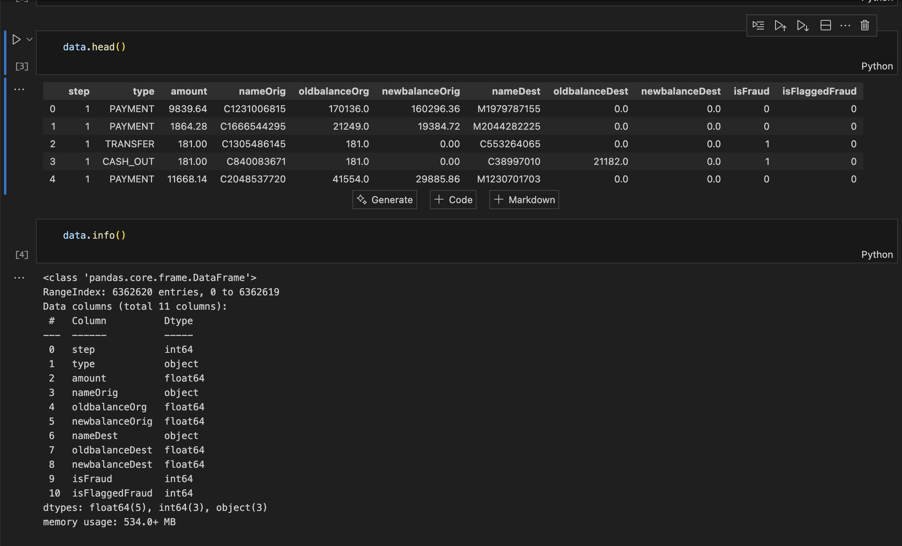
Dataset description

Slide 9
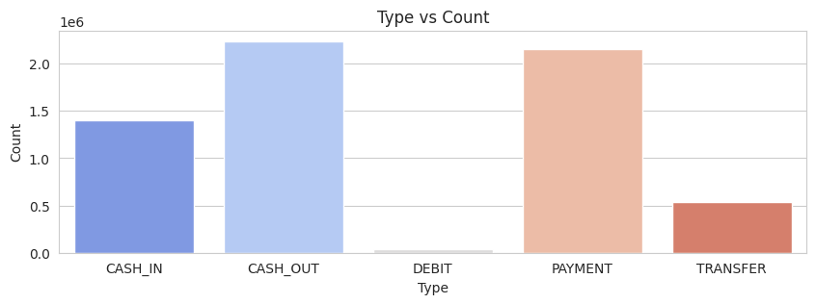
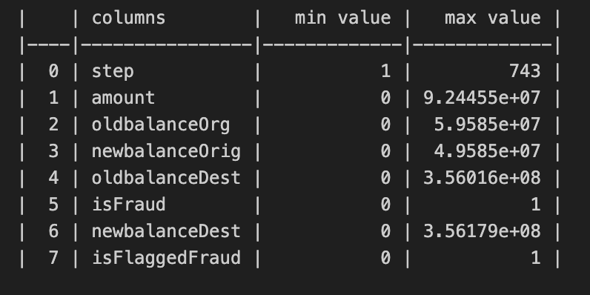

Slide 10
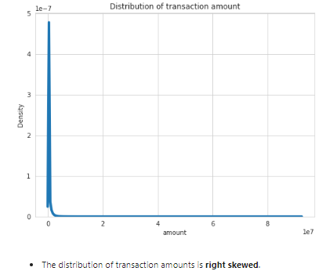
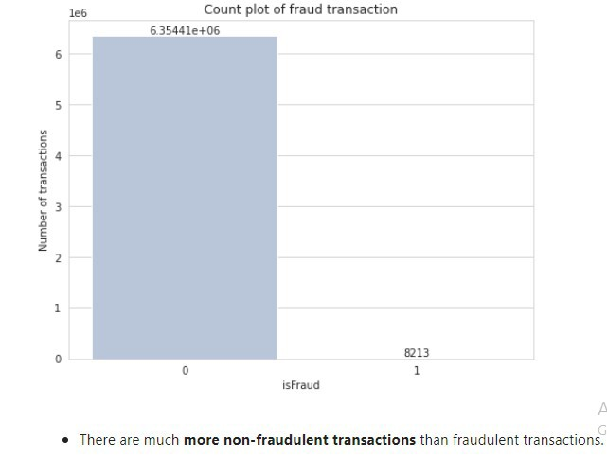

Slide 11
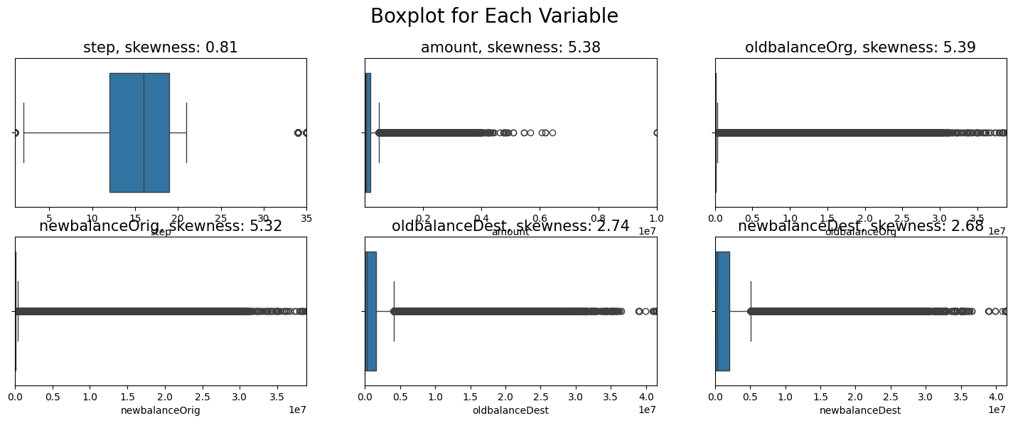

Slide 12
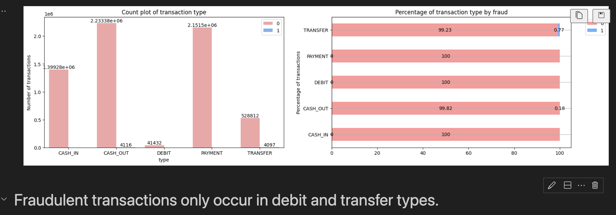

Slide 13
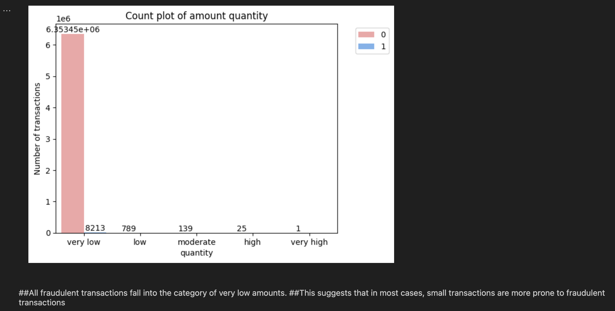

Slide 14
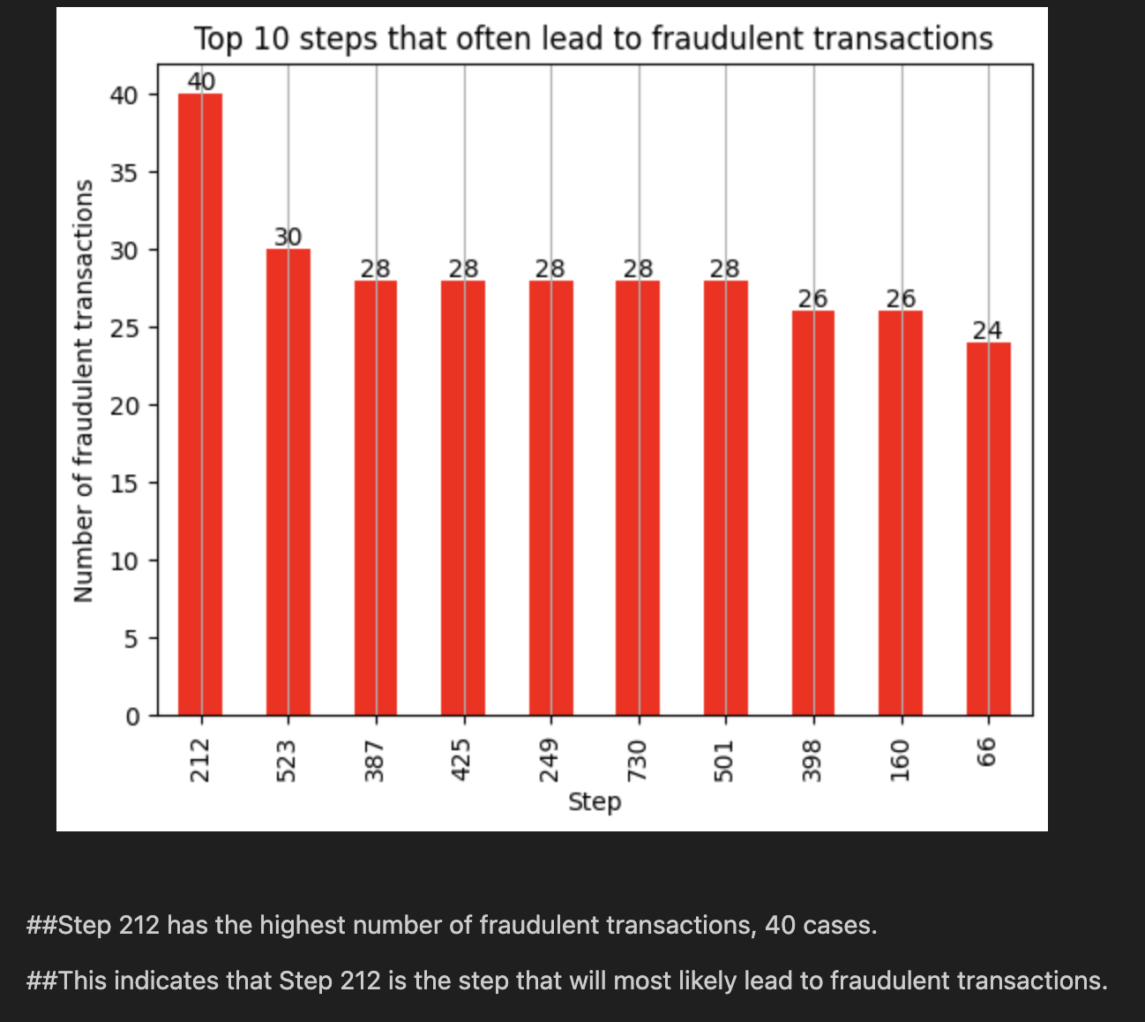

Slide 15
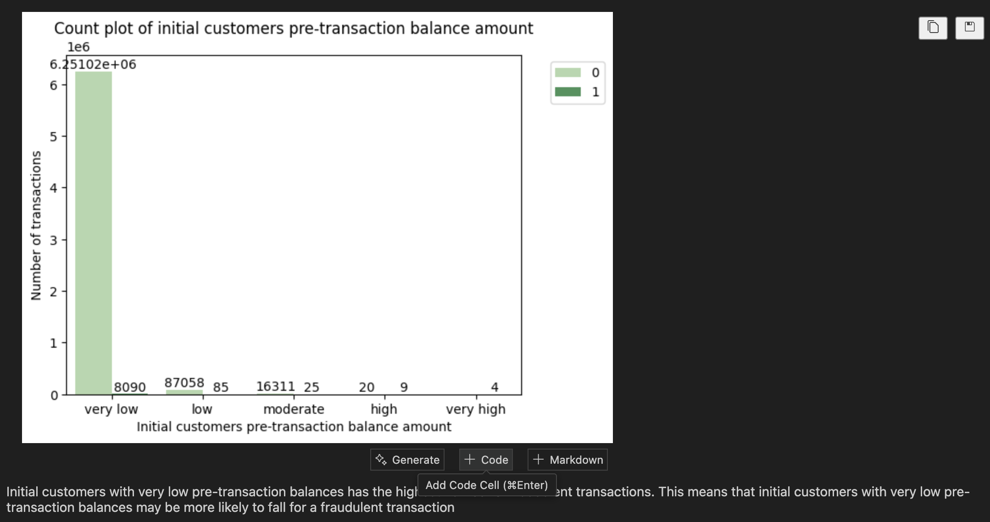

Slide 16
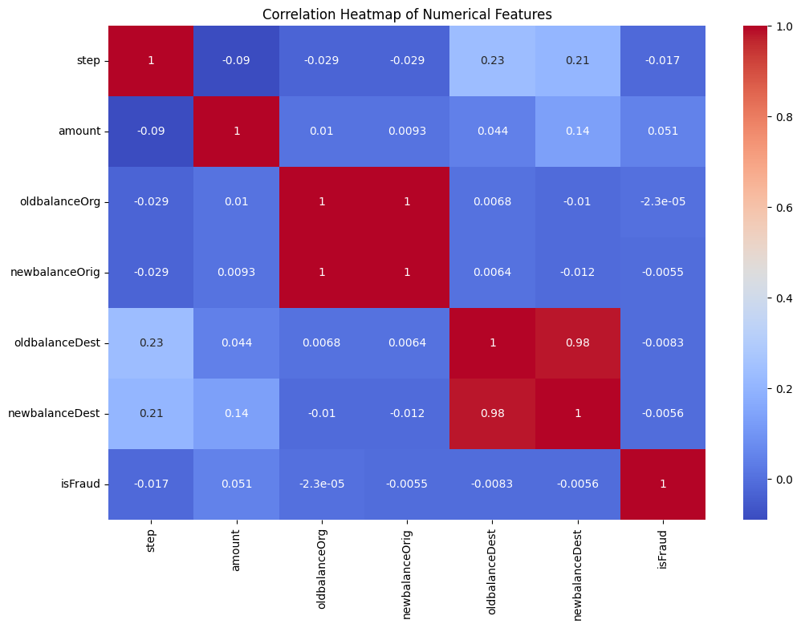

Slide 17
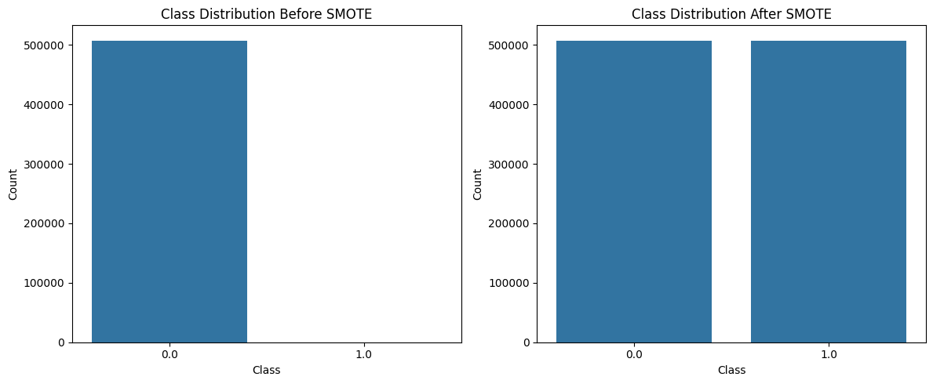
Models Used
1. Synthetic Minority Over-sampling Technique (SMOTE)
Description: SMOTE is a technique used to address class imbalance by generating synthetic samples for the minority class.
Key Parameters: ` random_state=42 `
Performance:
Accuracy: 99.94%
Precision for Fraud Detection: 32%
Recall for Fraud Detection: 51%
AUC: 0.95

Slide 18
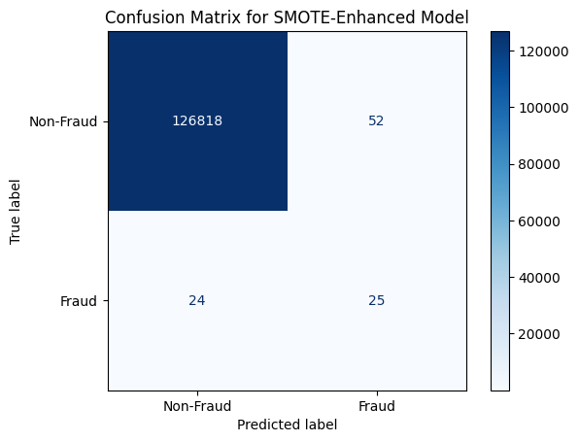
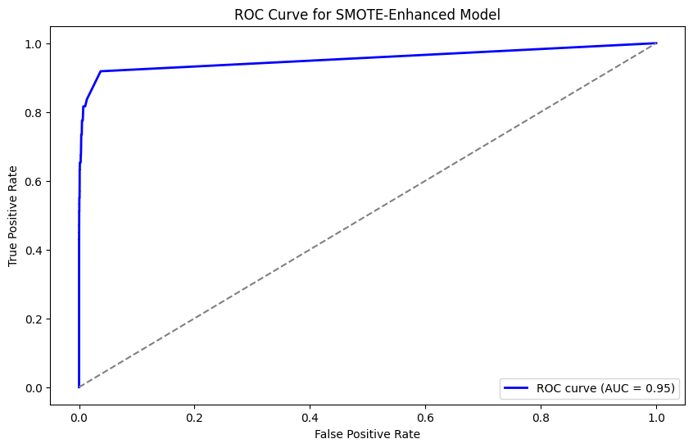
SMOTE Model

Slide 19
2. Logistic Regression
Description: Linear model for binary classification.
Key Parameters: `class_weight='balanced'`, `solver='liblinear’`
Performance:
Accuracy: 92.95%
Precision for Fraud Detection: 0.00
Recall for Fraud Detection: 84%
AUC: 0.95

Slide 20
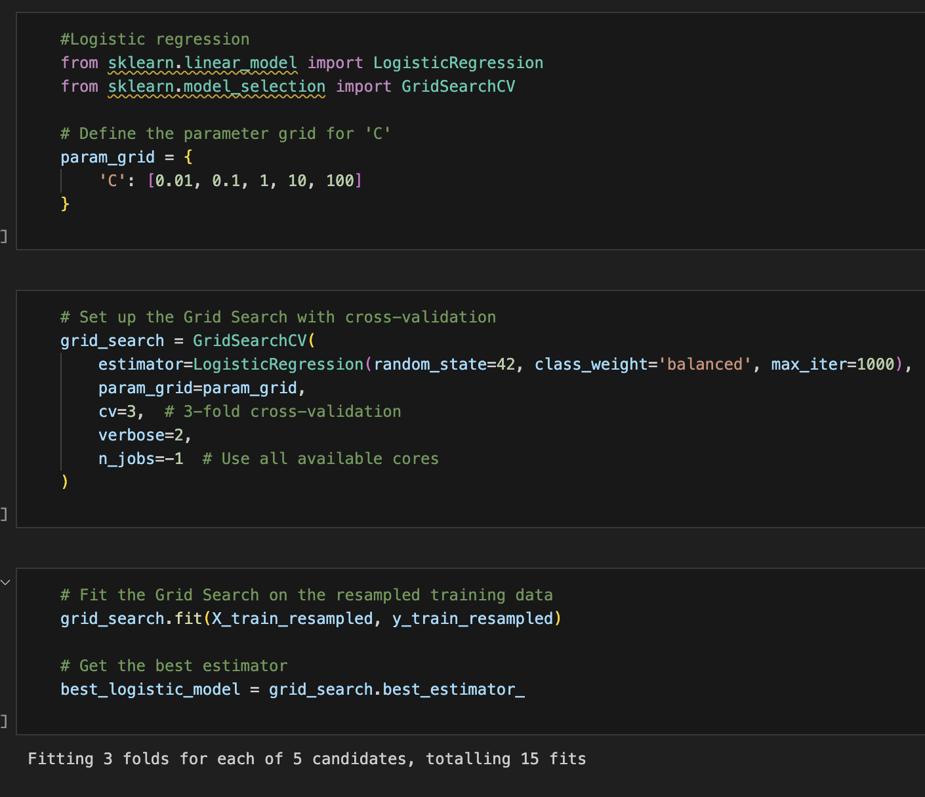
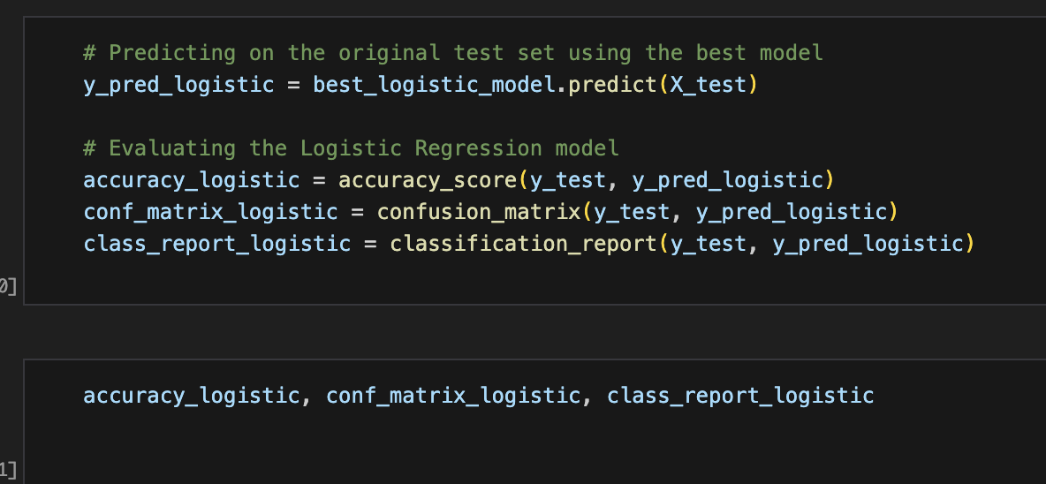
Best Model Evaluation

Slide 21
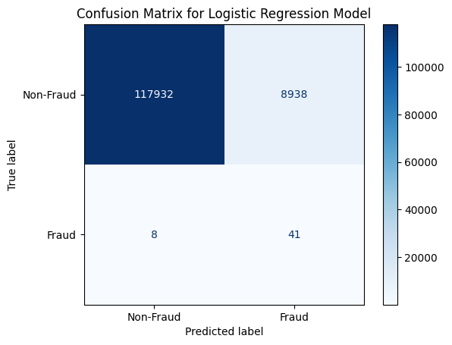
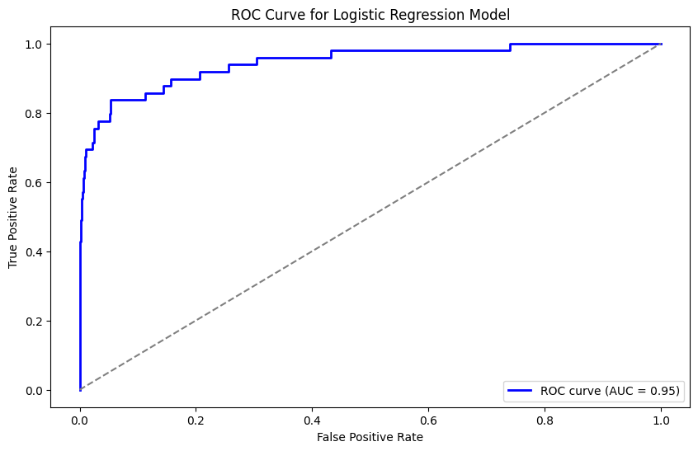
Logistic Regression Model

Slide 22
3. XGBoost Classifier
Description: Optimized gradient boosting algorithm.
Key Parameters: `n_estimators=100`, `learning_rate=0.1`, `max_depth=3`, `scale_pos_weight=balance_ratio`
Performance:
Accuracy: 99.47%
Precision for Fraud Detection: 5%
Recall for Fraud Detection: 67%
AUC: 0.97

Slide 23
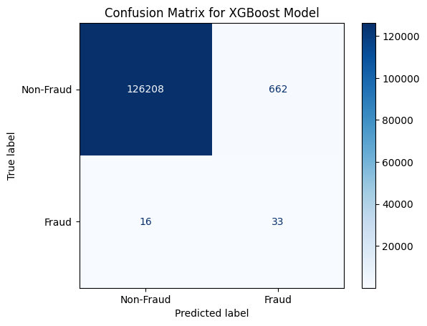
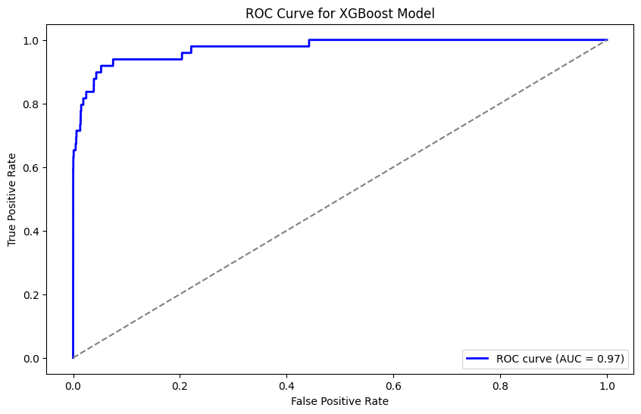
XGBoost Classifier Model

Slide 24
4. Stacking Ensemble
Description: Combines multiple models for improved performance.
Base Models: Logistic Regression, RandomForest, XGBoost
Meta-Model: Logistic Regression
Performance:
Accuracy: 99.98%
Precision for Fraud Detection: 100%
Recall for Fraud Detection: 53%
AUC: 0.96

Slide 25

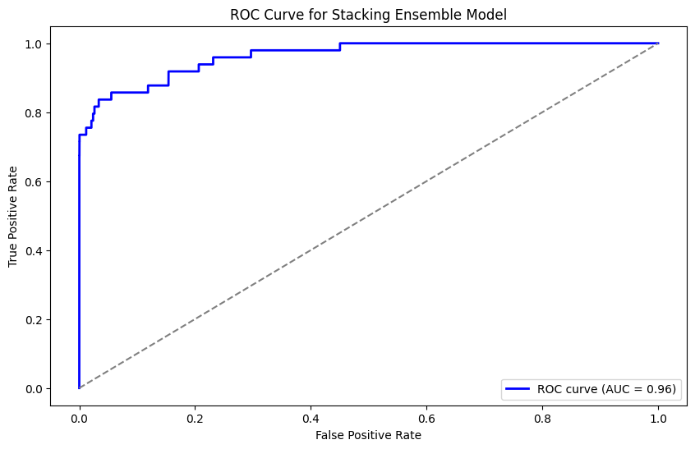
Stacking Ensemble Model

Slide 26
References
Fraud Detection in Mobile Payments Utilizing Process Behavior Analysis https://ieeexplore.ieee.org/document/6657303
IEEE-CIS Fraud Detection Dataset: https://www.kaggle.com/c/ieee-fraud-detection
Fraud Detection in Mobile Money Transactions using Machine Learning https://dr.lib.iastate.edu/server/api/core/bitstreams/02d3b629-4b8a-4e2e-a498-7e0910636d5a/content
https://www.kaggle.com/code/ethafelisya/kelompok-10-big-data
https://www.kaggle.com/code/elifdaglar/ml-project

Slide 27

Thank you

