Slide 1

DMA-L GLOB PROJECT-1
Crime Analysis: Analysing Boston City Crime
Domain: Machine Learning
Category- Software
Batch ID- 19
Praneeth Saradhi 22241A3243
Revanth Sallangula 22241A3249
Gunti Akash 23245A3205

Slide 2
Content
Introduction and Objectives
Dataset and Methodology
Exploratory Analysis and Modelling
Results and Interpretation
Conclusion and Future Work

Slide 3
Introduction and Objectives
Introduction:
Background: Crime data from Boston, spanning several years, provides a comprehensive view of urban safety, law enforcement strategies, and socio-economic influences on criminal behavior. With thousands of records detailing incident types, locations, times, and outcomes, this dataset serves as a vital resource for understanding public safety trends and neighborhood-level crime dynamics in one of America’s oldest cities.
Why It Matters: Analyzing Boston's crime data enables evidence-based decision-making for urban planning, policing strategies, and community interventions. It offers insights into patterns of criminal activity over time, identifies high-risk areas, and helps stakeholders understand the impact of socio-economic and policy changes on crime rates. These insights are essential for developing effective crime prevention programs, allocating resources efficiently, and fostering safer communities.
Problem Statement: Despite the availability of extensive crime records, this data often remains underexplored, with limited deep-dive analyses into temporal, spatial, and socio-demographic crime patterns. As a result, crucial insights that could enhance policing efficiency, inform community safety initiatives, and guide policy reforms remain largely untapped. A more thorough analysis can unlock trends critical for improving public safety and civic trust.

Slide 4
Introduction and Objectives
Objectives:
Merge and Clean Crime Datasets: Integrate various Boston crime data sources to create a unified, structured, and reliable dataset suitable for detailed analysis.
Analyze Crime Trends Over Time: Study patterns in crime frequency, type, and severity across different neighborhoods and time periods to identify seasonal or long-term trends.
Demographic and Geographic Analysis: Examine how crime rates vary across different demographics and locations, including correlations with factors such as population density, income levels, and time of day.
Visualization: Develop clear and interactive visualizations to present spatial and temporal crime patterns, making complex data more interpretable for stakeholders and the public.
Provide Strategic Insights: Generate actionable insights to support law enforcement planning, community safety initiatives, and policy development aimed at crime prevention and improved public security.

Slide 5
Dataset
Sources: The analysis is based on publicly available datasets sourced from Boston's crime records, specifically:
crime.csv: Contains detailed incident-level data including offense types, timestamps, locations, districts, and reporting officers.
offense_codes.csv: Provides mappings of offense codes to their respective descriptions and classifications, which is essential for interpreting and categorizing crime severity.
Scope: The dataset encompasses crime reports recorded within the City of Boston over multiple years. It includes thousands of entries detailing both violent and non-violent offenses, across all city districts and neighborhoods.
Features:
INCIDENT_NUMBER: Unique identifier for each reported incident.
OFFENSE_CODE: Encoded type of crime, which can be cross-referenced with offense_codes.csv.
OFFENSE_DESCRIPTION: Textual description of the reported crime.
DISTRICT: Police district where the incident occurred.
REPORTING_AREA: Numeric area code associated with crime mapping.
SHOOTING: Boolean field indicating if the incident involved a shooting.
OCCURRED_ON_DATE: Timestamp of the crime occurrence.
YEAR / MONTH / DAY_OF_WEEK: Temporal breakdown for trend analysis.
HOUR: Hour the incident occurred, useful for time-of-day analysis.
STREET / Lat / Long: Location data for spatial visualization and hot spot detection.

Slide 6
Dataset
Data Challenges:
Missing Values: Several records in the crime.csv dataset contain missing values, particularly in fields like DISTRICT, SHOOTING, and STREET. These gaps can impact the accuracy of location-based or categorical analysis and may require imputation or exclusion strategies.
Inconsistent Offense Mapping: The OFFENSE_CODE entries in crime.csv must be mapped to offense_codes.csv for meaningful interpretation. However, inconsistencies in naming conventions or code duplications may pose challenges during merging and classification.
Temporal Granularity: Some timestamps are recorded without consistent formatting or timezone clarification, making it difficult to perform precise time-based analysis without additional preprocessing.
Duplicate or Redundant Entries: The dataset may include repeated records for the same incident number or closely similar entries, which can skew aggregate statistics if not properly filtered.
Location Ambiguity: In some cases, latitude and longitude data may be missing or inaccurate, and street names may appear in varying formats, complicating geospatial analysis and mapping.

Slide 7
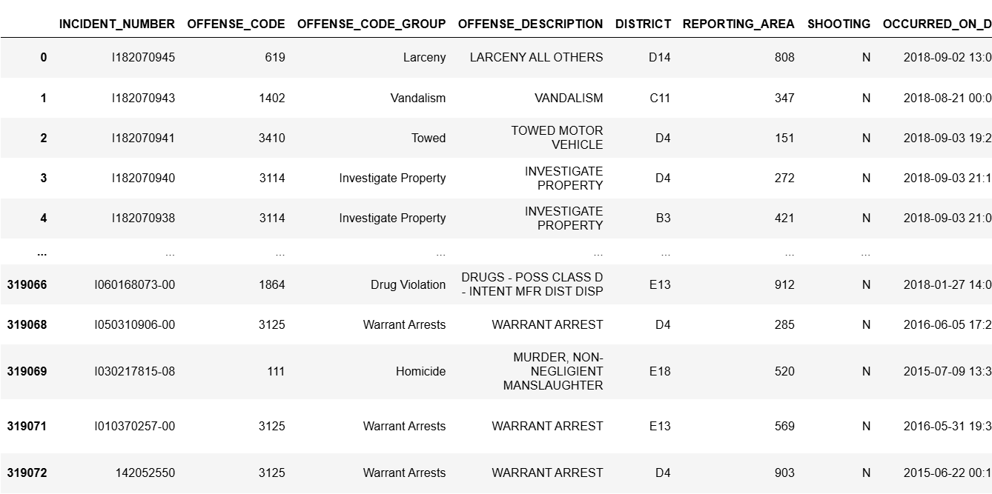
Dataset
VISUALS:

Slide 8
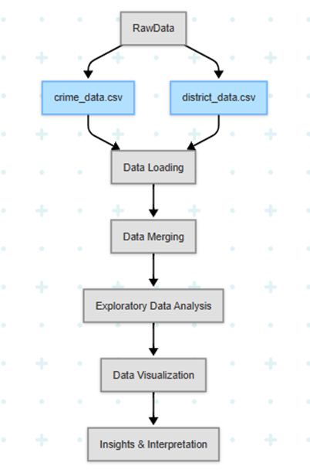
Methodology
Raw Datasets: The analysis uses two primary files:
crime.csv: Contains raw crime incident reports across various Boston districts.
offense_codes.csv: Maps offense codes to their detailed descriptions and categorizes the severity of crimes.
Data Loading: The datasets are imported into a Jupyter Notebook using Pandas for inspection and preprocessing.
Merging Datasets: A merge is performed on the OFFENSE_CODE column from crime.csv with the corresponding field in offense_codes.csv to attach human-readable crime descriptions to each record.
Exploratory Data Analysis (EDA): EDA focuses on understanding:
Most frequent crime types
Crime distribution across districts
Time-based patterns (hourly, daily, monthly trends)
Shooting-related incidents and their locations
Data Visualization (with Plotly): Interactive plots are generated using Plotly for:
Crime counts over time
Bar charts for top offenses
Heatmaps of incidents by hour and day
District-wise comparisons
Geographical mapping (if Lat/Long used) for hot spot detection
Insights & Interpretation: Patterns discovered through visuals are interpreted to identify:
High-crime districts and offense categories
Peak times for various types of crimes
Locations or timeframes with higher shooting incidents These insights can help guide urban safety strategies and law enforcement resource allocation.
Architecture diagram:

Slide 9
Methodology
Data Preprocessing:
Key preprocessing steps include:
Handle Nulls and Duplicates: Address missing values in essential fields such as DISTRICT, STREET, SHOOTING, Lat, and Long. Remove duplicate entries to maintain the integrity of crime incident reporting.
Merge Offense Code Data: Join the offense_codes.csv with crime.csv on the OFFENSE_CODE column to append meaningful descriptions and categories to each crime report.
Feature Extraction: Derive additional features such as:
Hour, Day, Month, and Year from the timestamp
Day of Week to analyze weekday vs weekend trends
Crime Severity if defined in offense mapping
Shooting Flag as a binary indicator for firearm-related incidents
Analytical Techniques:
Descriptive Statistics: Summarize overall crime frequency, most common offense types, and distribution across districts using measures like count, mean, and standard deviation.
Comparative Analysis: Evaluate differences in crime types across districts, months, and weekdays to detect high-risk areas and time windows.
Trend Analysis: Study temporal patterns such as:
Monthly or yearly changes in crime volume
Hour-by-hour variations throughout the day
Seasonal trends across different times of the year

Slide 10


Tools:
The analysis is conducted using Python within a Jupyter Notebook environment. Key libraries and tools include:
Pandas: For data loading, merging, cleaning, and manipulation of crime records and offense codes.
NumPy: For efficient numerical operations and handling of date/time-based features.
Plotly: For interactive and dynamic visualizations such as time-series plots, bar charts, and geospatial heatmaps.
Datetime: For parsing and extracting features like hour, day, month, and year from timestamps.

Slide 11
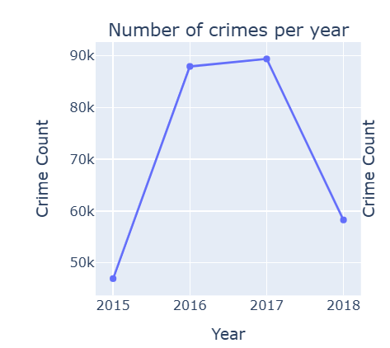
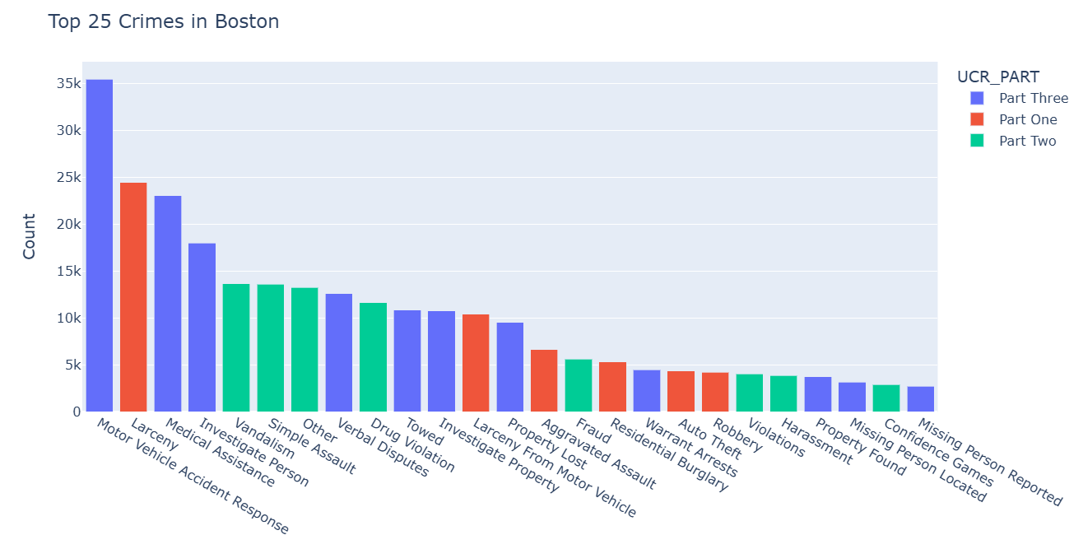
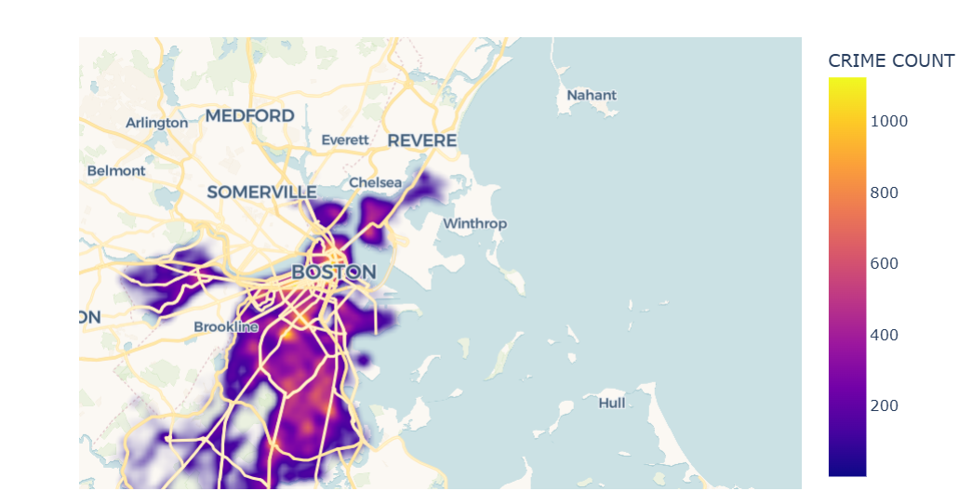
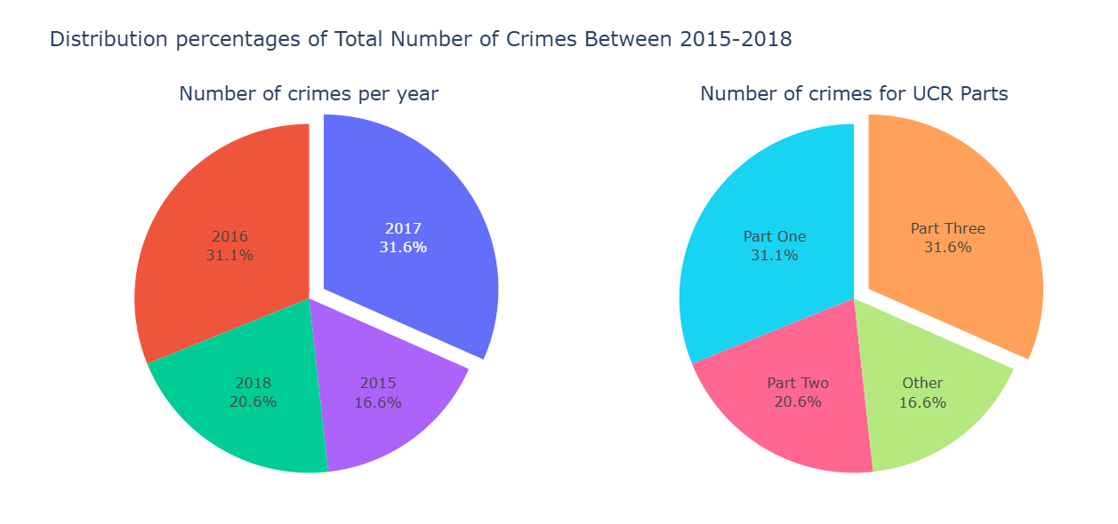
Exploratory Data Analysis
Line Plot of Crimes Over Time: Highlights the trend in total crime incidents across different years, helping to identify patterns and periods of spikes or drops.
Bar Chart of Crimes by District: Displays which police districts report the highest number of crimes, enabling comparative analysis across areas.
Pie Chart of Crime Categories: Visualizes the proportion of different crime types, offering a quick view of which offenses are most prevalent.
Map Plot of Crime Locations: Shows the geographic distribution of crimes across Boston, helping to pinpoint crime hotspots spatially.
Sunburst Chart of Crime Breakdown: Illustrates the hierarchical structure of crimes (e.g., parent category to specific offense), providing layered insight into offense types.
Scatter Subplots of Crime by Time: Plots crime frequency by year, month, day, and hour to analyze when crimes are most likely to occur.

Slide 12
Results and Interpretation
Insights:
1. Crime Trends Over Time: Line plots show that overall crime rates have fluctuated over the years, with noticeable dips and spikes possibly correlating with policy changes, public events, or law enforcement strategies.
2. High-Crime Districts Identified: Bar charts reveal that certain districts—like B2 and C11—consistently report higher crime counts, suggesting areas that may benefit from increased policing or community programs.
3. Offense Type Distribution: Pie charts and sunburst visuals indicate that a few crime categories (such as larceny, drug violations, and assault) make up a large portion of total offenses, highlighting the need for focused prevention measures.
4. Temporal Crime Patterns: Scatter plots across time dimensions (hour, day, month) show crime is more frequent in the late evening hours and weekends, providing valuable information for resource scheduling and patrol planning.
5. Geographic Crime Hotspots: Map plots clearly mark areas with high concentrations of crime, which can help city planners and law enforcement deploy targeted interventions.
6. Crime Resolution Status: Some visualizations reflect a large proportion of unresolved or open cases, which may warrant a review of investigative processes or resource allocation for case closures.

Slide 13
Conclusion
Conclusions:
The Boston Crime dataset uncovers valuable insights into the distribution, frequency, and nature of crimes across the city.
Visualizations help identify high-crime areas, peak crime times, and prevalent offense types, which can inform targeted law enforcement and public safety strategies.
Temporal and geographic analyses reveal patterns that can support better planning and resource allocation.
Limitations:
No Real-Time Updates: The dataset is historical and does not include real-time or most recent crime data, which limits the timeliness of insights.
Missing Contextual Factors: Data lacks demographic, socioeconomic, or environmental factors that may influence crime rates and patterns.
No Predictive Analysis: The current approach focuses on descriptive analytics; it does not incorporate forecasting or predictive modeling for future crime trends.

Slide 14
Conclusion
Future Work:
Predictive Crime Modeling: Implement machine learning models to predict crime hotspots or likelihood of crime occurrences based on time, location, and category.
Interactive Dashboards (e.g., Streamlit or Plotly Dash): Build a dynamic dashboard allowing users to explore crime trends interactively across districts, timeframes, and offense types.
Contextual Data Integration: Incorporate additional data sources such as poverty rates, education levels, and police response times to deepen understanding and analysis of crime patterns.
Crime Severity Analysis: Use the offense code mapping to quantify and visualize crime severity, prioritizing critical cases for intervention planning.

